Slide 1
Branden Chun-Ming 2nd Start
07/17/22

Slide 2

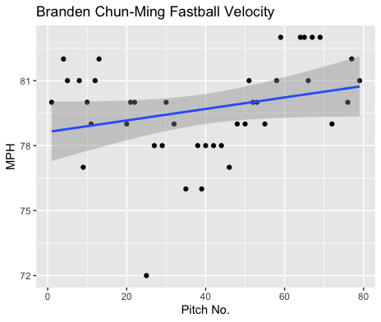
Fastball Usage
Average Velocity = 79.7MPH
Max Velocity = 83MPH
48% Usage
Chun-Ming’s fastball started off in the high 70s-low 80s.
He had a stretch in the ~78MPH range during the middle of his start.
His fastball seemed to be faster towards the end of his start, which might be why the fourth inning was his best inning.

Slide 3
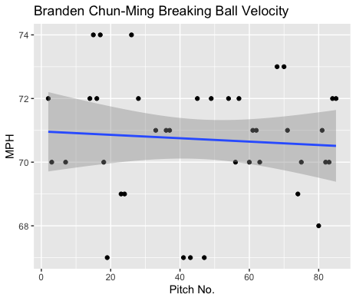
Breaking Ball
Average Velocity = 70.7MPH
Max Velocity = 74MPH
46% Usage
Chun-Ming threw his breaking ball a lot, almost more than his fastball.
His breaking ball ranged from 67-74MPH and hovered around 70-72MPH most of the time.

Slide 4
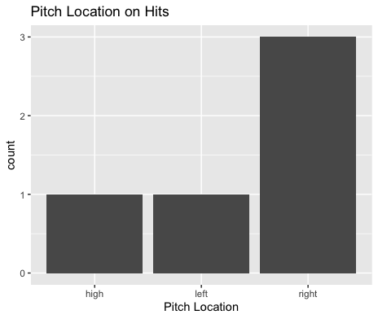
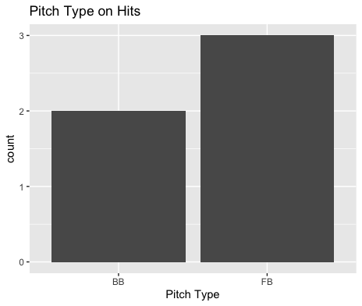
Hits
Chun-Ming gave up 3 singles to right-handed hitters on outside pitches.
4 of the 5 hits were to right-handed hitters.
Chun-Ming wasn’t really hit that badly.

Slide 5
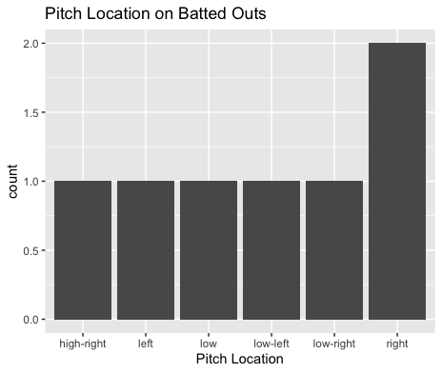
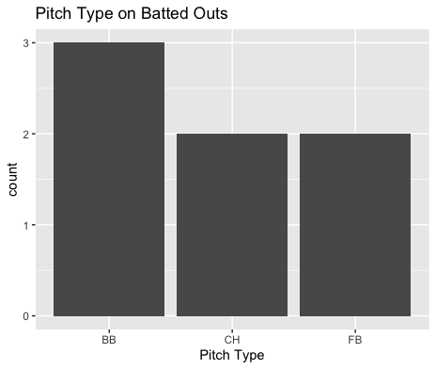
Outs
Chun-Ming’s breaking ball and changeup pitched very well to contact.
He didn’t really find that much success targeting specific locations, he seemed to mix his locations well.

Slide 6
Stats
BABIP = .385
H/9 = 11.25
K/9 = 11.25
BB/9 = 6.75 (one hit batter)
K:BB = 1.6
Chun-Ming pitched very solid.
His BABIP was somewhat high due to a couple of outside singles to right-handed hitters.
His H/9 was not bad, and his K/9 was fantastic.
The reason why his start went poorly was due to his high walk rate as well as hitting one batter.
If Chun-Ming can continue to mix his pitch locations well, as long as he doesn’t give up as many free passes he should pitch well.

Slide 7
Comparison to his first start
His second start was better than his first.
He increased his K/9 as well as lowered his BABIP.
He had the same H/9 and BB/9.
He also hit only 1 batter rather than 3.
Chun-Ming seems to struggle with his control, an increased breaking ball usage seemed successful.
Maybe an increased changeup usage could lead to more success in the future.

