Slide 1
Branden Chun-Ming 3rd Start
07/22/22

Slide 2

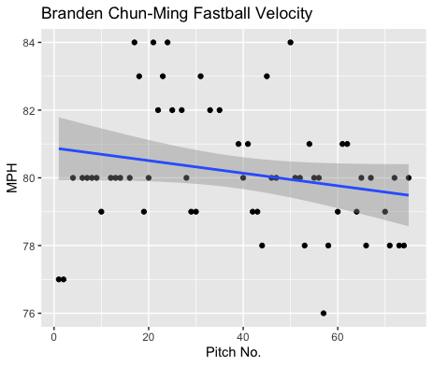
Fastball Usage
Average Velocity = 80.2MPH
Max Velocity = 84MPH
79% Usage
Chun-Ming’s fastball hovered around 80MPH for the most part.
He did tend to throw some higher velocity fastballs in the 20-40 pitch mark, and his velocity seemed to dip below 80 towards the end of his start indicating a downwards sloping trendline.

Slide 3
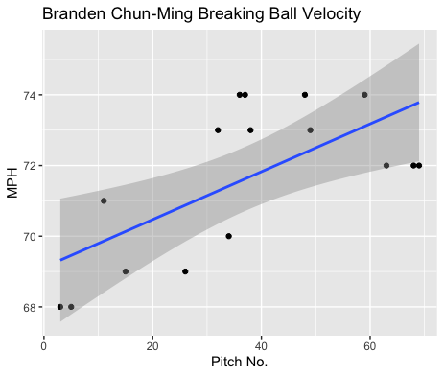
Breaking Ball Usage
Average Velocity = 71.6MPH
Max Velocity = 74MPH
21% Usage
While Chun-Ming didn’t throw his breaking ball as much as his fastball, his breaking ball seemed to be more effective in terms of velocity.
His breaking ball started in the high 60s-low 70s and ended in the mid/low-70s.

Slide 4
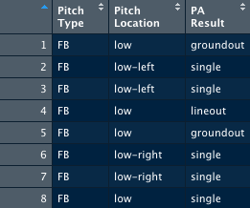
Batted Balls
Chun-Ming was hit only by left-handed hitters.
Chun-Ming was only really hit on his fastball, all on low pitches.
Chun-Ming did give up a lineout as well as 2 singles that were hit on the ground.
Possibly he could try to target his fastball in high or middle pitch locations and find less batted ball hits.

Slide 5
Stats
BABIP = .625
H/9 = 15
K/9 = 15
BB/9 = 9 (2 hit batters)
K:BB = 1.6 (1 with HBP)
Chun-Ming got hit badly on low pitches put in play, with hitters yielding a BABIP of .625.
However, his H/9 was not as high as one would expect with a .625 BABIP.
That’s especially in part to a lack of control that seems to elude Chun-Ming, he does have a high walk rate in addition to hitting 2 batters.

Slide 6
Comparison
Chun-Ming definitely has some control issues.
In all his starts he has had a very high walk rate.
In this start he did, however, have his highest K/9 yet.
He did also yield a higher BABIP and H/9.
This could be due to an almost 80% usage of his fastball.
In the past his breaking ball has seemed to yield positive results when put in play, especially in comparison to his fastball.
More mid/high fastballs and low breaking balls should lead to less batted ball success.
If Chun-Ming can try to be more effective with his control, he should yield more positive results.

