Slide 1
Michael DiForte
06/13/22

Slide 2
Pitch Velocities
Fastball
Avg = 78.3
Max = 83
Sinker
Avg = 76.8
Max = 81
Slider
Avg = 69.2
Max = 73
Curveball
Avg = 67.2
Max = 69

Slide 3
Pitch Usage
Fastball
53/97 = 55%
Sinker
13/97 = 13%
Slider
19/97 = 20%
Curveball
10/97 = 10%

Slide 4
Hits Given Up
8 Singles
1 Curveball, 2 Sinkers, 2 Sliders, 3 Fastballs
2 Doubles
2 Fastballs
1 Home Run
On a Fastball
It seems like he was hit hard on his fastball. Obviously with the highest usage it should be hit more, but all three extra base hits came off the fastball, whereas his other pitches weren’t hit as bad.
Additionally, 6 of the 11 hits were in the middle of the strike zone as well as 4 in the low part of the strike zone.
Should try to throw high zone pitches as well as more sliders and curveballs.

Slide 5
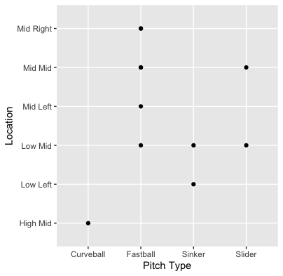

Slide 6
Stats
BABIP =.611
H/9 = 26.98
K/9 = 7.36
BB/9 = 9.81
DiForte got extremely unlucky on balls put it play. He gave up 11 hits in 3 and 2/3 innings.
His K/9 is quite solid with 3 strikeouts in 3 and 2/3 innings.
2 of his 3 strikeouts came on sliders which can add to my previous claim of increased slider usage.
He also had a high walk rate, so command may be an issue.

