Slide 1
Michael DiForte 2nd Start
06/19/2022

Slide 2
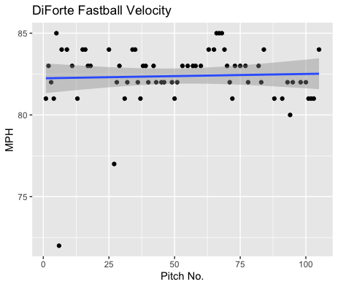
Fastball Usage
Average Velocity = 82.4MPH
Max Velocity = 85MPH
63% Usage
DiForte’s fastball was super consistent throughout the entire game and peaked at 85MPH.
He even reached 84MPH on his final fastball thrown.
Aside from 2 outliers 64 of 66 fastballs were above 80MPH.

Slide 3
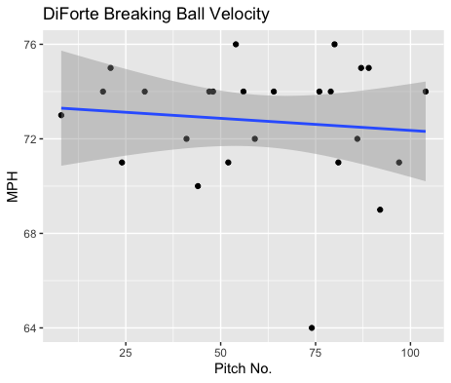
Breaking Ball Usage
Average Velocity = 72.8
Max Velocity = 76MPH
24% Usage
Aside from one outlier of 64MPH his breaking ball was super consistent.
His breaking ball mostly ranged around 70-76MPH consistently.

Slide 4
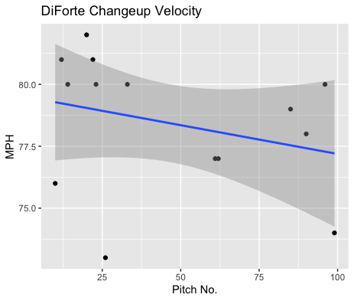
Changeup Usage
Average Velocity = 78.4MPH
Max Velocity = 82MPH
13% Usage
DiForte did not use his changeup much.
He threw his changeup in the 80s during the beginning of his start.
He didn’t throw his changeup much until the end of his start where he threw more in the high 70s.

Slide 5
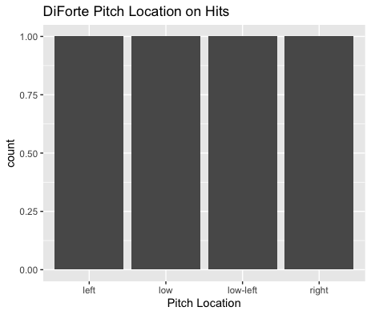
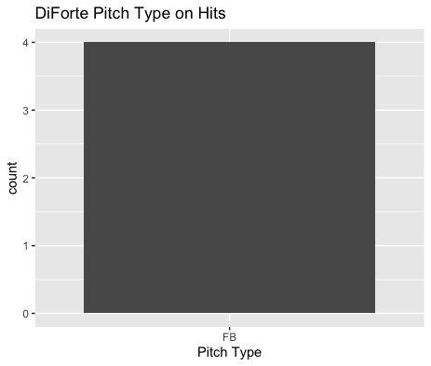
Hits
DiForte performed really well on balls that were put in play.
He gave up 4 hits (all on fastballs) and of varying locations.
Esai Santos had 3 of the hits. And all the hits were from left-handed batters.

Slide 6
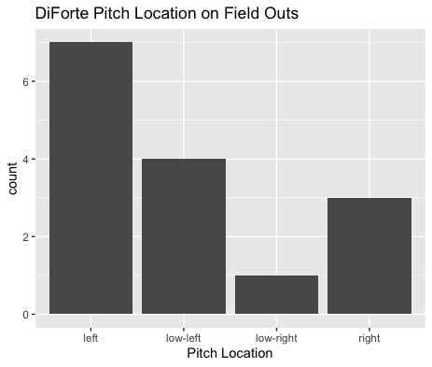
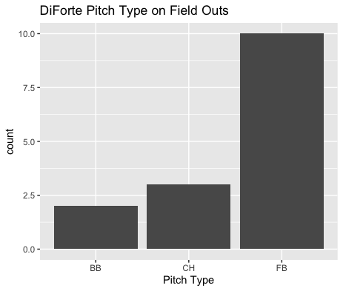
Outs
DiForte found a lot of success on pitches inside against right-handed hitters getting 5 outs from inside pitches (4 fastballs)
Of his batted outs he got 10 out on fastballs and 3 and 2 for his changeup and breaking ball.

Slide 7
Stats
BABIP = .211
BABIP (without Esai Santos) = .067
H/9 = 5.14
K/9 = 6.43
BB/9 = 6.43
K:BB = 1
DiForte pitched extremely well to contact, however he struggled with his command, seen in a high walk rate as well as a poor strikeout to walk ratio of 1.
If you eliminate his matchups against Esai Santos, DiForte pitched even better against the rest of the team, giving up a .067 BABIP to hitters not named Esai Santos.

Slide 8
Comparison to his 1st Start
The main difference for DiForte from his first to second start is that his BABIP was much better in his second start than his first.
He had a poor walk rate in his first start and while his walk rate lowered this start, it’s still poor overall.
His strikeout rate also isn’t the best, and he walks batters more often than he strikes them out.
I would suggest an increased usage of inside fastballs on right-handed hitters as he performed well on contact when right handers had an inside fastball.
An increase in Changeup and Curveball usage may also lead to better BABIP numbers as the opposing team went 0 for 5 on the two pitches combined.

