Slide 1
Michael DiForte 3rd Start
06/28/22

Slide 2

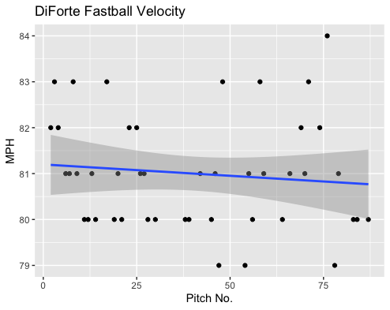
Fastball Usage
Average Velocity = 81MPH
Max Velocity = 84MPH
47% Usage
DiForte’s fastball, like in his other starts, was very consistent again.
The trendline is almost directly straight which indicates consistent velocity.
DiForte even peaked in his velocity at 84MPH towards the end of his start.
DiForte hovered around 80-81MPH with a decent number of 82-83MPH fastballs over the course of his start.

Slide 3
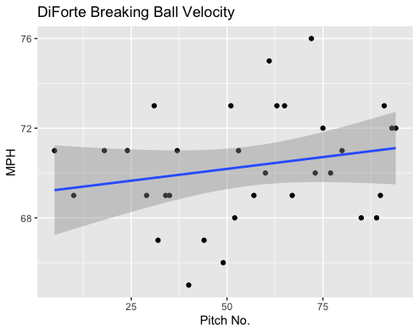
Breaking Ball Usage
Average Velocity = 70.3MPH
Max Velocity = 76MPH
35% Usage
DiForte’s breaking ball grew in velocity over the course of the game.
Initially, his breaking ball hovered around 69-71MPH, however, with game progression it hovered more around 69-73MPH.

Slide 4
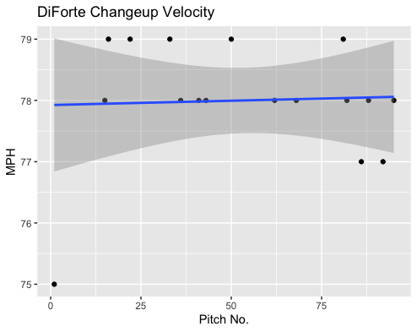
Changeup Usage
Average Velocity = 78MPH
Max Velocity = 79MPH
18% Usage
Like his other performances and pitches, his changeup was consistent.
Aside from 3 pitches, all his changeups were of 78 or 79MPH.

Slide 5
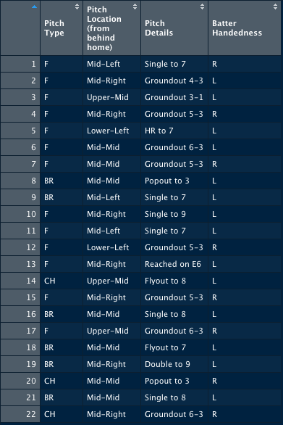
Batted Balls
DiForte gave up a lot of contact, having 22 total batted balls.
His breaking ball got hit hard, ultimately having a .667 BABIP as hitters were 4-for-6 against the pitch.
His changeup was effective when put in play, however, as hitters were 0-for-3 on his changeup.
Hitters went 2-for-6 on Mid-Mid pitches.
Hitters went 4-for-11 on his fastball, more effective than his breaking ball, but got hit hard.
Left-Handed hitters went 2-for-2 on middle outside pitches (one a fastball, one a breaking ball)
Left-Handed hitters went 2-for-4 on middle inside pitches(one fastball, one breaking ball).
Righties went 1-for-8 and Lefties went 7-for-14, so DiForte got hit pretty hard by the Lefties to say the least.

Slide 6
Stats
BABIP = .364
H/9 = 14.4
K/9 = 3.6
BB/9 = 5.4
K:BB = 0.67
DiForte got unlucky with balls in play which might indicate why the H/9 may seem high..
His BB/9 is more concerning because he had more walks than strikeouts and his H/9 should decrease with an increased changeup usage, and a decreased breaking ball usage.
If DiForte could have pitched against Left-Handed Batters better, his entire line could be drastically different.

Slide 7
Comparison
DiForte seems to have some command issues, as his walks per nine has been high in every single one of his starts.
In two of his starts he have a higher walk rate than strikeout rate.
In his second start, he had a BABIP of .211 which is a lot lower than his first starts’ BABIP of .611
His BABIP in this start could very well be an accurate representation of how he pitches to contact.
I believe with an increased Fastball and Changeup Usage that BABIP should be closer to .211 than .611.

