Slide 1
Michael DiForte 4th Start
07/09/22

Slide 2

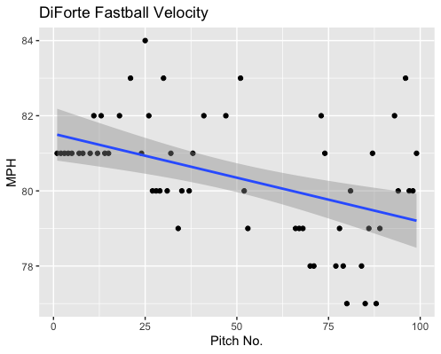
Fastball Usage
Average Velocity = 80.4MPH
Max Velocity = 84MPH
58% Usage
Unlike in his past starts, DiForte lost a lot of his velocity around the 60-pitch mark.
He hovered around the low-mid 80s for most of the game until he started losing velocity
There were 3 singles after the 80-pitch mark, which could be due to lost velocity.

Slide 3
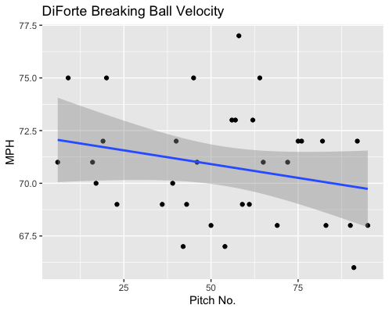
Breaking Ball Usage
Average Velocity = 70.6MPH
Max Velocity = 77MPH
34% Usage
DiForte’s breaking ball was consistent for the most part, with a lot of his breaking balls in the high 60s/low 70s range.
The velocity range of his breaking ball was 11MPH.

Slide 4
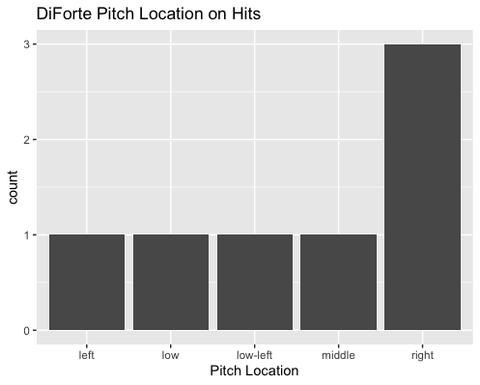
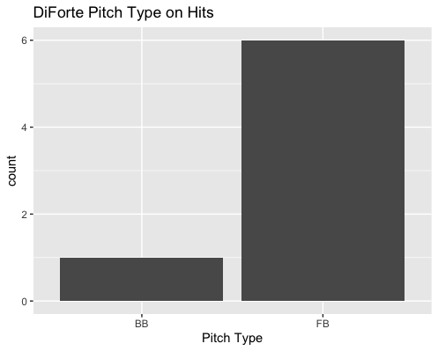
Hits
Right-handed hitters went 2-for-3 on outside fastballs.
DiForte’s fastball gave up 6 hits, his breaking ball only gave up 1.
His groundball rate on balls in play was 50%.
DiForte also got 2 lineouts.

Slide 5
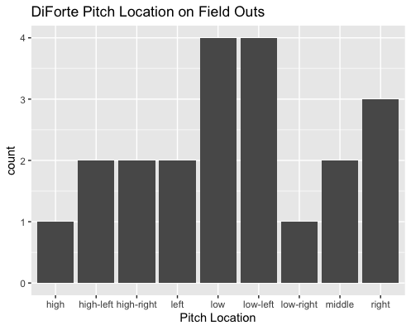
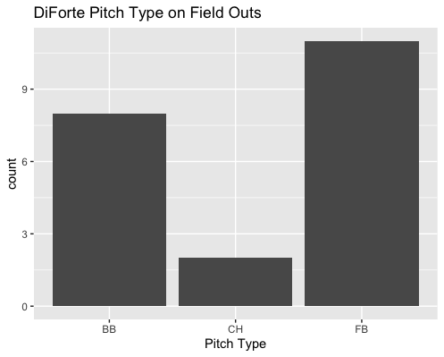
Field Outs
DiForte’s breaking ball played well to contact.
DiForte yielded a .200 BABIP on low pitches.
His changeup also got 2 field outs despite one being a lineout.
DiForte also did well on low-inside pitches to right-handed hitters. Also getting a .200 BABIP.
DiForte got 5 outs and gave up 0 hits on high batted balls in play.

Slide 6
Stats
BABIP = .286
H/9 = 7.88
K/9 = 2.25 (super lucky with balls in play super low strikeout rate)
BB/9 = 2.25
K:BB = 1
K% = 6.25%
BB% = 6.25%

Slide 7
Start Comparison
DiForte continued his trend on low strikeout rates and poor strikeout to walk rates.
This was his first start in which his fastball decreased in velocity.
The decrease in velocity can also explain why he gave up 4 singles after the 75-pitch mark.
As stated in his previous reports, his breaking ball and changeup both perform well to contact.
DiForte’s off-speed pitches seem to perform well to contact however he might have a lot of BABIP luck from his past 3 starts.
He could have appearances like his first start, in which he gave up a BABIP of .611 and a H/9 > 25.

