Slide 1
Michael DiForte 5th Start
07/15/22

Slide 2

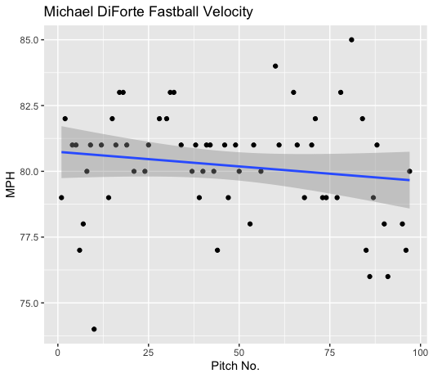
Fastball Usage
Average Velocity = 80.2MPH
Max Velocity = 85MPH
63% Usage
DiForte’s fastball was consistent over the course of the game aside from a drop to the high 70s at the very end of the start.
His fastball ranged in the low 80s up until around his 75th pitch where his velocity began to dip.

Slide 3
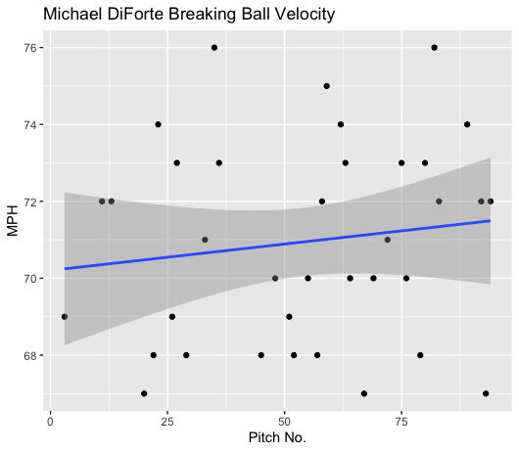
Breaking Ball Usage
Average Velocity = 70.9MPH
Max Velocity = 76MPH
37% Usage
DiForte’s breaking ball increased in velocity as the game progressed.
It started in the high 60-low 70 range and ended in the low 70-mid 70 range.

Slide 4
Hits
DiForte gave up 5 hits, 3 on fastballs, 2 on breaking balls.
DiForte gave up 4 singles and a double, 3 of the hits on linedrives.
Hitters didn’t really find much success attacking one location

Slide 5
Outs
DiForte is very good at inducing ground ball contact.
Of 18 balls hit in play, over half of them were groundballs (10).
Hitters also were 1-for-10 went putting the ball in play on the ground.
DiForte also found some success on middle-outside fastballs.
DiForte got 5 field outs on his breaking ball, and 8 outs on his fastball.

Slide 6
Stats
BABIP = .222
H/9 = 6
K/9 = 6
BB/9 = 4.5
K:BB = 1.33
DiForte pitched well to contact, and both his fastball and breaking ball performed well. He possibly threw some changeups that were tracked as breaking balls however it seems either way that changes in velocity from his fastball are effective.
He has a low BABIP and H/9.
If he can continue to induce ground balls he will continue to have a low BABIP and H/9.
The only possibly knock on him during this start is a somewhat high walk rate and low K:BB, but he pitched well enough to contact so that would not be an issue.

Slide 7
Comparison to other starts
This was one of DiForte’s best starts of the year.
Both his fastball and breaking ball pitched great to contact, especially when hit on the ground.
His Strikeout rate also increased in this start.
If DiForte can continue to induce groundballs, maintain this strikeout level, and lower his walk rate, he will be almost unhittable.
DiForte also does seem to struggle with velocity after around the 75 pitch mark on his fastball.

