Slide 1
Michael DiForte 6th Start
07/21/22

Slide 2

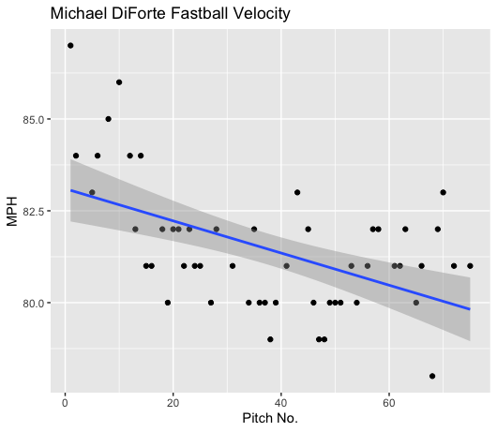
Fastball Usage
Average Velocity = 81.5MPH
Max Velocity = 87MPH
69% Usage
DiForte threw an 87MPH fastball to start the game, however as he reached the ~15 pitch mark his fastball dipped and hovered almost exclusively in the 80-82MPH range.
His fastball was thrown very hard to start the game but the downward trendline is present because he had an immediate drop-off in velocity once he started to hit 82MPH.

Slide 3
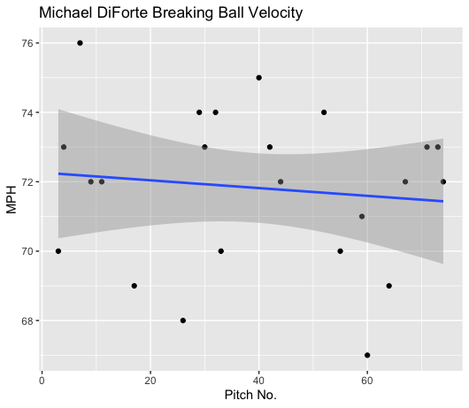
Breaking Ball Usage
Average Velocity = 71.8MPH
Max Velocity = 76MPH
31% Usage
DiForte’s breaking ball was all over the place in terms of velocity.
He peaked in velocity early at 76MPH hover at his 60th pitch he hit 67MPH.
His breaking ball on average was about 72MPH.

Slide 4
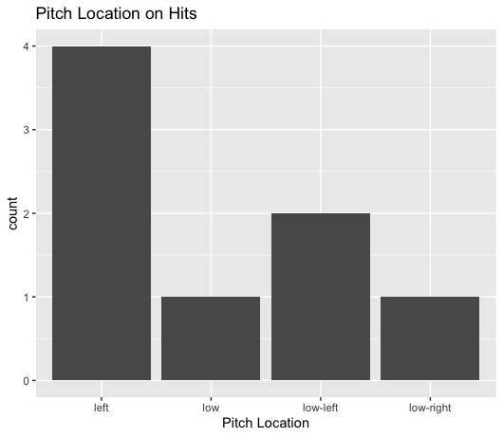
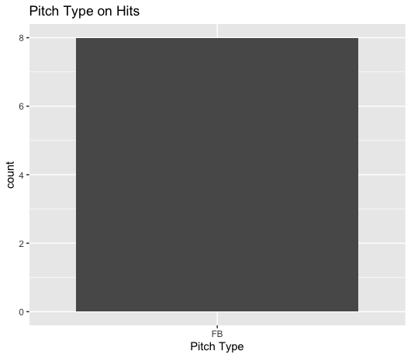
Hits
All hits given up were on the fastball.
Especially pitches targeted on the left side of the plate.
Right-handed hitters hit 3 singles and a double on inside fastballs.

Slide 5
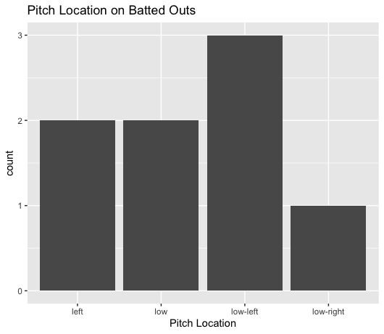
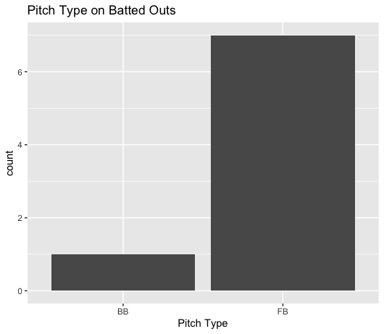
Outs
While DiForte gave up all his hits on his fastball, all except for 1 ball hit in play were fastballs.
DiForte got hit a lot on the left side and lower part of the plate, as well as a lot of batted outs.
However, it seems hitters did better on those locations.

Slide 6
Stats
BABIP = .500
H/9 = 18
K/9 = 9
BB/9 = 4.5
K:BB = 2
DiForte was hit really badly on his fastball.
Hitters went 8-for-15 when putting fastballs in play.
While he had a poor BABIP and H/9 his strikeout rate was extremely good, although his walk rate was higher than desired.
His strikeouts to walks was 2 strikeouts per walk.

Slide 7
Comparison
DiForte should throw his breaking ball more.
In past starts his breaking ball has played very well to contact, and in this start, hitters went 0-for-1.
This was one of DiForte’s worst starts of the season.
Something very positive is that his K/9 was 9 strikeouts per nine innings.
With more breaking balls, and possible more effective pitch location, DiForte should find a lot more batted ball success, coupled with a good strikeout rate should make him even better.

