Slide 1
Evan Knipe
06/14/2022

Slide 2
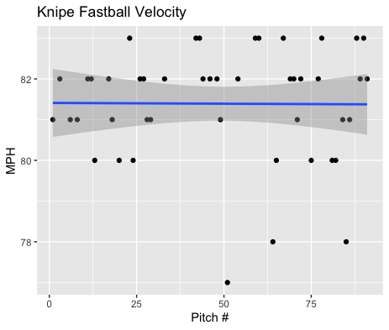
Fastball Usage
Average Velocity = 81.4MPH
Max Velocity = 83MPH
53% Usage
Knipe was consistent with his fastball throughout his appearance. With only 3 of 48 fastballs below 80MPH.

Slide 3
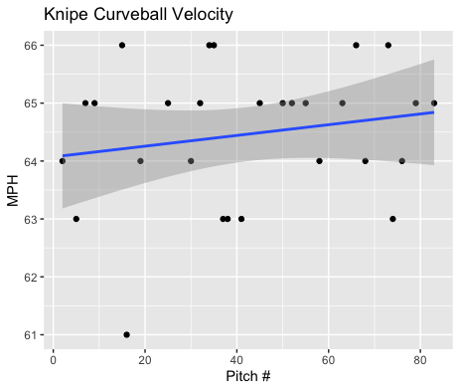
Curveball Usage
Average Velocity = 64.5 MPH
Max Velocity = 66MPH
31% Usage
He peaked at 66MPH multiple times and had a minimum of 61MPH.
He increased his Curveball velocity as the game progressed.
His Curveball ranged from 63-66MPH throughout.

Slide 4
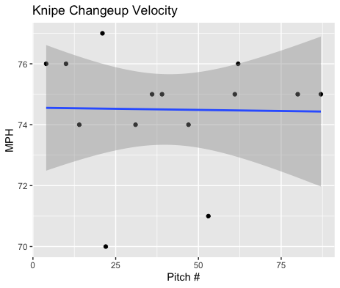
Changeup Usage
Average Velocity = 74.5MPH
Max Velocity = 77MPH
15% Usage
He didn’t throw that many changeups however when he did throw it it ranged from 74-77MPH for the most part.
Aside from two pitches of 70 and 71MPH his changeup was super consistent throughout.

Slide 5
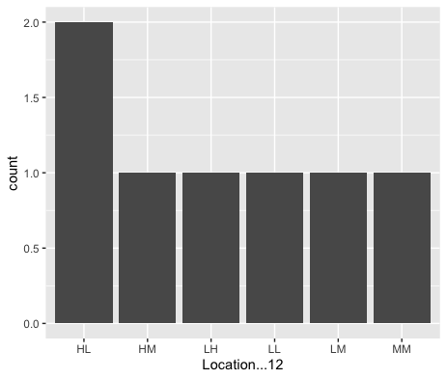
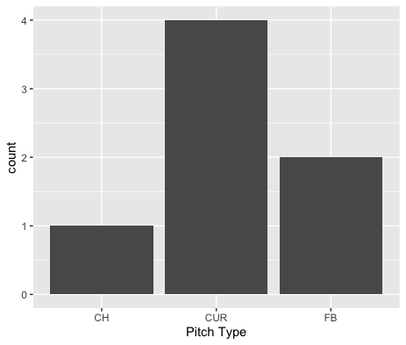
Batted Balls
Knipe gave up 2 hits on High-Left pitches as well as 4 of 7 hits on curveballs.
6 of the 7 hits came from Right-Handed hitters.
I would suggest a lower usage of his curveball and possibly an increase in fastball and changeup usage for the benefit of better batted ball data.

Slide 6
Stats
BABIP = .467
H/9 = 15.75
K/9 = 11.25
BB/9 = 4.5
K:BB = 2.50
Knipe got pretty unlucky on balls in play. His BABIP should go down with an increased fastball usage as well as an increased changeup usage.
He had a good K/9, slightly high walk rate but a solid strikeout to walk ratio of 2.5 strikeouts per walk.
His H/9 should also decrease with an increase fastball and changeup usage.

