Slide 1
Evan Knipe 2nd Start
06/19/2022

Slide 2
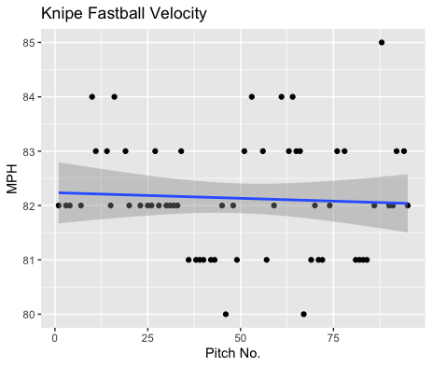
Fastball Usage
Average Velocity = 82.1MPH
Max Velocity = 85MPH
63% Usage
Again, Knipe was super consistent with his fastball, as indicated by the trendline throughout his appearance.
He hovered around 81-83MPH throughout the game.

Slide 3
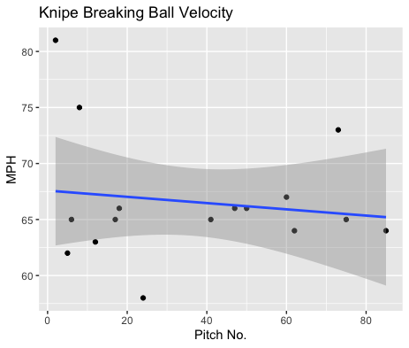
Breaking Ball Usage
Average Velocity = 66.6MPH
Max Velocity = 81MPH
17% Usage
Knipe peaked early with an 81MPH breaking ball but hovered around 62-67MPH range for his breaking ball.

Slide 4
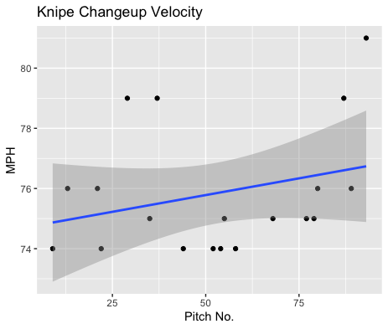
Changeup Usage
Average Velocity = 75.8MPH
Max Velocity = 81MPH
20% Usage
Knipe’s changeup increased in velocity throughout the game.
This was mostly due to 4 outlying pitches on 79(3x) and 81.
Otherwise, he had most of his pitches in the 74-76MPH range.

Slide 5
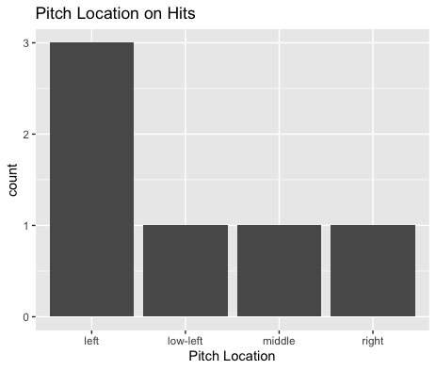
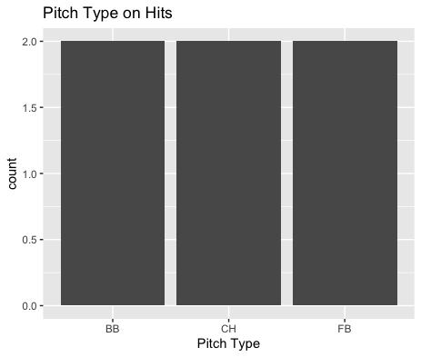
Hits
Knipe gave up 2 hits on inside fastballs to right-handed hitters.
He also gave up 6 hits with 2 from each pitch.
His fastball seemed to be good against contact, only yielding 2 hits which is equal to hits given up by changeups and breaking balls despite having a higher pitch frequency for his fastball.

Slide 6
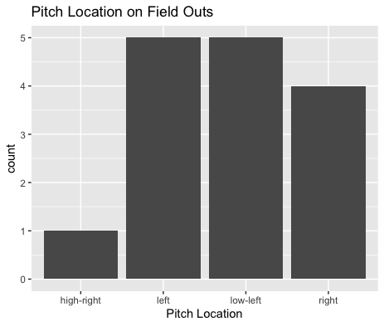
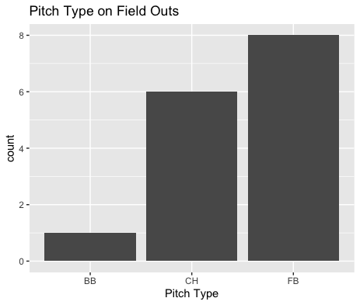
Field Outs
Knipe gave up a lot of contact, especially on his fastball.
However, his fastball yielded 8 outs on 10 fastballs. His changeup also yielded 6 outs on 8 pitches.
He got a ton of his outs on left side pitches as well as in the low left.
Low and inside fastballs on right-handed hitters was very effective.
Outside pitches to left-handed hitters also was very effective.

Slide 7
Stats
BABIP = .286
H/9 = 9
K/9 = 4.5
BB/9 = 1.5
K:BB = 3
Knipe performed well to contact and might have gotten a bit lucky with all the contact he gave up.
Knipe had a lack of strikeouts, and most of his outs came from contact rather than something he can control.
His walks per nine and his strikeout to walk ratio were both pretty good. While he has a low strikeout rate, there doesn’t seems to be any control issues.

Slide 8
Comparison to his 1st Start
In his second start it can be seen that with better performances to contact his BABIP and H/9 decreased.
As stated in my first report with an increased changeup and fastball usage he should find more success.
Both were increased in frequency and performed very well to contact.
He continued to have a good strikeout to walk ratio, in fact his strikeouts to walks increased from 2.5 to 3.

