Slide 1
Evan Knipe
06-25-2022

Slide 2
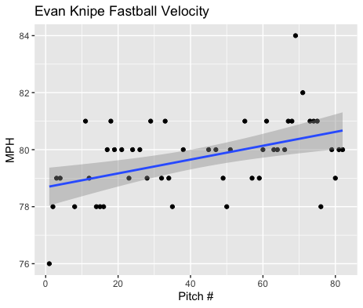
Fastball Usage
Average Velocity = 79.7MPH
Max Velocity = 84MPH
58% Usage
Increased in fastball velocity as the game progressed.
He hovered around the 78-81MPH range, however, threw around 80-81MPH towards the end of his start.

Slide 3
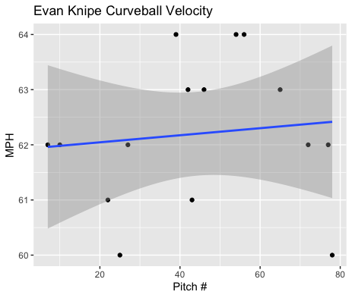
Curveball Usage
Average Velocity = 62.2MPH
Max Velocity = 64MPH
18% Usage
Like his fastball, his curveball velocity increased with game progression.
His curveball was about 17MPH slower than his fastball.

Slide 4
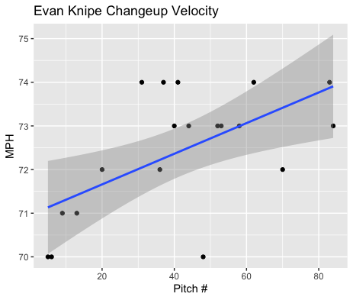
Changeup Usage
Average Velocity = 72.4MPH
Max Velocity = 74MPH
23% Usage
His changeup dramatically increased with game progression, with a lot of pitches ranging from 73-74MPH after pitch 30.

Slide 5
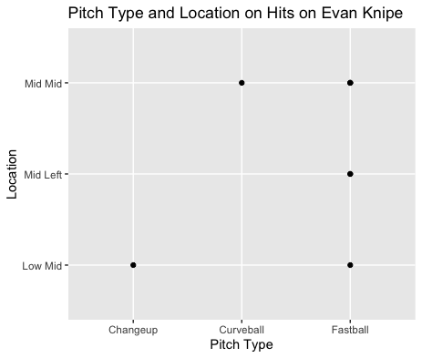
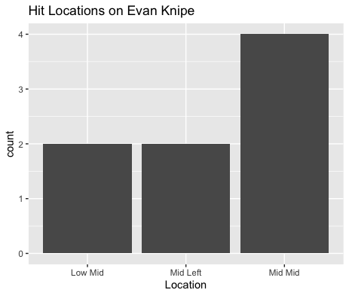
Batted Balls
On 18 balls in play, Knipe gave up 8 singles.
Half of those singles were on middle-middle pitches which may indicate a control issue.
6 of the 8 were fastballs.

Slide 6
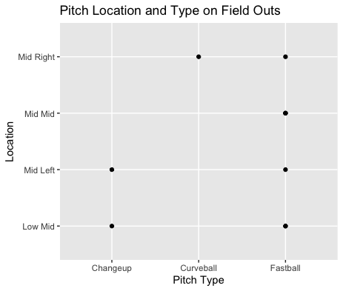
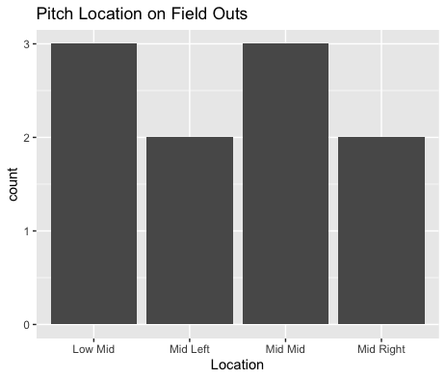
Hitters went 1/3 on batted balls for his Changeup and 1/2 on his Curveball.
There seems to be no batted ball data for high pitches so maybe he can throw more high pitches.
He did get a lot of his batted outs on middle pitches which contradicts the hits given up, however Low-Mid pitches seem to be the most effective for him.

Slide 7
Stats
BABIP = .444
H/9 = 14.4
K/9 = 5.4
BB/9 = 1.8
K:BB = 3
Knipe has a high H/9 which a majority came from middle-middle fastballs so if he could try to locate his fastball better that BABIP and H/9 should decrease. He doesn’t appear to have any command issues that could lead to a high walk rate or K:BB ratio.

