Slide 1
Evan Knipe’s Fourth Start
7/3/22

Slide 2

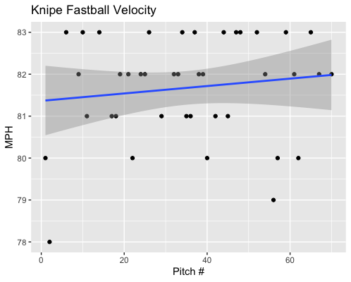
Fastball Usage
Average Velocity = 81.7MPH
Max Velocity = 83MPH
57% Usage
Knipe’s fastball increased in velocity with game progression.
Most of his fastballs ranged from 81-83MPH.

Slide 3
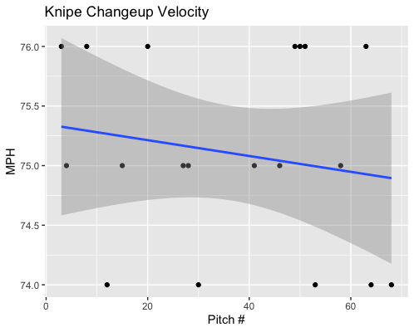
Changeup Usage
Average Velocity = 75.1MPH
Max Velocity = 76MPH
27% Usage
Knipe’s changeup seems to have a downward indicator for velocity for game progression.
However, his changeup velocity hovered from 74-76MPH for the entire duration of the game.

Slide 4
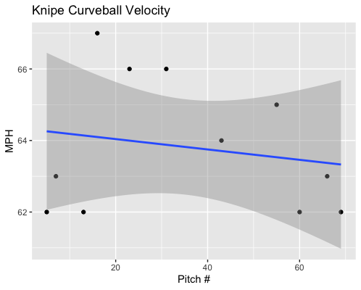
Curveball Usage
Average Velocity = 63.8MPH
Max Velocity = 67MPH
16% Usage
Knipe used his curveball the least.
His trendline has a very small negative slope and out of the 11 curveballs he threw, over half were either 62 or 63 MPH.

Slide 5
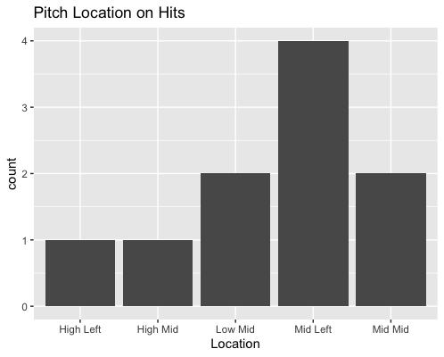
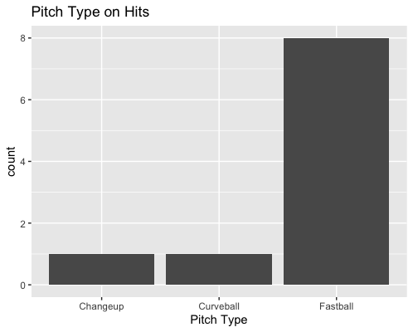
Hits
Knipe gave up 10 hits, all singles.
9 of them to right-handed hitters.
Knipe gave up 8 of 10 hits on his fastball.
4 of 10 hits were middle-inside fastballs to right-handed hitters.
Right-handed hitters went 4-for-5 on middle-in fastballs.

Slide 6
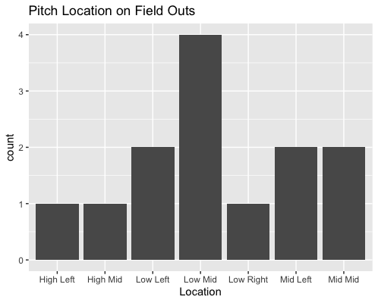
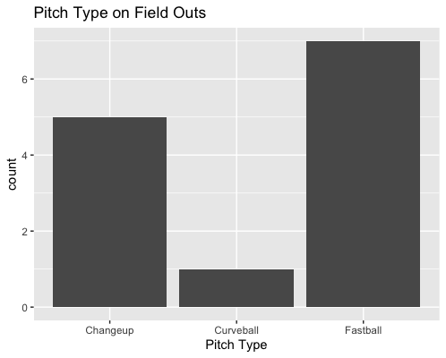
Field Outs
Knipe threw 6 low-middle pitches, 2 for hits and 4 for outs.
Knipe’s changeup was extremely successful when put into play, yielding a BABIP of .167.

Slide 7
Stats
BABIP = .435
H/9 = 15
K/9 = 6
BB/9 = 0
K:BB = INF
Knipe yielded a pretty high BABIP which leads to a larger H/9.
His K/9 is solid, and he didn’t walk anyone, so he has a great nonexistent walk rate as well as an infinite strikeout to walk ratio.

Slide 8
Comparison to Other Starts
Just like his other starts, Knipe threw his pitches extremely consistently over the course of his start.
Knipe doesn’t seem to possess any control issues seen in all his starts. Something that could be concerning is his high BABIP, in 3 of his 4 starts his BABIP has been above .400 and his H/9 has been above 14.
Knipe again had a solid strikeout to walk ratio given that he did not walk any batters.
Knipe has consistently had lower BB/9 and higher K:BB.
Knipe’s changeup has done really really well when put in play during a lot of his starts so I think that an increase changeup usage should set him up for a lot more batted ball success.

