Slide 1
Evan Knipe 5th Start
07-08-22

Slide 2

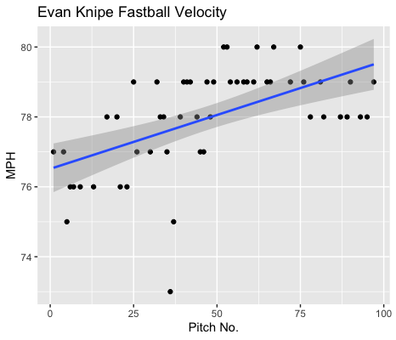
Fastball Usage
Average Velocity = 78MPH
Max Velocity = 80MPH
55% Usage
Knipe started off throwing his fastball slowly.
He ranged in the mid 70s during the beginning of his start.
However, with game progression his fastball increased in velocity, ranging from 78-80 from about pitch 50 until the end of his start.

Slide 3
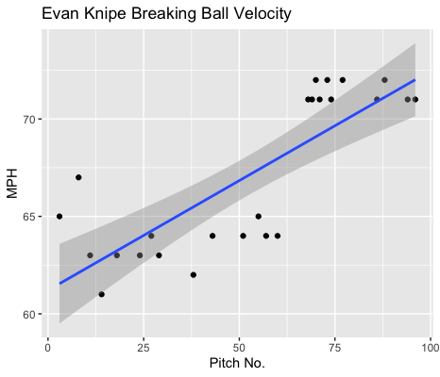
Breaking Ball Usage
Average Velocity = 67.1MPH
Max Velocity = 72MPH
26% Usage
Like his fastball, Knipe’s breaking ball grew in velocity with game progression.
He began his start throwing in the mid-low 60s and ended in throwing in the low 70s around the 65-pitch mark to the end of his start.
The really steep slope shows his increase in velocity well.

Slide 4
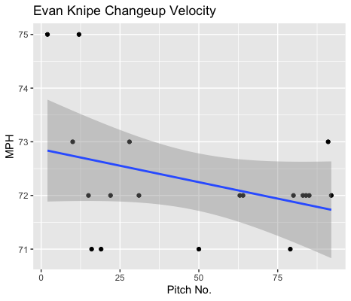
Changeup Usage
Average Velocity = 72.3MPH
Max Velocity = 75MPH
20% Usage
Unlike with his fastball and breaking ball, Knipe lost velocity on his changeup as the game progressed.
His changeup stayed in the 71-73MPH range, however two early pitches of 75MPH skew the distribution to the right, indicating the downward slope.

Slide 5
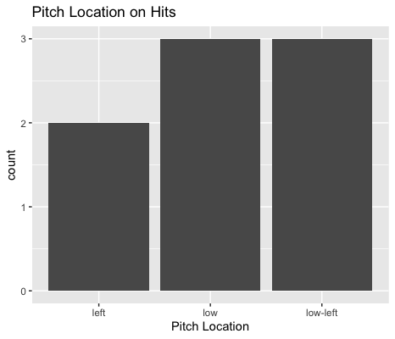
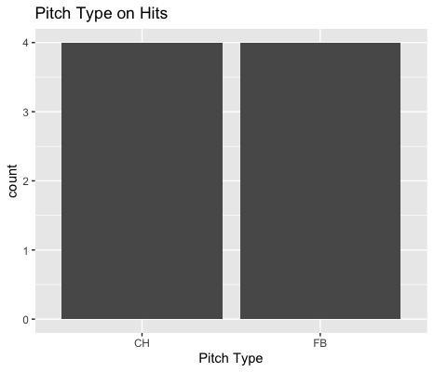
Hits
Knipe got hit badly.
Especially on his changeup, yielding 4 hits on 5 times made contact.
Knipe gave up 5 of his 8 hits to left-handed hitters.
He additionally gave up 2 home runs and 2 doubles.
Knipe gave up 4 hits on outside pitches to lefties.

Slide 6
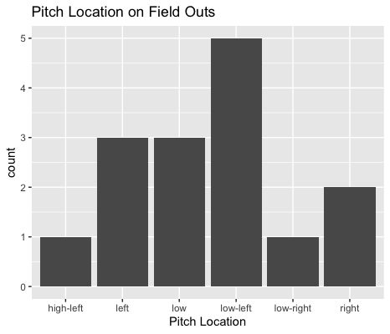
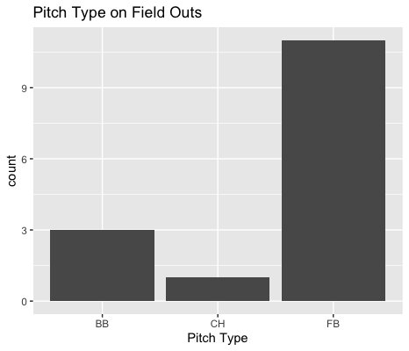
Outs
Knipe’s fastball and breaking ball played well to contact.
Aside from 1 home run, right-handed hitters went 1-for-4 on low-inside pitches.
The same applies for low pitches on lefties. 1-for-4 with 1 home run.

Slide 7
Stats
BABIP = .348
H/9 = 12
K/9 = 4.5
BB/9 = 3
K:BB = 1.5
Despite giving up 2 home runs and 2 double’s Knipe wasn’t hit extremely hard.
It’s important to note that both home runs were solo home runs.
His K/9 was down as well as having a low K:BB.
His BABIP and H/9 weren’t horrible and with a decrease in changeup usage and an increase in fastball and breaking ball usage his BABIP should go down, leading to better performances.

Slide 8
Comparison
Knipe continued his prowess with maintaining his pitch velocity over the course of his start.
His BABIP was the second lowest during this start.
However, he gave up 4 extra base hits and he got extremely lucky that both home runs were with no men on base.
He had his 2nd highest walk rate and his worst strikeout to walk ratio in this start. He pitched a lot to contact.
This was his first start where his changeup didn’t pitch that well. In other starts it’s been either his fastball or curveball that got hit badly.
Overall, Knipe’s average velocity was down about 2MPH per pitch from his previous start, which could possibly explain why his changeup didn’t perform well.

