Slide 1
Evan Knipe 6th Start
07/13/22

Slide 2
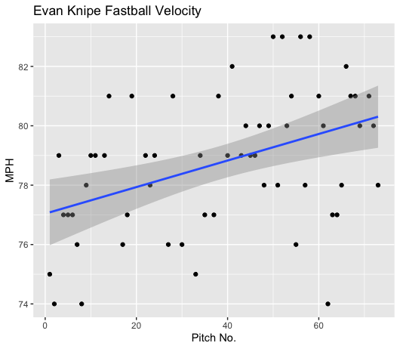
Fastball Usage
Average Velocity = 78.8MPH
Max Velocity = 83MPH
79% Usage
Like his other starts, Knipe’s fastball increased in velocity as the game progressed.
His fastball started in the mid-high 70s and eventually ended in the high 70s and low 80s range.

Slide 3
Changeup Usage
Average Velocity = 73.8MPH
Max Velocity = 74MPH
8% Usage
Knipe only threw 6 changeups.
He threw 5 changeups of 74MPH and 1 that was 73MPH.
He didn’t really lose any velocity because he only threw 6 pitches in the same velocity range.

Slide 4
Breaking Ball Usage
Average Velocity = 71.3MPH
Max Velocity = 73MPH
12% Usage
Knipe only threw 9 breaking balls.
Aside from one 67MPH breaking ball, his velocity ranged from 71-72MPH throughout his start.

Slide 5
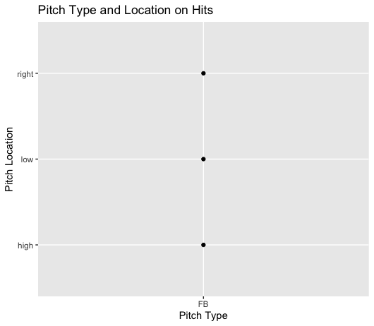
Hits
Knipe only gave up 3 hits, 2 singles and a double.
All the hits given up were fastballs to right-handed hitters.
All to varying locations, which might not indicate hitters find success against Knipe based on location.

Slide 6
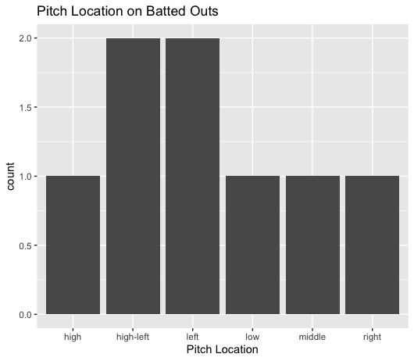
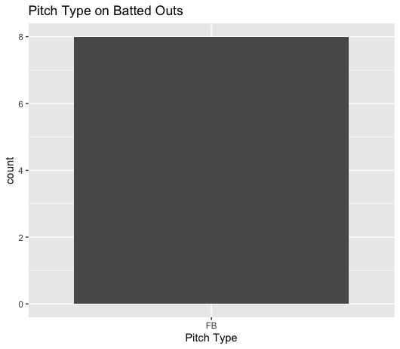
Outs
Knipe didn’t find that much success by targeting locations.
He got all his field outs as well as all the hits.
With an 80% usage rate that’s not too surprising.
Hitters went 3-for-11 on balls in play.

Slide 7
Stats
BABIP = .272
H/9 = 5.4
K/9 = 9
BB/9 = 1.8
K:BB = 5
Knipe pitched incredibly well to contact, in addition to a high strikeout rate and a low walk rate.

Slide 8
Comparison to other starts
This was Evan Knipe’s best start.
He had his lowest BABIP, lowest H/9 and his highest K/9.
Knipe additionally kept his control secure, with a low walks per nine below 2 and a strikeout to walk ratio of 5 strikeouts per walks.
There’s nothing much else to say, Knipe’s fastball and breaking ball both pitched very well, and he had one of his best starts of the season.
Maybe a high fastball usage, mixed with some breaking balls will help him continue this kind of success.

