Slide 1
Evan Knipe 7th Start
07/19/22

Slide 2

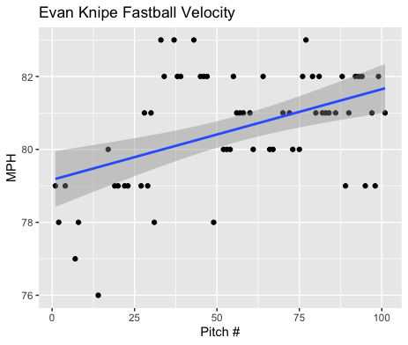
Fastball Usage
Average Velocity = 80.5MPH
Max Velocity = 83MPH
69% Usage
Knipe threw his fastball A LOT, almost 70% of the time.
His fastball started in the high 70s and ended around the low-mid 80s.

Slide 3
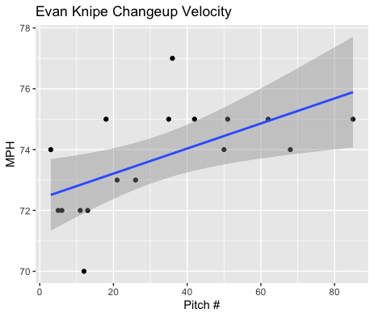
Changeup Usage
Average Velocity = 73.7MPH
Max Velocity = 77MPH
19% Usage
Knipe threw his changeup the second most.
His changeup was hit really bad.
His changeup did grow in velocity as the game progressed.

Slide 4
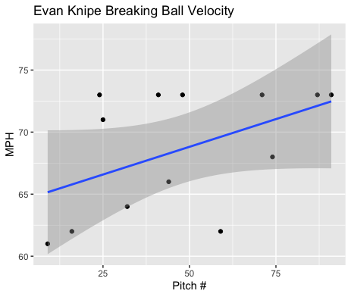
Breaking Ball Usage
Average Velocity = 68.6MPH
Max Velocity = 73MPH
13% Usage
Knipe threw only a few curveballs and sliders.
As you can see his sliders are probably the pitches in the ~72MPH range, and his curveballs are in the low-mid 60s.
However, it seems that both pitches grew in velocity over the course of the game.

Slide 5
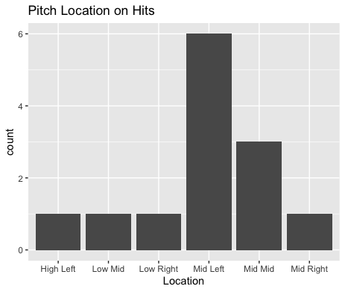
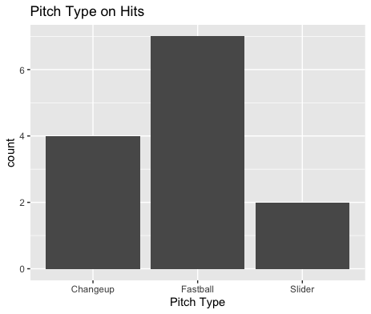
Hits
Knipe was hit mostly by righties.
His changeup was hit really badly for its low usage.
His changeup gave up 2 home runs, a double and a single.
1 home run and 1 double were middle-in.
3 righties got singles on middle-in fastballs.
He also gave up a double, home run and single on middle-middle pitches (1FB, 1CH, 1SL)

Slide 6
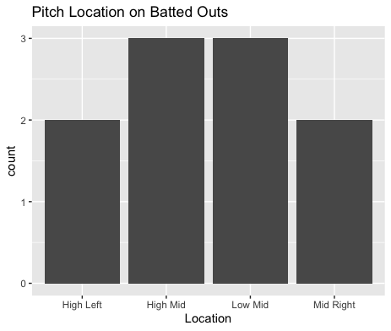
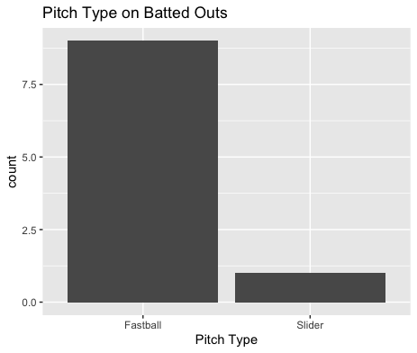
Outs
While he pitched poorly, he seemed to have found success with high pitches.
Hitters were 1-for-4 on low-middle pitches.
Right-handed hitters went 0-for-2 on high-inside fastballs.
Hitters were also 0-for-3 on high middle fastballs.

Slide 7
Stats
BABIP = .565
H/9 = 25.05
K/9 = 7.71
BB/9 = 1.93
K:BB = 4

Slide 8
Comparison to other starts
This was Knipe’s worst start by a large margin.
His fastball was hit pretty badly, and his changeup was destroyed.
Knipe definitely should lower his changeup usage as hitters went .1000 when hitting it in play, with a single, double and 2 home runs.
His breaking ball and slider could be effective pitches with increased usage.
His fastball continued to pitch well.
If he can lower his changeup usage to maybe 10% and have 30% usage for his slider and changeup he can throw his fastball with success 60-70% of the time.

