Slide 1
Cole Koeppel 2nd Start
06-16-2022

Slide 2
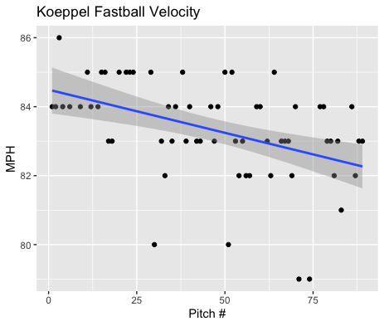
Fastball Usage
Average Velocity = 83.3MPH
Max Velocity = 86MPH
71% Usage
Again, Koeppel peaked early and the trendline indicates a decrease in velocity as his start progressed.
After pitch 50 Koeppel was more susceptible to outlying pitches under his 83.3MPH average.

Slide 3
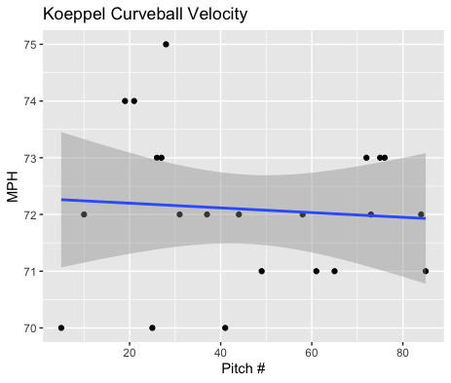
Curveball Usage
Average Velocity = 72.1MPH
Max Velocity = 75MPH
25% Usage
Unlike his fastball, Koeppel’s curveball velocity was a lot more consistent throughout his start, hovering about 72MPH like the trend line indicates.

Slide 4
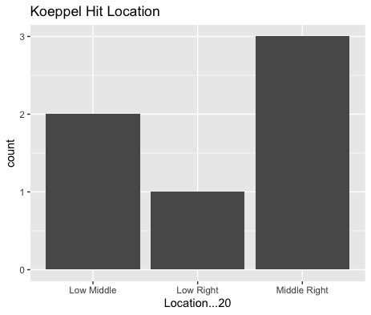
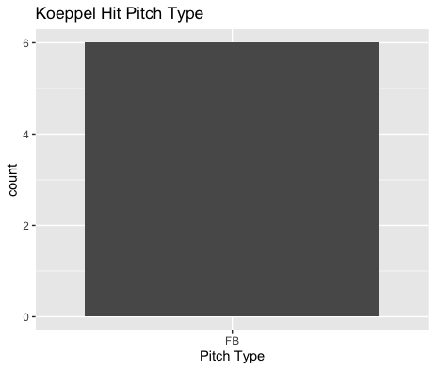
Batted Ball Hits
Koeppel gave up 6 singles on 17 batted balls.
2 of those singles however were on bloopers which may indicate him being unlucky.
He did get two line-drive put outs, however.
He gave up all his hits on the fastball as well as half of them coming from the middle outside on right-handed hitters.

Slide 5
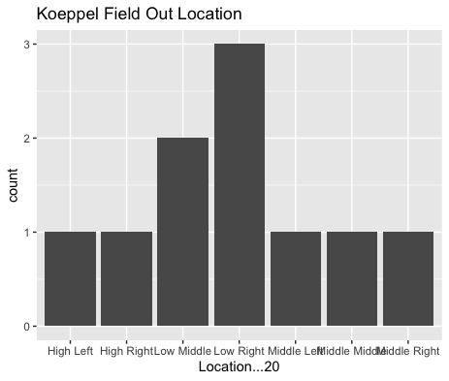
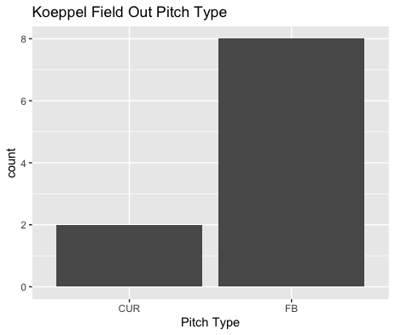
Batted Ball Outs
Koeppel got 3 of his field outs on pitches in the low-right (2 being righties).
He got 2 field outs on his curveball and 8 on his fastball.
Maybe an increased curveball usage can lead to better batted ball success for Koeppel.

Slide 6
Stats
BABIP = .353
H/9 = 11.56
K/9 = 5.78
BB/9 = 3.85
K:BB = 1.5
Koeppel got hit hard on his fastball which led to a higher BABIP.
An increased Curveball usage should result in better BABIP luck and a better H/9.
Koeppel didn’t have an extremely high strikeout rate or walk rate however had a pretty poor strikeout to walk ratio of 1.5.

Slide 7
Comparison to his 1st Start
Koeppel had similar performances in his BABIP and H/9.
However, Koeppel has shown signs of a lot of improvement.
In addition to having a .000 BABIP on his Curveball he increased his K/9 while decreasing his BB/9 and his K:BB.

