Slide 1
Cole Koeppel 3rd Start
06-23-2022

Slide 2

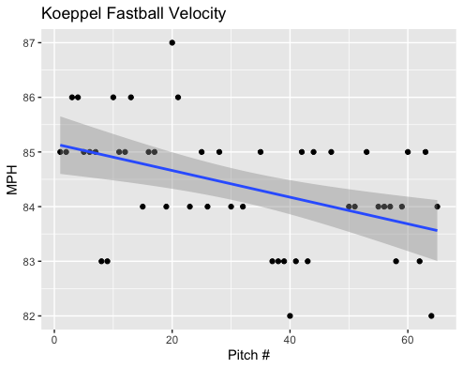
Fastball Usage
Average Velocity = 84.4MPH
Max Velocity = 87MPH
73% Usage
At the beginning of his start Koeppel’s fastball hovered around the 85/86 range.
However, as his start progressed his velocity regressed.
It hovered from 83-85MPH after his ~30th pitch.

Slide 3
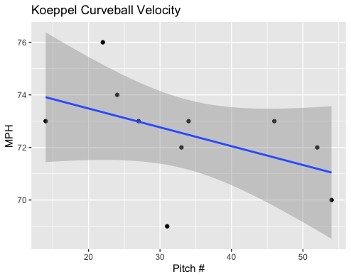
Curveball Usage
Average Velocity = 72.5MPH
Max Velocity = 76MPH
15% Usage
Koeppel didn’t really use his breaking pitches that much with a lowly 15% usage of his curveball and an even lower 6% usage on his slider.
Like his fastball, with game progression Koeppel lost velocity on his curveball.
As you can see the trendline accurately depicts where his Curveball velocity was.

Slide 4
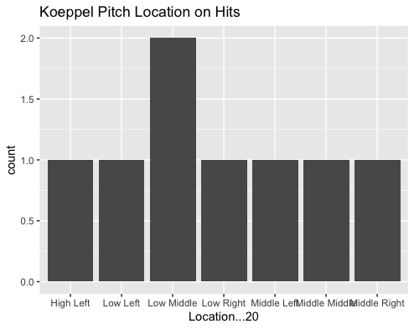
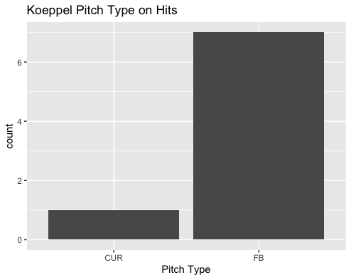
Hits
Koeppel threw his fastball 73% of the time, so it definitely makes sense that 7 of his 8 (87.5%) hits given up came off the fastball.
Of which included a double and a home run.
The home run was given up on a middle-middle pitch.
The double was given up on a low-inside fastball to a right-handed hitter.

Slide 5
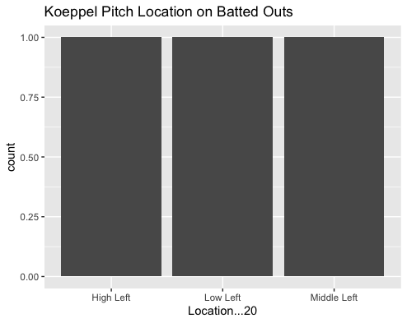
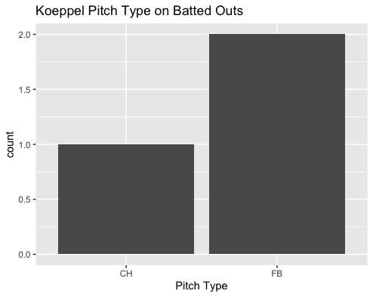
Outs
Field outs were a rare occurrence for Koeppel in this start. His fastball yielded him a .778 BABIP.
An increased usage of high outside pitches to left-handers should be advantageous. Koeppel gave up a groundout and a Popfly single on fastballs in that location.
The same can apply to middle-inside pitches on right-handers.

Slide 6
Stats
BABIP = .727
H/9 = 24
K/9 = 9
BB/9 = 3
K:BB = 3
Koeppel had a solid K/9 and BB/9 which goes along with strikeout to walk ratio.
However, Koeppel just yielded way too much contact on his fastball and was hit super hard.
His H/9 wasn’t completely terrible and was definitely inflated because of a super high BABIP, of which include some possible “fluke” pop-fly hits.

Slide 7
Comparison to his first 2 starts
Koeppel kept the same velocity consistencies throughout his first 3 starts, decreasing in fastball velocity with game progression.
Like his second start, Koeppel had a somewhat low walk rate.
Additionally, like his second start, Koeppel had some pretty bad BABIP luck, especially on his fastball.
I would suggest a decreased usage for his fastball and an increase in Curveballs and Changeups, Koeppel should perform better with more off-speed pitches.

