Slide 1
Cole Koeppel 4th Start
06/29/22

Slide 2

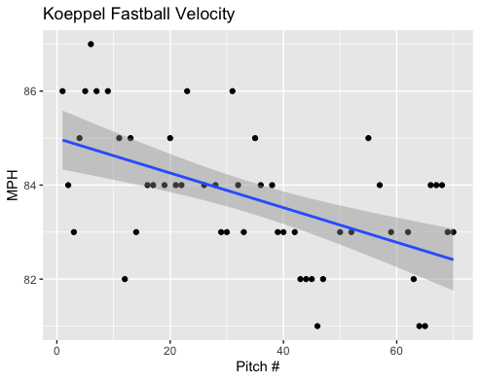
Fastball Usage
Average Velocity = 83.7MPH
Max Velocity = 87MPH
74% Usage
Again, Koeppel lost velocity with game progression.
Overall, his velocity was never consistent ranging from 83-87MPH throughout the game.
With game progression his fastball hovered more around the 83-84MPH range, however there was a healthy number of fastballs lower than 83 after the 40th pitch.

Slide 3
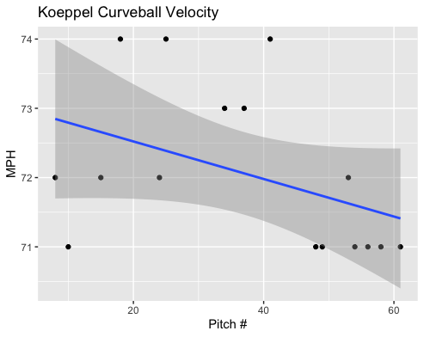
Curveball Usage
Average Velocity = 72.1MPH
Max Velocity = 74MPH
23% Usage
Like his fastball, Koeppel’s curveball also dipped in velocity as the game progressed.
He started off around the 72-74MPH range, however towards the 50th pitch and on, he only threw around 71MPH

Slide 4
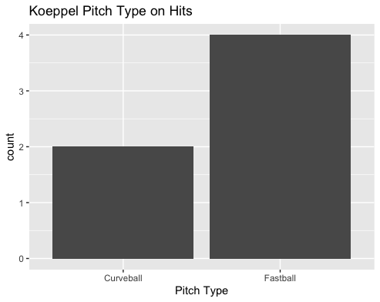
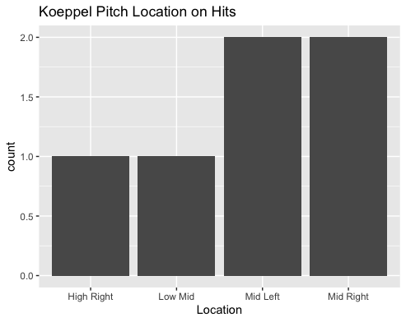
Hits
Koeppel gave up 2 batted balls on curveballs both yielding hits.
All hits given up were to right-handed hitters.
With 2 middle-outside fastballs (1 single, 1 double) and 2 middle-inside pitches (one fastball, one curveball)
He also gave up a high-outside curveball and a low-middle fastball for singles.

Slide 5
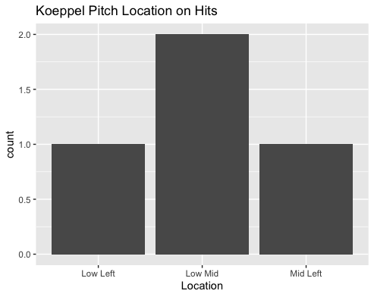
Outs
Koeppel got all his field outs via the fastball.
He got 2 outs on low middle fastballs (one to a right-handed hitter, the other to a left-handed hitter.
Hitters went 1-for-3 on low-middle fastballs.
He got one out on a middle-in fastball but hitters 2-for-3 on pitches in that location.
Koeppel also got an out on a low-outside fastball on a left-handed hitter.
He never yielded a hit on a low-outside pitch.

Slide 6
Stats
BABIP = .600
H/9 = 18
K/9 = 3
BB/9 = 12 (also hit one batter)
K:BB = .25
One of Koeppel’s worst performances.
Koeppel had an extremely high walk rate in addition to hitting one batter.
He got unlucky on balls in play yielding a BABIP of .600 and a H/9 of 18.
He also struck out only one batter and walked 4 batters for every strikeout.
5 batters if you count the hit by pitch.
He found success on low-outside fastballs, despite the small sample size maybe that could lead to more success.

Slide 7
Comparison to other starts
His walk rate jumping back up is concerning.
In his last start he got hit hard on his fastball.
He only threw 2 changeups, maybe with an increased changeup usage both the fastball and curveballs can yield better results.
His changeup can also be a successful pitch.
In his last start, Koeppel had a very high BABIP which was lowered by .127 points in this game. Despite it also being high in this performance.

