Slide 1
Cole Koeppel 5th Start
07/11/22

Slide 2

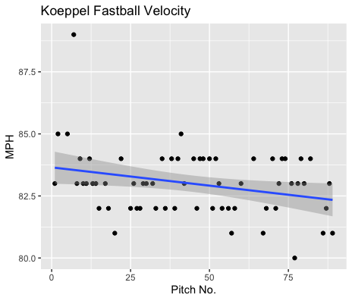
Fastball Usage
Average Velocity = 83MPH
Max Velocity = 89MPH
70% Usage
This was one of his most consistent starts with his fastball.
Aside from one 89MPH pitch early on his fastball mostly hovered in the 82-84MPH range.
The downward trendline is mostly influenced by his early higher velocity, otherwise he’s very consistent.

Slide 3
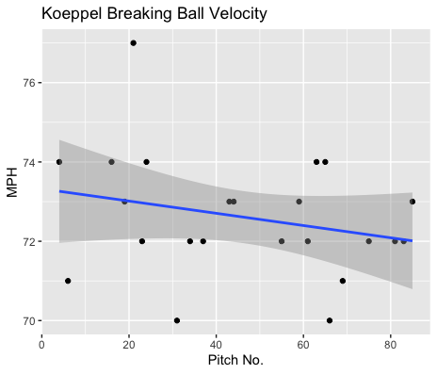
Breaking Ball Usage
Average Velocity = 72.6MPH
Max Velocity = 77MPH
26% Usage
Aside from 5 pitches, all Koeppel’s breaking balls were in the 72-74MPH.
Like his fastball his breaking ball was consistent throughout the course of the game.

Slide 4
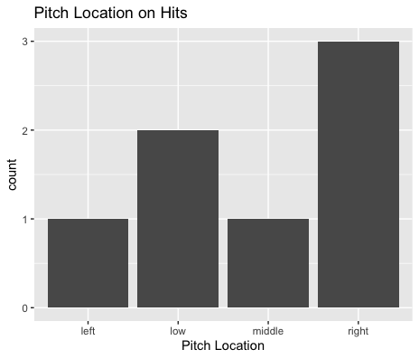
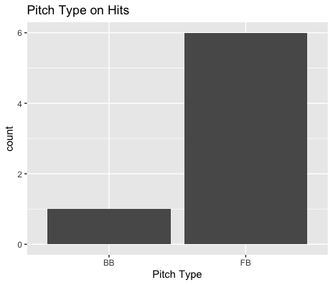
Hits
Koeppel gave up 3 hits on 5 inside pitches to left-handed hitters. (all on fastballs)
Koeppel gave up 2 home runs on outside fastballs to Esai Santos.
Hitters also went 2-for-4 on low pitches.
Koeppel also gave up a single on an inside fastball to a right-handed hitter.

Slide 5
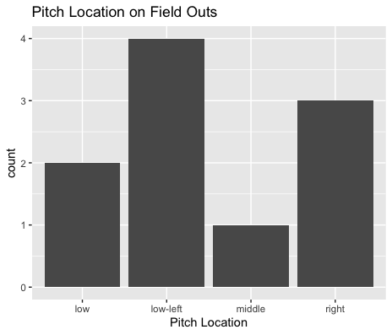
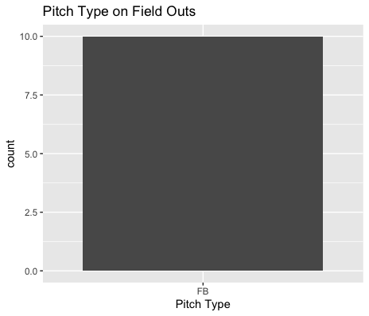
Outs
Koeppel found a lot of success in low-left pitches, with righties(low-inside) going 0-for-2 and lefties(low-outside) going 0-for-2.
Koeppel did additionally get all his field outs on his fastball.
Koeppel got hit hard on inside pitches to lefties and righties so maybe targeting outside locations can yield better results.

Slide 6
Stats
BABIP = .412
H/9 = 12.6
K/9 = 9
BB/9 = 5.4
K:BB = 1.6
Koeppel had a solid K/9 and H/9.
His BABIP was somewhat high, especially due in part to him being hit badly on inside pitches.
While his H/9 was solid, he did give up 2 home runs and a double, so it wasn’t mostly singles.
He also had a high walks per nine.

Slide 7
Comparison to other starts
In his last start he found success on low-outside fastballs.
That same trend seems to have occurred in this start as well.
Maybe Koeppel can target outside zones rather than inside zones as it seems he gets hit hard on inside contact.
Koeppel only threw a few changeups, possibly could it be an effective pitch?
All his field outs came on the fastball, as well as all but one hit.

