Slide 1
Jomari Rosa
06/16/22

Slide 2
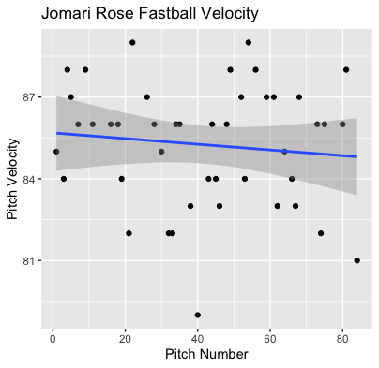
Fastball Velocity
Avg = 85.2
Max = 89
Rose’s Fastball was consistent throughout the entire game, aside from fading during the later innings for a bit.
There was a lot of variance in pitch velocity throughout the entire game with fastballs ranging from the high to low 80s

Slide 3
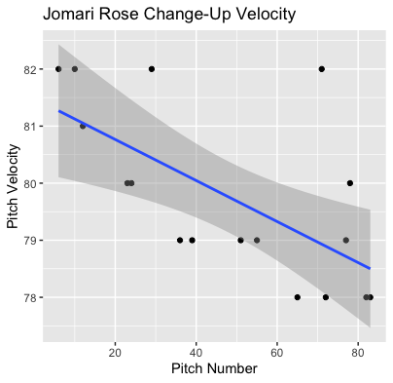
Change-Up Velocity
Avg = 79.8
Max = 82
Rose’s Changeup started off in the 80s, however with low usage and game progression his changeup hovered more around the high 70s towards the end of the game.

Slide 4
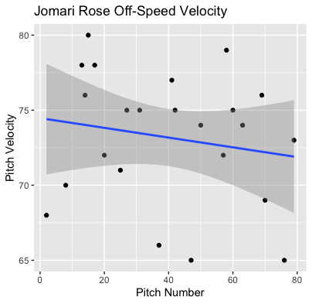
Off-Speed Velocity
Avg = 73.2
Max = 80
Like his fastball, Rose’s Off-Speed was consistent throughout the entire game. There’s a slightly downward slope which can possibly indicate fatigue.

Slide 5
Hits
Rose gave up 7 hits (6 singles and a double) with 6 of the 7 being off his fastball.
Rose had 19 balls put in play meaning he had a BABIP of 7/19, or .368
He did not give up a hit on 2 change-ups put in play, which may indicate a reason for increased usage.

Slide 6
Pitch Usage
Fastball (44/84) = 52%
Change-Up (19/84) = 23%
Off-Speed (23/84) = 27%
His changeup performed really well, so it might help to try and get that usage up to maybe 30%.

Slide 7
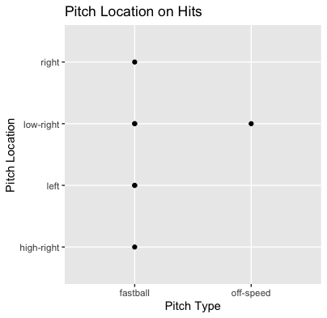
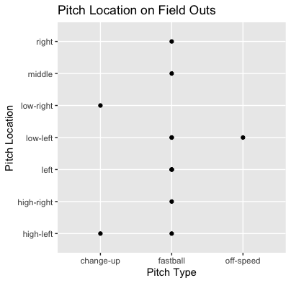

Slide 8
Pitch Location
It seems that Rose got a lot of contact, and on the contact, he varied his location a lot.
He had 2 pitches get hit from the low-right, however one hitter was right-handed, and the other was left-handed.
As much as his fastball got hit, it also got 6 field outs on its own. Despite his fastball having a .400 BABIP.

Slide 9
Stats
BABIP = .368
H/9 = 9
K/9 = 3.6
BB/9 = 7.2
Rose got unlucky with BABIP, he does put most balls in play in addition to having a low K/9.
In addition to a low K/9, he has a high BB/9 of 7.2.

