Slide 1
Jomari Rosa’s 2nd Start
7/3/22

Slide 2

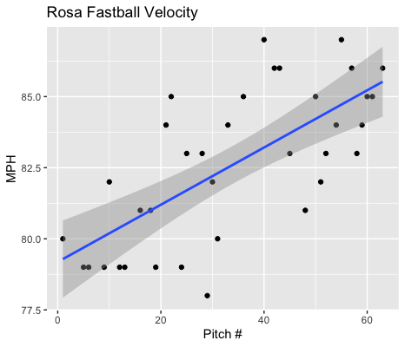
Fastball Usage
Average Velocity = 82.6MPH
Max Velocity = 87MPH
60% Usage
Rosa increased his fastball velocity with game progression.
He started off with his velocity ranging in the high 70s-low 80s.
After throwing for about half of his appearance he began to throw the ball in the low 80s and he ended throwing the ball in the mid 80s.

Slide 3
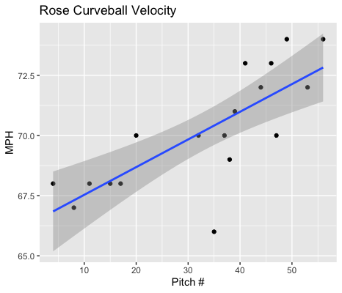
Curveball Usage
Average Velocity = 70.2MPH
Max Velocity = 74MPH
28% Usage
Rosa began the game throwing in the high 60s, however, with game progression he began to consistently throw in the low 70s.
Given the trendline you can see that Rosa increased his velocity as the game progressed.

Slide 4
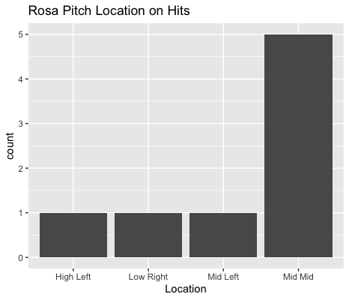
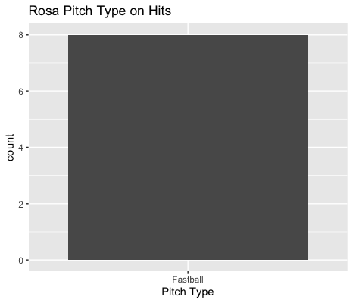
Hits
Rosa gave up 8 hits, all on his fastball.
5 of the 8 hits were on mid-mid fastballs.
All to right-handed hitters.

Slide 5
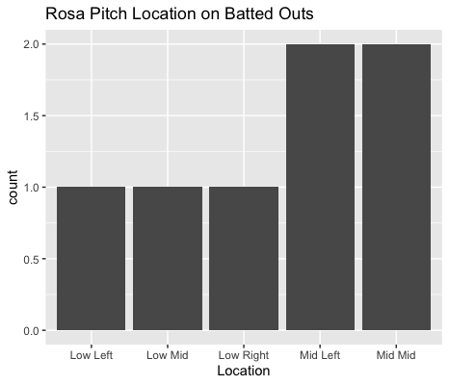
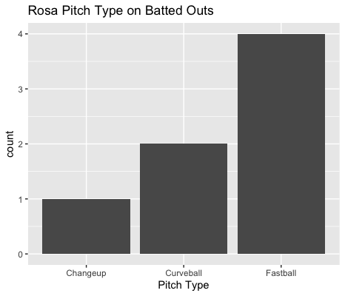
Outs
All his field outs were from right-handed hitters.
Rose didn’t give up any hits on curveballs or changeups.
His fastball got hit very hard, yielding a BABIP of .667.
Rosa found success targeting low-inside and low-middle.

Slide 6
Stats
BABIP = .533
H/9 = 21.62
K/9 = 2.70
BB/9 = 5.41
K:BB = 0.5
Rosa got hit hard on his fastball, especially on middle-middle fastballs.
Rosa might struggle with command, especially given a high number of middle-middle fastballs as well as 5.41 walks per nine innings.
His walks also outnumbered his strikeouts having two walks per every one strikeout.

Slide 7
Comparison
In his first start he threw less fastballs and he had a lower BABIP and H/9.
I’d suggest a higher changeup and curveball usage because they both had a BABIP of .000.
Rosa may have command issues.
He has a low strikeout rate and a high walk rate.
He also gave up a lot of hits on middle-middle fastballs so his BABIP should go down with improved accuracy.

