Slide 1
Jomari Rosa 3rd Start
07/10/22

Slide 2

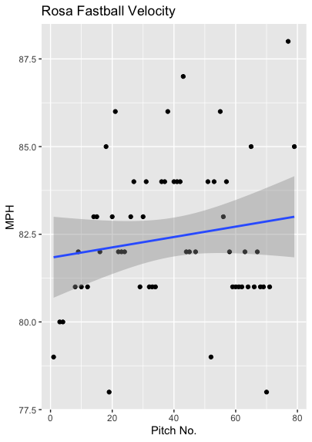
Fastball Usage
Average Velocity = 82.4MPH
Max Velocity = 88MPH
72% Usage
Rosa used his fastball for most of his pitches, and his fastball velocity gained velocity as the gave progressed.
Even peaking at 88MPH towards the end of his start.
The positive trendline indicates increasing velocity.

Slide 3
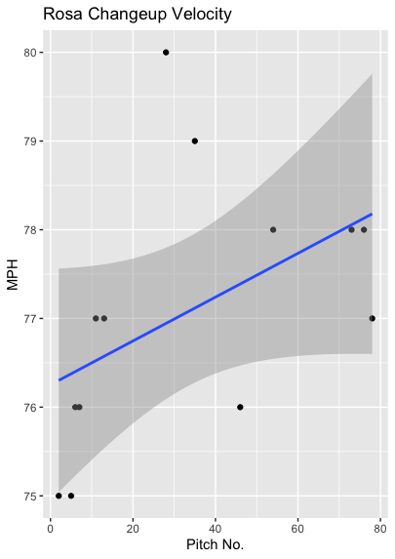
Changeup Usage
Average Velocity = 77.1MPH
Max Velocity = 80MPH
16% Usage
Like his fastball, his changeup also gained velocity as the game progressed.
He started off throwing in the mid 70s and ended in the high 70s.

Slide 4
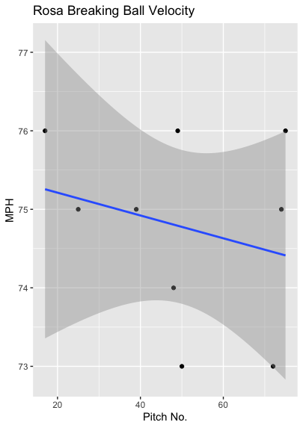
Breaking Ball Usage
Average Velocity = 74.8MPH
Max Velocity = 76MPH
11% Usage
While he didn’t really use his breaking ball, his breaking ball was the only pitch that decreased in velocity as the game progressed.
His breaking ball started in the 75-76MPH range however multiple pitches of 73MPH and 74MPH pull the trendline downwards.

Slide 5
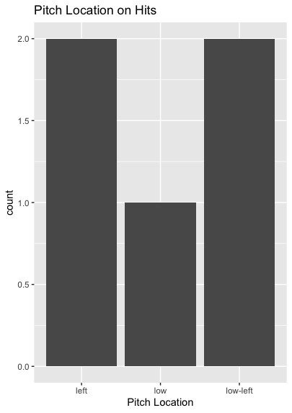
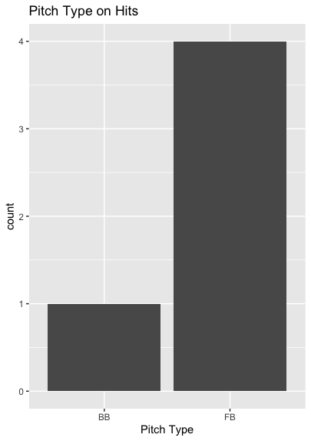
Hits
All the hits given up were to right-handed batters.
4-of-5 hits had to deal with some variation of an inside pitch.
Whether it was low and inside or just inside.
4 hits were also on fastballs. (all inside pitches)

Slide 6
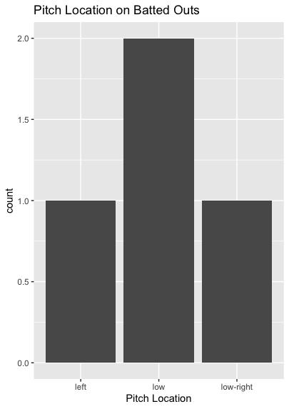
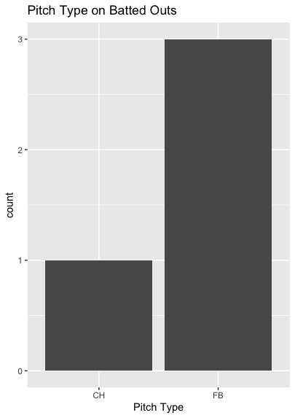
Outs
Rosa got shelled on inside pitches.
Hitters did go 1-for-3 on low contact. He did also get an out on a low and outside pitch.
Rosa did get an additional out on an outside pitch to a left-handed hitter.

Slide 7
Stats
BABIP = .556
H/9 = 22.5
K/9 = 9
BB/9 = 27
K:BB = 0.33
The real issue that Rosa had was that he walked six batters in the span of two innings.
His poor pitching to contact was much overshined by a BB/9 of 27 and a walk rate of 33.3% not to mention another hit batter.
He might have gotten unlucky pitching inside to right-handed batters, however he could try to throw more outside pitches given he found a low of success on the outside part of the plate.

Slide 8
Comparison to Other Starts
Rosa continued his trend of having a high walk rate.
In this start it was the highest it’s ever been and it’s not close.
In his previous starts he has gotten hit hard on his fastball, yet he hasn’t been hit badly on his changeup or curveball.
With a 70%+ Usage it makes sense for most of the damage to be on his fastball however if he could get at least 35% combined usage of his changeup and curveball his BABIP and H/9 should go down.
Rosa should also try to target outside pitches to hitters, given he’s been hit hard on inside pitches.

