Slide 1
Teo Torrado 2nd Start
06/18/22

Slide 2
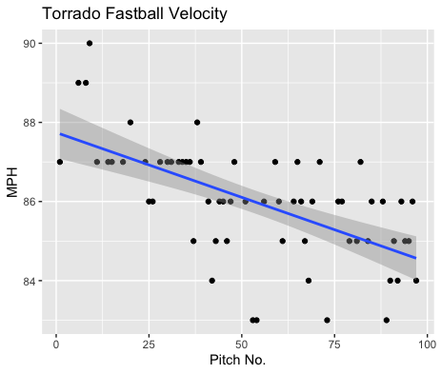
Fastball Usage
Average Velocity = 86MPH
Max Velocity = 90MPH
62/97 = 64%
Most of his pitches came from the fastball. Unlike his first start his fastball was not as consistent throughout the game.
He maxed out at 90MPH in the beginning of the game and was consistently hovering around the 87MPH range throughout his first 40 or so pitches.
However, his fastball velocity decreased as the game persisted.
After his 50th pitch his FB velocity ranged from 83-86 MPH.

Slide 3
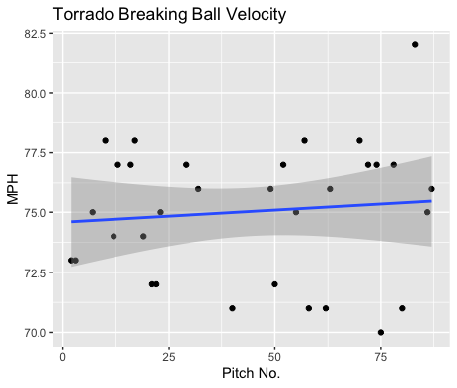
Breaking Ball Usage
Average Velocity = 75MPH
Max Velocity = 82MPH
32/97 = 33%
Throughout the game, Torrado was very consistent with his breaking ball, even gaining velocity as the game progressed.

Slide 4
Batted Balls
Of the 16 batted balls, Torrado gave up 3 hits, 2 on his fastball and 1 on a breaking ball.
On the hits given up it was on a high and mid fastball, and a left side breaking ball on a right-handed hitter.
Additionally, all his batted balls came off right-handed hitters.

Slide 5
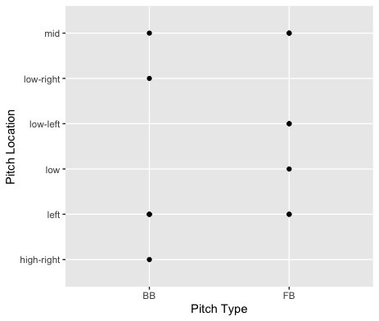
His breaking ball did well when it was hit, leaving him with an overall .200 BABIP on his breaking ball.
On 6 pitches thrown to the left side of the strike zone, he had a BABIP of .167.

Slide 6
Stats
BABIP = .188
H/9 = 4.05
K/9 = 9.45
BB/9 = 2.70
K:BB = 3.50
Torrado has done really well on balls put in play, with a BABIP below .200.
He additionally has a pretty low H/9 and a good K/9. As well as a solid walk rate and strikeout to walk ratio.

