Slide 1
Teo Torrado 3rd Start
07-04-2022

Slide 2

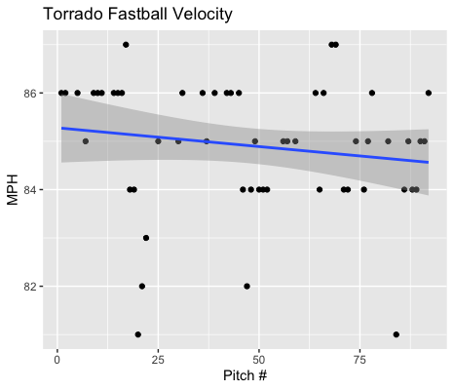
Fastball Usage
Average Velocity = 84.9MPH
Max Velocity = 87MPH
60% Usage
Torrado’s fastball was consistent throughout his start, as seen in his trendline.
Most of his fastballs ranged from 84-86MPH.
His fastball was in the 86MPH range and slowly decreased to 85 and 84MPH towards the end of his start.
There were 8 pitches of 55 that weren’t 84 or 86MPH.

Slide 3
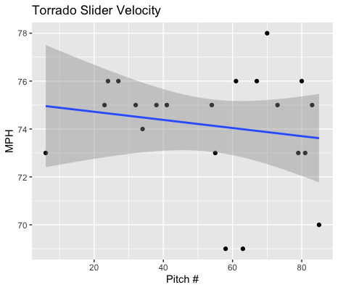
Slider Usage
Average Velocity = 74.1MPH
Max Velocity = 78MPH
23% Usage
Aside from three sliders(69, 69, 70) towards the end of his start, most of his pitches were from 73-76MPH.
The downwards trendline indicates a decrease in velocity, however his sliders were consistent from the beginning and end of his start.
The three sliders are outliers to his overall range of velocity.

Slide 4
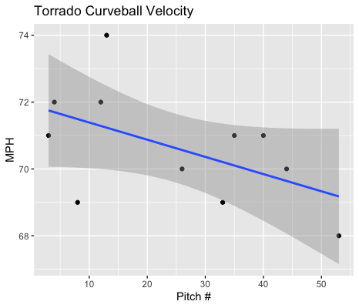
Curveball Usage
Average Velocity = 70.6MPH
Max Velocity = 74MPH
12% Usage
Torrado’s start began with curveballs in the low-mid 70s.
As the game progressed his curveball began to decrease in velocity to the high 60s and low 70s.

Slide 5
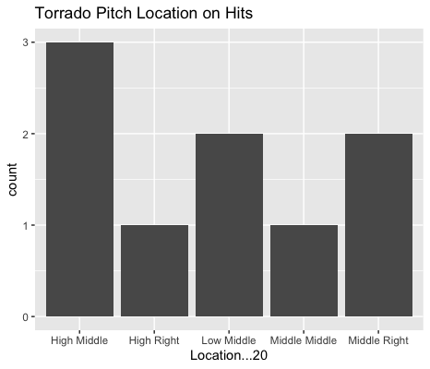
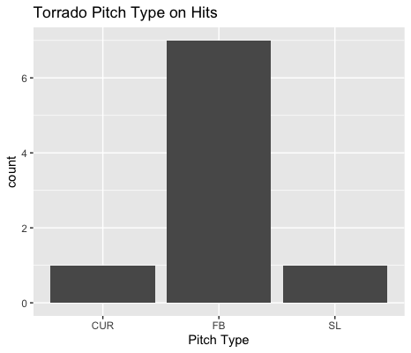
Hits
Torrado was hit badly on high-middle pitches.
There were also 2 low-middle and 2 middle-inside (left-handed) pitches that were hits.
Lefties went 5-for-8 against Torrado.

Slide 6
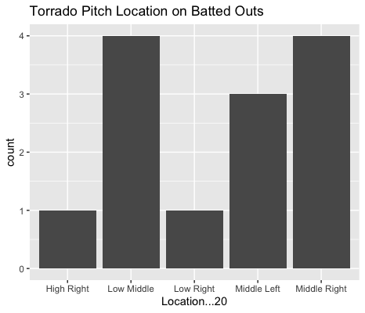
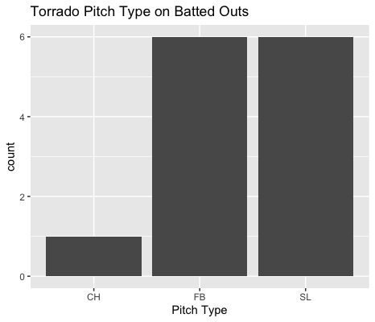
Outs
Torrado’s slider pitched extremely well to contact, yielding a BABIP of .143.
On middle-inside pitches against left-handed hitters, Torrado yielded 2 hits along with 3 field outs.
Torrado got 3 outs on middle-inside pitches on right-handed hitters without yielding any hits.

Slide 7
Stats
BABIP = .409
H/9 = 14.29
K/9 = 3.17
BB/9 = 4.76
K:BB = 0.67
Torrado got unlucky on some pop-flies that ended up resulting in some singles and a double.
Hitters went 3-for-3 on line-drives.
Hitters had a BABIP of .400 on pop-flies.
Torrado’s BABIP and H/9 should go down with less success on pop-flies and possibly with an increased groundball rate.
Torrado also had a low strikeout and high walk rate. With increased strikeout success and pitch accuracy his performance also should be better.

Slide 8
Start Comparisons
Despite allowing 5 runs, Torrado pitched well.
Torrado has always found a lot of success pitching with his breaking ball. I think that if he throws his slider more, he will have a lot of success.
In all his starts his breaking ball has done well when hit and his slider had a BABIP of .143 in this past start.
His fastball pitches well however his breaking ball does even better.
He should try to increase his slider usage into 30%+ as well as 20%+ for his curveball.
That should yield better overall results.
Torrado should target low-middle locations as well as middle-inside pitches to right-handers.
He should also find more success if he doesn’t throw many high-middle pitches.

