Slide 1
Teo Torrado 4th Start
07/10/22

Slide 2

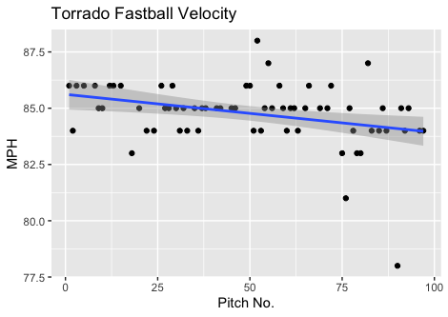
Fastball Usage
Average Velocity = 84.8MPH
Max Velocity = 88MPH
68% Usage
Torrado was very consistent with his fastball. As you can see almost all his pitches were in the 84-86MPH range, indicated by his average fastball velocity being 84.8MPH.
The slightly decreasing trendline can mostly be explained in a shift from 85-86MPH to 84-85MPH after around the 50-pitch mark.

Slide 3
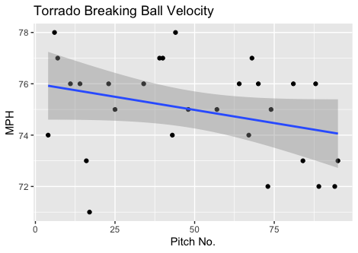
Breaking Ball Usage
Average Velocity = 75MPH
Max Velocity = 78MPH
29% Usage
Like his fastball, Torrado’s breaking ball had a slight decrease in velocity with game progression.
His breaking ball is nowhere near as consistent as his fastball as his velocity ranges from 71-78MPH during the game.

Slide 4
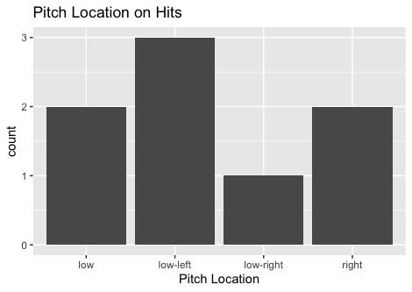
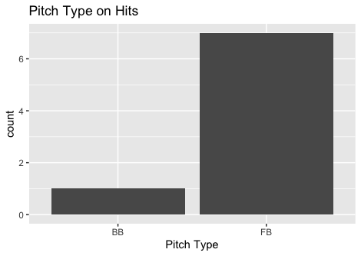
Hits
All hits given up were on singles.
7 of the 8 singles were to right-handed batters.
4 hits were on low-inside pitches (3R, 1L).
2 hits were on outside and also low pitches to right handed hitters.

Slide 5
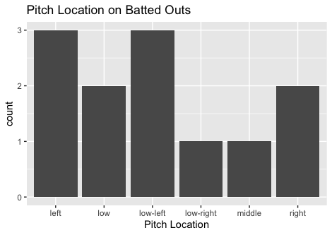
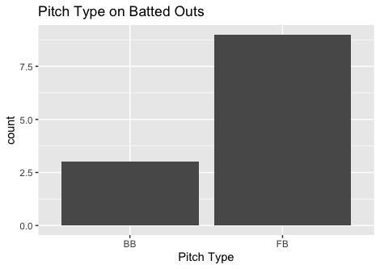
Outs
Torrado got 3 outs on his breaking ball, ending with a .250 BABIP on his breaking ball.
Hitters were 0-for-3 on inside pitches (all FBs, all Rs).

Slide 6
Stats
BABIP = .400
H/9 = 12
K/9 = 3
BB/9 = 7.5
K:BB = 0.4

Slide 7
Comparison to Other Starts
Torrado’s fastball was hit badly in his last start, yet he increased his fastball usage.
While his H/9 and BABIP slightly went down, with an increased breaking ball usage it should decrease even more, more comparable to his first 2 starts. Maybe he can get his breaking ball usage up to ~40% and have his fastball around 55-60% possibly mixing in a couple of changeups like he did in this past start.
Like in his 3rd start, Torrado also had some command issues, with a K:BB below 1 again, a somewhat low strikeout rate and high walk rate.
Torrado should find more batted ball success on inside pitches to right-handers, like I suggested after his last start.

