Slide 1
Teo Torrado 5th Start
07-16-22

Slide 2

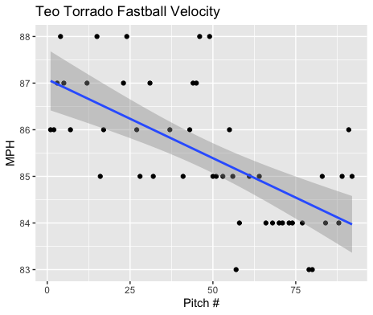
Fastball Usage
Average Velocity = 85.5
Max Velocity = 88MPH
54% Usage
This was his first start where there was a clear decrease in velocity as the game progressed.
There were 2 of 5 singles in the 7th inning where his velocity had dipped.
His fastball started off ranging form 85-88MPH and ended around 83-85MPH.

Slide 3
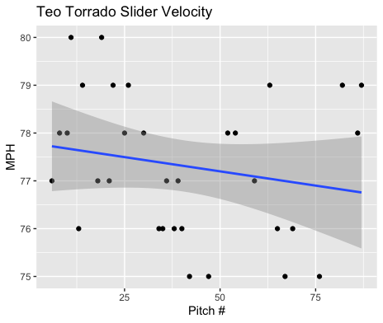
Slider Usage
Average Velocity = 77.3MPH
Max Velocity = 80MPH
35% Usage
Unlike his fastball, Torrado’s slider was a bit more consistent throughout the game.
His slider ranged from 75-80 throughout his start, with a majority of his pitches coming from the 76-78MPH rangem.

Slide 4
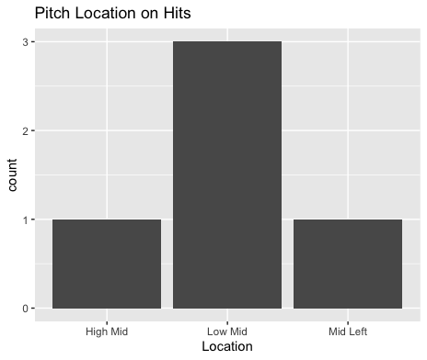
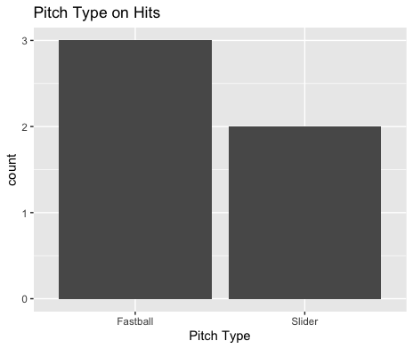
Hits
All hits were singles and from right-handed hitters.
It seems that his slider was hit more than his fastball.
Hitters thrived on low-middle pitches (2 FB, 1SL).

Slide 5
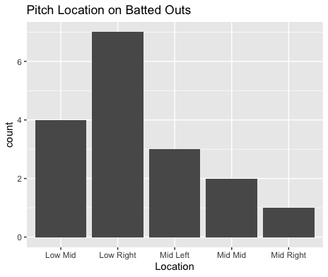
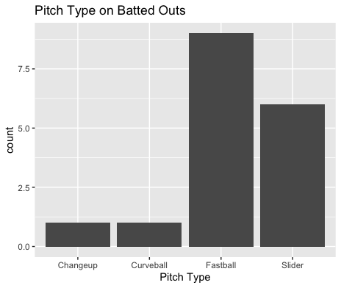
Outs
Right-handed hitters were 0-for-5 on low-outside pitches.
Lefties were 0-for-2 on low-middle pitches, righties were 3-for-5.
Righties also went 1-for-4 on middle inside pitches.

Slide 6
Stats
BABIP = .227
H/9 = 6.43
K/9 = 3.86
BB/9 = 0 (1 HBP)
K:BB = Infinity
Torrado again had a good start.
While his K/9 was down again, he didn’t walk any batters (although he did hit one), his strikeouts and walks were managed pretty well.
His BABIP and H/9 was also really good.

Slide 7
Comparison to other starts
This was a great bounce back start from Torrado after 2 somewhat shaky starts.
He didn’t walk any batters and lowered his walk rate, which is great considering his had a strikeout to walk ratio below 1 in his past 2 starts.
His fastball and slider both played great to contact and his slider continued the trend with good velocity, his slider velocity went up from his last start.
His fastball velocity did drop a bit which did lead to 2 7th inning singles.

