Slide 1
Teo Torrado 6th Start
07/21/22

Slide 2

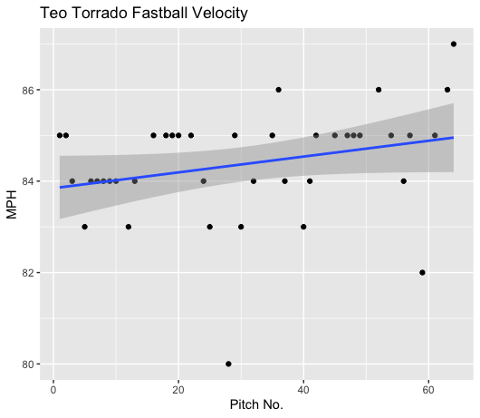
Fastball Usage
Average Velocity = 84.4MPH
Max Velocity = 87MPH
63% Usage
Torrado’s fastball pitched pretty well and grew in velocity as the game progressed.
His fastball hovered around 83-85MPH for all except 6 pitches – 4 above, 2 under that range.

Slide 3
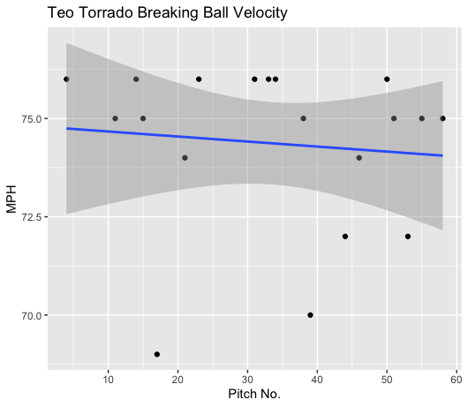
Breaking Ball Usage
Average Velocity = 74.4MPH
Max Velocity = 76MPH
30% Usage
Torrado’s breaking ball also performed well, including game progression.
Most of his breaking balls hovered around the 74-76MPH range aside from 4 pitches.

Slide 4
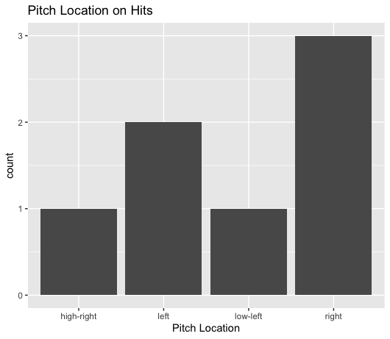
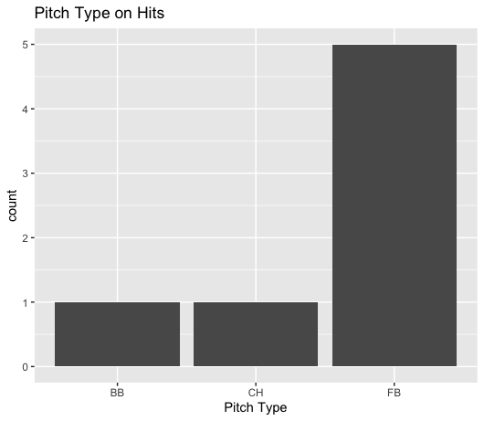
Hits
Torrado’s fastball got hit more than any other pitch.
Hitters seemed to do well on pitches located on the right side of the plate. (2 righties, 1 lefty)
There were also 2 singles on inside pitches to righties. (both offspeed)

Slide 5
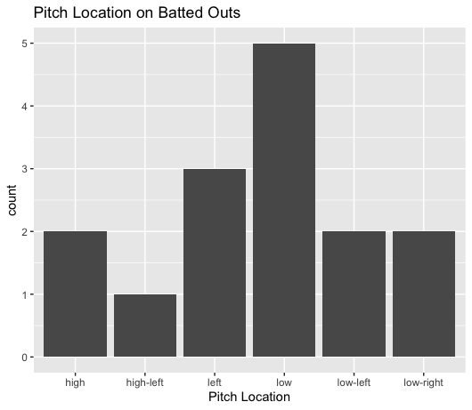
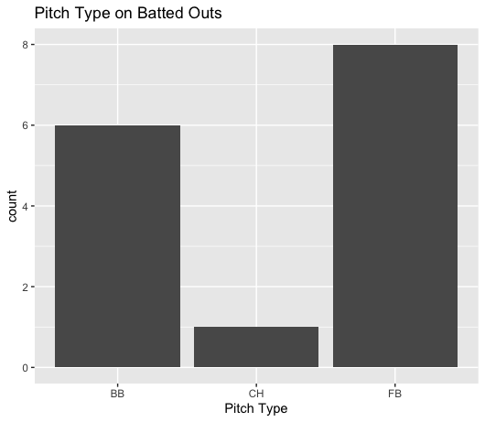
Outs
Torrado’s breaking ball pitched much better to contact than his fastball.
Torrado found a lot of success on low pitches, forcing a lot of groundouts on low pitches. (3FB, 2BB)
Hitters went 1-for-4 on pitches that were of some high variation.

Slide 6
Stats
BABIP = .318
H/9 = 12.6
K/9 = 0
BB/9 = 1.8 (1 hit batter)
K:BB = 0
Torrado pitched well to contact, yielding batters to a low BABIP.
His H/9 was solid; however, he did give up a double and a home run.
He didn’t strikeout any batters, but his walk rate was low.

Slide 7
Comparison
Torrado pitched pretty solid.
While he didn’t strike out any batters, he also didn’t have any control issues, seen in his low walk rate.
His BABIP was alright, and many of the balls that resulted in hits were off his fastball.
With an increased usage on low and high pitch locations, as well as his breaking ball, hitters should find less success when making contact.
Also, it would be extremely helpful for Torrado to increase his strikeout rate.

