Slide 1
Jarrett Taylor
Intern - Grid Applications Developer
GAD Team
2019
Notes:
Howdy, I am Jarrett Taylor and this is my final presentation as an intern with the Grid Applications Development team under Joel Koepke and today I will describe how I reduced 118 manually maintained county displays to a single model-driven webpage.

Slide 2

About Me
Background:
Coppell, TX
Texas A&M: B.S. in Computer Science (Minor in EE)
Hockey, 16 years
Graduate May 2021: Software Application Developer
Notes:
A little about me is that I was born and raised in a suburb near Dallas named Coppell. From an early age I began thinking like an engineer and this continued after high school as I choose to attend Texas A&M University under the school of engineering. Ultimately, I decided to pursue my Bachelor’s in Computer Science and minor in Electrical Engineering. For my hobbies, I played hockey for 16 years, amassing various accolades and was even offered positions on multiple NCAA teams. And after I graduate in May of 2021, I would love a career in software application development.

Slide 3
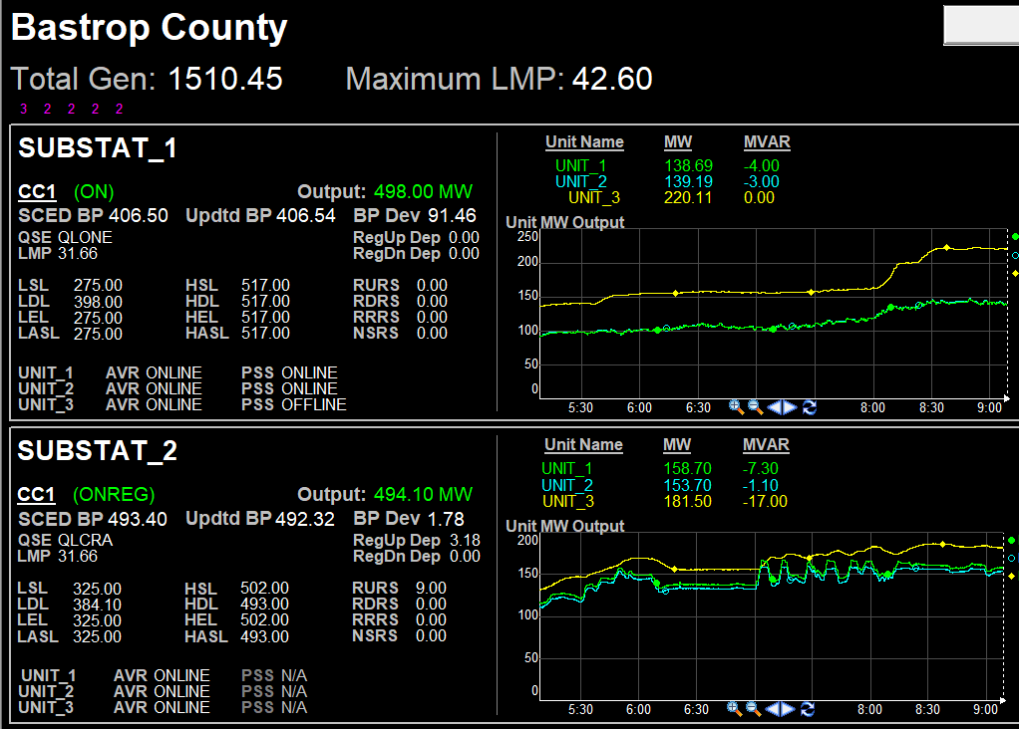
County Generation Display Introduction
Notes:
To first explain, PI Process Book is a program that operators use to access county summary displays in the control room. Here is a typical display for a county in ProcessBook.
This display shows all the generation details for a certain county, by having each county sectioned into substations where each substation has units that display their generation.

Slide 4
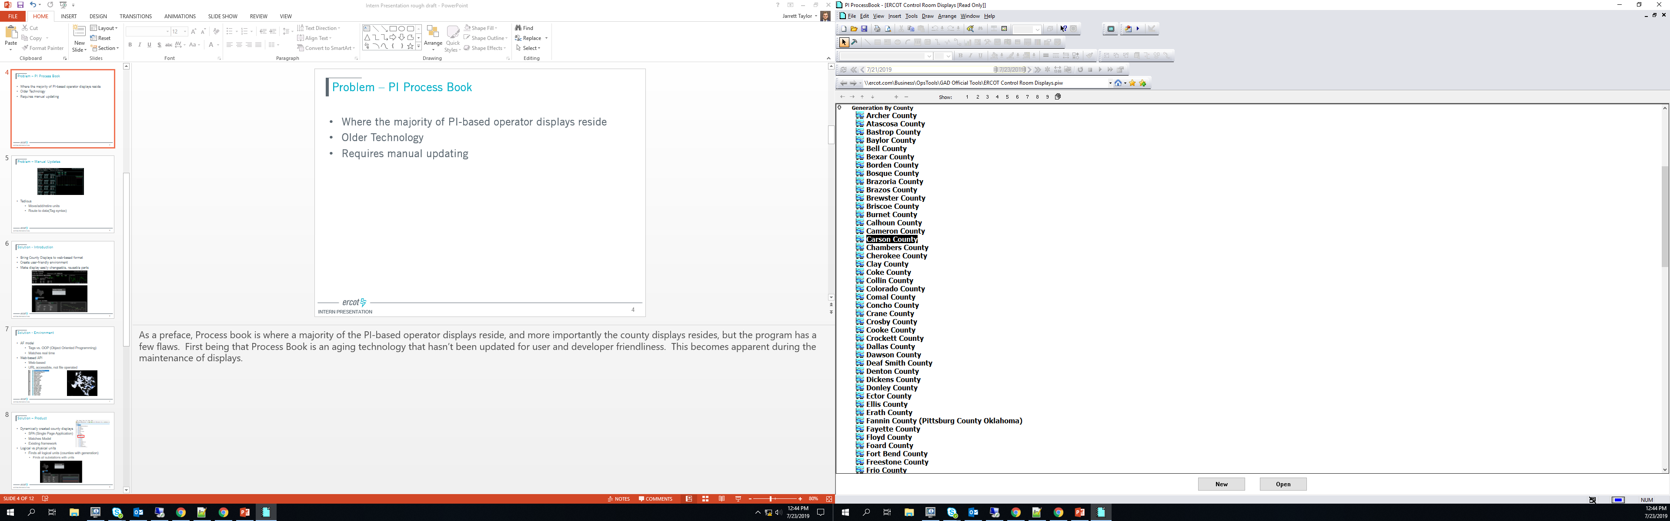
Problem – ProcessBook
Manual Maintenance
Inefficient Updating
Accuracy Problems
Aging technology
Notes:
Though ProcessBook is useful for showing a county’s generation, it’s framework and developer tools lead to major inefficiencies and accuracy issues.
This is because ProcessBook is an aging technology that requires manual updates for each individual county display as the program can utilize the Network Operations Model

Slide 5
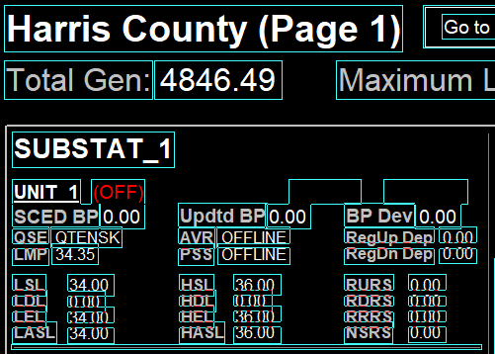
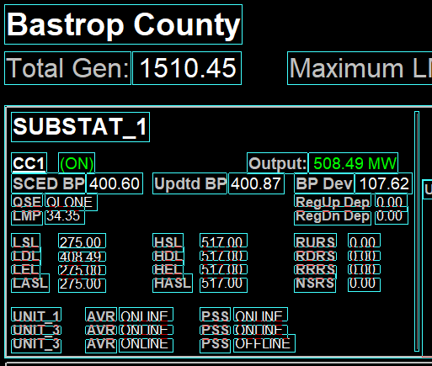
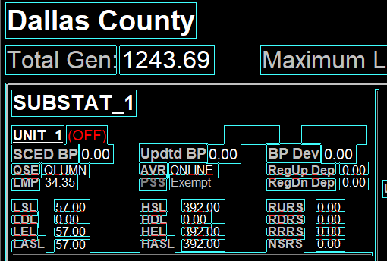
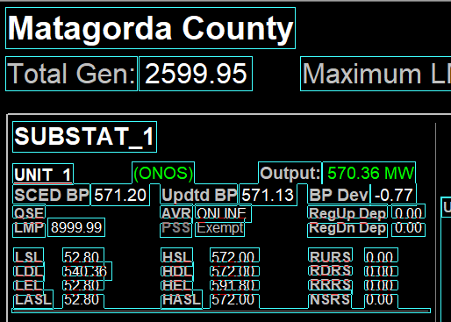
Problem – Manual Updates
All values must be placed and configured manually.
Notes:
This makes display maintenance a cumbersome burden as manual display updates are required with any change to a modeled county. Examples of such changes are new or retired units, or adjustments to a unit's geographical location.
Naturally this process is inefficient considering there are over 100 generating counties each with an individual ProcessBook display. And, in total, there are around 800 units to update within these county displays. Furthermore, each unit has around 30 tags that have to be routed to data.
This means if you just wanted to add a single attribute, such as fuel type, to the units display, you would have to complete this action 800 times. This is not only inefficient, but it also allows for some margin of error as everything is done by hand.

Slide 6
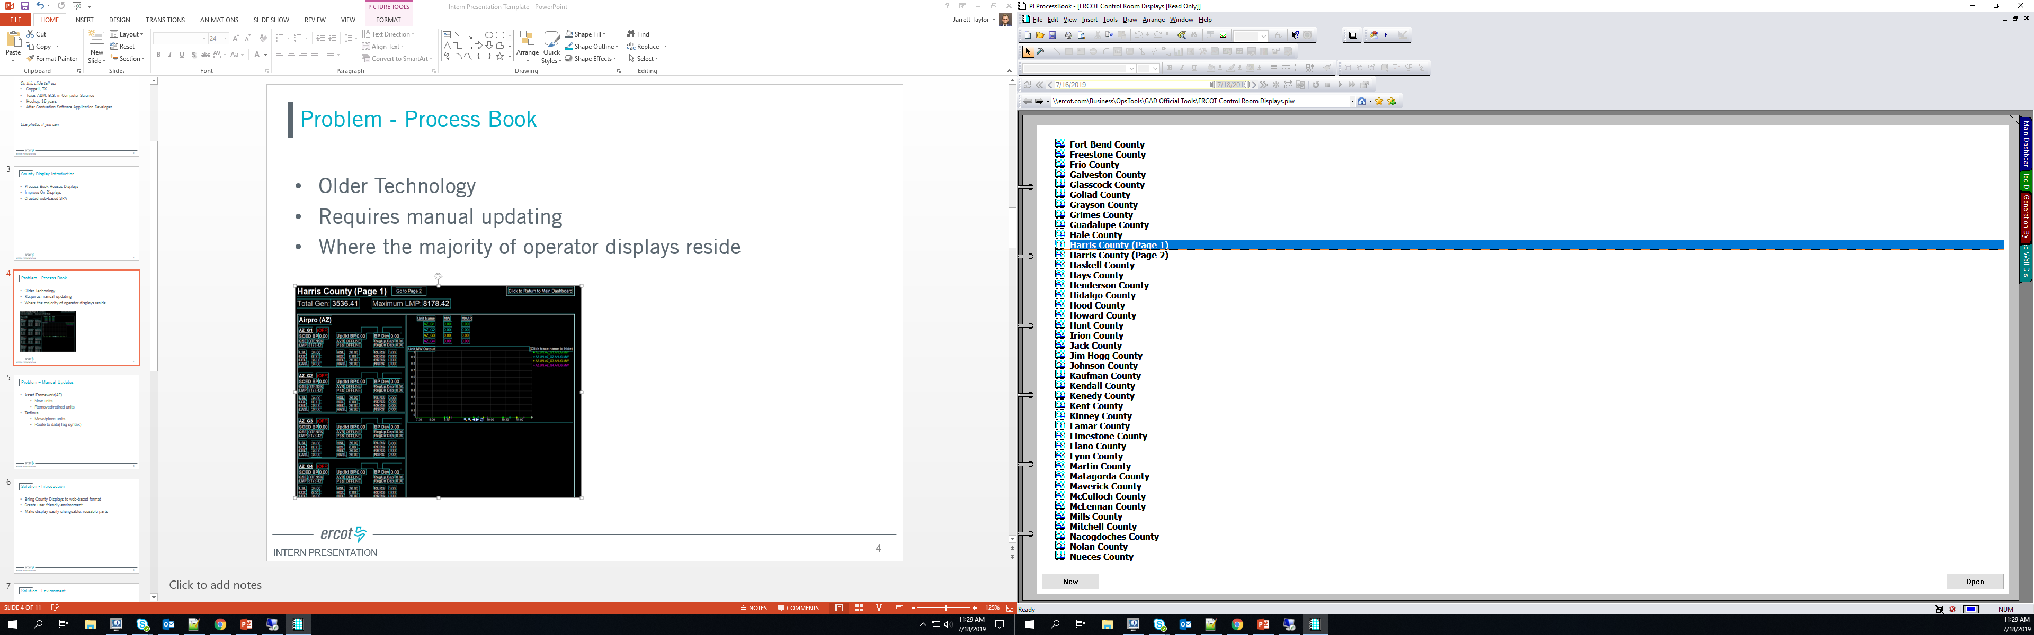
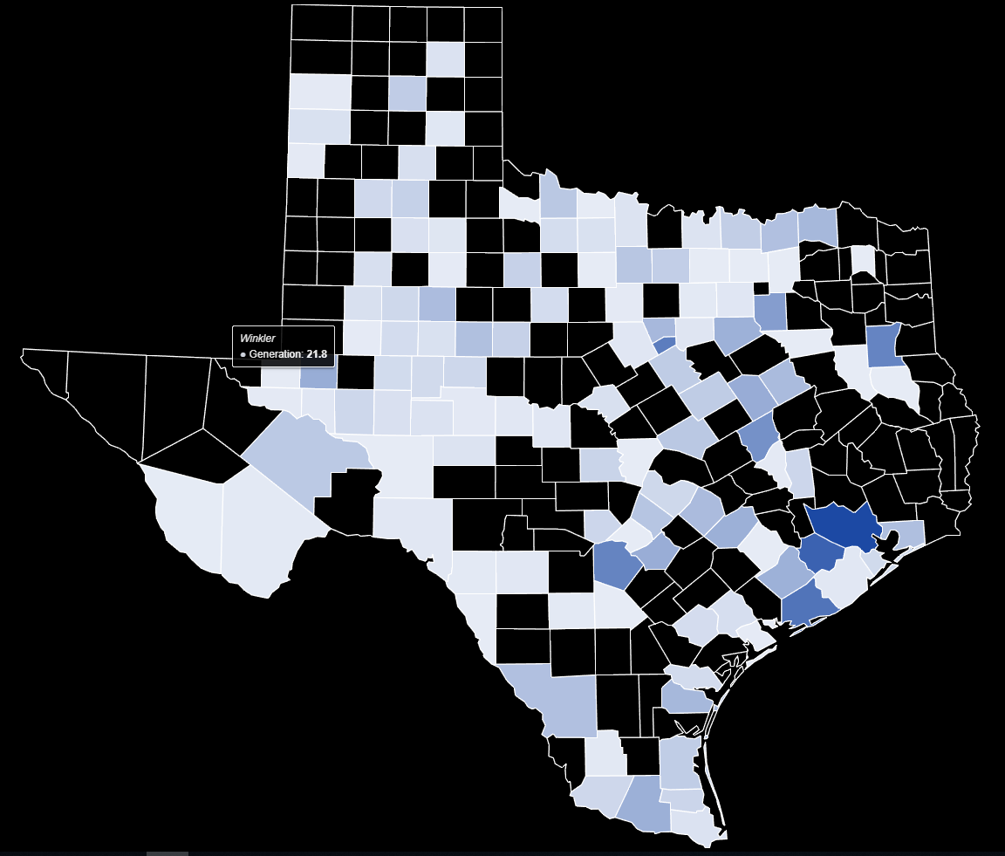
Solution – Transition: ProcessBook to Web Application
The displays will be moved from separate display files…
…to a single web based application which can be bookmarked.
Notes:
With this manually updating problem in mind, I contemplated a viable solution and decided upon a web-based model-driven county display format.
The main change in user environment would be that ProcessBook county displays are accessible by saved files while the web-based application displays are accessible at the click of a county from the Texas County Map or from a simple drop down menu. The web-based displays are also individually accessible by a their specified URL, allowing users to store shortcuts to specific counties they are interested in.

Slide 7
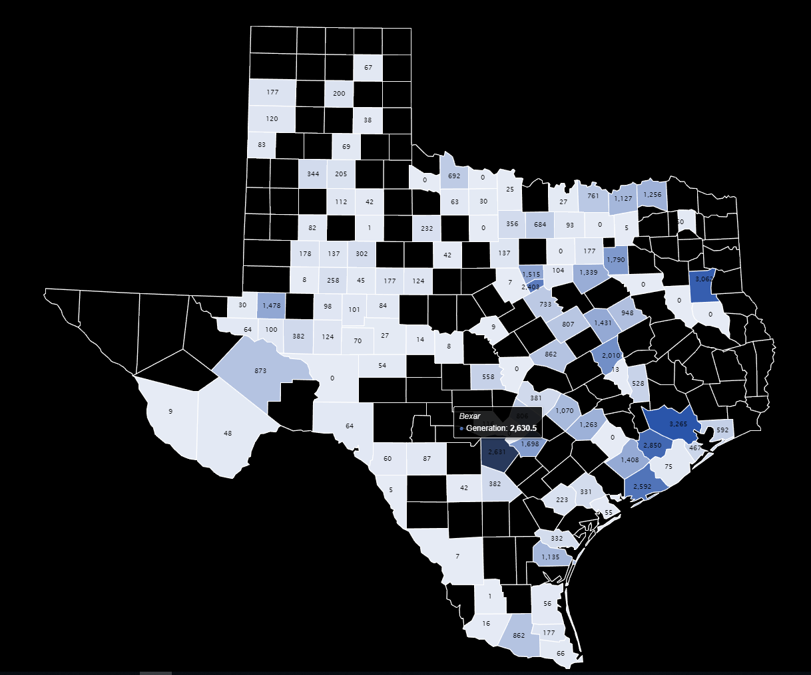
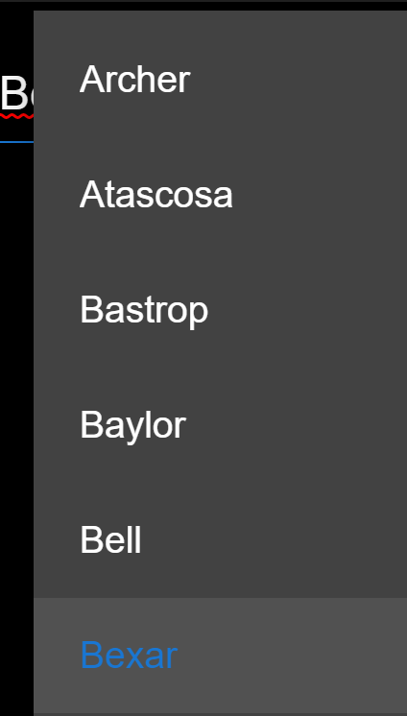
Typical Use Case – Texas Map/Input Field
Notes:
Here are the 2 options to be able to select a county. You can select a county from the Texas County Map or you can type in an input field that holds all of the county names and as you type, the search will be narrowed down to the specific county you want and on the selection of a county…

Slide 8
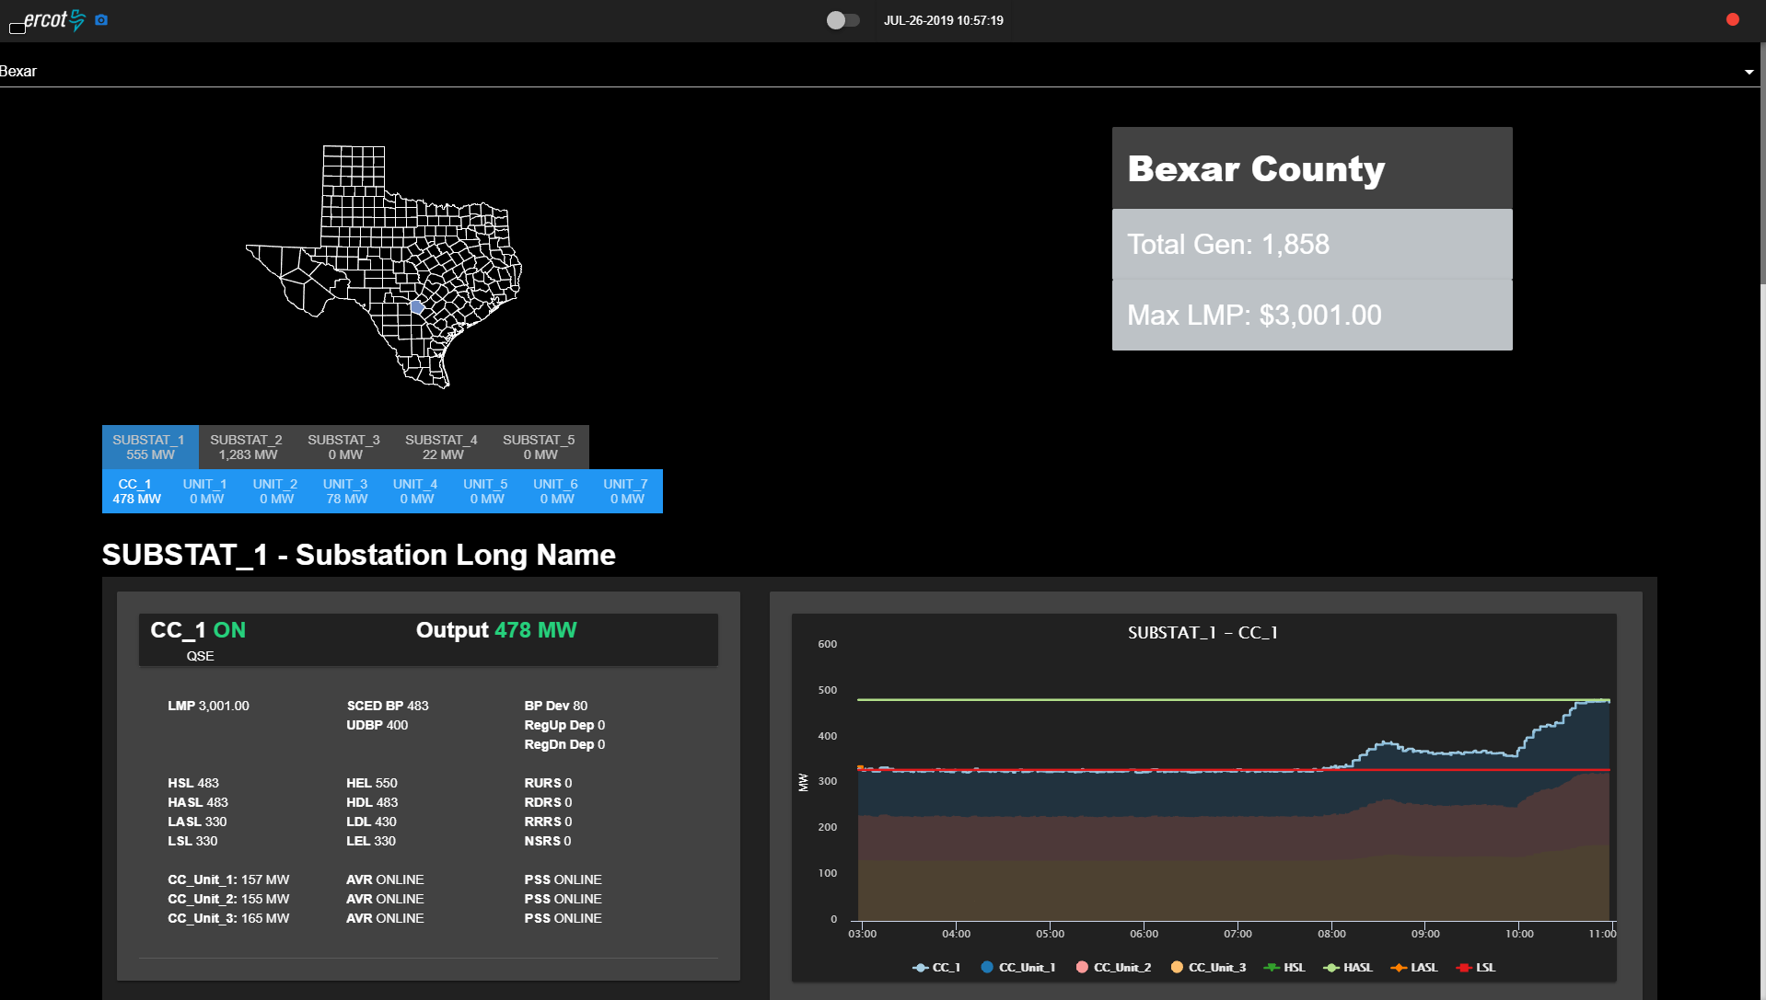
Typical Use Case – County Drill-Down
Notes:
You will be brought to a display that is similar to this. And because this application is based on user actions, I need to explain the user interface for this display.

Slide 9
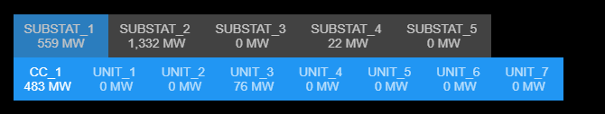
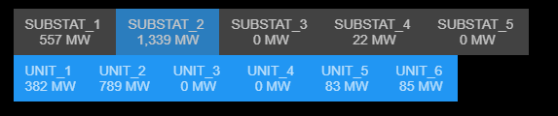
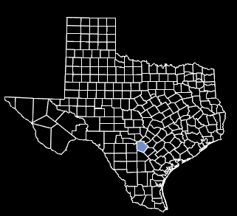
Typical Use Case – Drill-Down Components
User can see all the generating substations within the county…
…and the generators within each substation
User can switch between any generating substation in the county.
Notes:
To start, the top set of tabs represent each substation in the specified county and shows the substations aggregated mega-watt output and on a click of a tab, the webpage will display that substation‘s generation. The second set of tabs is each unit the certain substation also with each units mega-watt output, but I will get to its use in a bit.
Next, the small Texas Map that is housed at the top of the webpage highlights the county you clicked on to help show the user what geographical location the county is in.

Slide 10
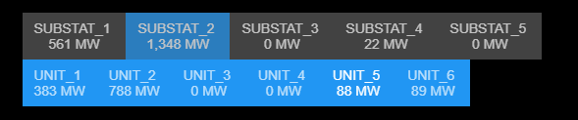

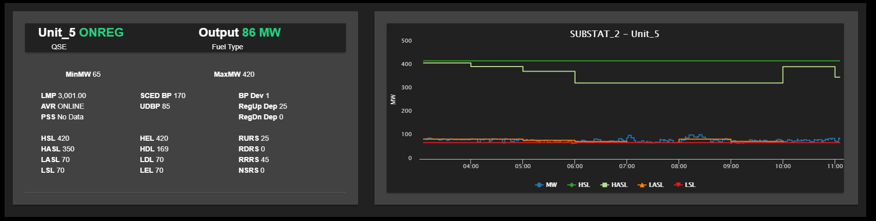
Typical Use Case – Fly-To Generator
Notes:
The second set of tabs automatically scrolls to the unit of choice as you click on the certain unit you would like to see, and instead of scrolling down to see that units generation, you are brought to that unit’s interface.

Slide 11
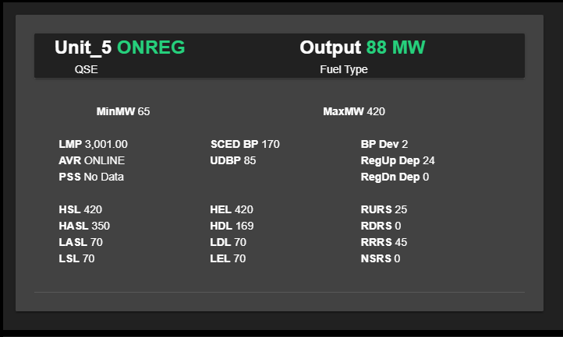
Typical Use Case – Generator Data
Notes:
To explain what you are brought to, the left side of the display shows all of the most recently updated data for the generator in an easily readable format, while…

Slide 12
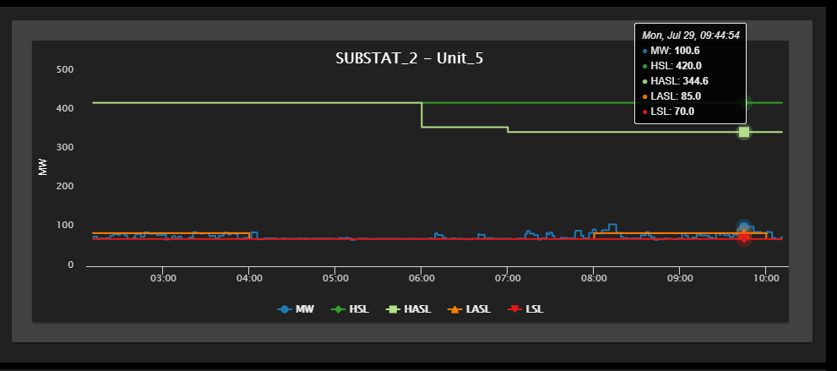
Typical Use Case – Graph
Notes:
The right side of the display is a graph that has the ability to interact with the user. As you hover over the graph, a tool tip will be displayed that shows all of the series readings for that exact time you hover over. You are also able to click a series at the bottom of the graph to hide or show certain attributes.

Slide 13
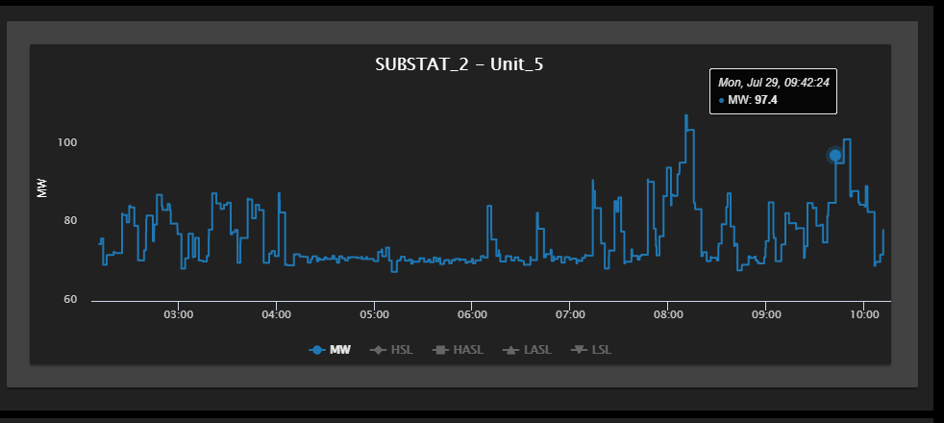
Typical Use Case – Graph Highlight
Notes:
This means if you just want to see the mega watts series for a graph you can click on the other attributes to hide their statistics and see a graph like so.

Slide 14
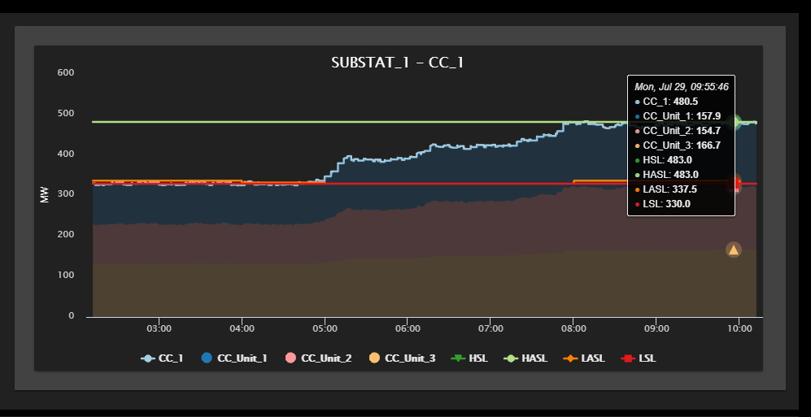
Typical Use Case – Stacked Graph
Notes:
But a detail for combined cycle graphs that should be accentuated, is that each unit’s megawatt output in the combined cycle is stacked on top of each other and the overall Combined Cycle mega-watt output is outlined. This stacked graph is a highly user intuitive feature that is not possible in ProcessBook.

Slide 15
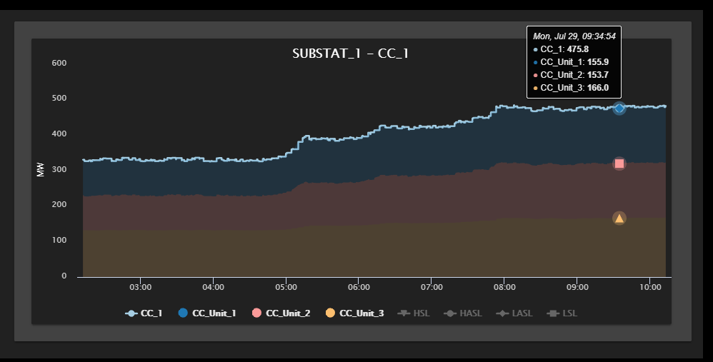
Typical Use Case – Stacked Graph Highlight
Notes:
This graph is also still able to highlight the series of your choice like so.

Slide 16
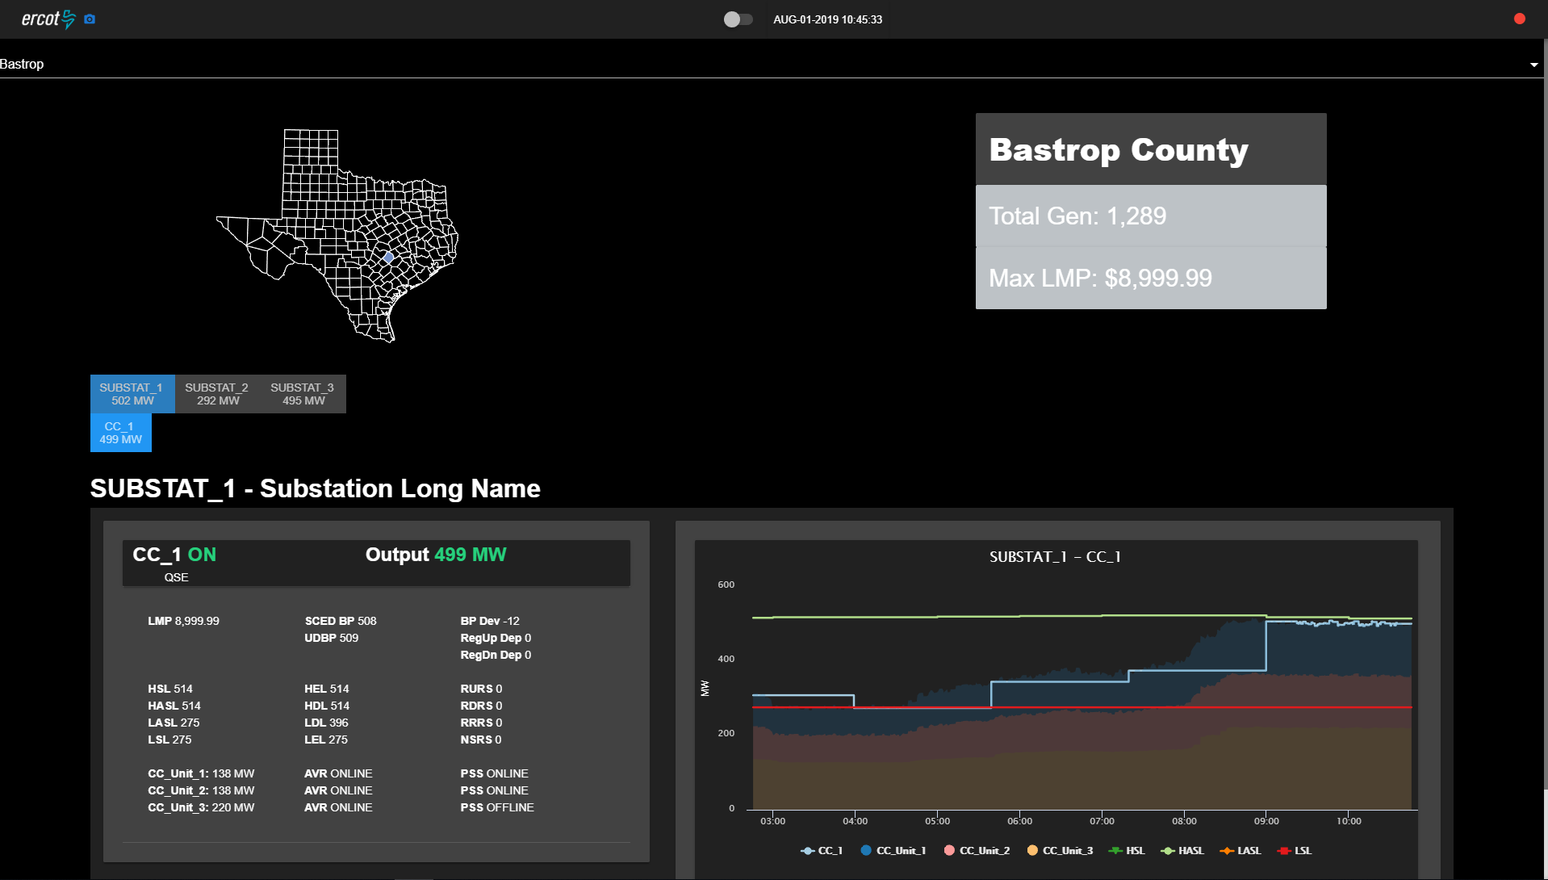
Solution – Product
Model-Driven, Efficient, Accurate and Consistent Application
Notes:
This web-based product constructs the webpage by traversing the weekly updated Model each time the program is instantiated, meaning when called upon, and dynamically creates the county display via the info contained from the Model and then houses this data into a user friendly webpage.
With this application being model driven, it’s efficient and its room for error is minute with the use of templated actions.

Slide 17

Comparison
Operation | ProcessBook | Web-based
Reusable Code
Efficient and Consistent
Easily Accessible
User/Developer Friendly
High Accuracy
Model Driven
Requires Tedious Manual Updating
Notes:
Overall, the new web-based application is a supplemental upgrade to the old ProcessBook technology through the communication with the model to develop displays dynamically. This leads to the increase in efficiency by eradicating the need to manually update displays while also creating an accurate display by pulling directly from the model.
The web-page also contains various user based actions that improve the user interface that ProcessBook does not accomplish, not to mention the enhanced environment from saved files to easy accessible webpages.
Lastly, I would like to emphasize that the web based application creates displays dynamically, so augmenting the user interface is very simple for the developer as adding a single attribute to the unit display format, such as fuel type, takes a couple lines of code when compared to ProcessBook which takes 800 updates.

Slide 18
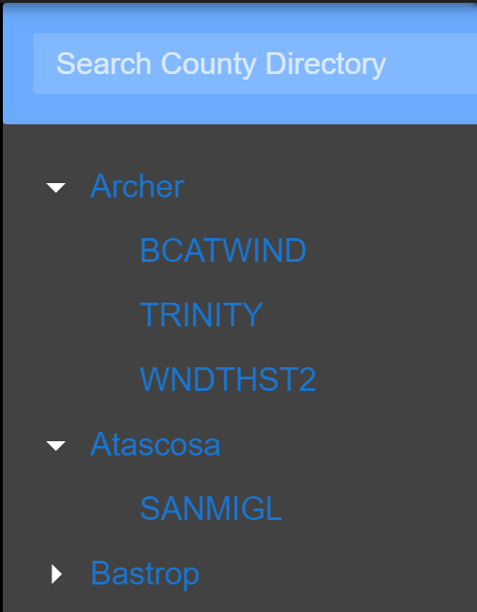
Future Improvement – Substation Search
Notes:
For future steps, other than adding more user interactions such as a search for substation input field, it is relatively easy to create similar displays for other county data such as lines, loads, transformers, and capacitors/reactors. This is because my program acts like an outline to creating webpages and this could expanded to more county data than just units.

Slide 19
What I Learned
Technical Knowledge
Business Etiquette
Notes:
During my internship, working at ERCOT has taught me how to carry myself in work environment and how to adjust to problems that arise in every day work.
I also gained useful technical knowledge by becoming more experienced with multiple coding languages and with web-development as a whole.

Slide 20
Special Thanks
ERCOT
Joel Koepke
GAD
Notes:
Finally, I would like to thank ERCOT and the hiring team for granting me my first internship.
I would like the thank my manager Joel Koepke for being a great boss and teacher during this process. I would like to thank Aaron Rosenthal for creating the framework that will house my application and also the Grid Applications Development team as a whole for being so understanding with all of my questions and for embracing a 20 year into a well-established team and believing in me to succeed.

Slide 21
Questions?
Notes:
Any questions?

