Slide 1
What Relationships Exist Between COVID-19, the FAANGS, and the U.S. Dollar?
Jarrod Horan & Yuan Huang

Slide 2
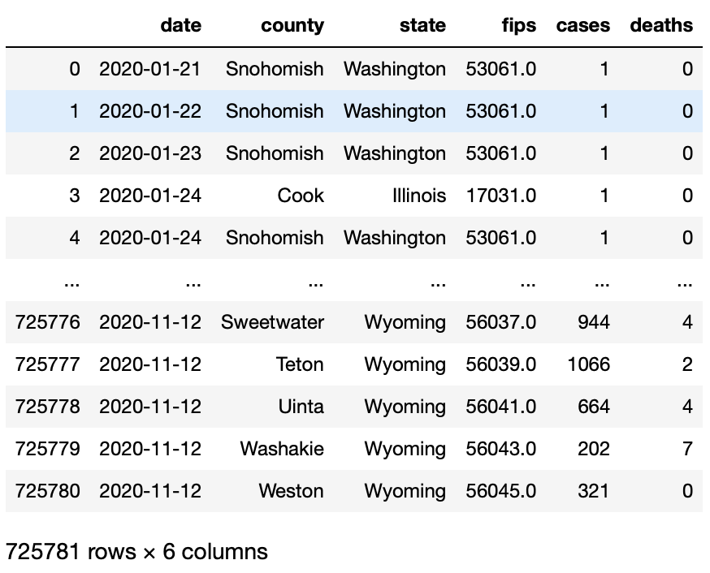
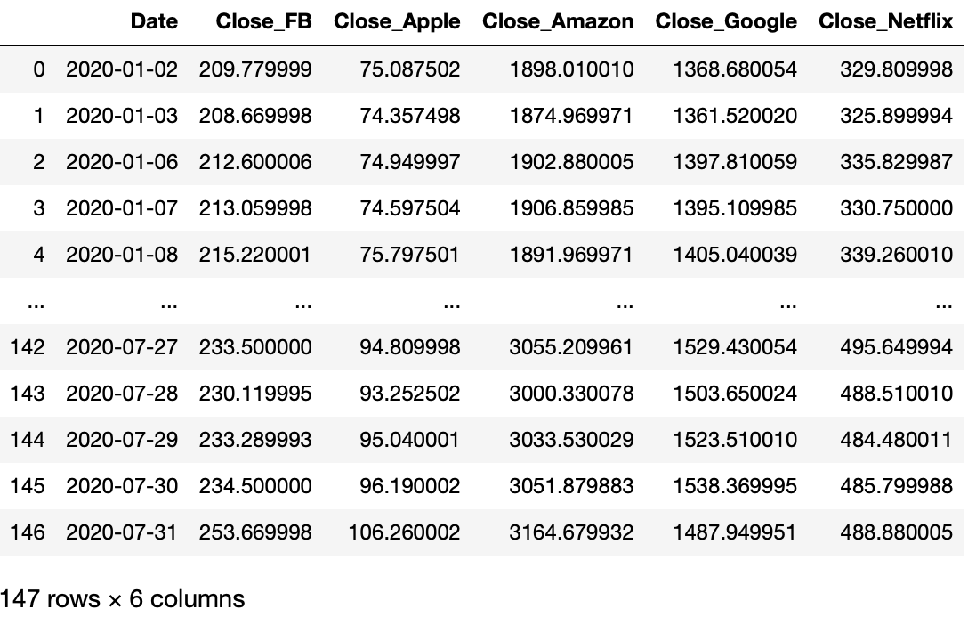
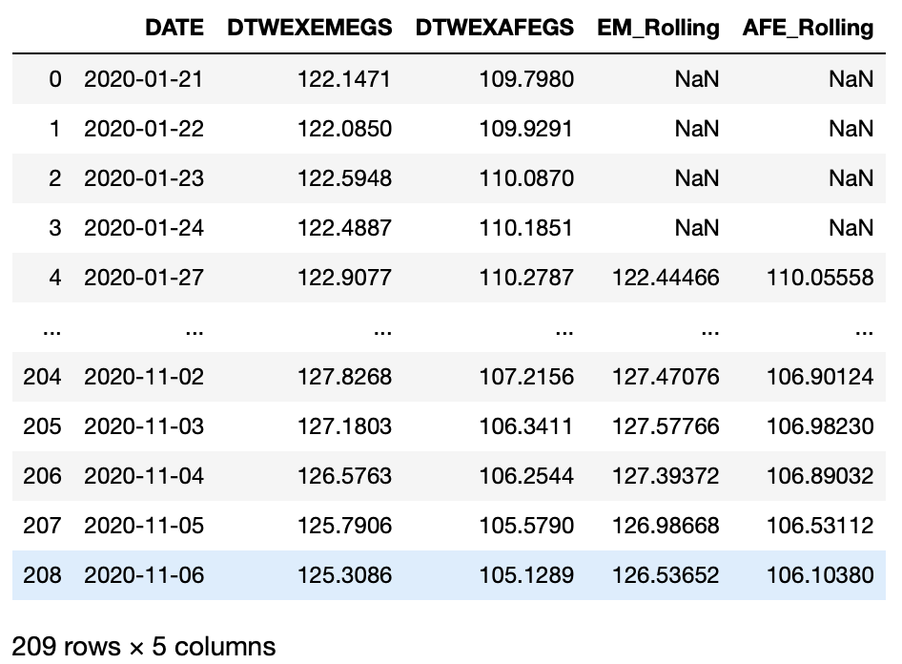
Where is our Data From?
From Kaggle
FAANG datasets: https://www.kaggle.com/aayushmishra1512/faang-complete-stock-data
World Covid: https://www.kaggle.com/cristiangarrido/covid19geographicdistributionworldwide?select=Total_population_by_Country_ISO3_Year_2018.csv
Trade weighted USD v. Advanced Econ/ Emerging Markets: https://fred.stlouisfed.org/series/DTWEXAFEGS
https://fred.stlouisfed.org/series/DTWEXEMEGS

Slide 3
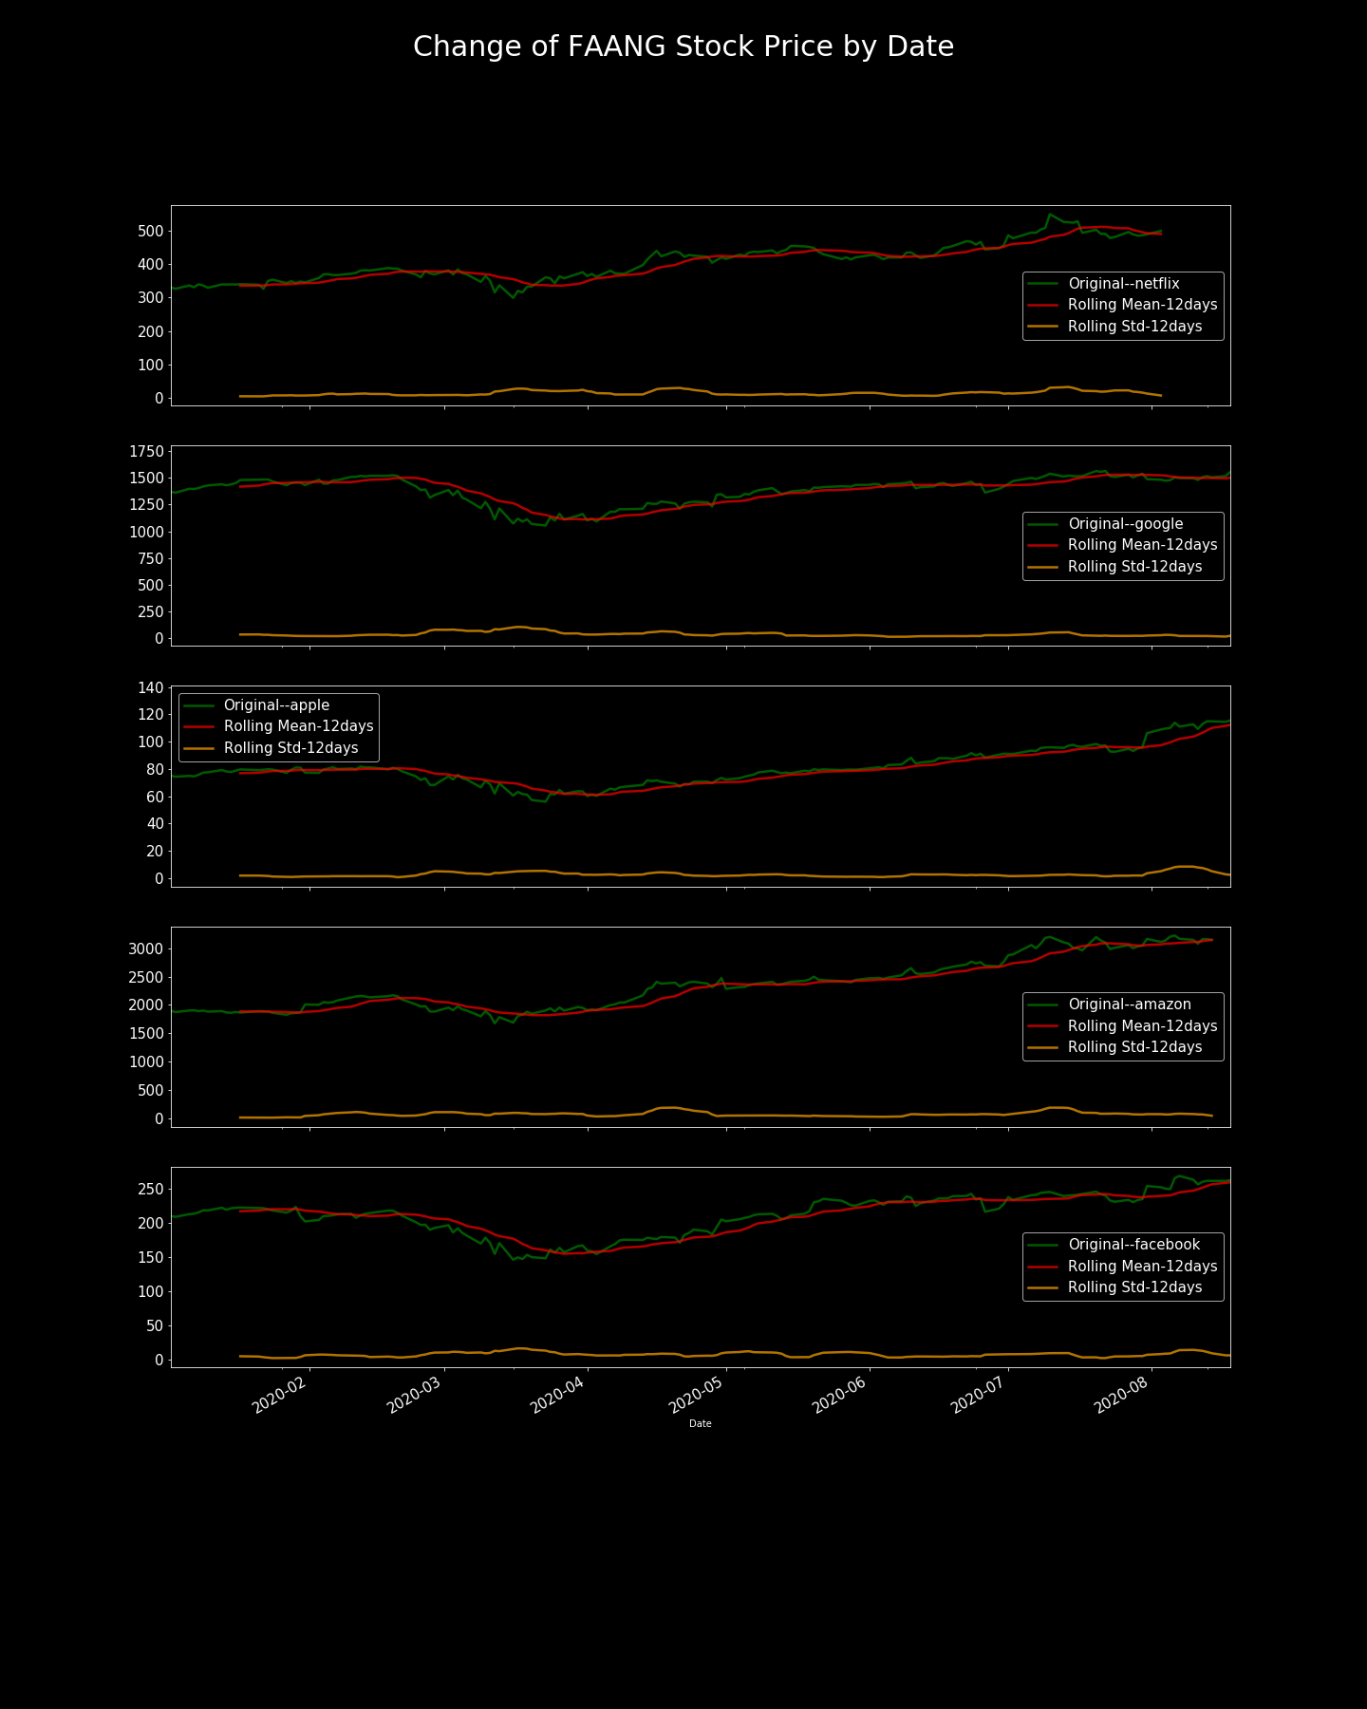
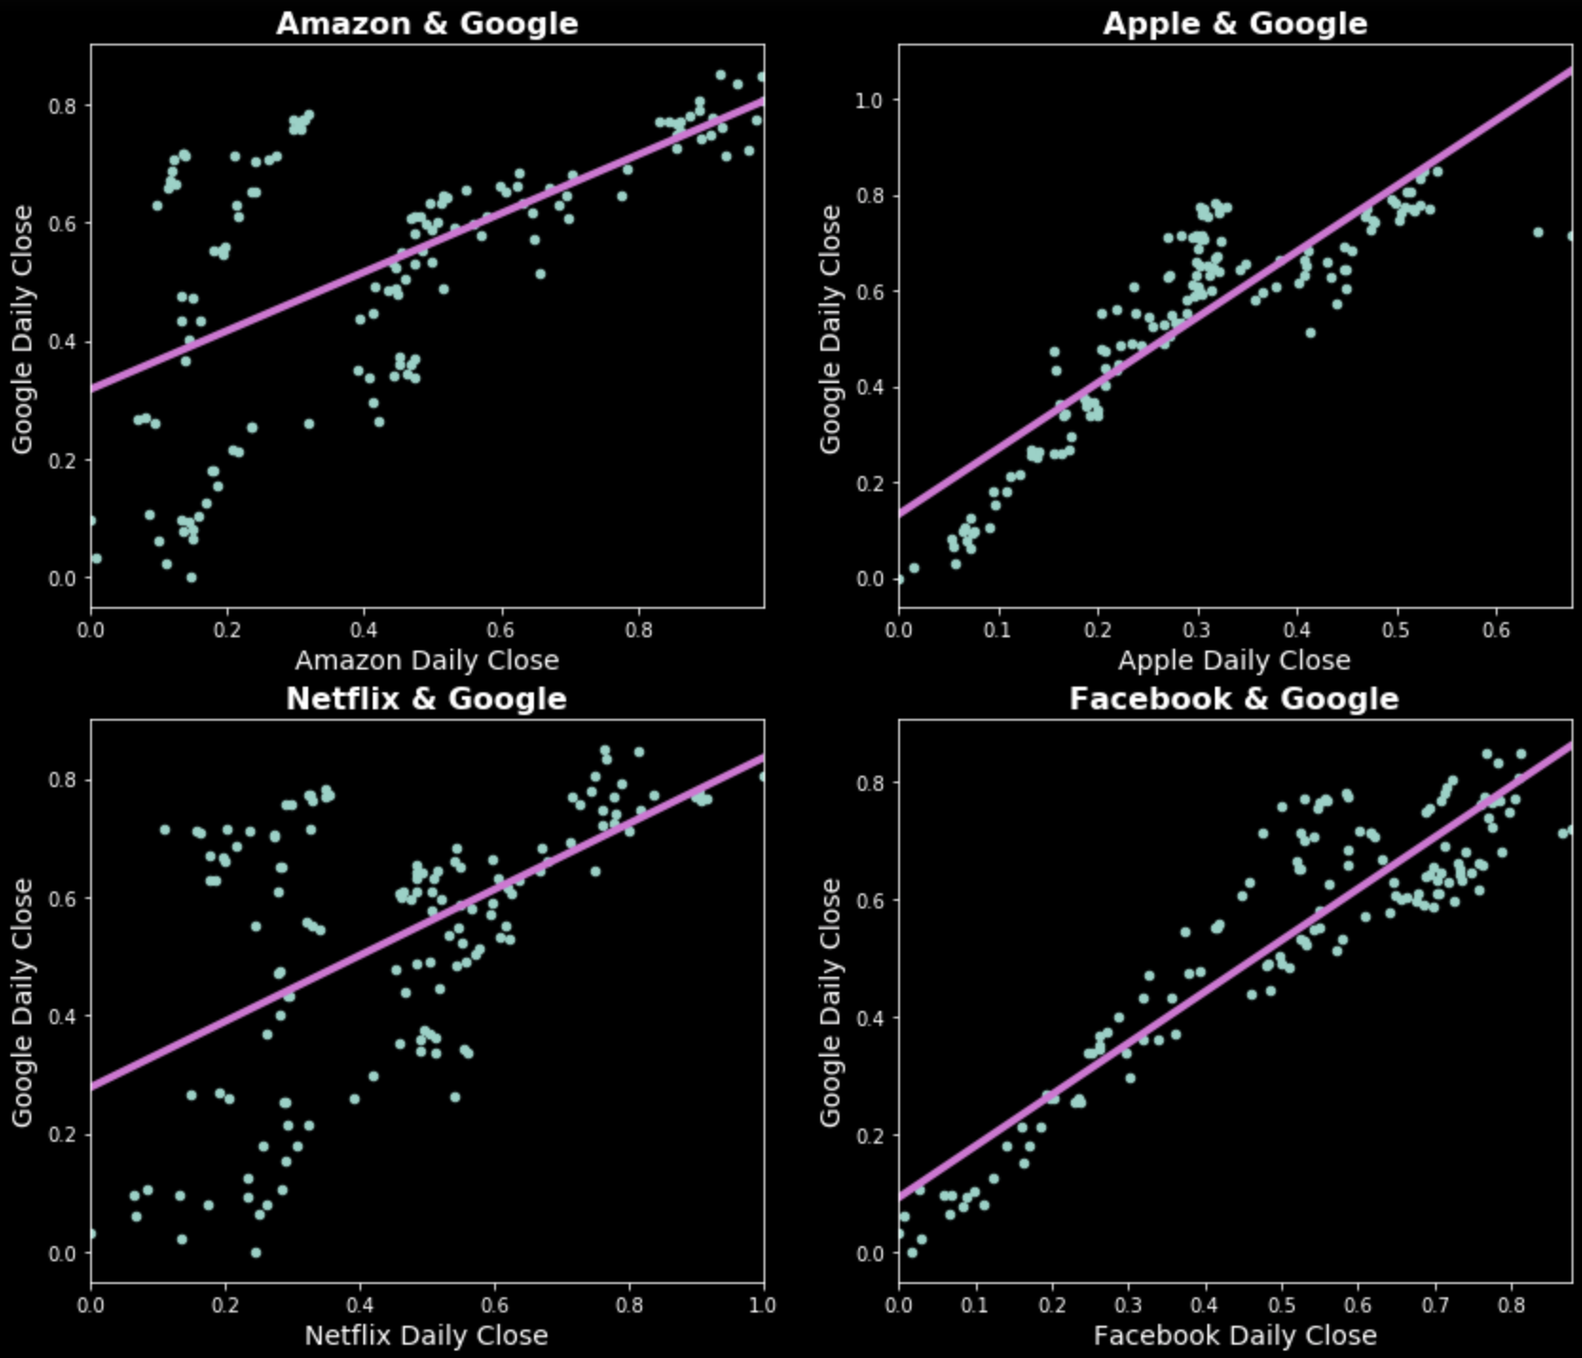
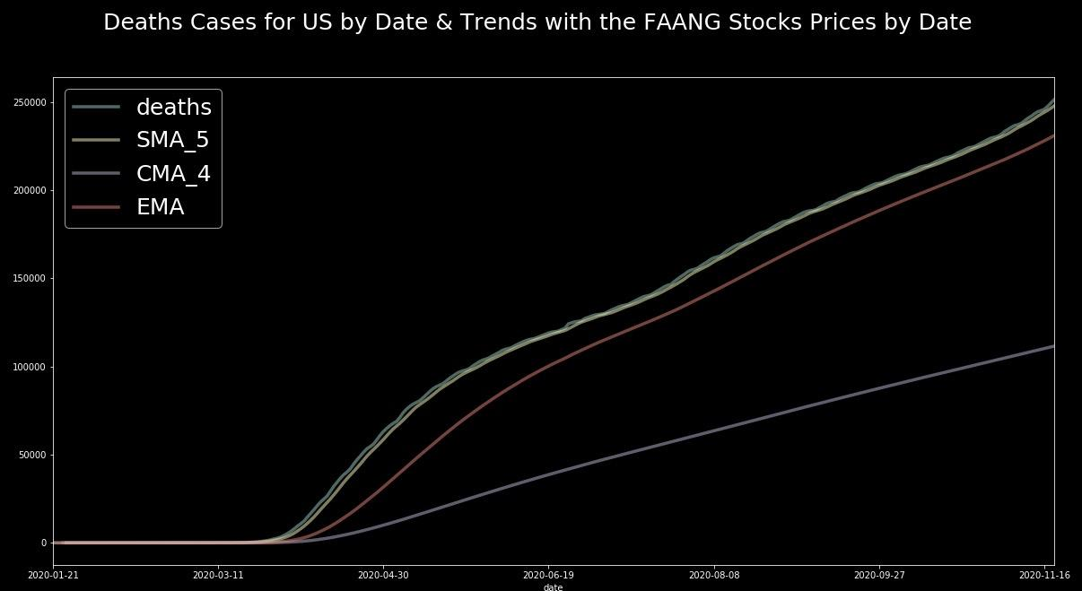
Time Series of FAANG Stock Price Change & COVID Death Toll
Stock price decreased circa mid-March (height of the pandemic)
Facebook is the best predictor of Google stock

Slide 4
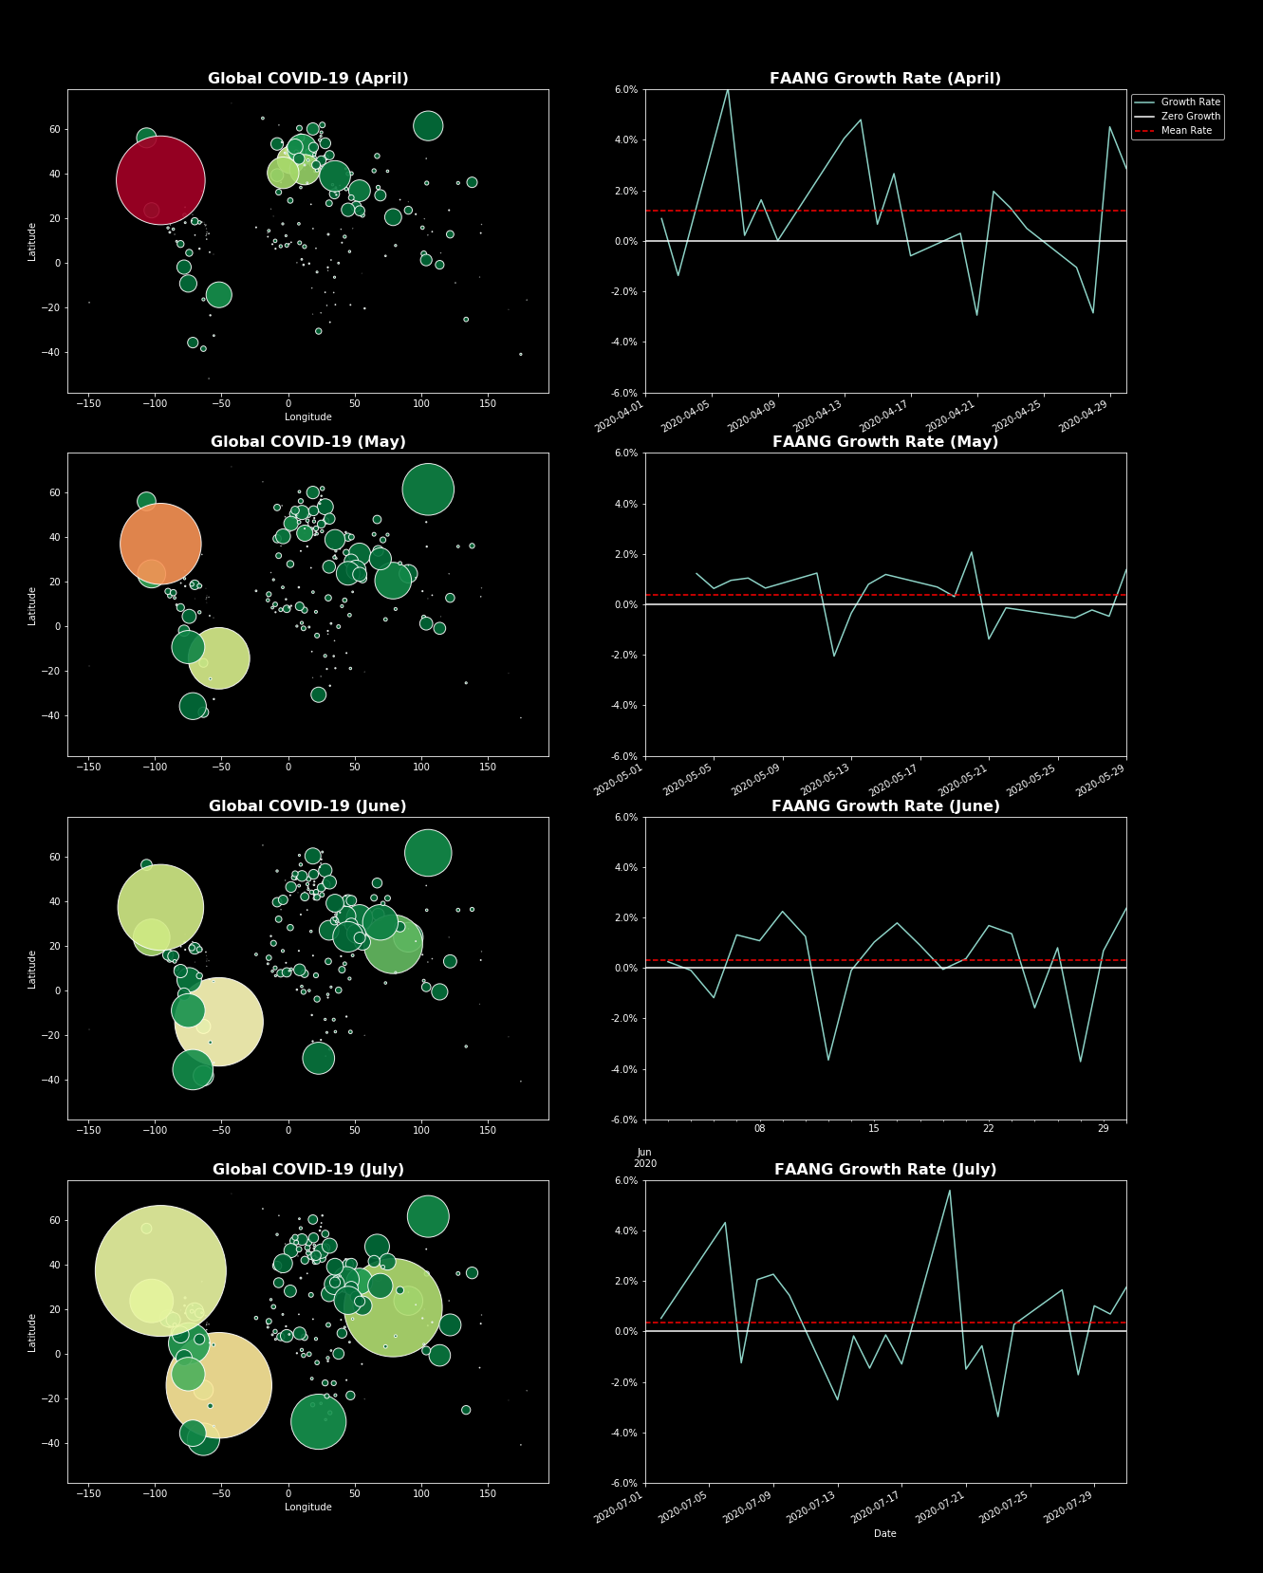
World COVID per Month & FAANGs
Greatest acceleration in the FAANGs growth increase occurs when U.S. COVID deaths at the highest level
As global cases increased but U.S. deaths decreased, FAANG growth slowed
Average FAANG percent change:
April: 1.18%
May: 0.37%
June: 0.32%
July: 0.35%

Slide 5
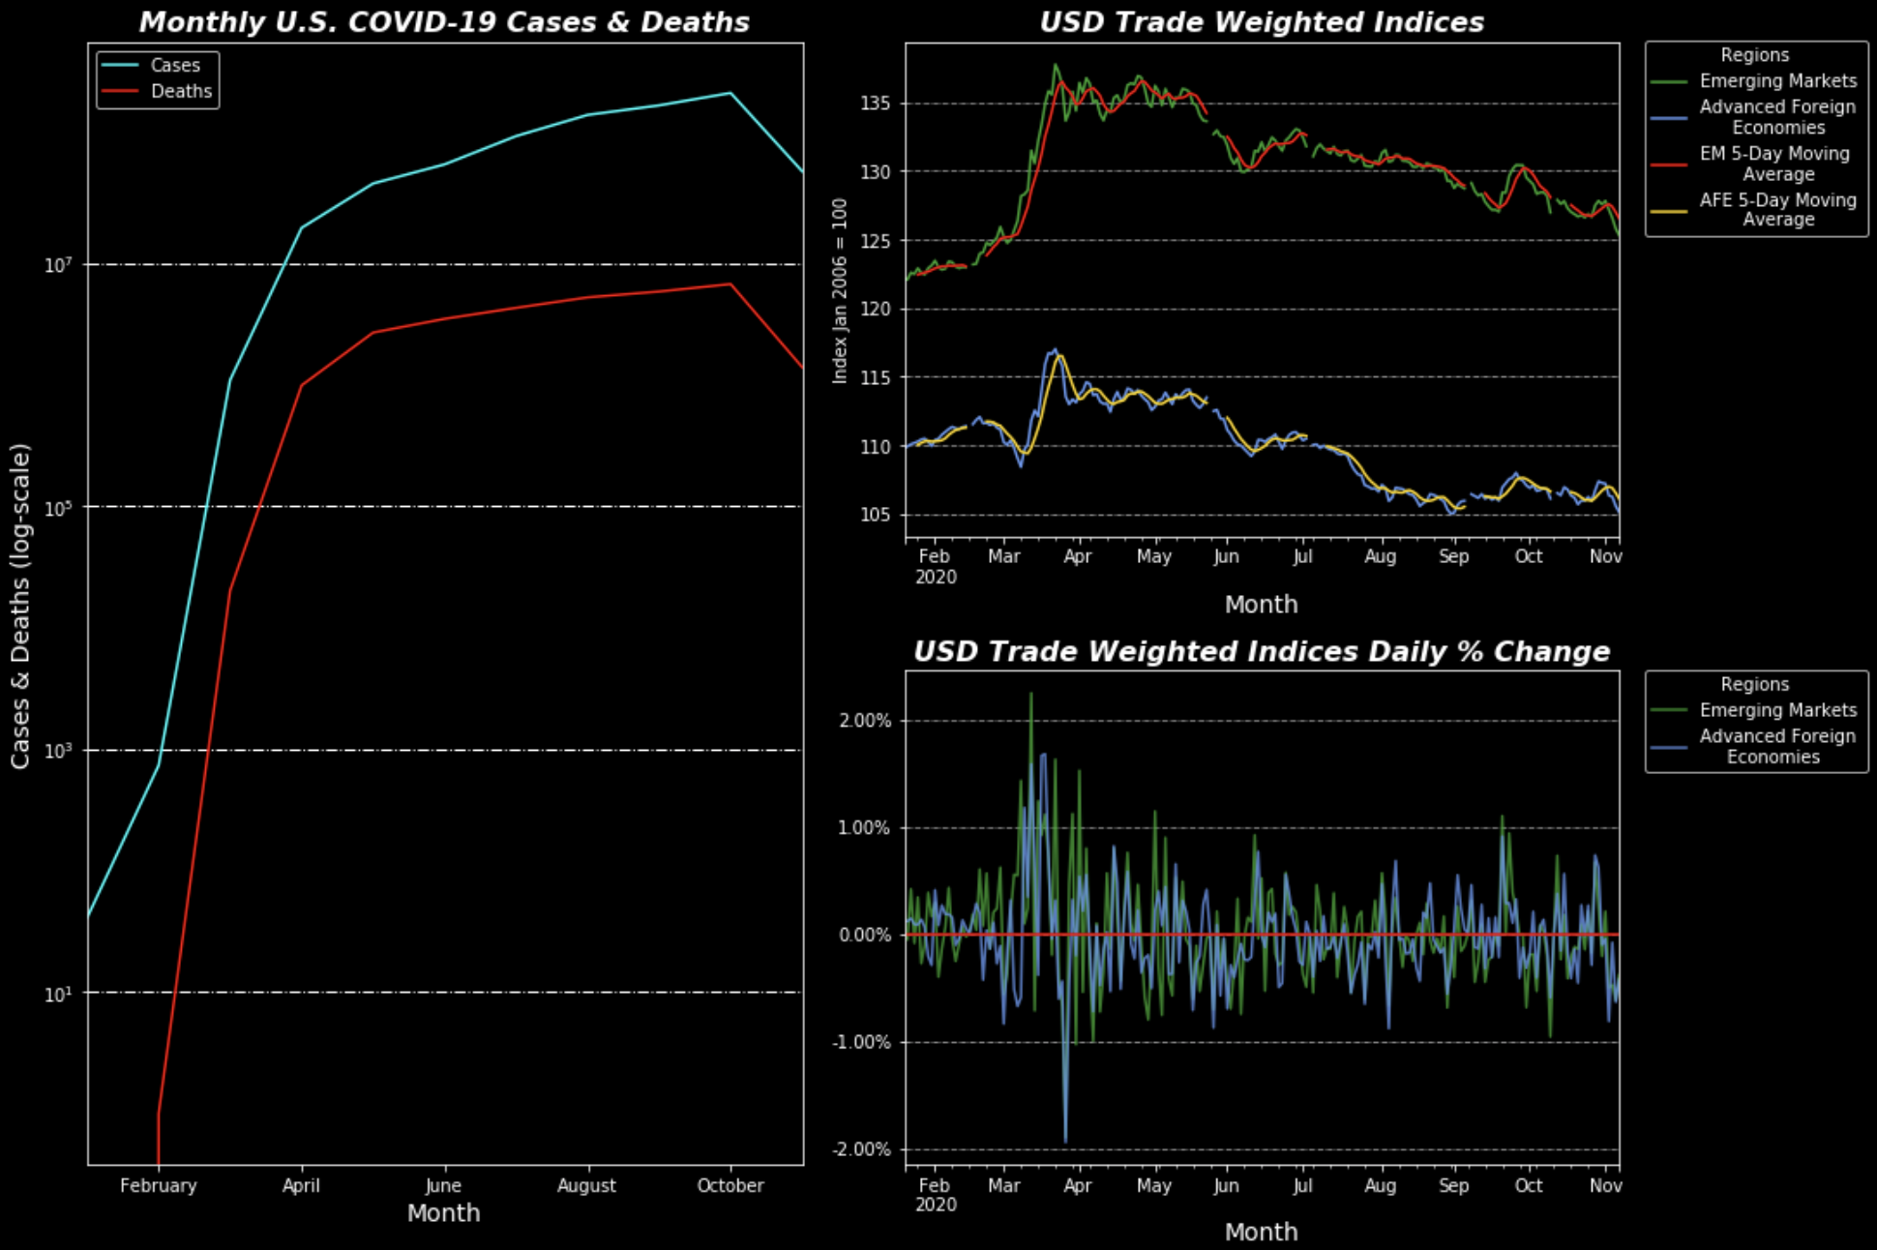

Relationship Between US COVID & USD
Increased COVID-19 ROC occurs with USD appreciation and higher volatility
5-day moving averages suggest COVID-19’s effect on USD was similar for both EM and AFE
The dollar depreciated in months with lower volatility
November COVID-19 drops because data was not available for the entire month*

