Slide 1

DEVELOPING PRACTICAL INVESTMENT RESILIENCE July 20, 2021 RESOURCE: GITHUB.COM/JARRODWILCOX/RESILIENCE_LAB.
Jarrod Wilcox

Slide 2
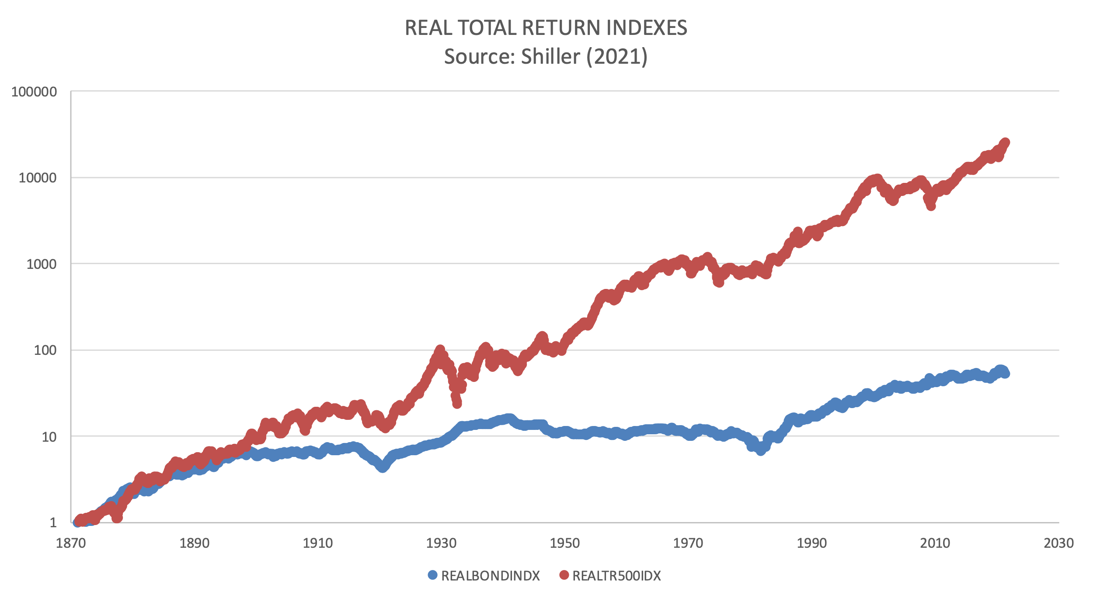
DIFFERENT RETURN CHARACTERISTICS AT DIFFERENT SCALES

Slide 3
WHY STUDY RESILIENT INVESTING?
What we face:
Markets are never at more than momentary equilibrium.
Returns are not i.i.d. Parameters are uncertain.
Investors differ more widely than we assume.
Continuous time finance is an heroic assumption.
Market disruptions awaken us to our deeper need for better asset allocation methods.

Slide 4
GOING BACK TO EXPECTED UTILITY
Investor’s Probability of Consequent Utility Need
 |  | Investment Return Probability Distributions
 |  |  |  | Trial Allocation
 | { | Pa1 Outcome | X | Utility a1
Pa |  | Pa2 Outcome | X | Utility a2
 |  | Pa3 Outcome | X | Utility a3
 | { | Pb1 Outcome | X | Utility b1
Pb |  | Pb2 Outcome | X | Utility b2
 |  | Pb3 Outcome | X | Utility b3
 | { | Pz1 Outcome | X | Utility z1
Pz |  | Pz2 Outcome | X | Utility z2
 |  | Pz2 Outcome | X | Utility z3
 |  | Expected Utility
A single period decision…
Responding to multiple future time points,
Multiple return probability regimes,
And investors with widely different needs.

Slide 5
STUDY UNIVERSE, 18 YEARS

Slide 6
THE SIMPLEST BAYESIAN POSTERIOR (real returns would have been an improvement)
Let N be the number of observations, and V their variance, with subscripts h signifying the prior history and o signifying the new observations.
P_{h} = N_{h} / V_{h} , P_{o} = N_{o} / V_{o} (the precisions)
W_{h} = P_{h} / (P_{h} + P_{o}), W_{o} = 1 – W_{h} (the weights)
For a conjugate normal with known variance approximation,
the shrinkage mean M_{S} is calculated as: M_{S} = W_{h} M_{h} + W_{o}M_{o}

Slide 7
A Little Utility Math
Mean-variance: MV = μ – L σ²/2
Ensemble statistics μ, σ²
Rubinstein utility: GLUM=ln(1+Lr)
Each outcome portfolio return r has a well-defined utility
Let Q = Lσ / (1+Lμ), then:
Expected GLUM = ln(1+Lμ) – Q²/2 + SQ³/3 – KQ⁴/4 + …
Limit △t → 0 of Expected GLUM = L (MV)

Slide 8
WHERE IS SIMPLEST TAIL RISK?
Return Distribution Skew and Kurtosis
Utility Function
Risk Aversion
In this case:
Utility = ln(1+Lr)
L is risk aversion
r is investment return
The rightmost 3 columns represent change in utility from skewness and kurtosis.

Slide 9
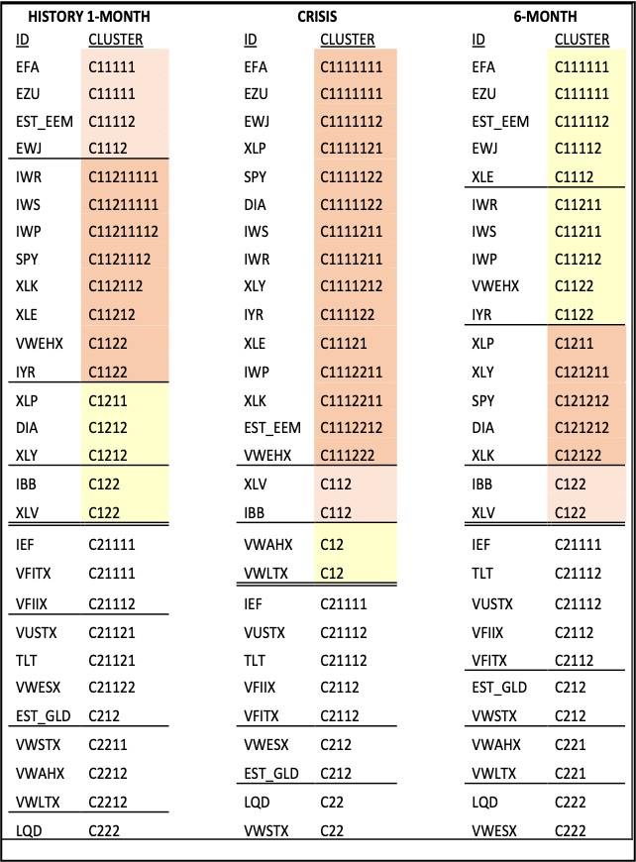
CLUSTERS TO IDENTIFY STRUCTURE
Top-Down Hierarchical Clusters, McQuitty & Clark 1968.
Identify Structure-Based Modeling Potential.

Slide 10
THE INVESTOR JOINS THE DECISION TREE (But how should valuation probabilities be set?)

Slide 11
SEARCH FOR BEST ALLOCATION

Slide 12
DISRUPTION CREATES MORE HIGH MOMENT THREAT
Mixing pdf’s increases tail risk.
This improves the benefit of Rubinstein utility.

Slide 13
WHICH PORTFOLIO WOULD YOU CHOOSE TODAY?
Base your answer just on holdings.
If the investor has said she will have little turnover?
Does the utility comparison tell you anything?

Slide 14
RESILIENT INVESTORS CAN
Trigger better tail-risk review with:
Return mean shrinkage to make history usable,
Quantify return higher moment threats to surplus,
Cluster analysis to reveal structure change and outliers.
Manage tail risk better using return matrices, Rubinstein utility, and scenarios.
Reflect future trends, reversals and drift vs noise with multiple time point evaluations.

