Slide 1
Bundle
A Virtual Memory Based Resource System
Jarryd Hall & Taher Odeh

Slide 2
Introduction and Motivation
RQ: How can we decrease the memory footprint?
Limited memory available in RAM
Larger memory block on disk (Virtual Memory)
Increase of SSDs on market (already in smartphones)
SSDs provide faster data read/write operations
Best game development studios keep techniques secret
With the rise of app stores, mobile and desktop, thousands of developers
No open-source solution available
Inspired by Johan Knutzen (Dark Nebula 2, 2012 Nordic Innovation nominee, losing to MineCraft)

Slide 3
Introduction and Motivation
As an example
Apple’s App Store
111 000 active games
635 000 active applications (all categories)
157 000 active publishers

Slide 4
Related Work
Virtual Memory Based Data Streaming
Texture Streaming
MegaTextures
Virtual Texturing (uses texture pagetable) Issues:
Texture filtering
Thrashing
Level Of Detail Transitions Under High Latency

Slide 5
Related Work
Memory Enhancements For Embedded Systems
CRAMES
Read/Write Fileystem
Doubles amount of RAM
Stores swapped out pages in compressed format
Enables in-RAM filesystem compression
Targets low-power embedded systems
Cramfs
Compresses pages for read access on ROMS

Slide 6
Related Work
File Systems And Archived File Types For Video Games
Various games uses archived files
Quake 3 - .pk3
Quake 4 - .pk4
Doom 3 - .pk4
Doom 3 source code on github
Documented Filesystem using .pk4 files

Slide 7
Related Work
OSX and iOS Bundles
Holds:
Executable code
Resources to be used by the code

Slide 8
Constructive research method
The approach: A way to turn existing knowledge into novelty or innovation. (Crnkovic, 2009)
Why choosing this method’s principles?
Suitable for computer science related research.
Flexible, freedom in mixing social science approaches.
Knowledge is gained iteratively as the development process is on.

Slide 9
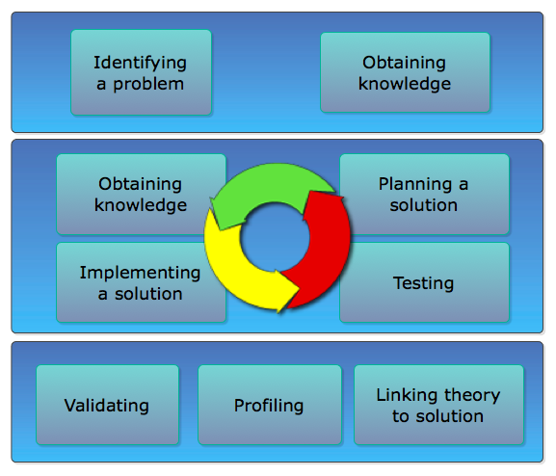
Process Model

Slide 10
Bundle
What is Bundle?
Developed using C
Contains Objective-C Wrappers
Packaging Tool
File Format with .pak extension
API
Open-Source Project licensed under BSD

Slide 11
Bundle
How Does It Work?
Packages all resources into a file with .pak extension
API: Creates a hash map from pak file header data
API: Loads the pak file into virtual memory
API: Allows read access to data within mapped pak file

Slide 12
Bundle
Kernel Operations
A process is allocated space in RAM and VM
When data is needed from VM Kernel pages the page in
When data is not needed Kernel pages data out

Slide 13
Bundle
Bundle and ARC
Automatic Reference Counting was introduced in iOS 5 and OSX.
New LLVM compiler feature for Obj-C
Automatically inserts retain and release calls for objects during compilation
A project can use ARC for non-assets objects and VM based assets data using Bundle API

Slide 14
Bundle Design
Design Principles
Use Low Level Language To Target Multiple Platforms
Package Assets According To Users’ Needs
Provide Simple API To Use Generated Pak Files
Allow File Retrievals In Random Access Manner

Slide 15
Bundle Design
Design Overview
File Format
Pak file extension
A Pak File’s content is non-standardized

Slide 16
Bundle Design
Design Overview
Packaging Tool
Command line tool
Args: <Source Folder> <Destination Path.pak> <ext list>

Slide 17
Bundle Implementation
Tool And Pak File Creation:
Count files (ignoring .DS_Store)
Calculate variable header length
Traverse source folder packaging file by file
if (fileShouldBeCompressed) zlib compress
Package file into data segment of pak file
Update header segment
Each file’s info is stored in header (name, size, offset in pak, compression flag)
pak file is generated at destination

Slide 18
Bundle Implementation
The API
Developed in C
Provides 3 functions:
int bundle_start(char * pakFile, struct mappedData *mData)
offset_p bundle_getIndexDataFor(char * fileName)
Int bundle_stop(struct mappedData *mData)
mData->mappedAddress and ->fileSize
Simplified API for ease of use

Slide 19
Bundle Implementation
Memory Mapping with POSIX mmap function
mmap is a low-level virtual memory mapping technique
Bundle calls the function as follows:
mData->mappedAddress = mmap(NULL, mData->fileSize, PROT_READ, MAP_PRIVATE, fileDescriptor, offset)
Developers can use PROT_EXEC to allow execution of packaged scripts directly from VM
madvise is used with the macro MADV_RANDOM to force kernel to optimize by turning readahead off. This avoids unwanted CPU overhead.

Slide 20
Bundle Implementation
Hash Table
Static size – size is known beforehand => no collisions.
Hashes of filenames are keys
Values are of offset type, containing a requested file’s size, offset address and access to the mapped data area.

Slide 21
Bundle Implementation
Objective-C Wrapper
Provides conversion from NSString * to char *
Determines pak file path on the appropriate device
Pointer to data in VM is stored in an NSData object using:
+(id) dataWithBytesNoCopy:(void *)bytes length:(NSUInteger)length freeWhenDone:(BOOL)freeWhenDone

Slide 22
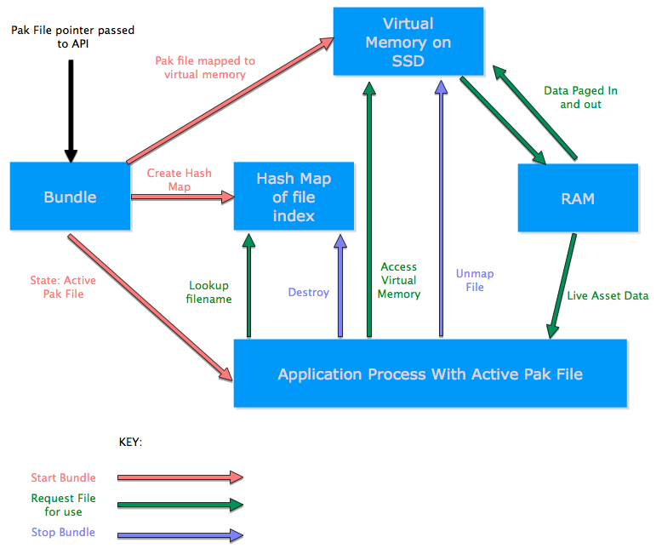

Slide 23
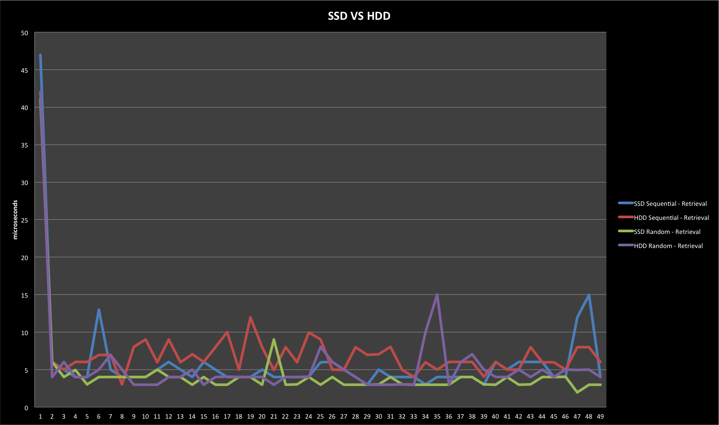
Test Results

Slide 24
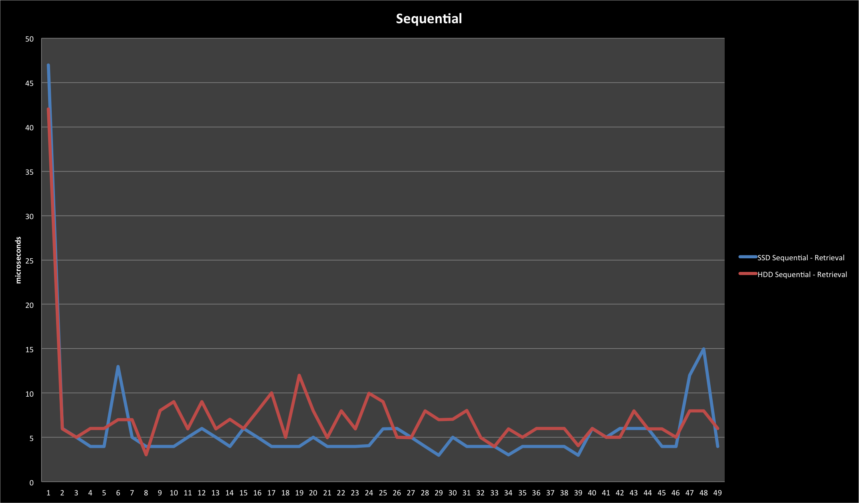
Test Results

Slide 25
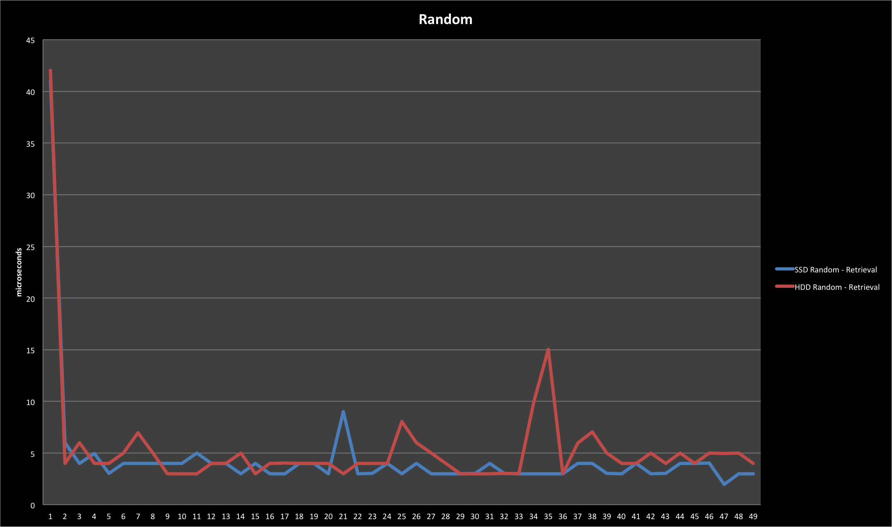
Test Results

Slide 26
Test Results
Shows that random access on both SSD and HDD is faster than sequential access due to madvise MADV_RANDOM
SSD is substantially faster than HDD for random and sequential access.
Mapping and using 125MB of data (larger than RAM limit) uses 3.1MB RAM (Live Bytes)

Slide 27
Future Research
Hooking in to File IO
Automated iOS project conversion
Wrappers for e.g. openGL, openAL, cocos2d, Android

Slide 28
Discussion
Bundle Offers:
Reduced Memory Management
File Name Based Data Retrieval
Substantially Lower RAM footprint (around 0MB)
Larger Memory Block Available (700MB VM iphone 4, 40MB RAM)
Compression Of Selected File Types
Open-Source – Allows enhancements and modifications

Slide 29
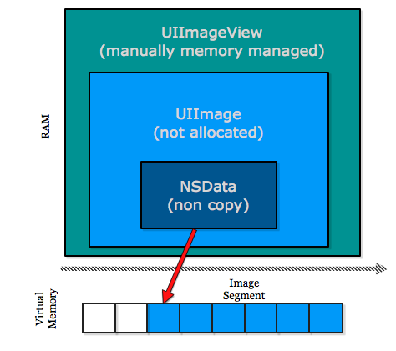
Objective-C object hierarchy

Slide 30
Other Uses:
iOS In-App Purchases
Android APK (Android devs must use NDK)

Slide 31
3G based Downloads
Apps limited to 20MB over 3G
Use Bundle in a skeleton application
Application can be designed around content
UI Elements, Levels, Characters, Sounds etc.
Pak files can be downloaded and plugged in to skeleton.
These pak downloads are not limited in size.
App can reach a larger market, downloadable on 3G and Wifi

Slide 32
Limitations
Virtual Memory Block needs to be large enough
Mapping file smaller than 4kb(page size) results in memory waste
No “on the fly” decompression
Only tested with C Runtime and Objective-C Runtime

Slide 33
Conclusion
Bundle answers the research question “How can we decrease the memory footprint”
Using Virtual memory and a filesystem RAM usage can be close to page size (4KB) for assets
Open-Source C Based solution can be used on many platforms with minimal modifications
Please contact us if you are interested in getting involved with Bundle in the future

Slide 34
Acknowledgements
Johan Knutzen for his guidance and opinion throughout the R&D of Bundle.
Lennart Petersson for supervising our thesis.
Thank you.

Slide 35
Demo

