Slide 1

Note: The data and information in this document is reflective of a hypothetical situation and client. This document is to be used for KPMG Virtual Internship purposes only.
Sprocket Central Pty Ltd
Data analytics approach
Jialu Wang

Slide 2
Note: The data and information in this document is reflective of a hypothetical situation and client. This document is to be used for KPMG Virtual Internship purposes only.
Agenda
Introduction
Data Exploration
Model Development: RFM Analysis
Interpretation

Slide 3
Note: The data and information in this document is reflective of a hypothetical situation and client. This document is to be used for KPMG Virtual Internship purposes only.
Introduction
Identify Top 1000 old Customer based on RFM analysis
analyze their demographic features
Outline of Problem
Sprocket Central Pty Ltd want to find high value customers from a list of 1000 potential customers
The data about new customers don’t have transaction history but with demographics and attributes
Sprocket have a dataset with existing customers’ transaction history with demographics and attributes
Analysis Approach
Use dataset about existing customers to get insights about demographics and attributes of high value customers based on RFM analysis
Encode the new customers’ demographics and attributes to predict their value

Slide 4
Note: The data and information in this document is reflective of a hypothetical situation and client. This document is to be used for KPMG Virtual Internship purposes only.
Data Exploration
Data Quality Assessment and Data Cleaning
Consistency | Inconsistent values for the same attribute Inconsistent data type for the same attribute | In CustomerDemographic, gender have 6 unique values, change F & Femal to Female, M to Male. Additionally, gender records where ‘U’ have been replaced based on the distribution from the training dataset. In CustomerAddress, state has different rules, some are full spelt, some are abbrev, change all to abbrev. Some column have wrong data types, such as product_first_sold_date and list_price in transactions, one is date not number, the other is currency not number. Default column in CustomerDemographic has Mojibake, don't know what's the right decode rule;
Completeness | Every sheet has missing values | If only a small number of rows are empty, we will filter out the record entirely from the training set for prediction, like less 1% transactions have missing fields. But if it is core field or the missing rate is high (like 12.5% missing rate of job_title in CustomerDemographic, we will impute the missing fields based on distribution in the training dataset.
Currency | customer_id's maximal in CustomerDemographic is 4000 , but three values of customer_id in Transactions is 5034 | ensure that all tables are from the same period. Only customers in CustomerDemographic will be used as a training set for our model. it’s better to merge data in both CustomerDemographic and NewCustomerList into one sheet, adding customer_id by DOB.

Slide 5
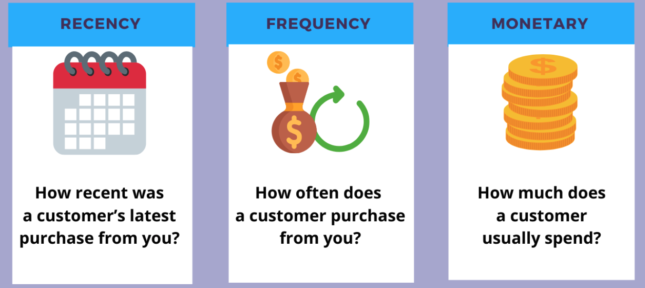
Note: The data and information in this document is reflective of a hypothetical situation and client. This document is to be used for KPMG Virtual Internship purposes only.
Model Development
RFM Analysis and Customer Segmentation
RFM stands for Recency, Frequency, and Monetary
Often used for reactivation campaigns, high values customer programs etc.

Slide 6
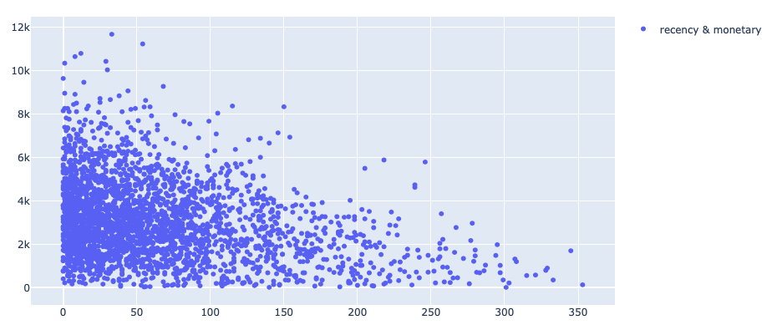
Note: The data and information in this document is reflective of a hypothetical situation and client. This document is to be used for KPMG Virtual Internship purposes only.
Model Development
Recency vs Monetary

Slide 7
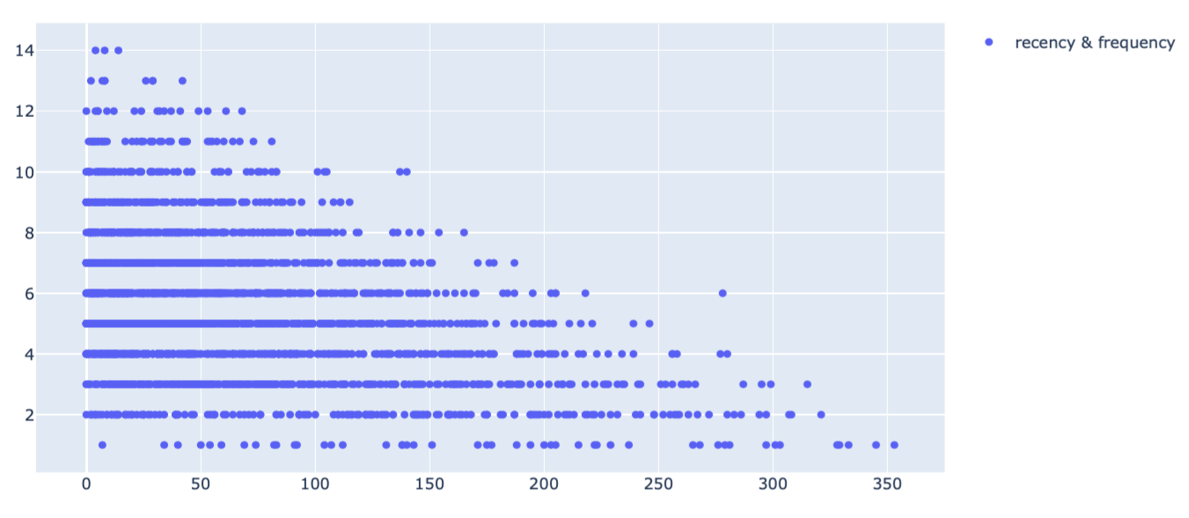
Note: The data and information in this document is reflective of a hypothetical situation and client. This document is to be used for KPMG Virtual Internship purposes only.
Model Development
Recency vs Frequency

Slide 8
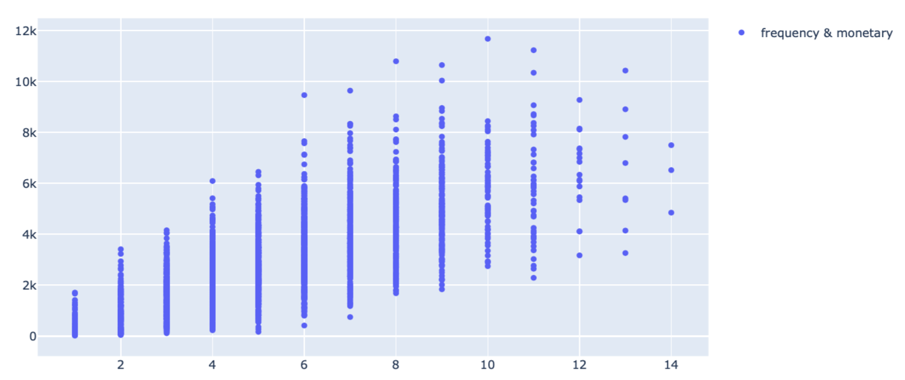
Note: The data and information in this document is reflective of a hypothetical situation and client. This document is to be used for KPMG Virtual Internship purposes only.
Model Development
Frequency vs Monetary

Slide 9
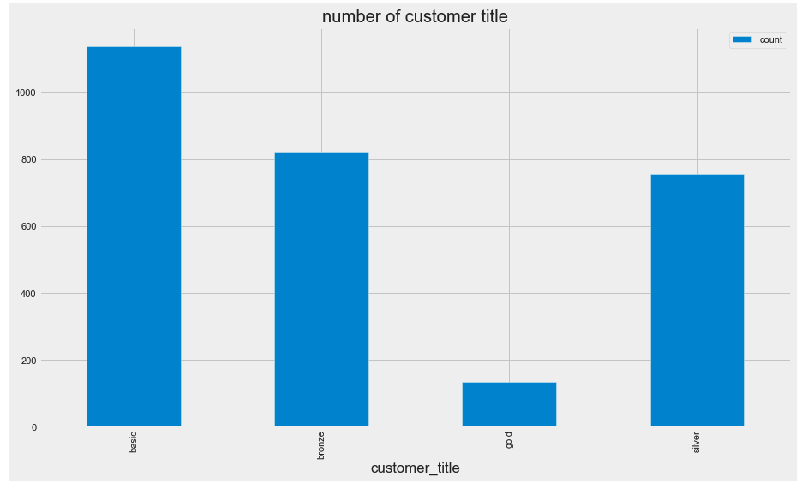
Note: The data and information in this document is reflective of a hypothetical situation and client. This document is to be used for KPMG Virtual Internship purposes only.
Model Development
Existing Customer Segmentation
The more recent a customer buy
The monetary value a customer pay
The more times a customer purchase
The higher value a customer is
Gold: total score <= 3,
Silver: total score <= 6, 25%
Bronze: total score <= 8, 50%
Basic: total score > 8
RFM Class | Basic | Bronze | Gold | Silver
Number | 1138 | 821 | 134 | 757

Slide 10
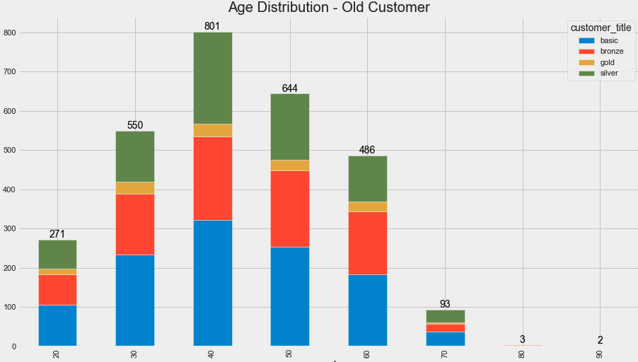
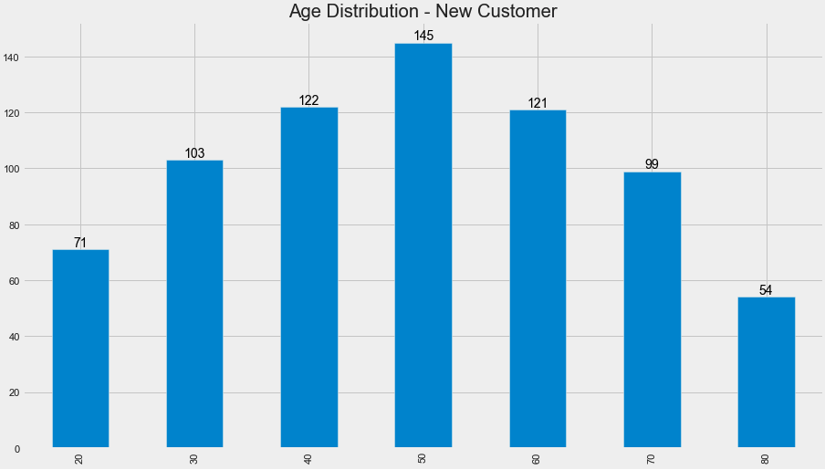
Note: The data and information in this document is reflective of a hypothetical situation and client. This document is to be used for KPMG Virtual Internship purposes only.
Interpretation
Age Distribution

Slide 11
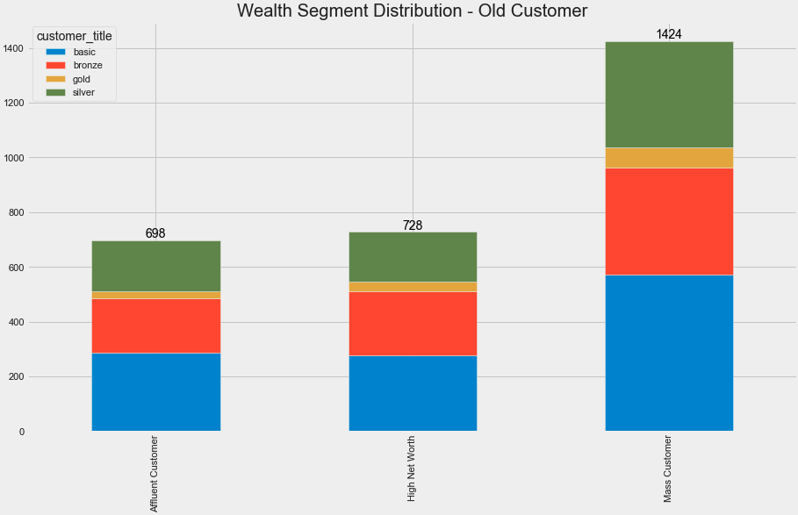
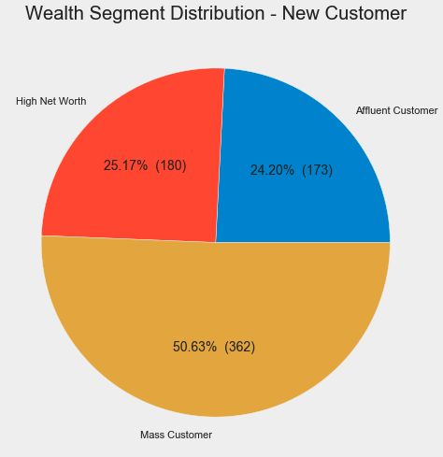
Note: The data and information in this document is reflective of a hypothetical situation and client. This document is to be used for KPMG Virtual Internship purposes only.
Interpretation
Wealth Segment Distribution

Slide 12
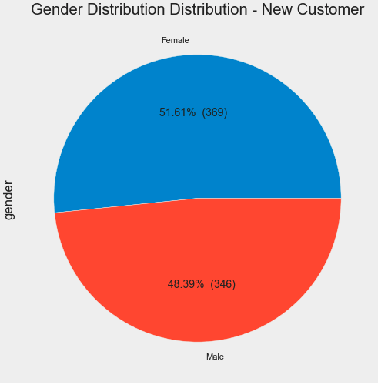
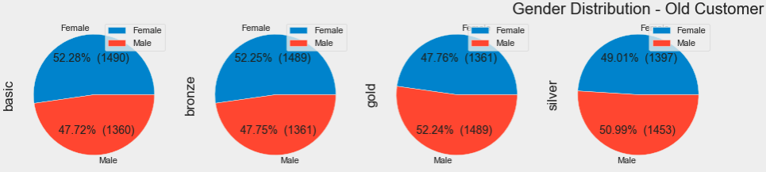
Note: The data and information in this document is reflective of a hypothetical situation and client. This document is to be used for KPMG Virtual Internship purposes only.
Interpretation
Gender Distribution

Slide 13
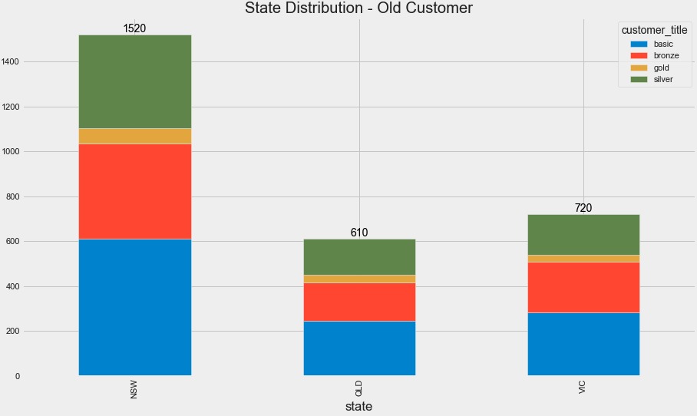
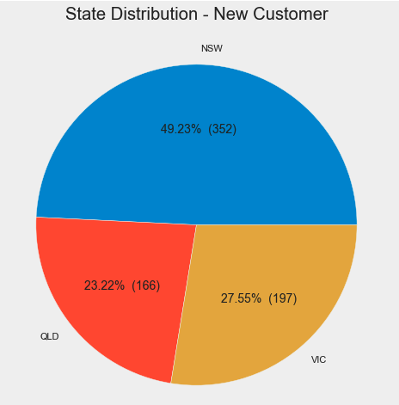
Note: The data and information in this document is reflective of a hypothetical situation and client. This document is to be used for KPMG Virtual Internship purposes only.
Interpretation
State Distribution

Slide 14
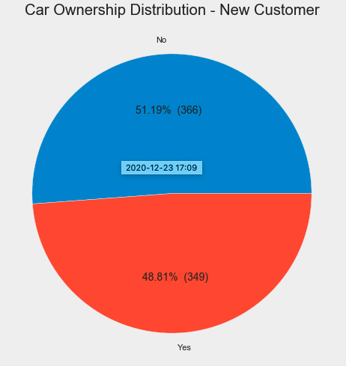
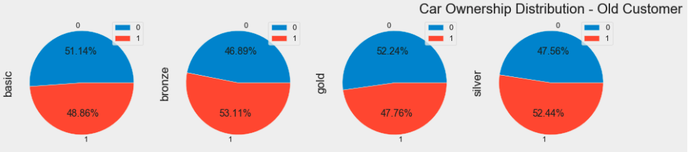
Note: The data and information in this document is reflective of a hypothetical situation and client. This document is to be used for KPMG Virtual Internship purposes only.
Interpretation
Car Ownership Distribution

Slide 15
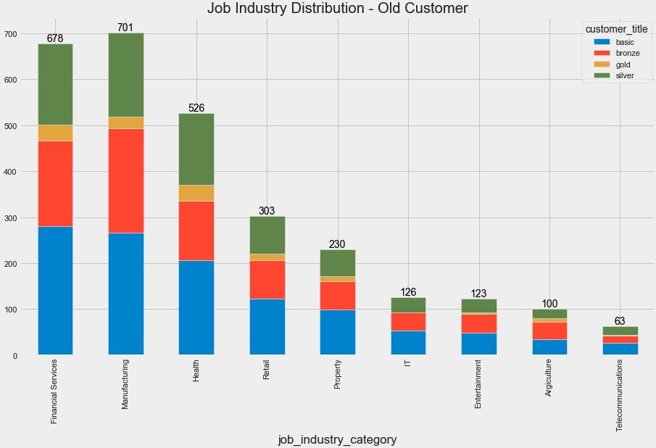
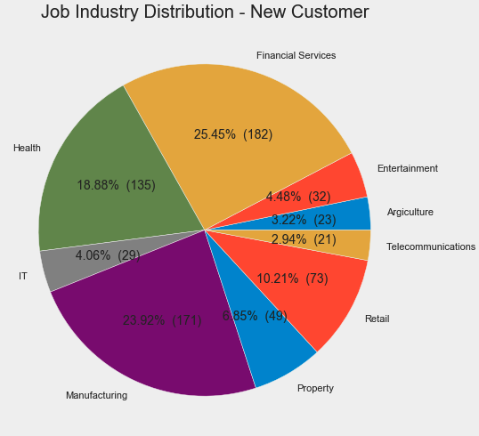
Note: The data and information in this document is reflective of a hypothetical situation and client. This document is to be used for KPMG Virtual Internship purposes only.
Interpretation
Job Industry Distribution

Slide 16
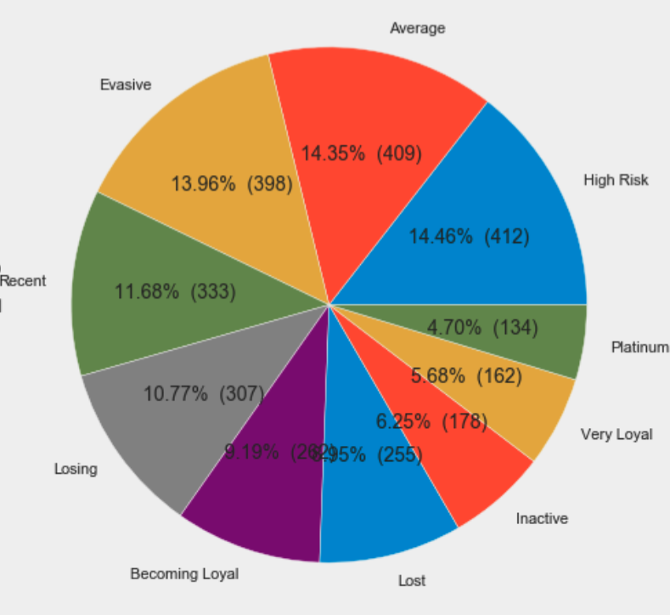
Note: The data and information in this document is reflective of a hypothetical situation and client. This document is to be used for KPMG Virtual Internship purposes only.
Interpretation
Customer Segmentation Standard
Rank | Class Name | Counts
1 | Platium Customer | 134
2 | Very Loyal | 162
3 | Becoming Loyal | 262
4 | Recent Customer | 333
5 | Average Customer | 409
6 | High Risk | 412
7 | Evasive | 398
8 | Losing | 307
9 | Inactive | 178
10 | Lost | 255

Slide 17
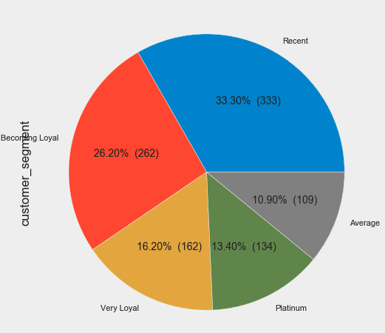
Note: The data and information in this document is reflective of a hypothetical situation and client. This document is to be used for KPMG Virtual Internship purposes only.
Interpretation
Top 1000 Customers Segmentation
Rank | Class Name | Counts
1 | Platium Customer | 134
2 | Very Loyal | 162
3 | Becoming Loyal | 262
4 | Recent Customer | 333
5 | Average Customer | 109

Slide 18
Note: The data and information in this document is reflective of a hypothetical situation and client. This document is to be used for KPMG Virtual Internship purposes only.
Interpretation
Top 1000 Customers Demographics
customer_id | gender | DOB | job_industry_category | wealth_segment | owns_car | tenure | state | customer_segment
2103 | Male | 1975/9/22 | Financial Services | Affluent Customer | 0 | 18 | NSW | Platinum
3470 | Female | 1967/10/1 | Health | Affluent Customer | 1 | 6 | VIC | Platinum
725 | Male | 1965/8/27 | Health | High Net Worth | 1 | 19 | QLD | Platinum
2476 | Male | 1956/9/25 | Property | High Net Worth | 0 | 17 | QLD | Platinum
902 | Female | 1989/7/26 | Retail | Mass Customer | 0 | 18 | NSW | Platinum
... | ... | ... | ... | ... | ... | ... | ... | ...
1763 | Female | 1994/10/30 | Manufacturing | Affluent Customer | 1 | 7 | VIC | Average
1776 | Male | 1978/8/26 | Financial Services | Affluent Customer | 0 | 10 | QLD | Average
1760 | Female | 1966/4/27 | Health | High Net Worth | 0 | 15 | VIC | Average
1759 | Male | 1969/6/2 | Financial Services | High Net Worth | 0 | 15 | NSW | Average
2354 | Female | 1958/12/19 | Retail | Mass Customer | 0 | 17 | VIC | Average

Slide 19
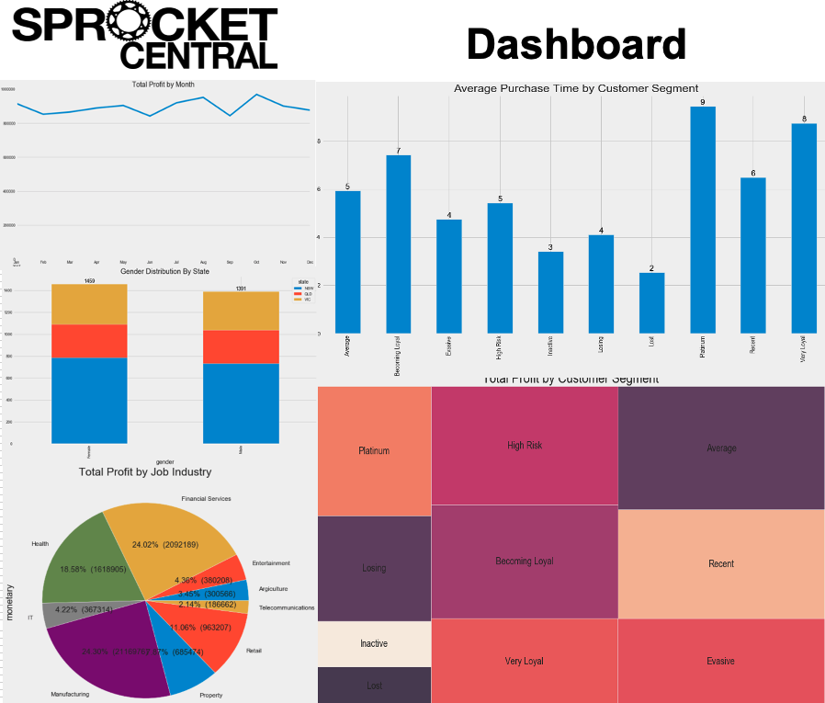
Note: The data and information in this document is reflective of a hypothetical situation and client. This document is to be used for KPMG Virtual Internship purposes only.
Dashboard

Slide 20
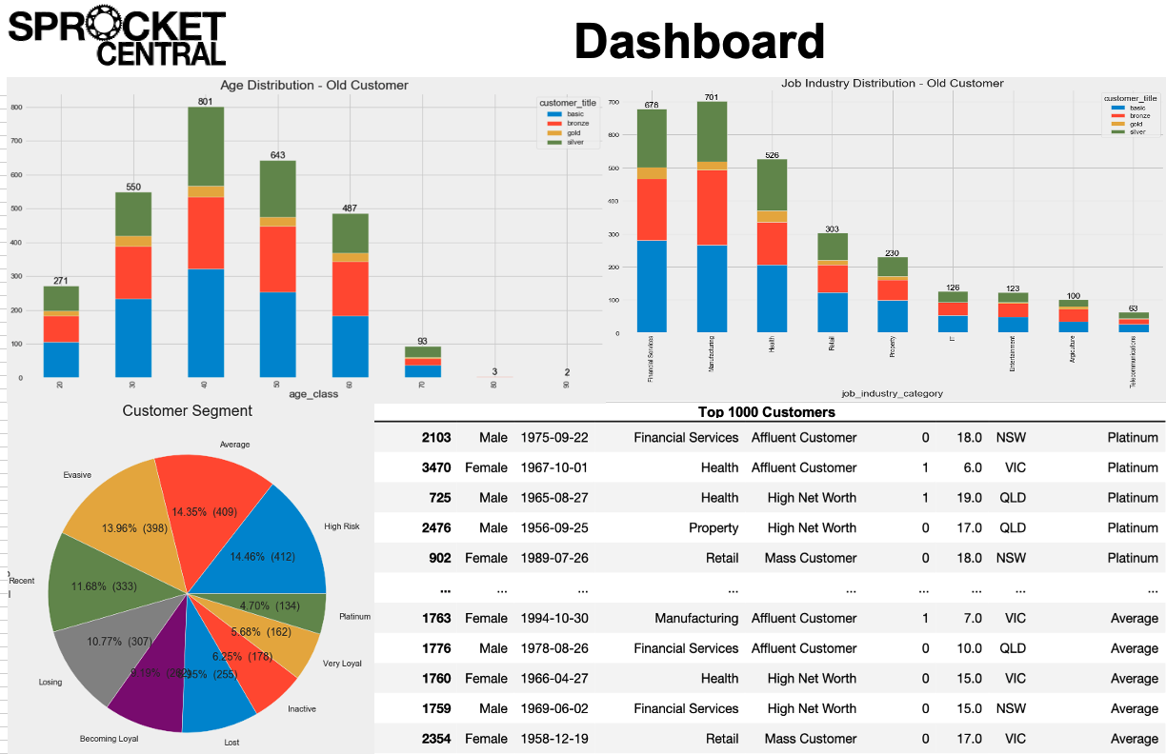
Note: The data and information in this document is reflective of a hypothetical situation and client. This document is to be used for KPMG Virtual Internship purposes only.
Dashboard

Slide 21
Note: The data and information in this document is reflective of a hypothetical situation and client. This document is to be used for KPMG Virtual Internship purposes only.
Appendix

Slide 22
Note: The data and information in this document is reflective of a hypothetical situation and client. This document is to be used for KPMG Virtual Internship purposes only.
Appendix
Python code about this work:
https://github.com/jarrywangcn/KPMG-Data-Analytic

