Slide 1

What is Orion?
Project initiated at Eclipse two years ago -- Tools for the web, on the web
An evolution in tooling leveraging the impressive recent improvements in browser capabilities and availability of cloud services
Embracing the shift to web-based application delivery and enabling cross site collaboration of “pluggable” services
A community that benefits from compatibility between a common set of components and services to create richer cloud based tools than they might otherwise by themselves

Slide 2
The Case for Developing in the Cloud
More and more applications have moved to the Web, to mobile devices, and are being run in cloud environments
Rational’s Application lifecycle tools offer lifecycle capabilities in the Web
But development tasks are largely still done on the desktop in environment like Eclipse or Visual Studio
Could we offer this experience in the Web, and integrate it into the software lifecycle?
This is what IBM is delivering with JazzHub, using the Eclipse Orion technology

Slide 3









Do developers really want to move to the Cloud?
Progression of desktop to cloud-based tools
Shift in developer knowledge sharing
Deploying to Cloud-based PaaS, IaaS, etc.
How enjoyable was your last IDE setup experience ???

Slide 4
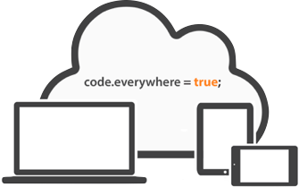
Orion Key Features
Replaces need for a desktop IDE
  Initially targeting needs of web developers (HTML, JavaScript, CSS, Ruby, Python)
Enable “Core” Coding Activities in a Browser
  Code editing, navigating source, search, integration with Source Control Management
Speed / Responsive UI Design
Extensibility and Community are what sets Orion apart

Slide 5
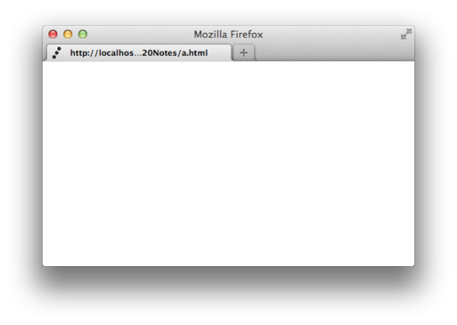
How is Orion extensible in the browser?
“plugins” live right in the page
Agnostic to where the plugin or code came from
Web Client
Plug-in
Plug-in
Web Server
Web Server
Web Server

Slide 6




Slide 7
Scott, insert your slides here

Slide 8
Ok Orion, here is what we need...
One million accounts
10,000 simultaneous connections
99.9% up-time
Single sign-on, LDAP integration, WAR deployment
Integrate with different client side frameworks
Skinning/branding
Globalized, accessible, secure, robust, scalable, fast, beautiful
Can we have that in 3 months?

Slide 9
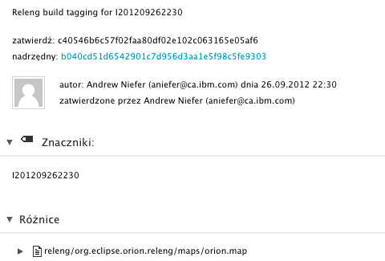
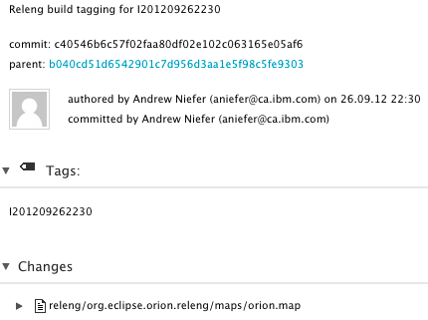
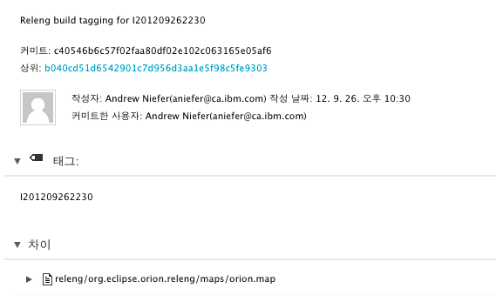
Supporting Developers Worldwide: Orion is International
i18N built in the core, the UI and in the plug-ins
Text editor capable of both Double Byte and Bidi
Working to be fully accessible
Plugin for Externalizing strings to bundles

Slide 10
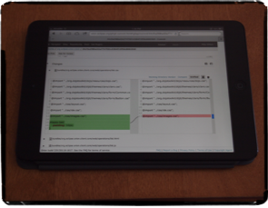
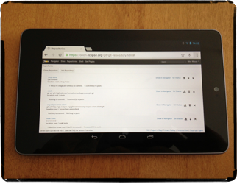
Mobile Support
Tablets such as the iPad, iPad mini and Android based platforms are fully supported by Orion
Add a bluetooth keyboard for a mini workstation

Slide 11

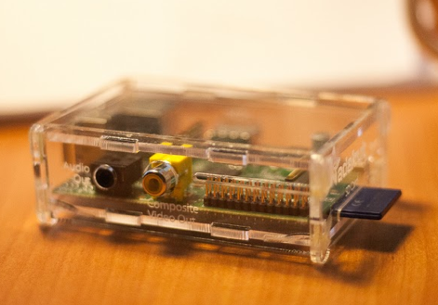
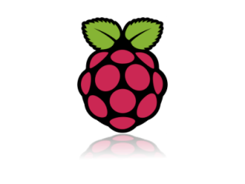
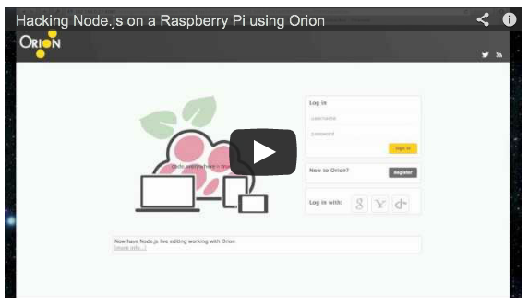
Two sources of an Orion Server
Multi-user Equinox based Java Server
Great for reusing existing Eclipse plug-ins and exposing them REST-fully to an Orion client
Node.js based single user NPM install
Very portable and great performance and used anywhere Node is installed
Also works on embedded boards like the Raspberry Pi
YouTube demo

Slide 13
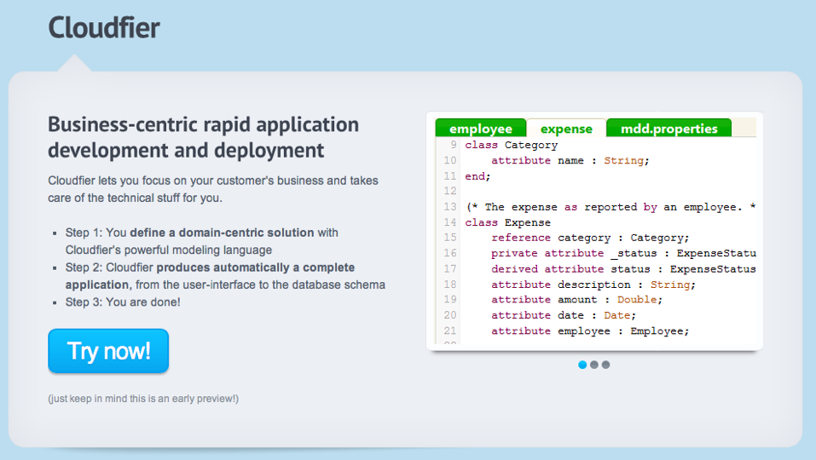
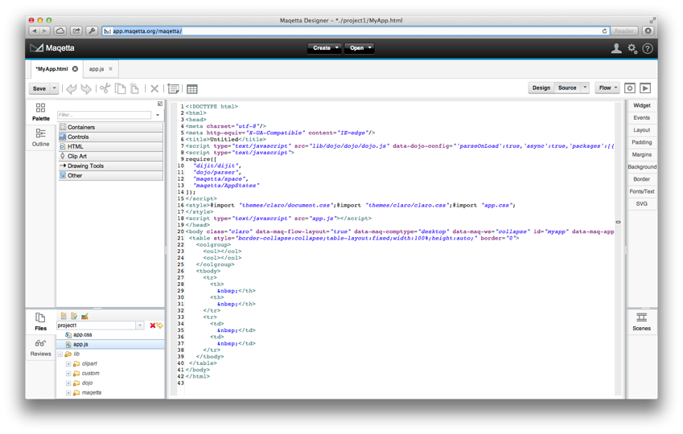
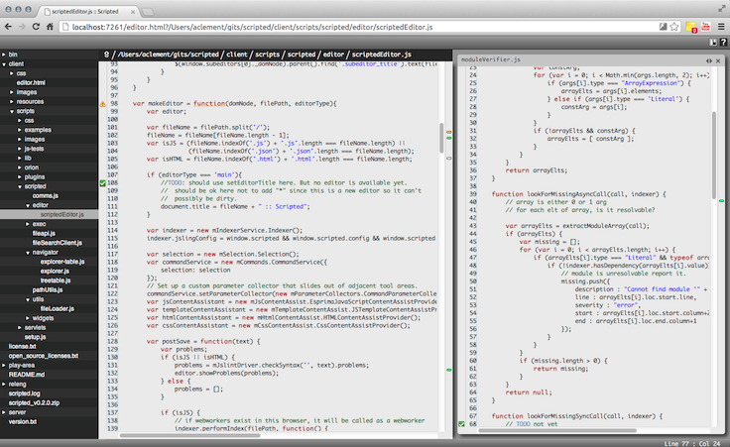
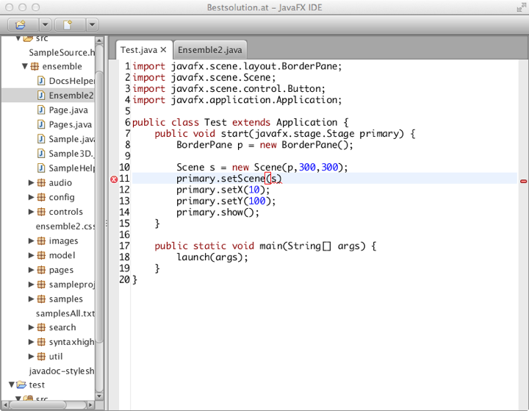
What about the Community?
Pivotal JavaScript tooling editor named “Scripted”
Firefox embeds Orion for the Scratchpad and Debug tools
e(fx)clipse leveraging JavaFX, OSGi, Eclipse and Orion
Maqetta leverages the Orion core and file system
HP and SAP, …

