Slide 1

Timers

Slide 2
RECAP – browser and node common concepts
aj browser Web API aj node.js (core modules API) majú spoločnú asynchrónnosť API
Okrem toho majú spoločný aj koncept Timers, ktorý umožňuje plánovanie udalostí a ich vykonanie neskôr
The timer functions within Node.js implement a similar API as the timers API provided by Web Browsers but use a different internal implementation that is built around the Node.js Event Loop.

Slide 3
timers
A timer in Node.js is an internal construct that calls a given function after a certain period of time. When a timer's function is called varies depending on which method was used to create the timer and what other work the Node.js event loop is doing.
setTimeout(callback, delay[, ...args]) -
schedules execution of a one-time callback after delay milliseconds
setInterval(callback, delay[, ...args])
Schedules repeated execution of callback every delay milliseconds.
setImmediate(callback[, ...args])
schedules the "immediate" execution of the callback after I/O events' callbacks.
Vykona sa na konci aktualneho loopu
process.nextTick(callback[, ...args])
schedules after the current operation on the JavaScript stack runs to completion and before the event loop is allowed to continue.
Ak to chceme vykonat hned!
queueMicrotask(callback) – expeimental
microtask queue is managed by V8 and may be used in a similar manner to the process.nextTick()
clearTimeout(timeout)
clearInterval(timeout)
clearImmediate(immediate)
cancels scheduled timeout or immediate
immediate.unref(), timeout.unref()
active Timeout/Immediate object will not require the Node.js event loop to remain active.
https://nodejs.org/api/timers.html

Slide 4
timers - delay
A timer in Node.js is an internal construct that calls a given function after a certain period of time.
A timer specifies the threshold after which a provided callback may be executed rather than the exact time a person wants it to be executed.
Timers callbacks will run as early as they can be scheduled after the specified amount of time has passed; however, Operating System scheduling or the running of other callbacks may delay them.

Slide 5
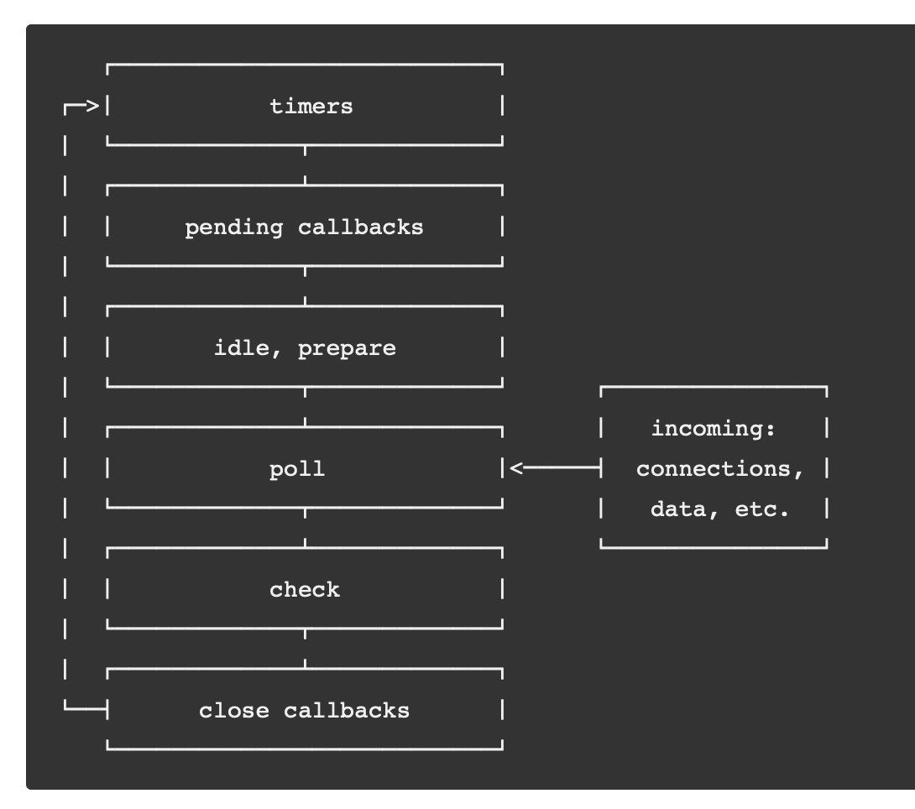
Timers and event loop
When a timer's function is called varies depending on which method was used to create the timer and what other work the Node.js event loop is doing.
https://nodejs.org/en/docs/guides/event-loop-timers-and-nexttick/

Slide 6

_aux

Slide 7
More details about timers

Slide 8
How node.js event loop works in general
Each phase has a FIFO queue of callbacks to execute. While each phase is special in its own way, generally,
when the event loop enters a given phase, it will perform any operations specific to that phase,
then execute callbacks in that phase's queue until the queue has been exhausted or the maximum number of callbacks has executed.
When the queue has been exhausted or the callback limit is reached, the event loop will move to the next phase, and so on.

Slide 9
process.nextTick
timers: this phase executes callbacks scheduled by setTimeout() and setInterval().
setImmediate() is designed to execute a script once the current poll phase completes
check: setImmediate() callbacks are invoked here.
process.nextTick() is not technically part of the event loop. Instead, the nextTickQueue will be processed after the current operation on stack completes, regardless of the current phase of the event loop.

Slide 10
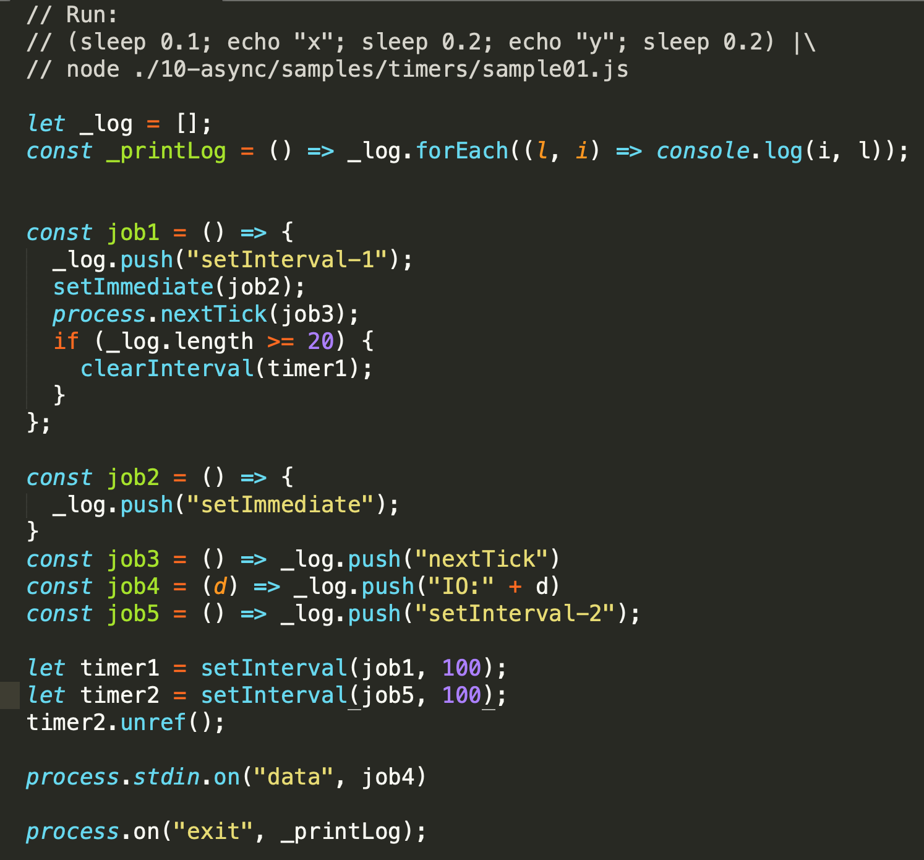
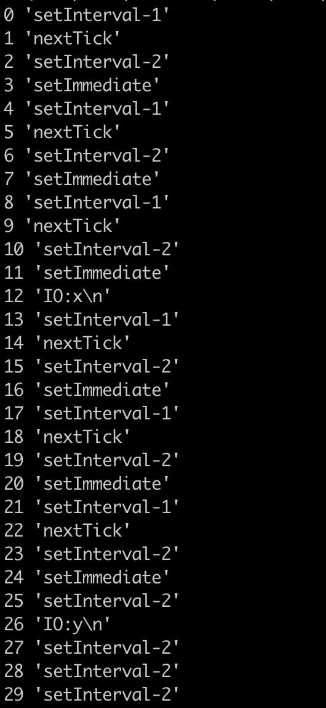
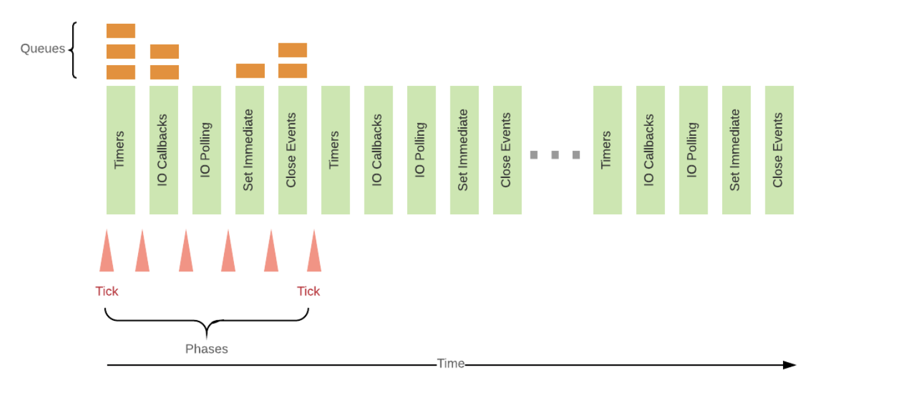
Event loop and order

Slide 11
setTimeout timers in browsers vs. node
it's important to note that setTimeout(..) doesn't put your callback on the event loop queue. What it does is set up a timer; when the timer expires, the environment places your callback into the event loop, such that some future tick will pick it up and execute it.
https://github.com/getify/You-Dont-Know-JS/blob/master/async%20%26%20performance/ch1.md
tak ako to je v node su sucastou event loopu IMHO....

Slide 12
ES6 now specifies how the event loop works
ES6 now specifies how the event loop works, which means technically it's within the purview of the JS engine, rather than just the hosting environment. One main reason for this change is the introduction of ES6 Promises, which we'll discuss in Chapter 3, because they require the ability to have direct, fine-grained control over scheduling operations on the event loop queue (see the discussion of setTimeout(..0) in the "Cooperation" section).

Slide 13
Synchronous and Asynchronous iteration

Slide 14
Asynchronous iteration
ES 2015 - synchronous iterations
ES 2017 - async functions
ES 2018 – async iterations

Slide 15
Iteration
Processing each of the items in a collection is a very common operation.
JavaScript provides a number of ways of iterating over a collection,
simple for loops
map() and filter()
...
Iterators and Generators bring the concept of iteration directly into the core language and provide a mechanism for customizing the behavior of for...of loops.

Slide 16
npm co
Generator based control flow goodness for nodejs and the browser,
using promises, letting you write non-blocking code in a nice-ish way.
v4

Slide 17
setTimeout timers in browsers vs. node
it's important to note that setTimeout(..) doesn't put your callback on the event loop queue. What it does is set up a timer; when the timer expires, the environment places your callback into the event loop, such that some future tick will pick it up and execute it.
https://github.com/getify/You-Dont-Know-JS/blob/master/async%20%26%20performance/ch1.md

Slide 18
ES6 now specifies how the event loop works
ES6 now specifies how the event loop works, which means technically it's within the purview of the JS engine, rather than just the hosting environment. One main reason for this change is the introduction of ES6 Promises, which we'll discuss in Chapter 3, because they require the ability to have direct, fine-grained control over scheduling operations on the event loop queue (see the discussion of setTimeout(..0) in the "Cooperation" section).

Slide 19
Starving the event loop with microtasks
https://gist.github.com/jesstelford/bbb30b983bddaa6e5fef2eb867d37678

Slide 20
Links
http://exploringjs.com/es2018-es2019/ch_asynchronous-iteration.html
https://jakearchibald.com/2017/async-iterators-and-generators/
https://medium.com/javascript-scene/the-hidden-power-of-es6-generators-observable-async-flow-control-cfa4c7f31435
https://medium.com/@deaniusaur/how-to-stream-json-data-over-rest-with-observables-80e0571821d3
https://medium.com/@fknussel/a-simple-observable-implementation-c9c809c89c69
https://rxjs-dev.firebaseapp.com/guide/observable

