Slide 1
X86 Assembly Library
Jakob Robinson \ Matthew Cronce

Slide 2
Overview
Starting this project, we were interested in how to make these procedures very similar to something like a C or Java function.
To get hands-on experience with something similar, we made as many procedures as possible to operate on the same data.
This forces out all the unnecessary changes that assembly makes to data and made us establish a scope and a consistent way of operating with data.
Doing this in a loop makes sure that all those procedures work the same way each time.

Slide 3
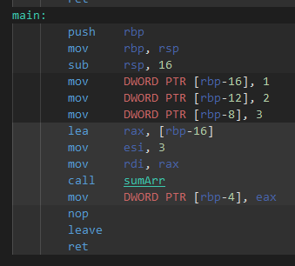
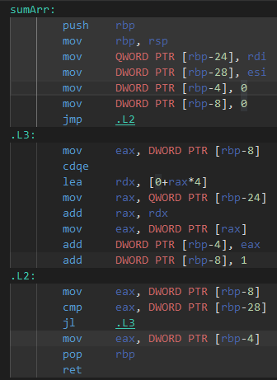
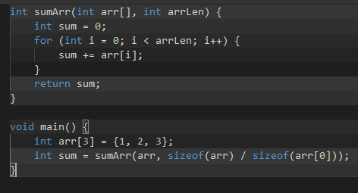
Compiling
The first place to turn to for how to make a function with a consistent scope was compiled C.

Slide 4
Implementing this process in TASM
First, save the base pointer and move the stack pointer into base pointer.
This makes bp into an offset that lets procedure “arguments” be referred to consistently.
When procedure is called, return address gets pushed to stack by the call operation, then bp is pushed to stack by us, bp holds the stack pointer at this moment in time.
[bp] is the original base pointer, [bp+2] is the address to return to, [bp+4] is the last “argument” pushed, then [bp+6], [bp+8], and so on.

Slide 5
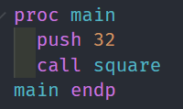
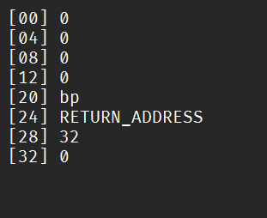
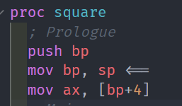
Implementing this process

Slide 6
Practicality
Most of the time, functions only take, at most, one or two arguments.
This is easy to implement by passing registers, so why bother pushing everything just to move it back into registers to do operations on?
Consistency: Literally every procedure can be designed to have the exact same input/output behavior, and that makes working with those procedures as if they were C functions extremely easy.
Push bx, call square is now identical to ax = square(bx), with no need to modify those registers before calling the function.

