Slide 1
Base conversion library
Jakob Robinson \ Matthew Cronce

Slide 2
Overview
Starting this project, we were interested in how to make these procedures very similar to something like a C or Java function.
To get hands-on experience with something similar, we made as many procedures as possible to operate on the same data.
This forces out all the unnecessary changes that assembly makes to data and made us establish a consistent way of operating with data, as well as passing data to and from procedures.
Doing this in a loop makes sure that all those procedures work the same way each time.

Slide 3
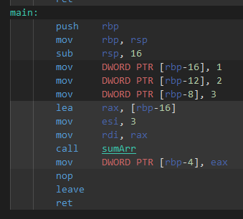
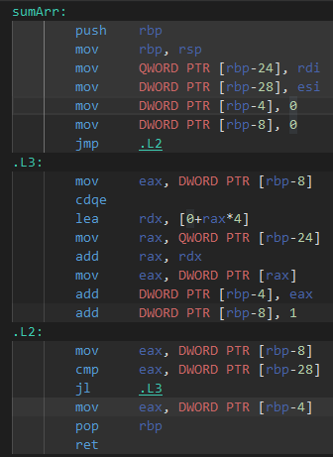
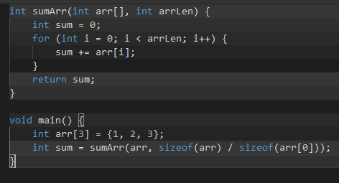
Compiling
The first place to turn to for how to make a function with a consistent scope was compiled C.

Slide 4
Calling conventions
There is no one way to interface with procedures, it is up to each programmer working with each other to decide how data gets passed to and from procedures.
However, there are several standards set up, to facilitate compiler creation or API creation.

Slide 5
Calling conventions
The specific way that these are implemented is very specific to each compiler.
GCC uses one calling convention, Turbo C++ uses a different one, etc. Even within calling conventions these can differ
Trying to interface with object files generated from the same code by different compilers can be very different.
Assemblers won’t enforce these conventions, when writing x86 assembly directly, it’s the programmer’s job to make sure that these conventions are followed.
However, using the same calling convention between x86 procedures and external, compiled C functions can let you work between them.

Slide 6
Cdecl calling convention
We start with a C function, something like int multiply(int x, int y) { return x * y; }
These data types are enforced by the compiler, we obviously won’t have them inside our assembly.
Our function name becomes a procedure.
Our arguments become things that we pass onto the stack before our procedure call. The specific way this compiles is from right to left, so we push y, then push x.
Our return value becomes a value that gets put into ax.
Void functions won’t return anything.
Our arguments are not cleared from the stack by the procedure, so our stack should be the same as before we called the procedure. (Same stack pointer, same data below it)

Slide 7
Implementing this process in TASM
First, save the base pointer and move the stack pointer into base pointer.
This makes bp into an offset that lets procedure “arguments” be referred to consistently, it also saves the stack pointer (so long as bp isn’t modified), letting us consistently return to our main function regardless of what we’ve put onto the stack.
When procedure is called, return address gets pushed to stack by the call operation, then bp is pushed to stack by us, bp holds the stack pointer at this moment in time.
[bp] is the original base pointer, [bp+2] is the instruction pointer to return to, [bp+4] is the last “argument” pushed (So the left-most, in compiled C), then [bp+6], [bp+8], and so on.

Slide 8
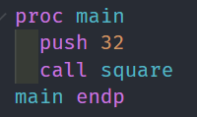
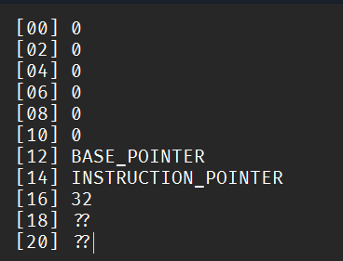
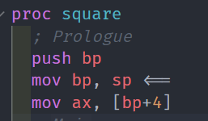
Implementing this process

Slide 9
Practicality
Most of the time, functions only take, at most, one or two arguments.
This is easy to implement by passing registers, so why bother pushing everything just to move it back into registers to do operations on?
Consistency: Literally every procedure can be designed to have the exact same input/output behavior, and that makes working with those procedures as if they were C functions extremely easy.
Push bx, call square, sub sp, 2 is now identical to ax = square(bx);

Slide 10
Practicality
However, to make it even more practical, we could make our calling convention match a specific C compiler, and then we would be able to interface external C functions with our assembly code.
Since we decided to study cdecl, our code will be easier to work with functions compiled with GCC, but our directives and structure is still set up for TASM.
However, this specific project was more about understanding how higher-level code compiles than it is about specifically interfacing our assembly code with C functions.

