Slide 1
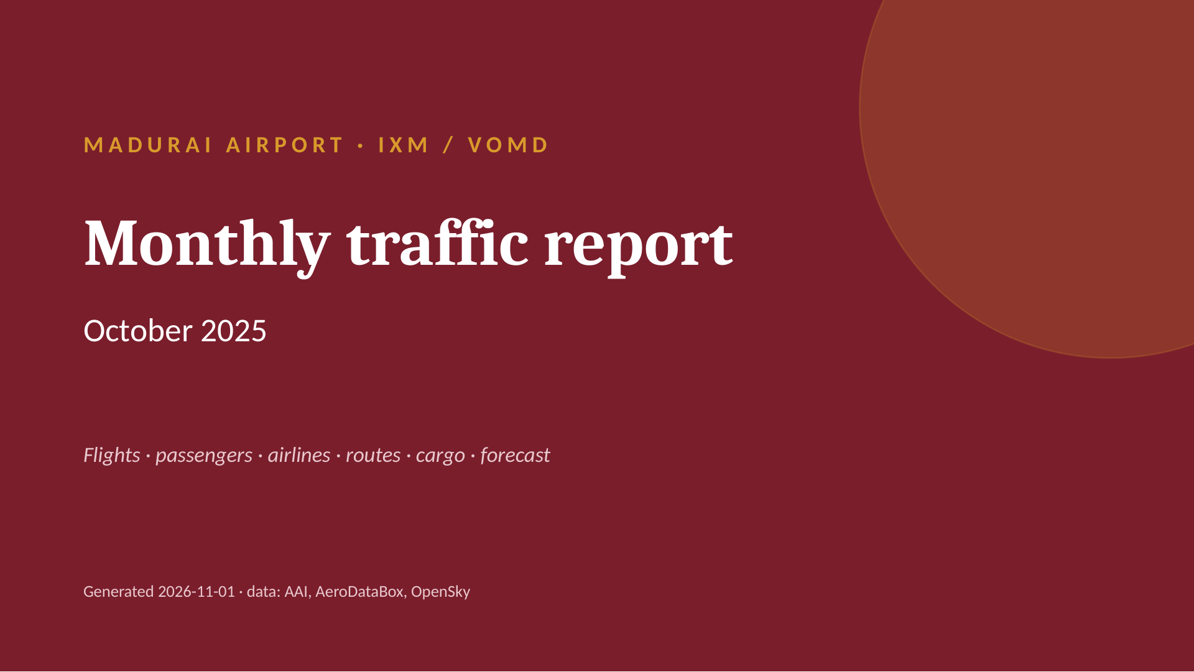
Notes:
MADURAI AIRPORT · IXM / VOMD
Monthly traffic report
October 2025
Flights · passengers · airlines · routes · cargo · forecast
Generated 2026-11-01 · data: AAI, AeroDataBox, OpenSky

Slide 2
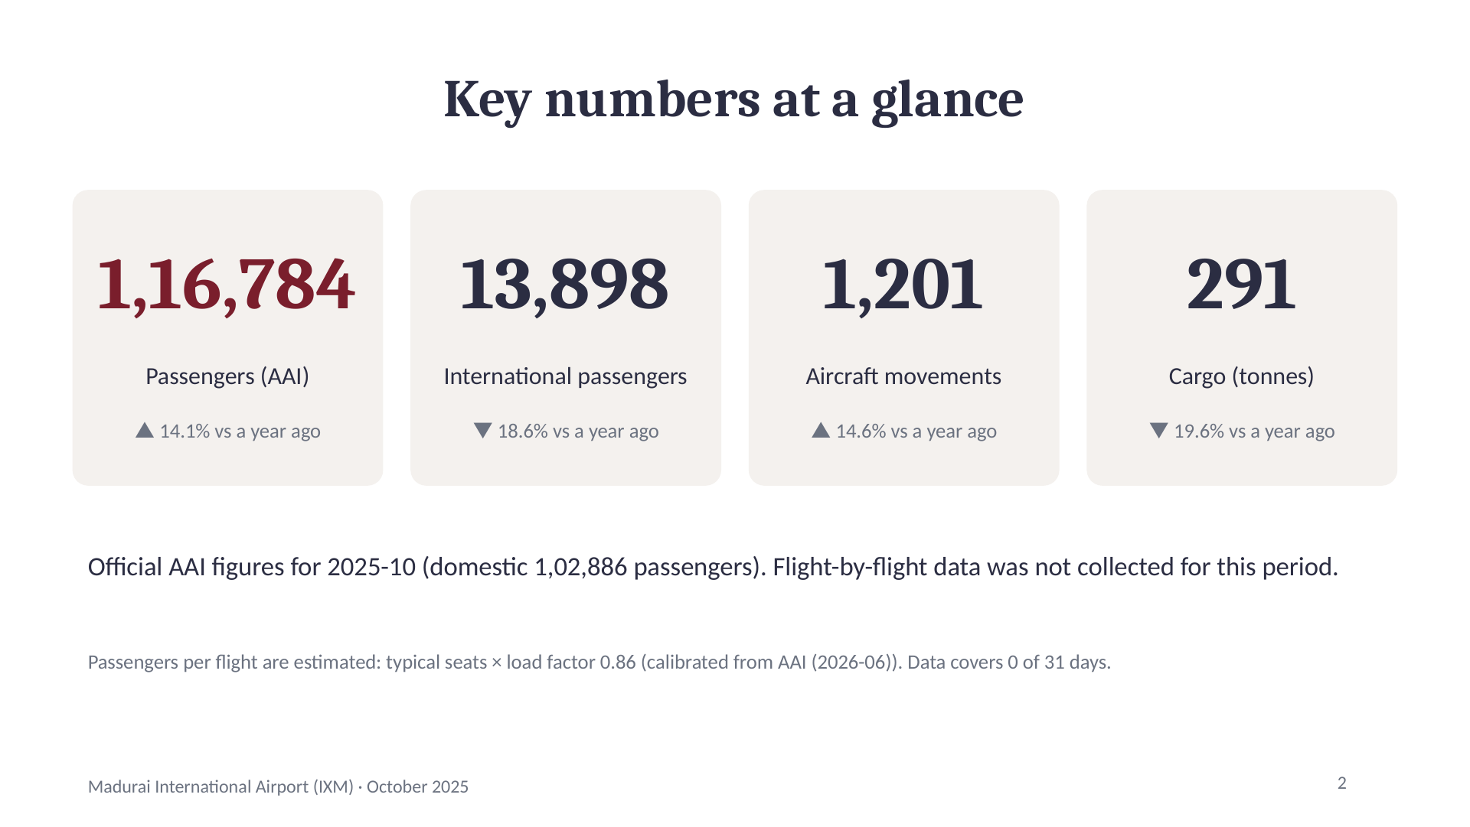
Notes:
Key numbers at a glance
1,16,784
Passengers (AAI)
▲ 14.1% vs a year ago
13,898
International passengers
▼ 18.6% vs a year ago
1,201
Aircraft movements
▲ 14.6% vs a year ago
291
Cargo (tonnes)
▼ 19.6% vs a year ago
Official AAI figures for 2025-10 (domestic 1,02,886 passengers). Flight-by-flight data was not collected for this period.
Passengers per flight are estimated: typical seats × load factor 0.86 (calibrated from AAI (2026-06)). Data covers 0 of 31 days.
2

Slide 3
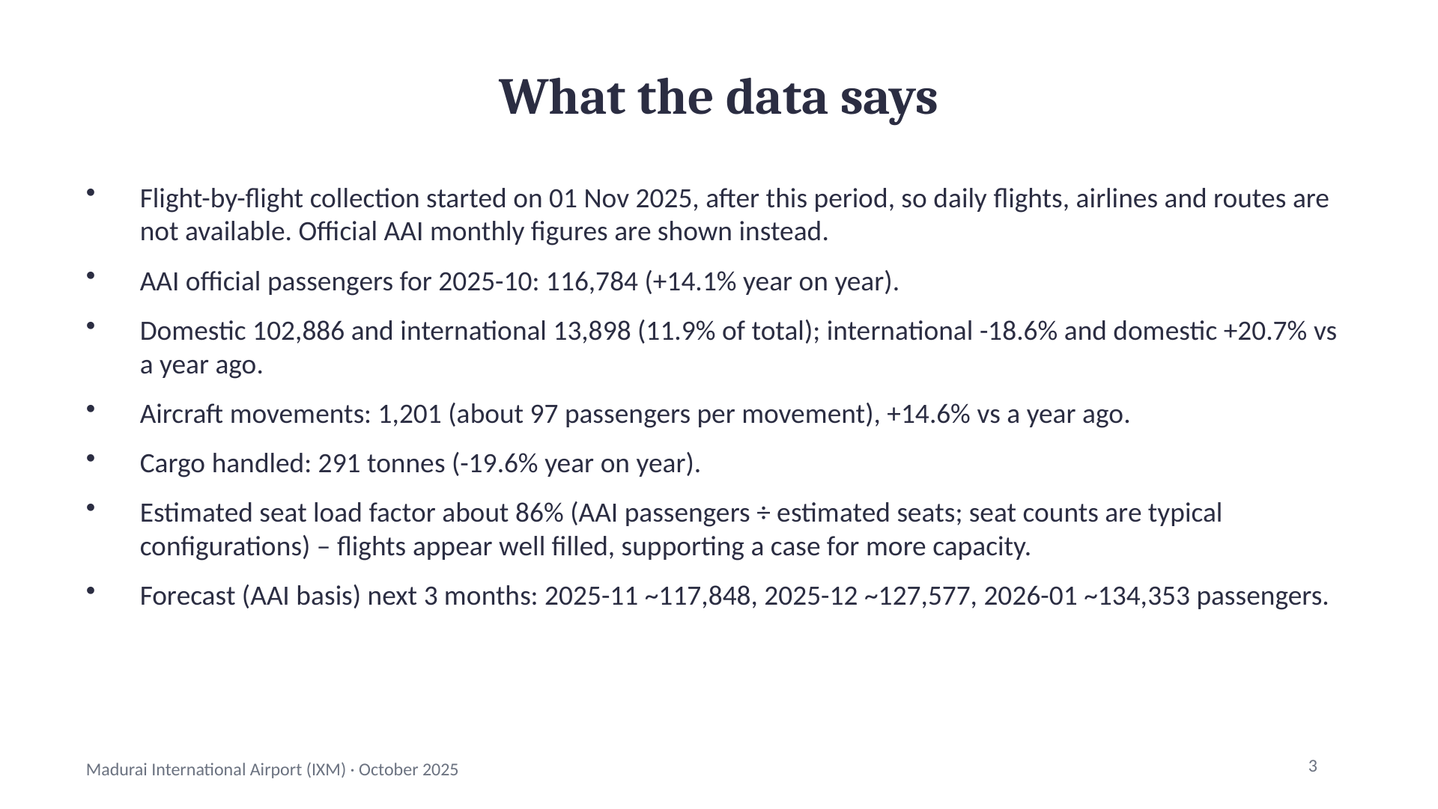
Notes:
What the data says
Flight-by-flight collection started on 01 Nov 2025, after this period, so daily flights, airlines and routes are not available. Official AAI monthly figures are shown instead.
AAI official passengers for 2025-10: 116,784 (+14.1% year on year).
Domestic 102,886 and international 13,898 (11.9% of total); international -18.6% and domestic +20.7% vs a year ago.
Aircraft movements: 1,201 (about 97 passengers per movement), +14.6% vs a year ago.
Cargo handled: 291 tonnes (-19.6% year on year).
Estimated seat load factor about 86% (AAI passengers ÷ estimated seats; seat counts are typical configurations) – flights appear well filled, supporting a case for more capacity.
Forecast (AAI basis) next 3 months: 2025-11 ~117,848, 2025-12 ~127,577, 2026-01 ~134,353 passengers.
3

Slide 4
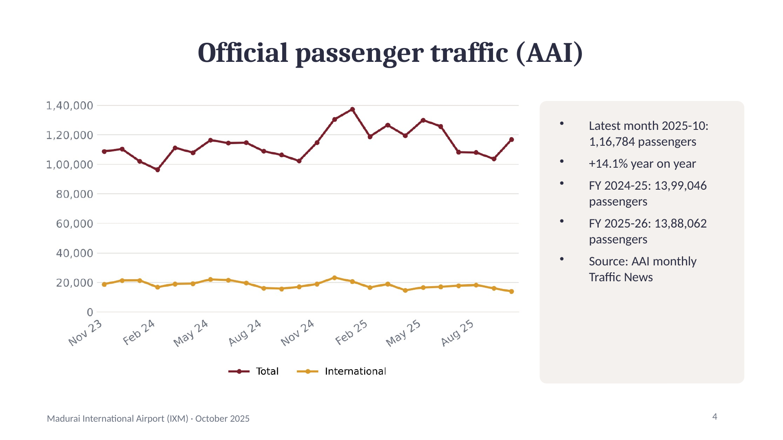
Notes:
Official passenger traffic (AAI)
Latest month 2025-10: 1,16,784 passengers
+14.1% year on year
FY 2024-25: 13,99,046 passengers
FY 2025-26: 13,88,062 passengers
Source: AAI monthly Traffic News
4

Slide 5
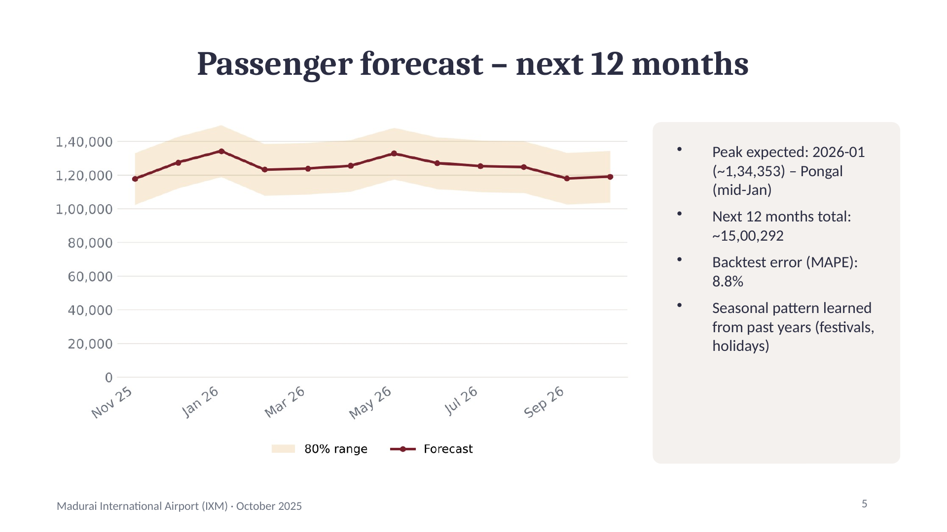
Notes:
Passenger forecast – next 12 months
Peak expected: 2026-01 (~1,34,353) – Pongal (mid-Jan)
Next 12 months total: ~15,00,292
Backtest error (MAPE): 8.8%
Seasonal pattern learned from past years (festivals, holidays)
5

Slide 6
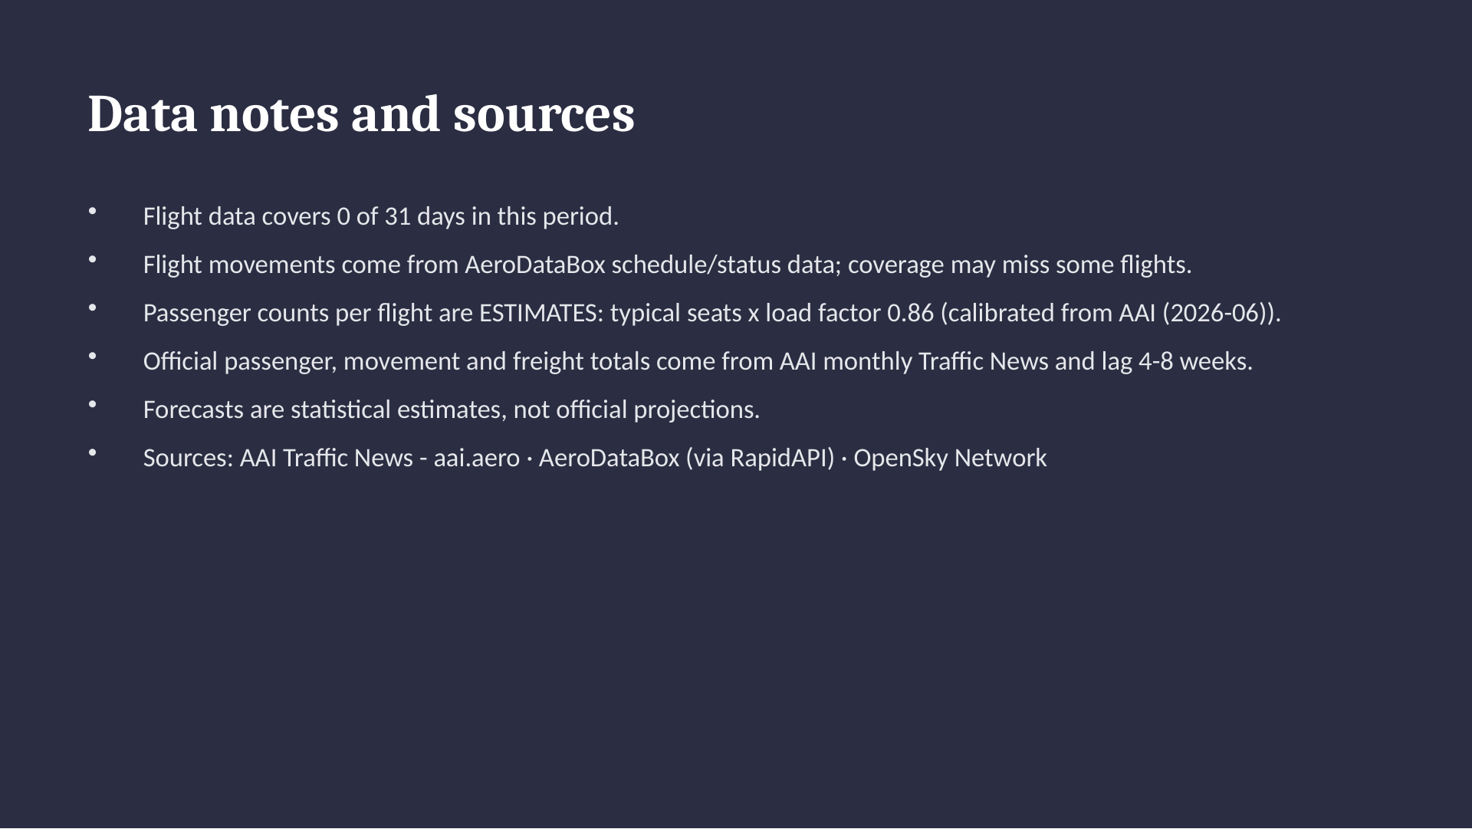
Notes:
Data notes and sources
Flight data covers 0 of 31 days in this period.
Flight movements come from AeroDataBox schedule/status data; coverage may miss some flights.
Passenger counts per flight are ESTIMATES: typical seats x load factor 0.86 (calibrated from AAI (2026-06)).
Official passenger, movement and freight totals come from AAI monthly Traffic News and lag 4-8 weeks.
Forecasts are statistical estimates, not official projections.
Sources: AAI Traffic News - aai.aero · AeroDataBox (via RapidAPI) · OpenSky Network

