Slide 1
MADURAI AIRPORT · IXM / VOMD
Monthly traffic report
November 2025
Flights · passengers · airlines · routes · cargo · forecast
Generated 2026-11-01 · data: AAI, AeroDataBox, OpenSky

Slide 2
Key numbers at a glance
1,090
1,14,255
132
0
Flight movements
Est. passengers
International movements
Cargo flight movements
no comparison
no comparison
no comparison
no comparison
AAI has not yet published figures for this period; cards show the latest published month, 2025-10 (domestic 1,02,886 passengers).
Passengers per flight are estimated: typical seats × load factor 0.86 (calibrated from AAI (2026-06)). Data covers 30 of 30 days.

Slide 3
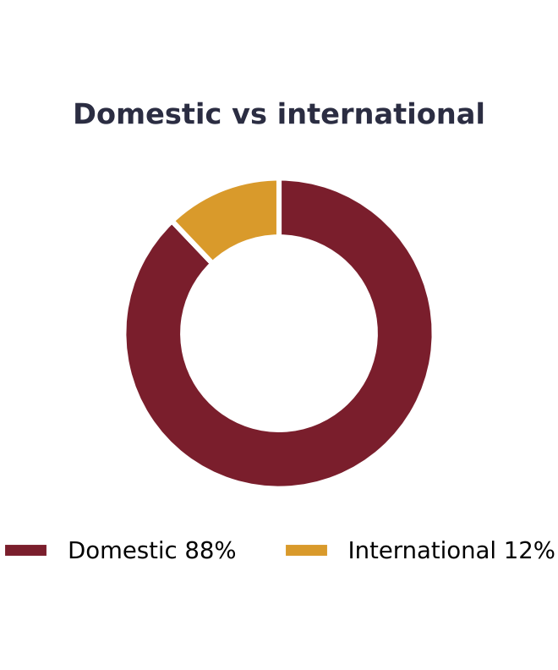
What the data says
1090 flight movements (546 arrivals, 544 departures).
IndiGo operated 84.4% of movements - the largest carrier.
Busiest route: Chennai with 540 movements (~18.0/day).
International movements: 132 (12.1% of total).
Peak hour: 13:00-13:59 local with 132 scheduled movements.
6 flights were cancelled or diverted.
AAI official passengers for 2025-10: 116,784 (+14.1% year on year).
Domestic 102,886 and international 13,898 (11.9% of total); international -18.6% and domestic +20.7% vs a year ago.

Slide 4
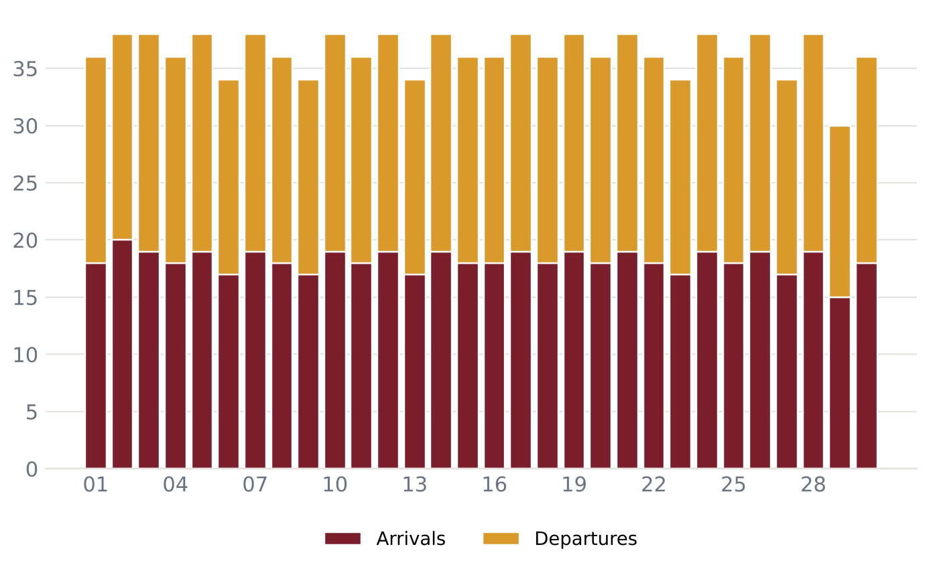
Daily flight movements – November 2025
36.3 movements per day on average
Busiest day: 2025-11-02 (38)
6 cancelled or diverted
On-time data not available

Slide 5
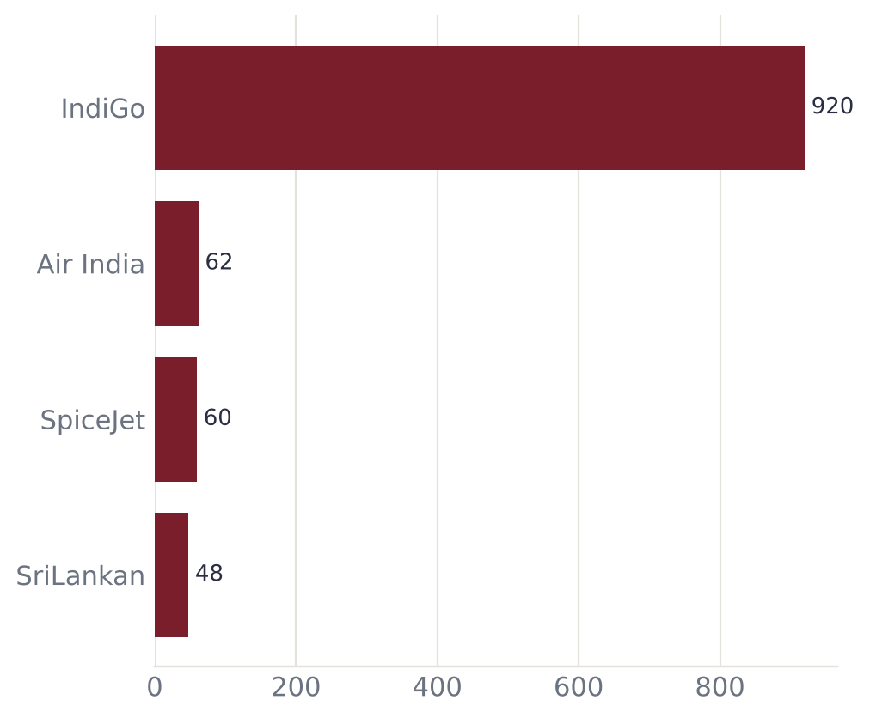
Airlines serving Madurai
Airline | Flights | Share | Est. pax
IndiGo | 920 | 84.4% | 86,853
Air India | 62 | 5.7% | 9,979
SpiceJet | 60 | 5.5% | 9,714
SriLankan | 48 | 4.4% | 7,709

Slide 6
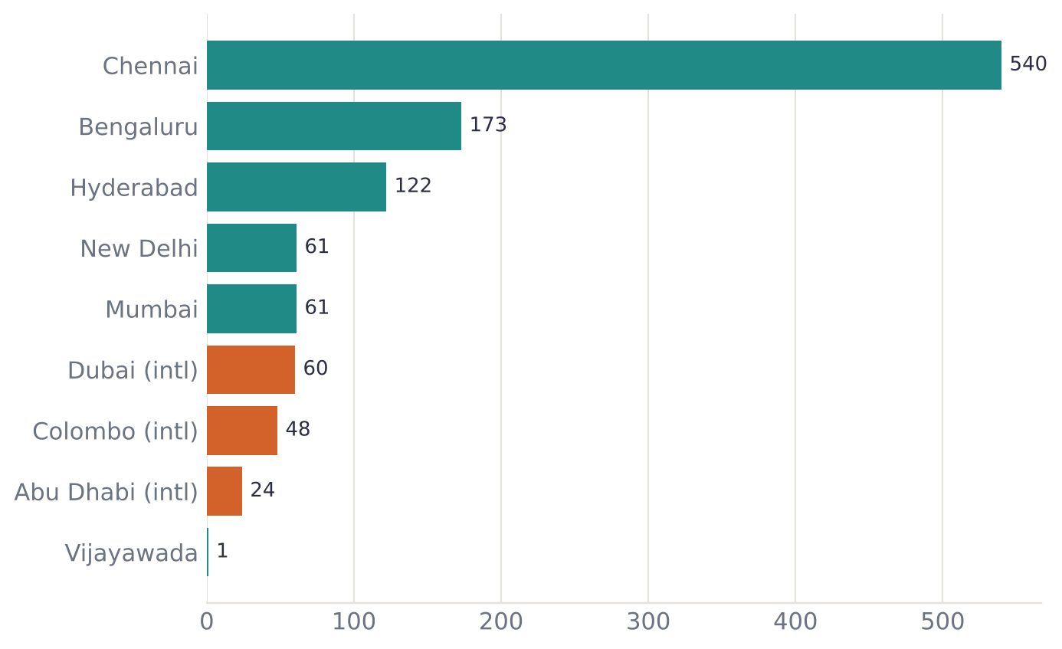
Routes and connectivity
9 destinations connected
3 international: Dubai, Colombo, Abu Dhabi
Top route: Chennai (~18/day)
Orange bars marked (intl) are international routes

Slide 7
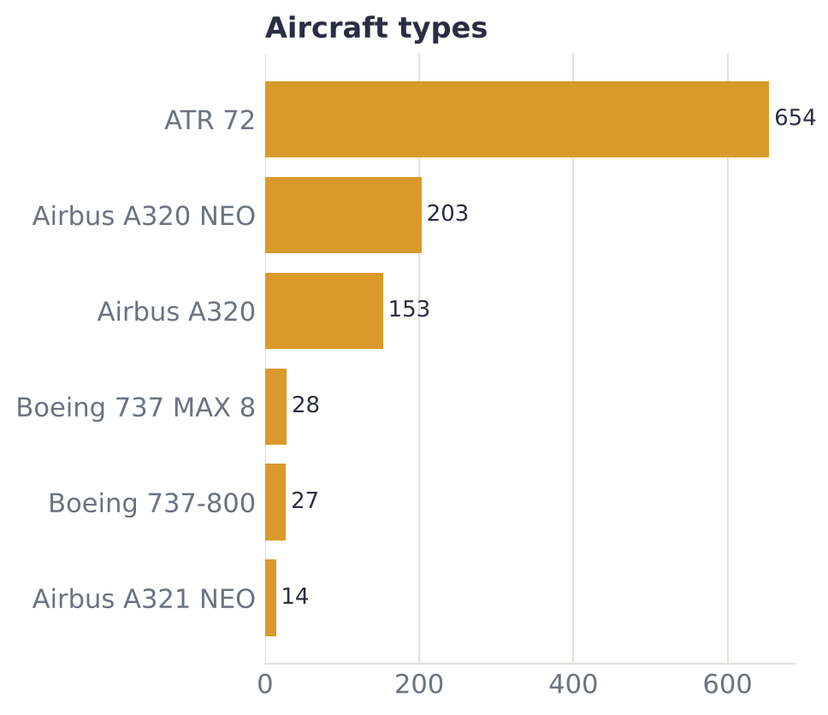
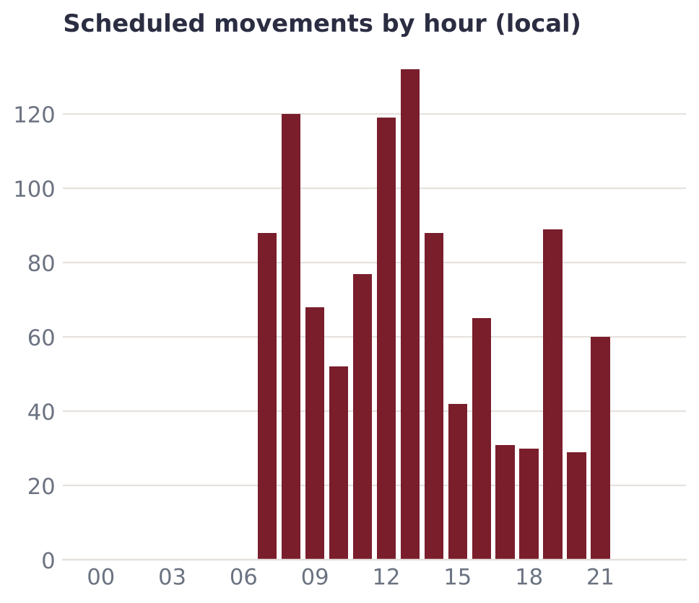
Fleet mix and peak hours

Slide 8
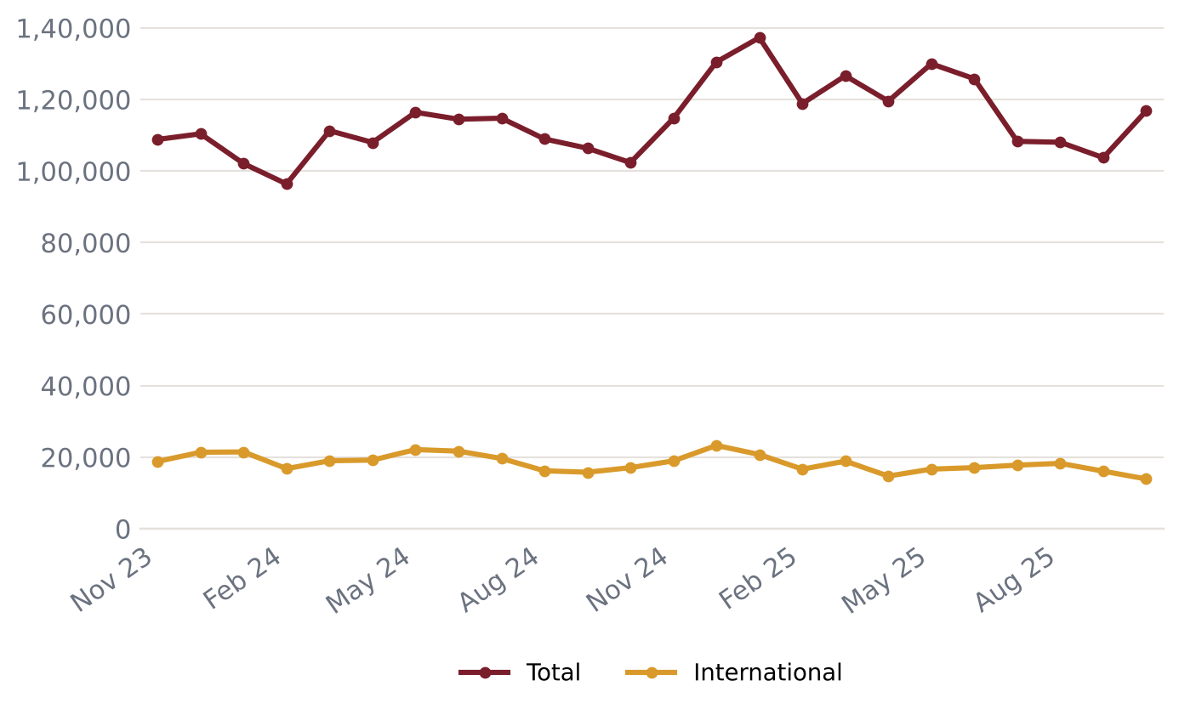
Official passenger traffic (AAI)
Latest month 2025-10: 1,16,784 passengers
+14.1% year on year
FY 2024-25: 13,99,046 passengers
FY 2025-26: 13,88,062 passengers
Source: AAI monthly Traffic News

Slide 9
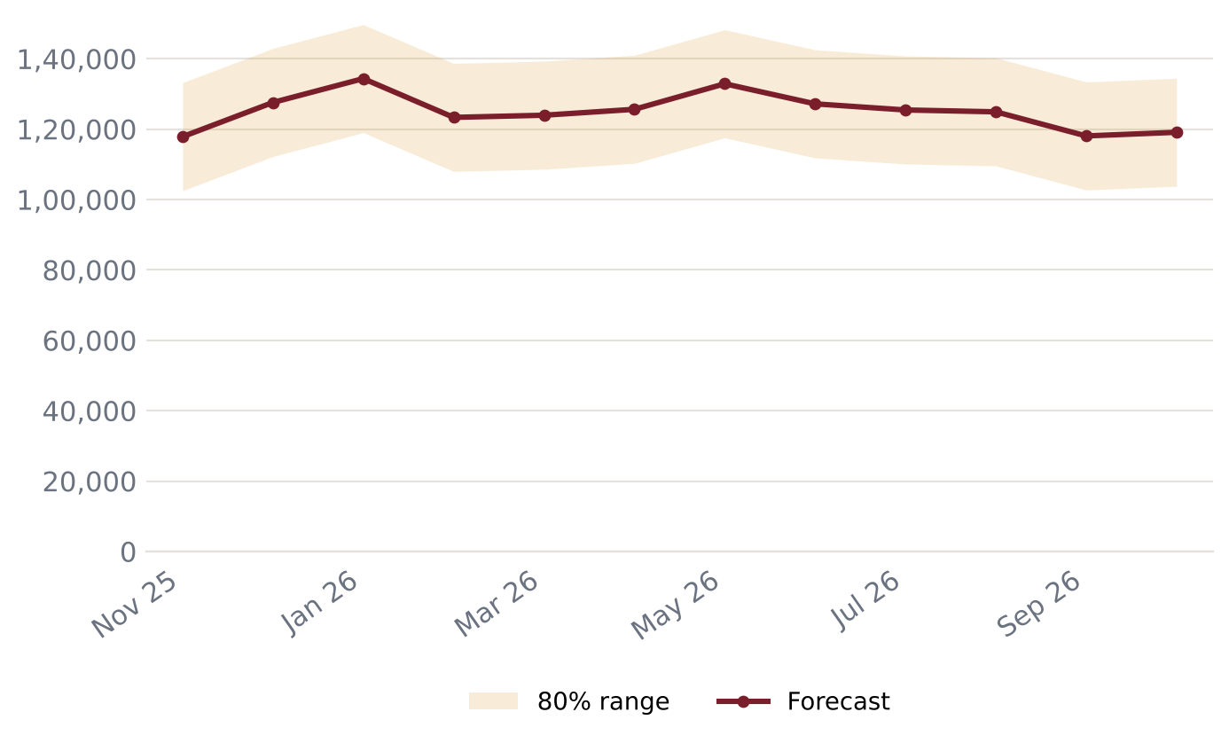
Passenger forecast – next 12 months
Peak expected: 2026-01 (~1,34,353) – Pongal (mid-Jan)
Next 12 months total: ~15,00,292
Backtest error (MAPE): 8.8%
Seasonal pattern learned from past years (festivals, holidays)

Slide 10
Data notes and sources
Flight movements come from AeroDataBox schedule/status data; coverage may miss some flights.
Passenger counts per flight are ESTIMATES: typical seats x load factor 0.86 (calibrated from AAI (2026-06)).
Official passenger, movement and freight totals come from AAI monthly Traffic News and lag 4-8 weeks.
Forecasts are statistical estimates, not official projections.
Sources: AAI Traffic News - aai.aero · AeroDataBox (via RapidAPI) · OpenSky Network

