Slide 1
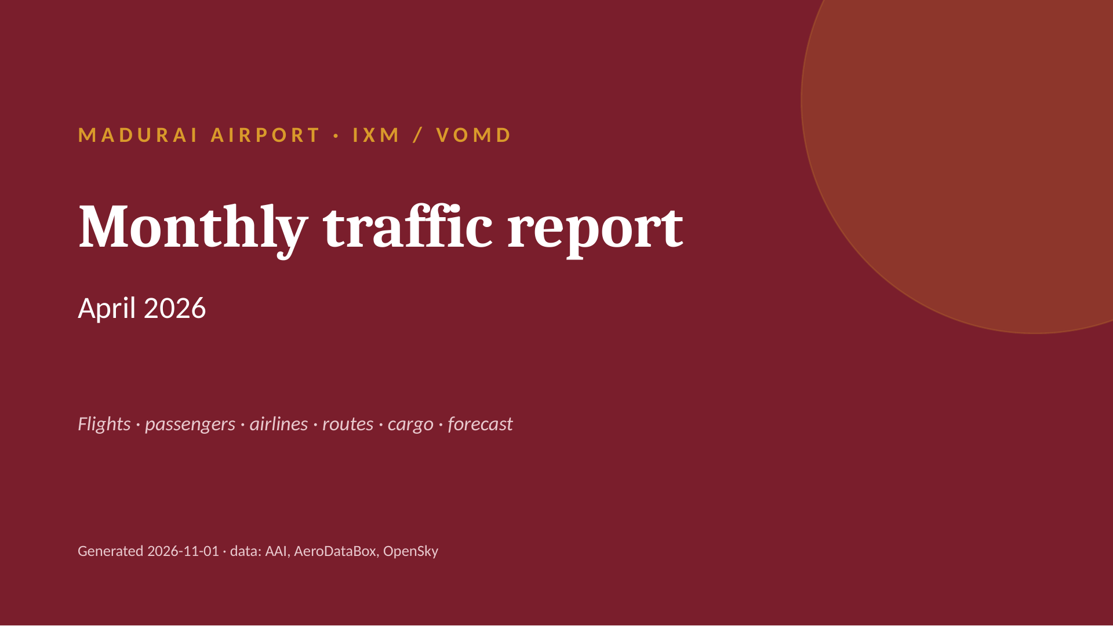
Notes:
MADURAI AIRPORT · IXM / VOMD
Monthly traffic report
April 2026
Flights · passengers · airlines · routes · cargo · forecast
Generated 2026-11-01 · data: AAI, AeroDataBox, OpenSky

Slide 2
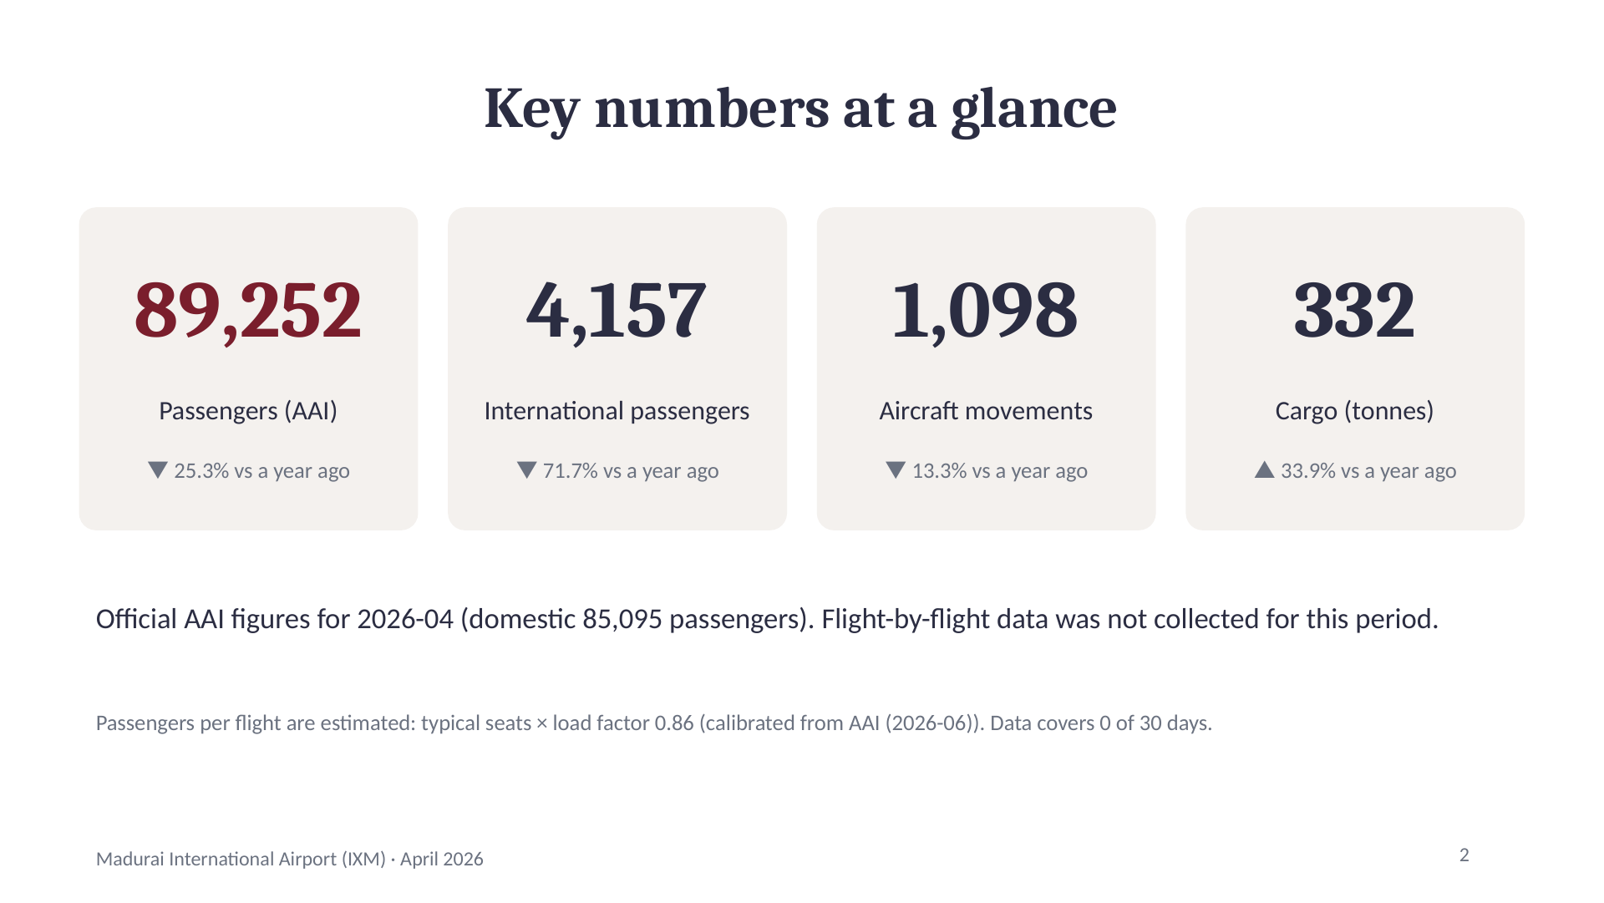
Notes:
Key numbers at a glance
89,252
Passengers (AAI)
▼ 25.3% vs a year ago
4,157
International passengers
▼ 71.7% vs a year ago
1,098
Aircraft movements
▼ 13.3% vs a year ago
332
Cargo (tonnes)
▲ 33.9% vs a year ago
Official AAI figures for 2026-04 (domestic 85,095 passengers). Flight-by-flight data was not collected for this period.
Passengers per flight are estimated: typical seats × load factor 0.86 (calibrated from AAI (2026-06)). Data covers 0 of 30 days.
2

Slide 3
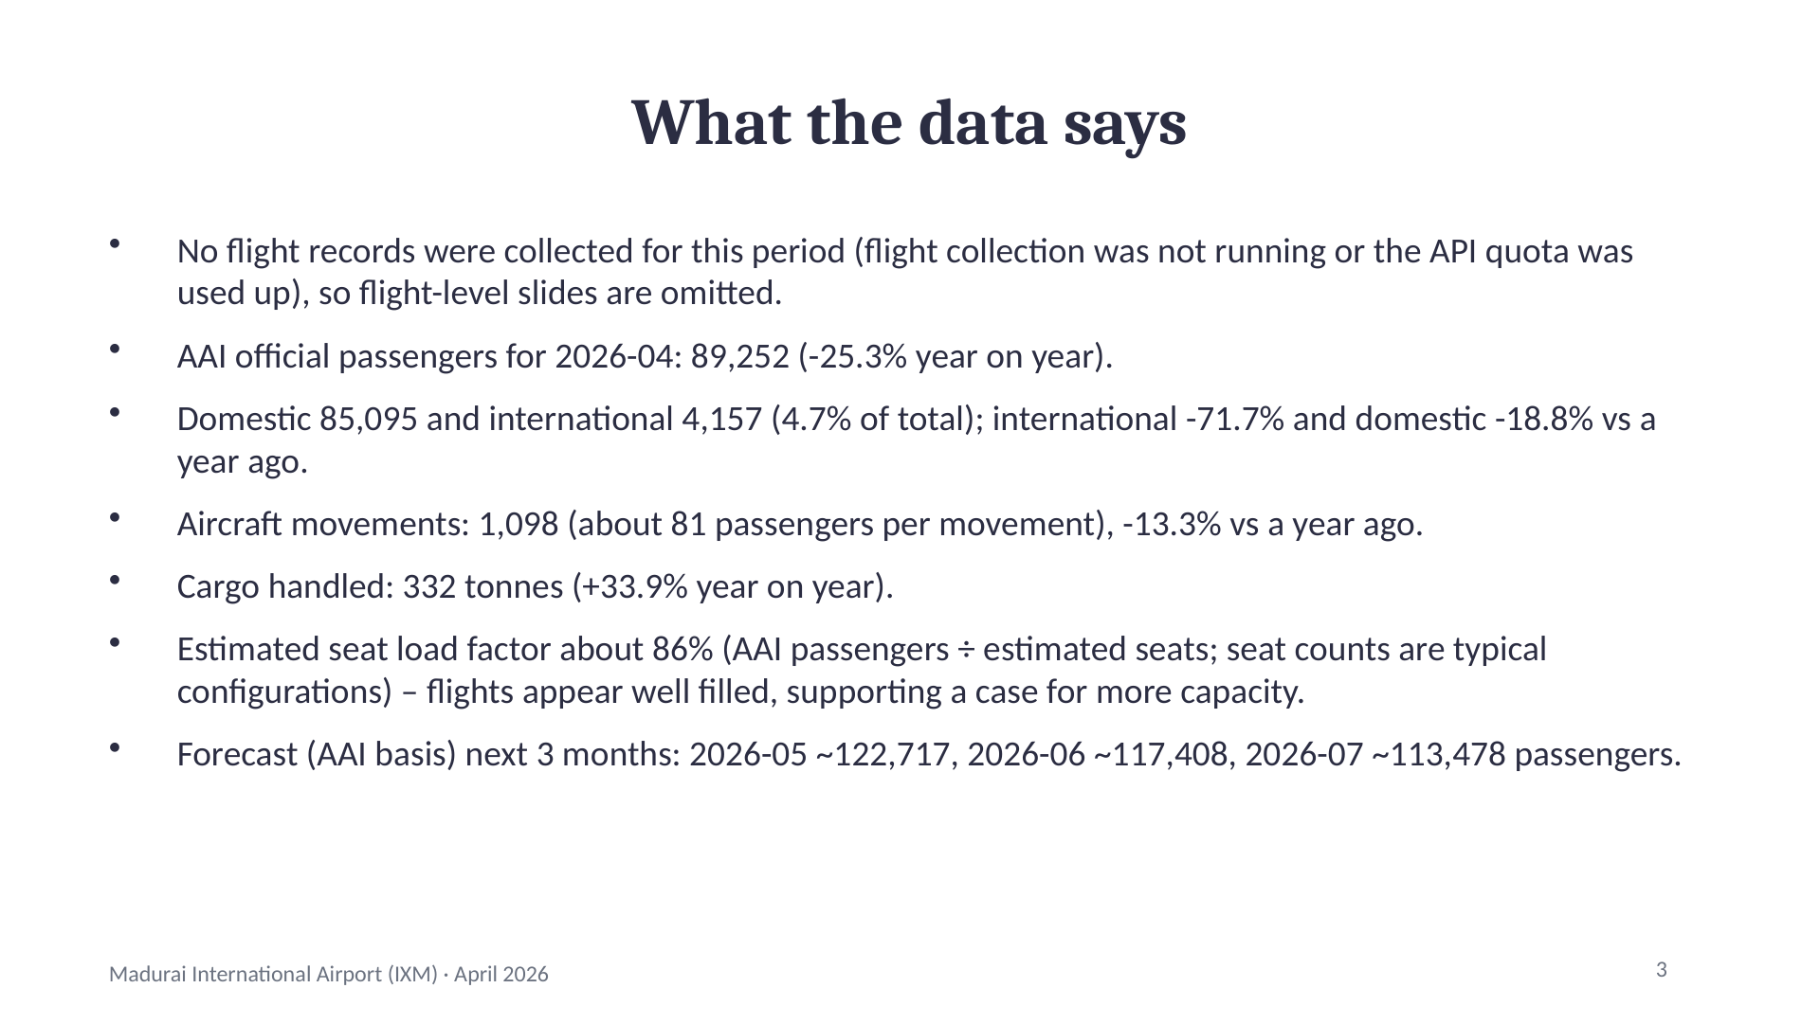
Notes:
What the data says
No flight records were collected for this period (flight collection was not running or the API quota was used up), so flight-level slides are omitted.
AAI official passengers for 2026-04: 89,252 (-25.3% year on year).
Domestic 85,095 and international 4,157 (4.7% of total); international -71.7% and domestic -18.8% vs a year ago.
Aircraft movements: 1,098 (about 81 passengers per movement), -13.3% vs a year ago.
Cargo handled: 332 tonnes (+33.9% year on year).
Estimated seat load factor about 86% (AAI passengers ÷ estimated seats; seat counts are typical configurations) – flights appear well filled, supporting a case for more capacity.
Forecast (AAI basis) next 3 months: 2026-05 ~122,717, 2026-06 ~117,408, 2026-07 ~113,478 passengers.
3

Slide 4
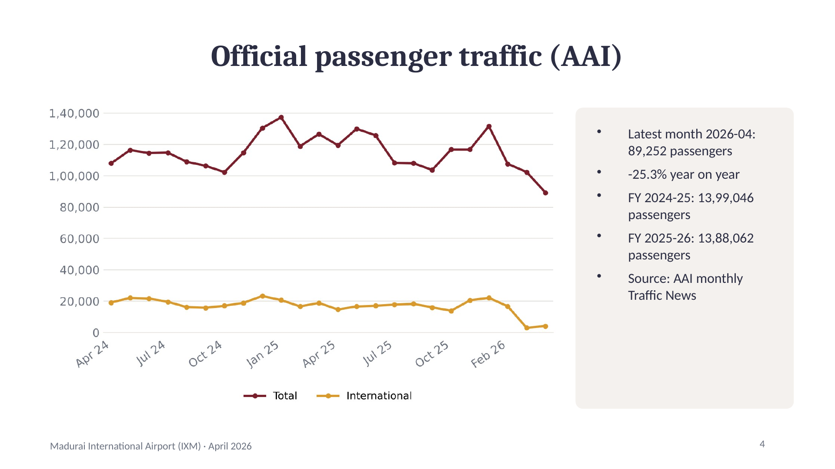
Notes:
Official passenger traffic (AAI)
Latest month 2026-04: 89,252 passengers
-25.3% year on year
FY 2024-25: 13,99,046 passengers
FY 2025-26: 13,88,062 passengers
Source: AAI monthly Traffic News
4

Slide 5
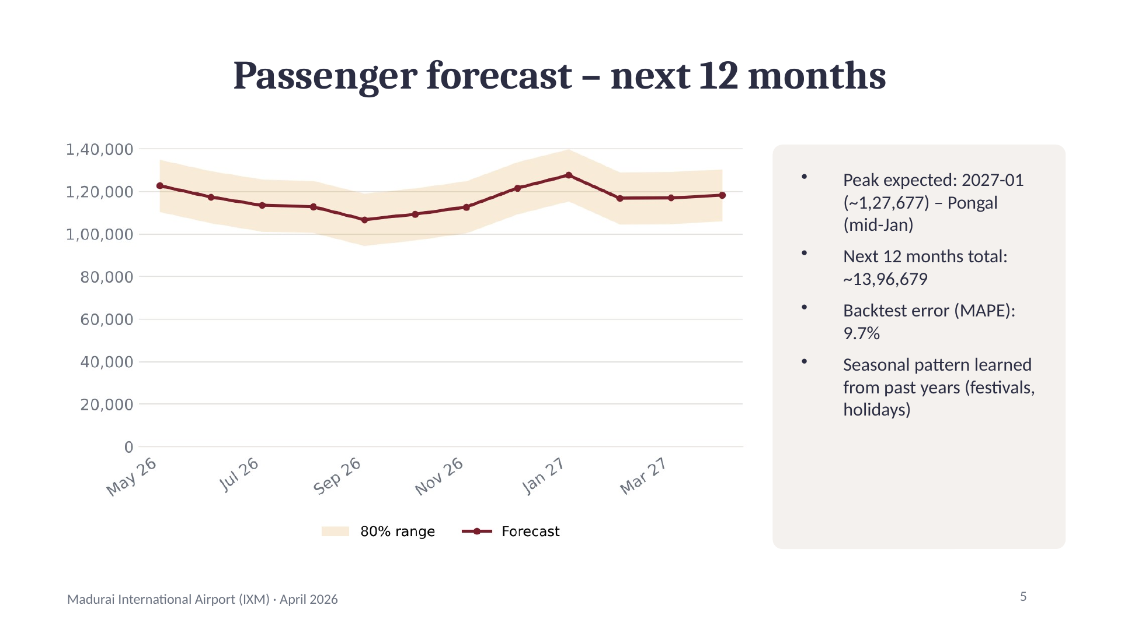
Notes:
Passenger forecast – next 12 months
Peak expected: 2027-01 (~1,27,677) – Pongal (mid-Jan)
Next 12 months total: ~13,96,679
Backtest error (MAPE): 9.7%
Seasonal pattern learned from past years (festivals, holidays)
5

Slide 6
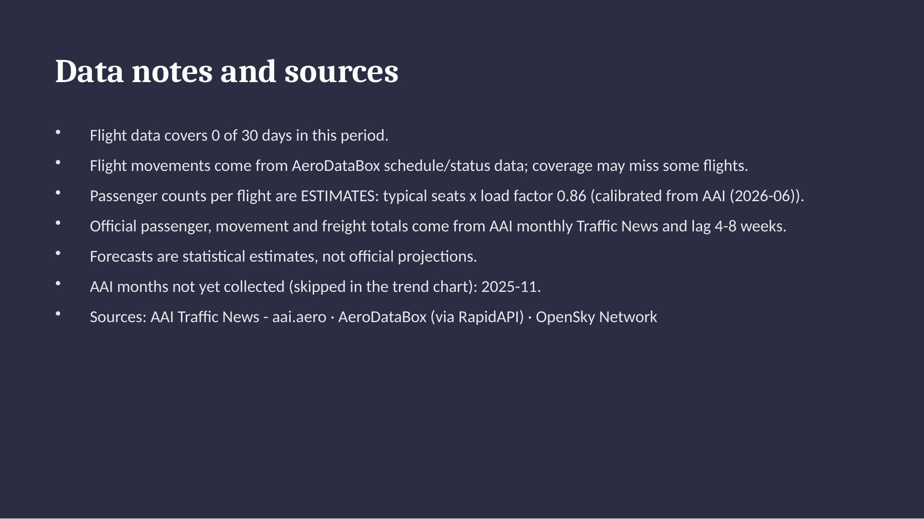
Notes:
Data notes and sources
Flight data covers 0 of 30 days in this period.
Flight movements come from AeroDataBox schedule/status data; coverage may miss some flights.
Passenger counts per flight are ESTIMATES: typical seats x load factor 0.86 (calibrated from AAI (2026-06)).
Official passenger, movement and freight totals come from AAI monthly Traffic News and lag 4-8 weeks.
Forecasts are statistical estimates, not official projections.
AAI months not yet collected (skipped in the trend chart): 2025-11.
Sources: AAI Traffic News - aai.aero · AeroDataBox (via RapidAPI) · OpenSky Network

