Slide 1
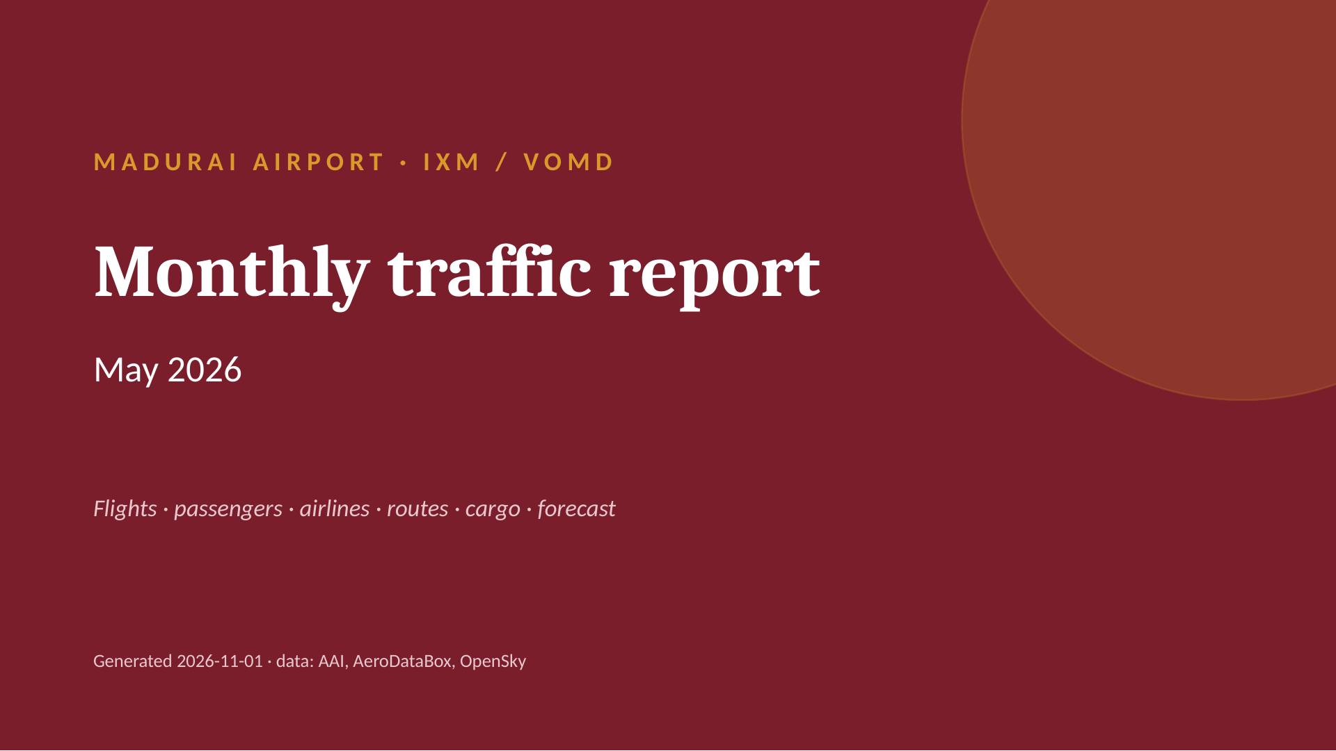
Notes:
MADURAI AIRPORT · IXM / VOMD
Monthly traffic report
May 2026
Flights · passengers · airlines · routes · cargo · forecast
Generated 2026-11-01 · data: AAI, AeroDataBox, OpenSky

Slide 2
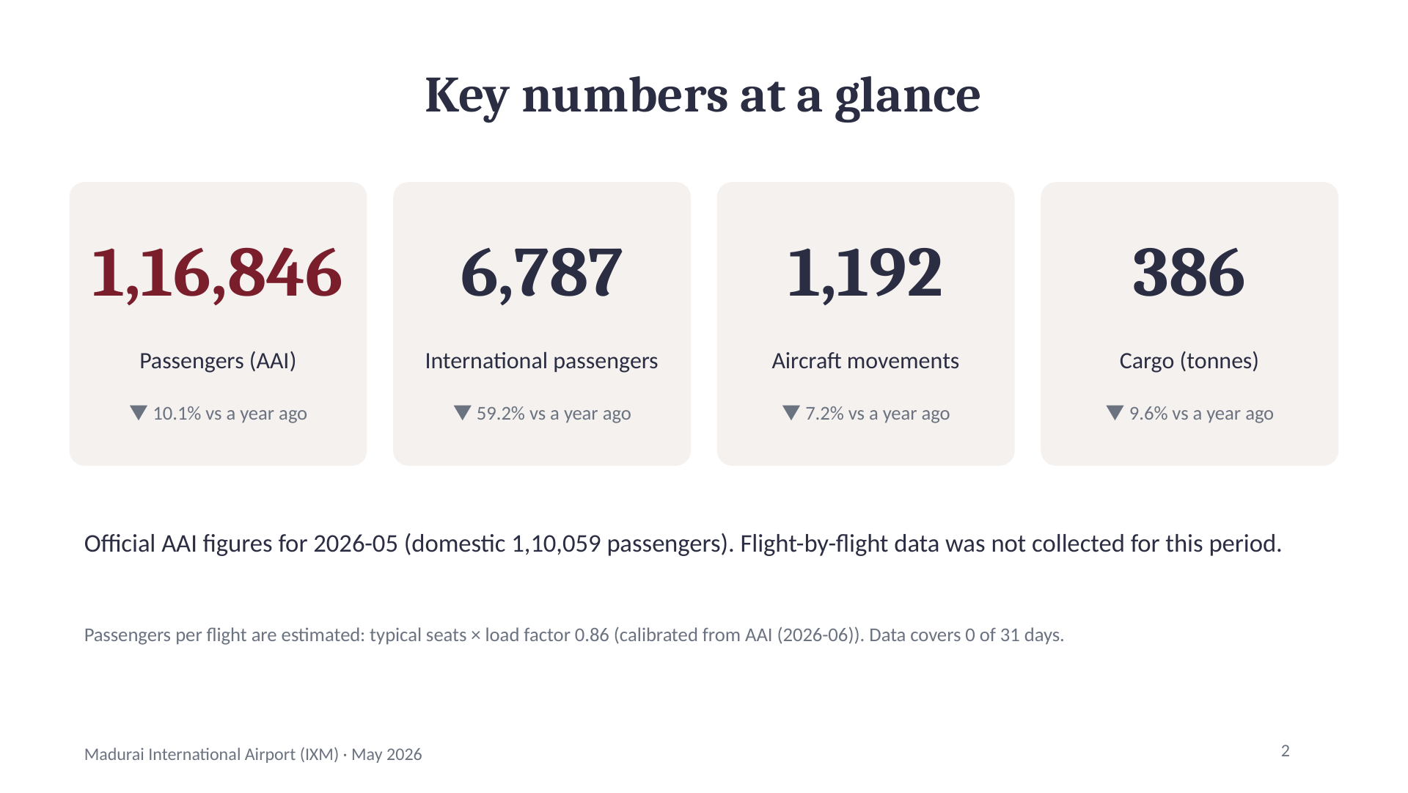
Notes:
Key numbers at a glance
1,16,846
Passengers (AAI)
▼ 10.1% vs a year ago
6,787
International passengers
▼ 59.2% vs a year ago
1,192
Aircraft movements
▼ 7.2% vs a year ago
386
Cargo (tonnes)
▼ 9.6% vs a year ago
Official AAI figures for 2026-05 (domestic 1,10,059 passengers). Flight-by-flight data was not collected for this period.
Passengers per flight are estimated: typical seats × load factor 0.86 (calibrated from AAI (2026-06)). Data covers 0 of 31 days.
2

Slide 3
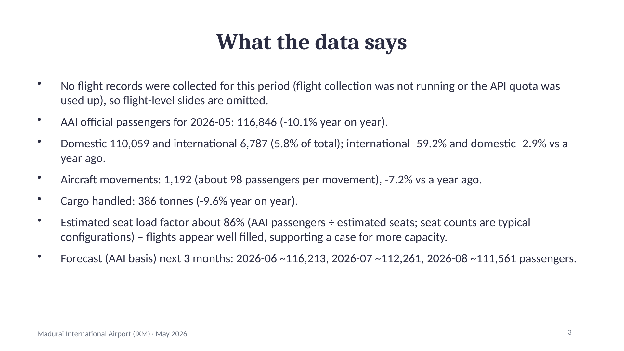
Notes:
What the data says
No flight records were collected for this period (flight collection was not running or the API quota was used up), so flight-level slides are omitted.
AAI official passengers for 2026-05: 116,846 (-10.1% year on year).
Domestic 110,059 and international 6,787 (5.8% of total); international -59.2% and domestic -2.9% vs a year ago.
Aircraft movements: 1,192 (about 98 passengers per movement), -7.2% vs a year ago.
Cargo handled: 386 tonnes (-9.6% year on year).
Estimated seat load factor about 86% (AAI passengers ÷ estimated seats; seat counts are typical configurations) – flights appear well filled, supporting a case for more capacity.
Forecast (AAI basis) next 3 months: 2026-06 ~116,213, 2026-07 ~112,261, 2026-08 ~111,561 passengers.
3

Slide 4
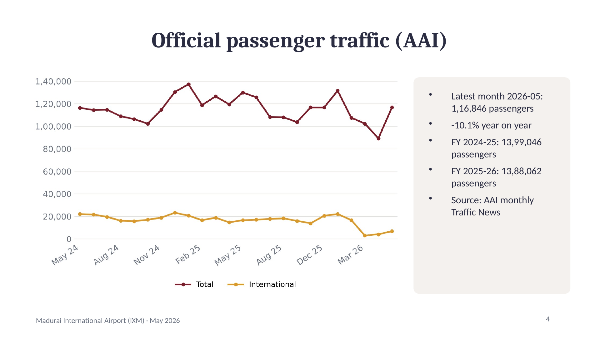
Notes:
Official passenger traffic (AAI)
Latest month 2026-05: 1,16,846 passengers
-10.1% year on year
FY 2024-25: 13,99,046 passengers
FY 2025-26: 13,88,062 passengers
Source: AAI monthly Traffic News
4

Slide 5
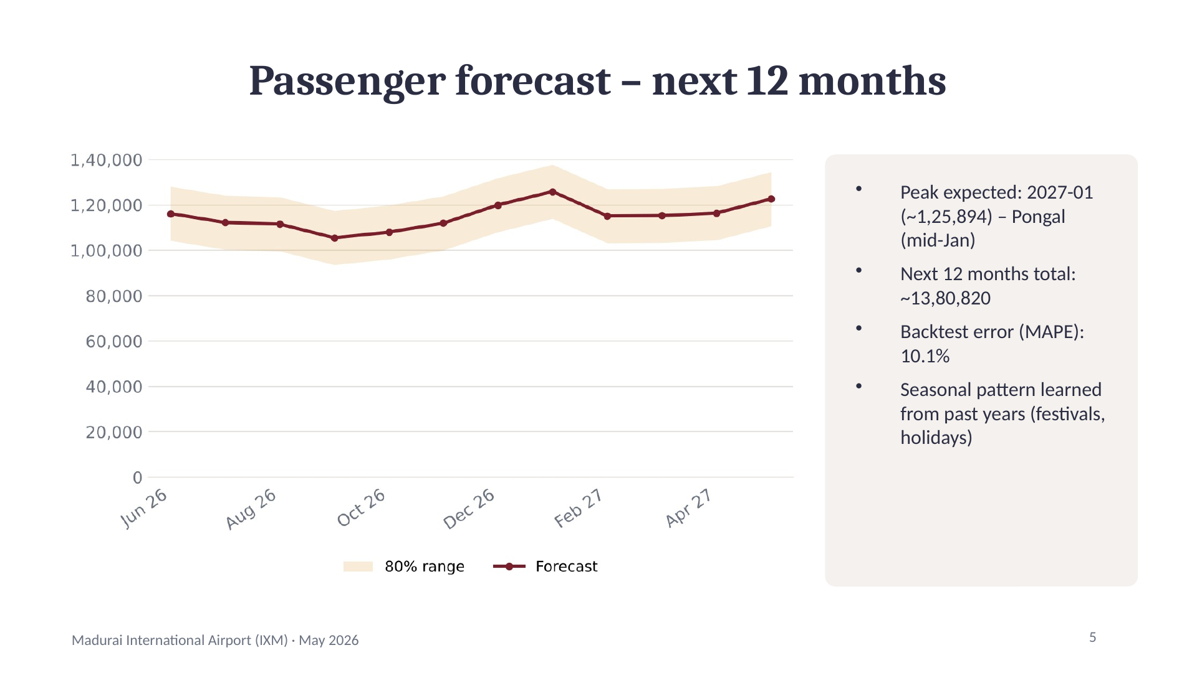
Notes:
Passenger forecast – next 12 months
Peak expected: 2027-01 (~1,25,894) – Pongal (mid-Jan)
Next 12 months total: ~13,80,820
Backtest error (MAPE): 10.1%
Seasonal pattern learned from past years (festivals, holidays)
5

Slide 6
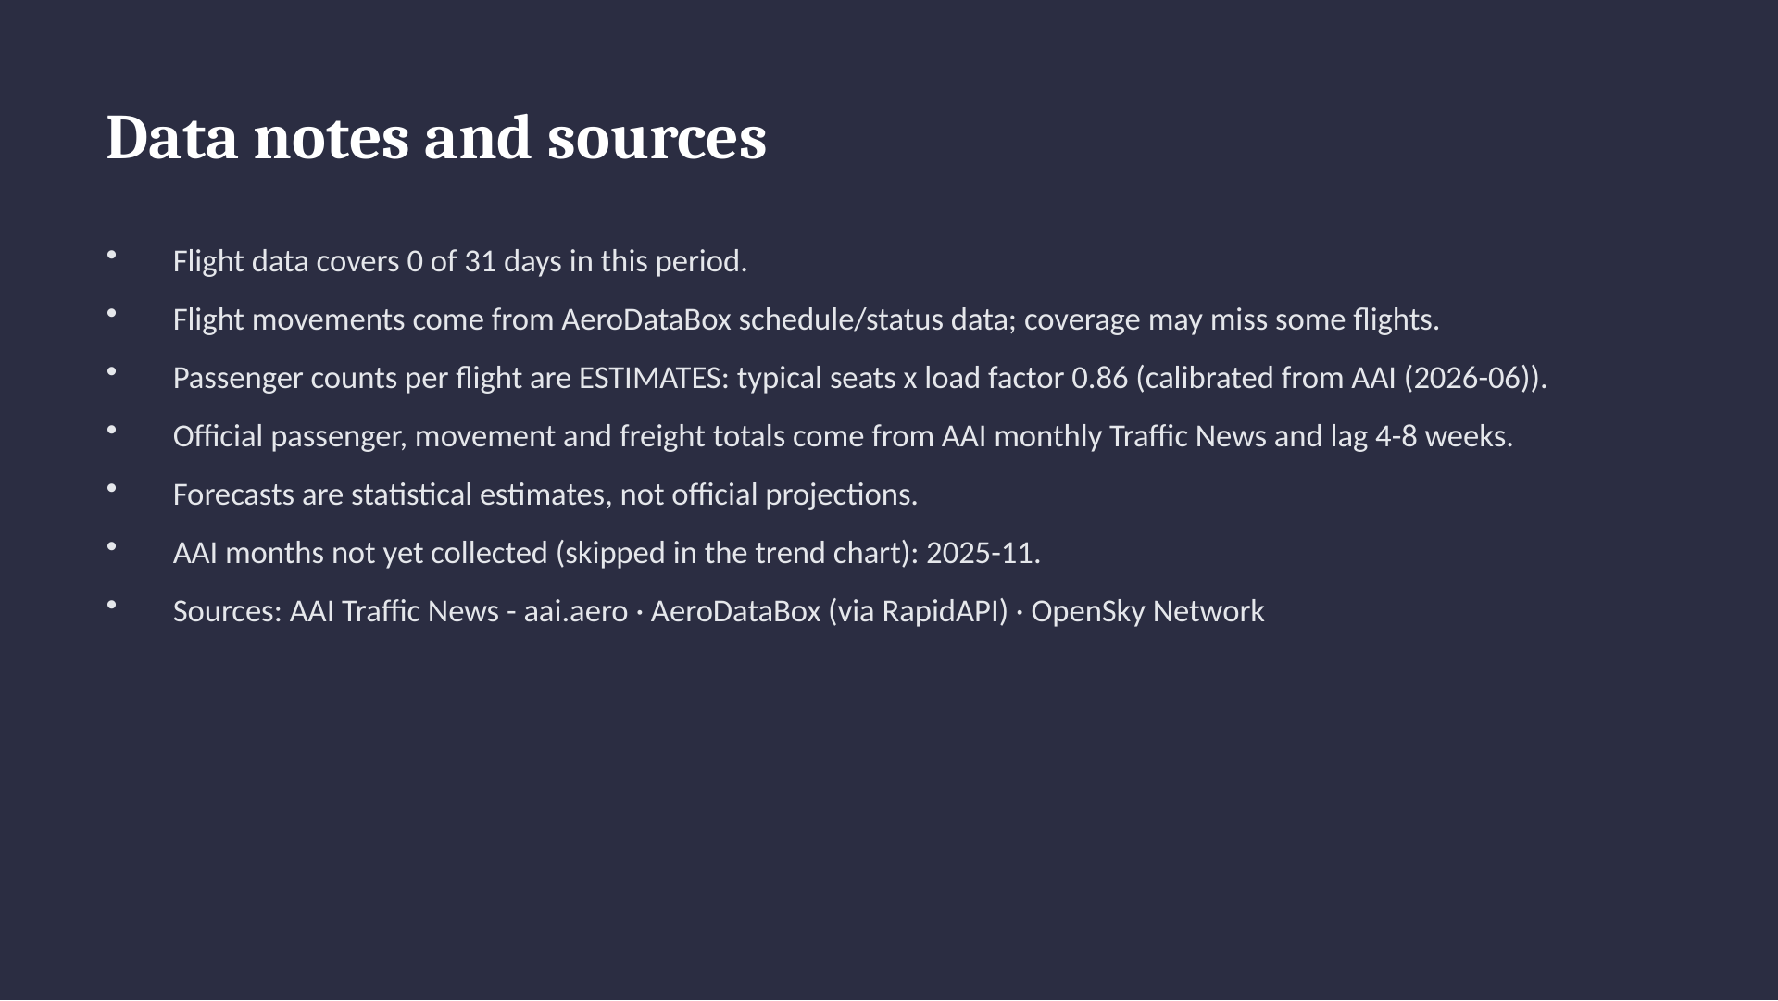
Notes:
Data notes and sources
Flight data covers 0 of 31 days in this period.
Flight movements come from AeroDataBox schedule/status data; coverage may miss some flights.
Passenger counts per flight are ESTIMATES: typical seats x load factor 0.86 (calibrated from AAI (2026-06)).
Official passenger, movement and freight totals come from AAI monthly Traffic News and lag 4-8 weeks.
Forecasts are statistical estimates, not official projections.
AAI months not yet collected (skipped in the trend chart): 2025-11.
Sources: AAI Traffic News - aai.aero · AeroDataBox (via RapidAPI) · OpenSky Network

