Slide 1
MADURAI AIRPORT · IXM / VOMD
Monthly traffic report
June 2026
Flights · passengers · airlines · routes · cargo · forecast
Generated 2026-11-01 · data: AAI, AeroDataBox, OpenSky

Slide 2
Key numbers at a glance
1,114
1,09,495
36
0
Flight movements
Est. passengers
International movements
Cargo flight movements
no comparison
no comparison
no comparison
no comparison
AAI official for 2026-06: 1,09,439 passengers · 1,128 aircraft movements · 372 t freight
Passengers per flight are estimated: typical seats × load factor 0.86 (calibrated from AAI (2026-06)). Data covers 30 of 30 days.

Slide 3
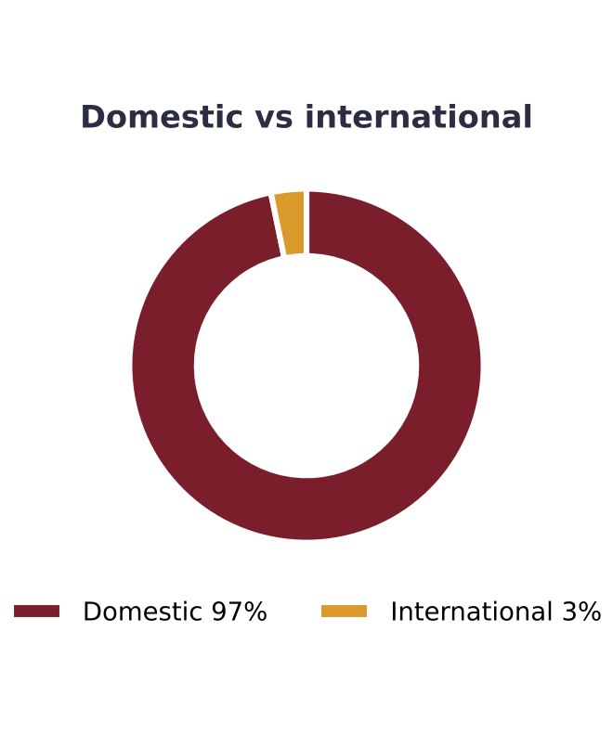
What the data says
1114 flight movements (557 arrivals, 557 departures).
IndiGo operated 91.4% of movements - the largest carrier.
Busiest route: Chennai with 540 movements (~18.0/day).
International movements: 36 (3.2% of total).
Peak hour: 08:00-08:59 local with 150 scheduled movements.
AAI official passengers for 2026-06: 109,439 (-13.0% year on year).
Domestic 104,543 and international 4,896 (4.5% of total); international -71.3% and domestic -3.8% vs a year ago.
Aircraft movements: 1,128 (about 97 passengers per movement), -10.5% vs a year ago.

Slide 4
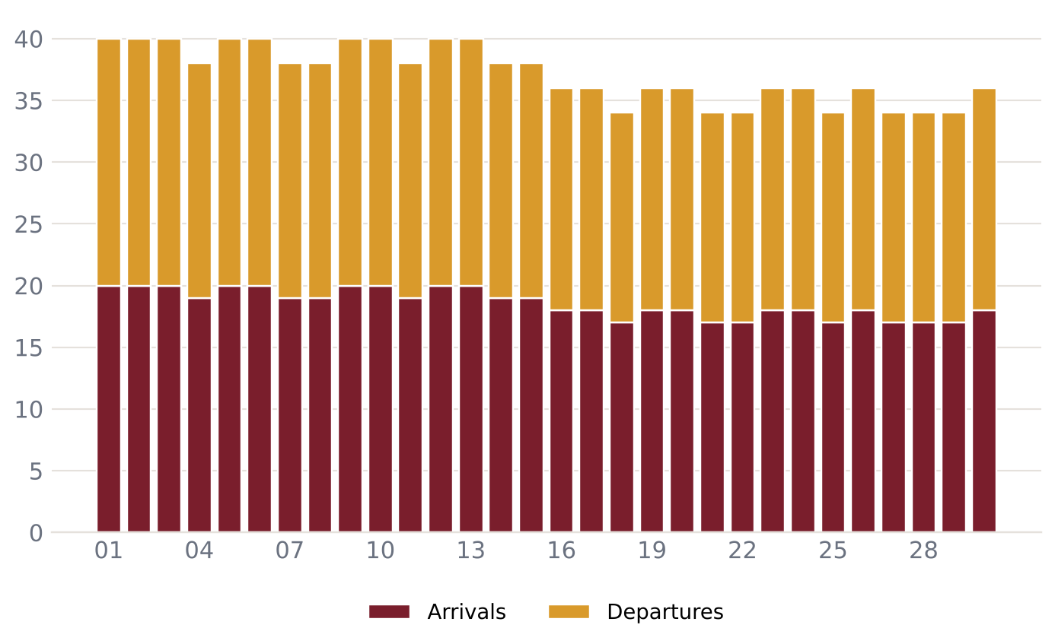
Daily flight movements – June 2026
37.1 movements per day on average
Busiest day: 2026-06-01 (40)
0 cancelled or diverted
On-time data not available

Slide 5
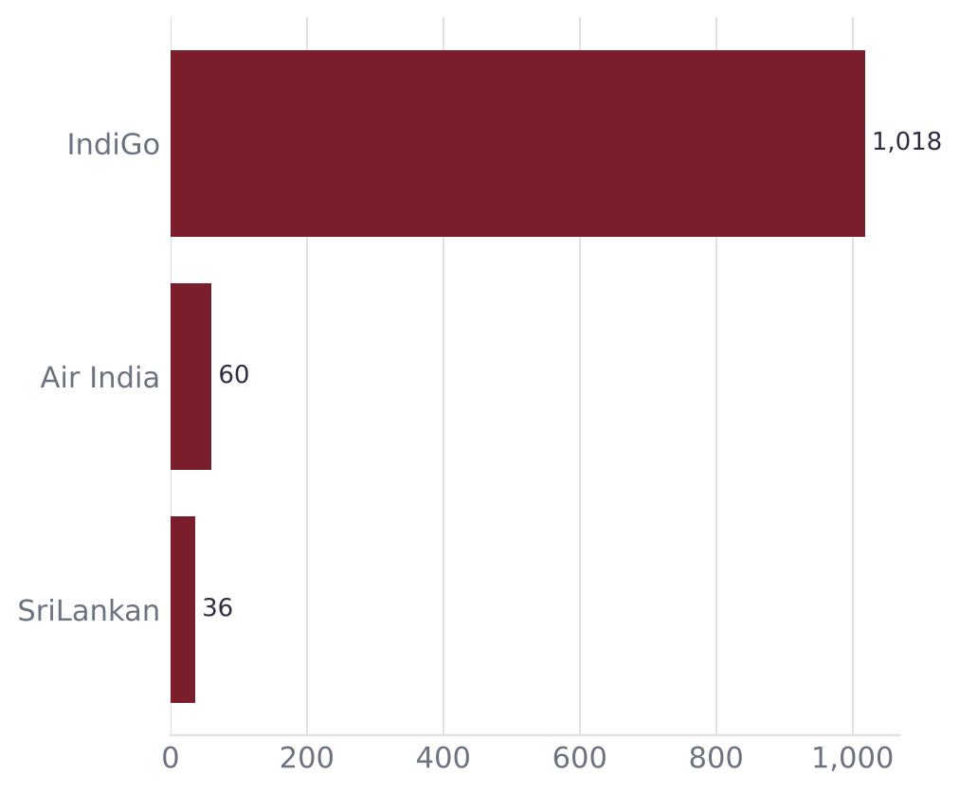
Airlines serving Madurai
Airline | Flights | Share | Est. pax
IndiGo | 1,018 | 91.4% | 94,139
Air India | 60 | 5.4% | 9,598
SriLankan | 36 | 3.2% | 5,759

Slide 6
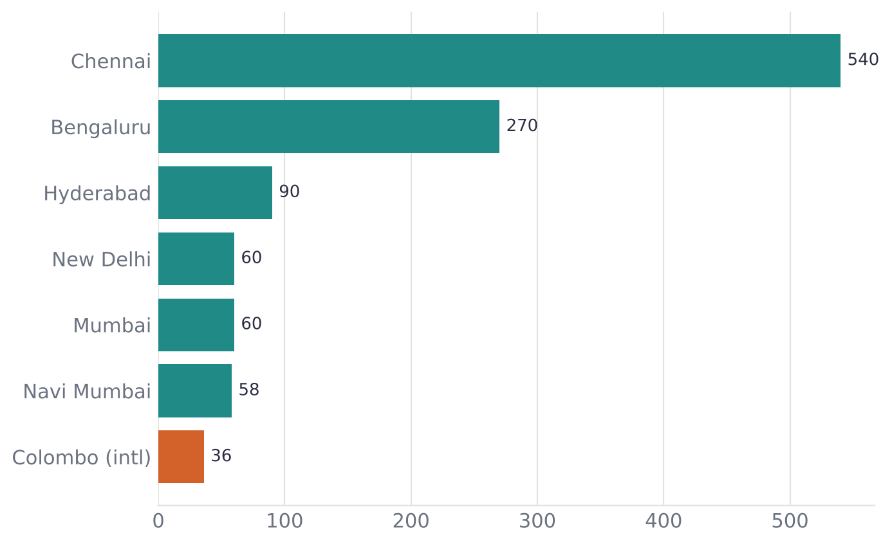
Routes and connectivity
7 destinations connected
1 international: Colombo
Top route: Chennai (~18/day)
Orange bars marked (intl) are international routes

Slide 7
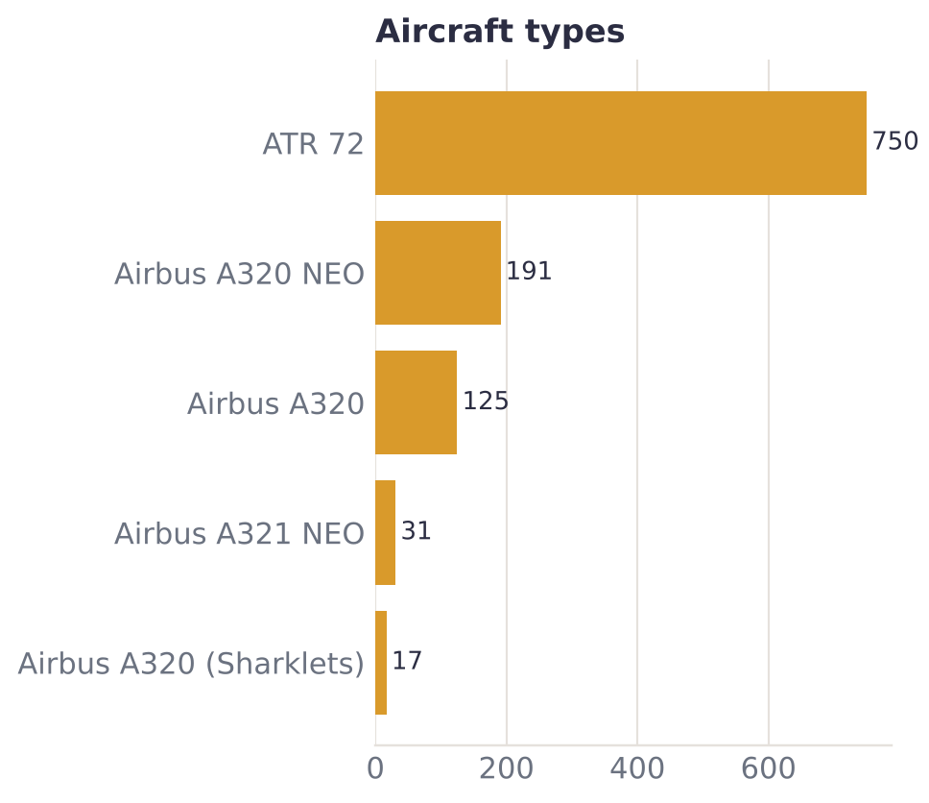
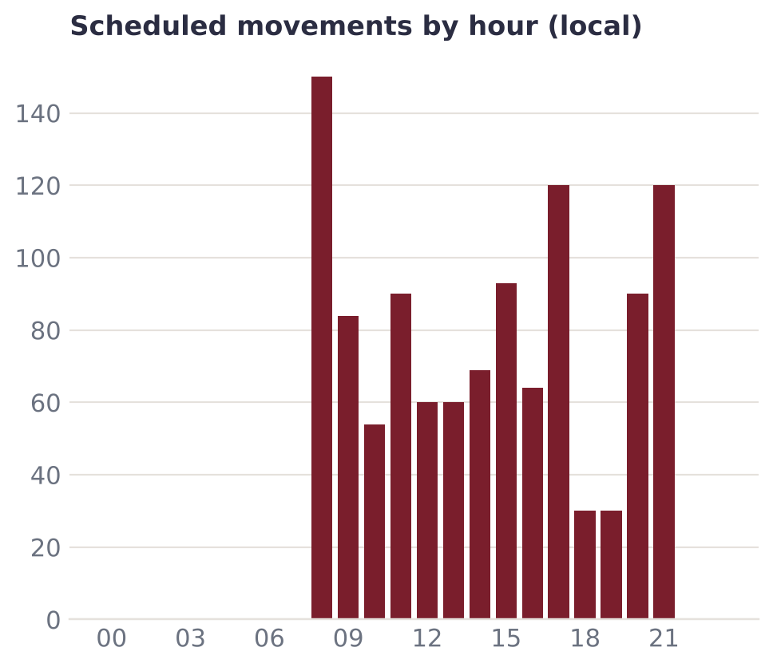
Fleet mix and peak hours

Slide 8
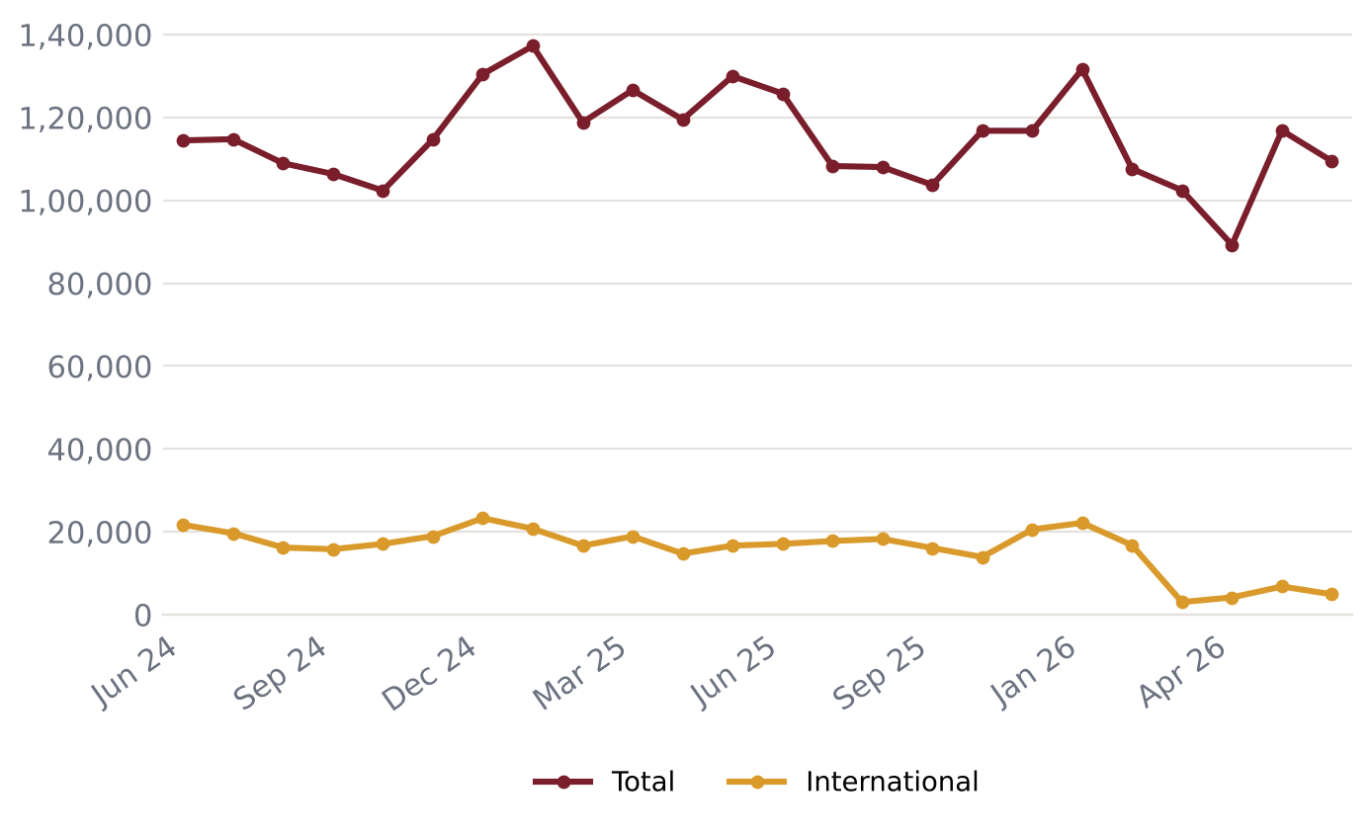
Official passenger traffic (AAI)
Latest month 2026-06: 1,09,439 passengers
-13% year on year
FY 2024-25: 13,99,046 passengers
FY 2025-26: 13,88,062 passengers
Source: AAI monthly Traffic News

Slide 9
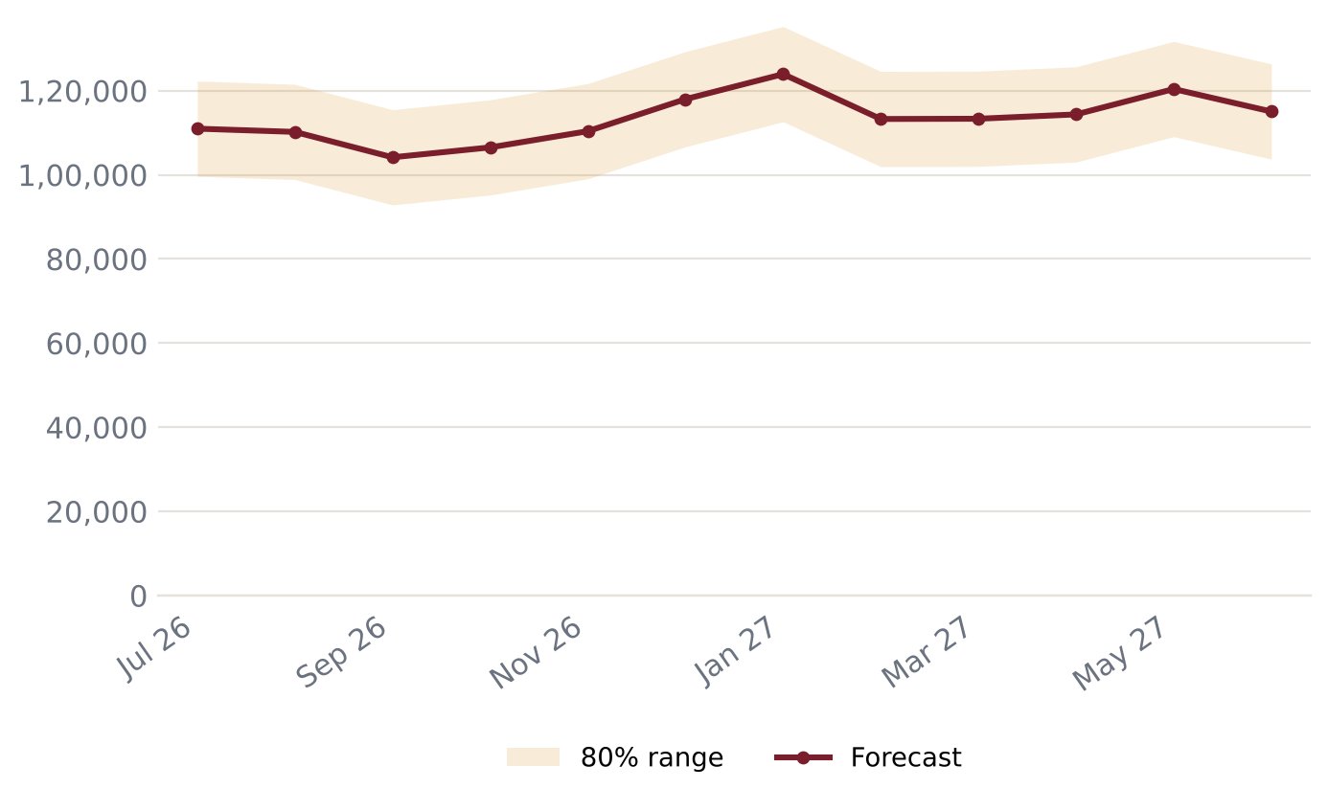
Passenger forecast – next 12 months
Peak expected: 2027-01 (~1,23,921) – Pongal (mid-Jan)
Next 12 months total: ~13,60,359
Backtest error (MAPE): 10.5%
Seasonal pattern learned from past years (festivals, holidays)

Slide 10
Data notes and sources
Flight movements come from AeroDataBox schedule/status data; coverage may miss some flights.
Passenger counts per flight are ESTIMATES: typical seats x load factor 0.86 (calibrated from AAI (2026-06)).
Official passenger, movement and freight totals come from AAI monthly Traffic News and lag 4-8 weeks.
Forecasts are statistical estimates, not official projections.
AAI months not yet collected (skipped in the trend chart): 2025-11.
Sources: AAI Traffic News - aai.aero · AeroDataBox (via RapidAPI) · OpenSky Network

