Slide 1
MADURAI AIRPORT · IXM / VOMD
Weekly traffic report
Week 43, 2026 (19 Oct - 25 Oct 2026)
Flights · passengers · airlines · routes · cargo · forecast
Generated 2026-11-01 · data: AAI, AeroDataBox, OpenSky

Slide 2
Key numbers at a glance
1,03,203
10,395
658
417
Passengers (AAI)
International passengers
Aircraft movements
Cargo (tonnes)
▼ 0.5% vs a year ago
▼ 35.4% vs a year ago
▼ 41.9% vs a year ago
▲ 32.8% vs a year ago
AAI has not yet published figures for this period; cards show the latest published month, 2026-09 (domestic 92,808 passengers). No flight records were collected for this period (flight collection was not running or the API quota was used up), so flight-level slides are omitted.
Passengers per flight are estimated: typical seats × load factor 0.86 (calibrated from AAI (2026-06)). Data covers 0 of 7 days.

Slide 3
What the data says
No flight records were collected for this period (flight collection was not running or the API quota was used up), so flight-level slides are omitted.
AAI official passengers for 2026-09: 103,203 (-0.5% year on year).
Domestic 92,808 and international 10,395 (10.1% of total); international -35.4% and domestic +5.9% vs a year ago.
Aircraft movements: 658 (about 157 passengers per movement), -41.9% vs a year ago.
Cargo handled: 417 tonnes (+32.8% year on year).
Estimated seat load factor about 86% (AAI passengers ÷ estimated seats; seat counts are typical configurations) – flights appear well filled, supporting a case for more capacity.
Forecast (AAI basis) next 3 months: 2026-10 ~105,240, 2026-11 ~109,016, 2026-12 ~116,506 passengers.

Slide 4
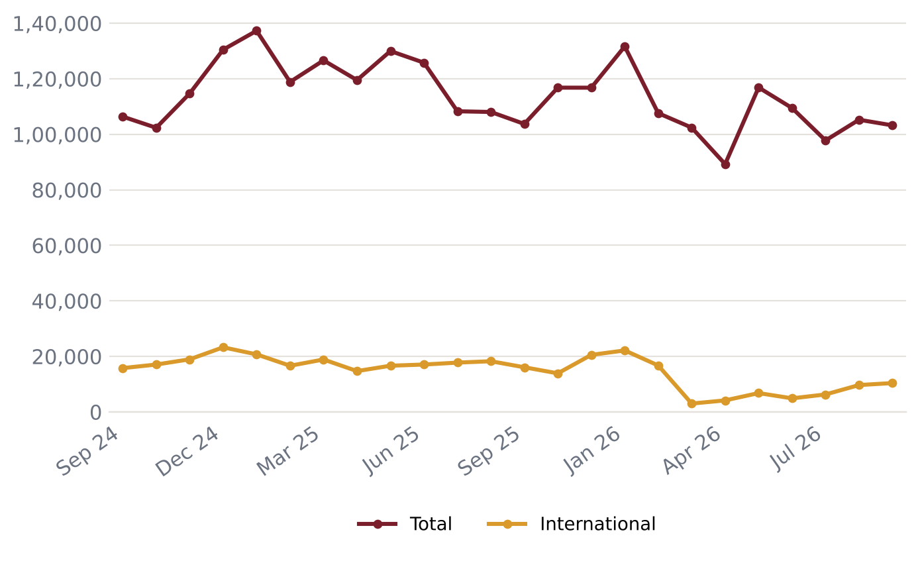
Official passenger traffic (AAI)
Latest month 2026-09: 1,03,203 passengers
-0.5% year on year
FY 2024-25: 13,99,046 passengers
FY 2025-26: 13,88,062 passengers
Source: AAI monthly Traffic News

Slide 5
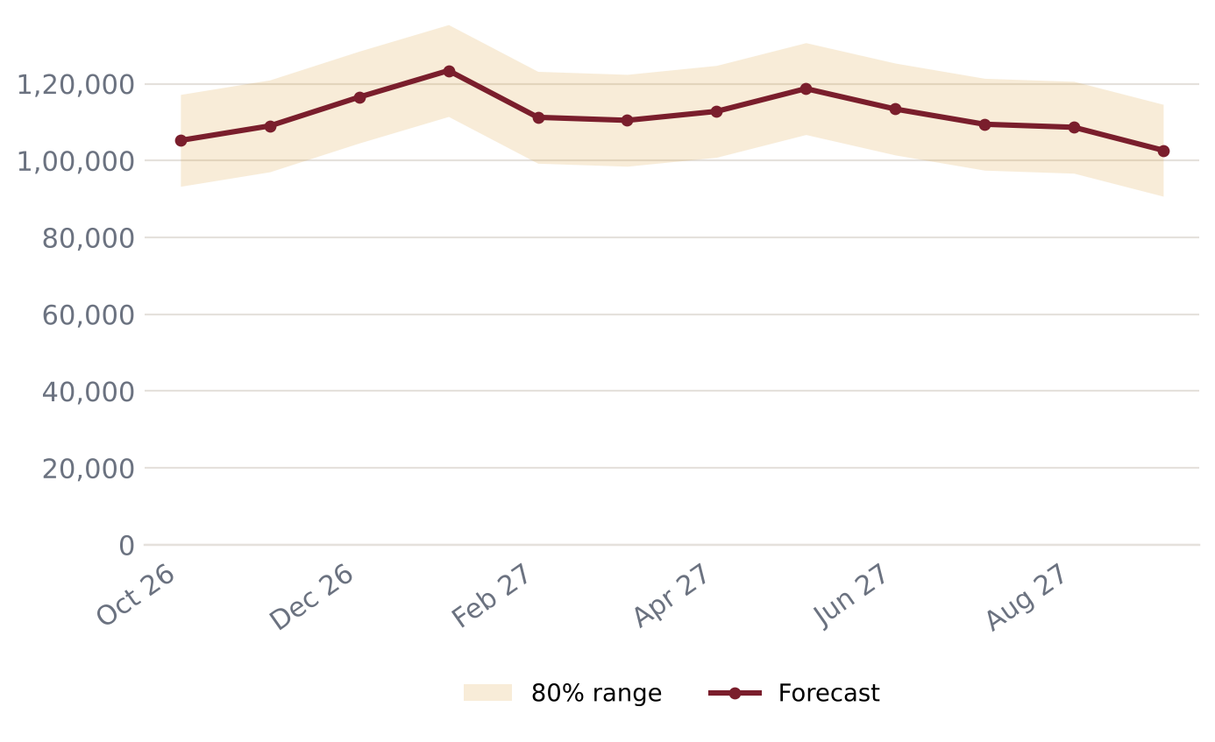
Passenger forecast – next 12 months
Peak expected: 2027-01 (~1,23,409) – Pongal (mid-Jan)
Next 12 months total: ~13,41,538
Backtest error (MAPE): 9.1%
Seasonal pattern learned from past years (festivals, holidays)

Slide 6
Data notes and sources
Flight data covers 0 of 7 days in this period.
Flight movements come from AeroDataBox schedule/status data; coverage may miss some flights.
Passenger counts per flight are ESTIMATES: typical seats x load factor 0.86 (calibrated from AAI (2026-06)).
Official passenger, movement and freight totals come from AAI monthly Traffic News and lag 4-8 weeks.
Forecasts are statistical estimates, not official projections.
AAI months not yet collected (skipped in the trend chart): 2025-11.
Sources: AAI Traffic News - aai.aero · AeroDataBox (via RapidAPI) · OpenSky Network

