Slide 1
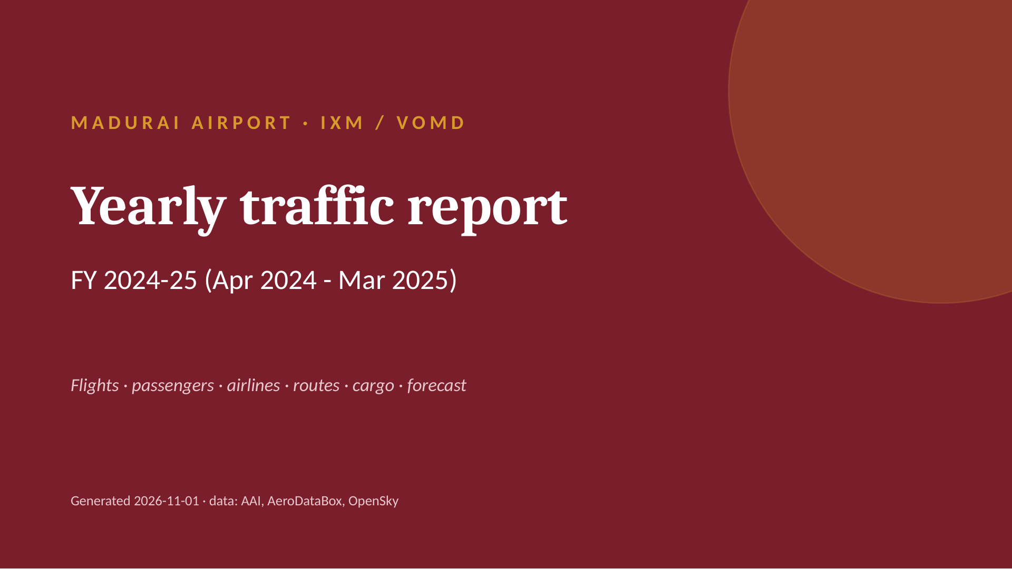
Notes:
MADURAI AIRPORT · IXM / VOMD
Yearly traffic report
FY 2024-25 (Apr 2024 - Mar 2025)
Flights · passengers · airlines · routes · cargo · forecast
Generated 2026-11-01 · data: AAI, AeroDataBox, OpenSky

Slide 2
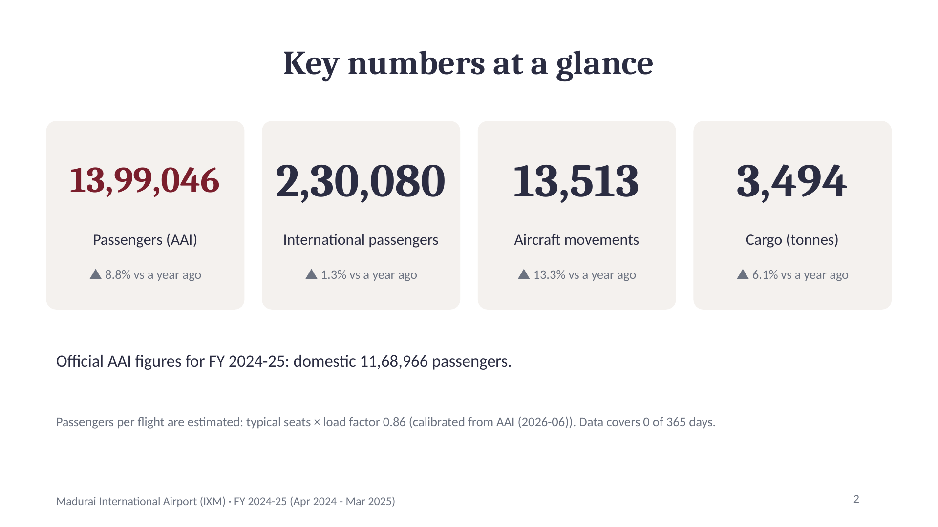
Notes:
Key numbers at a glance
13,99,046
Passengers (AAI)
▲ 8.8% vs a year ago
2,30,080
International passengers
▲ 1.3% vs a year ago
13,513
Aircraft movements
▲ 13.3% vs a year ago
3,494
Cargo (tonnes)
▲ 6.1% vs a year ago
Official AAI figures for FY 2024-25: domestic 11,68,966 passengers.
Passengers per flight are estimated: typical seats × load factor 0.86 (calibrated from AAI (2026-06)). Data covers 0 of 365 days.
2

Slide 3
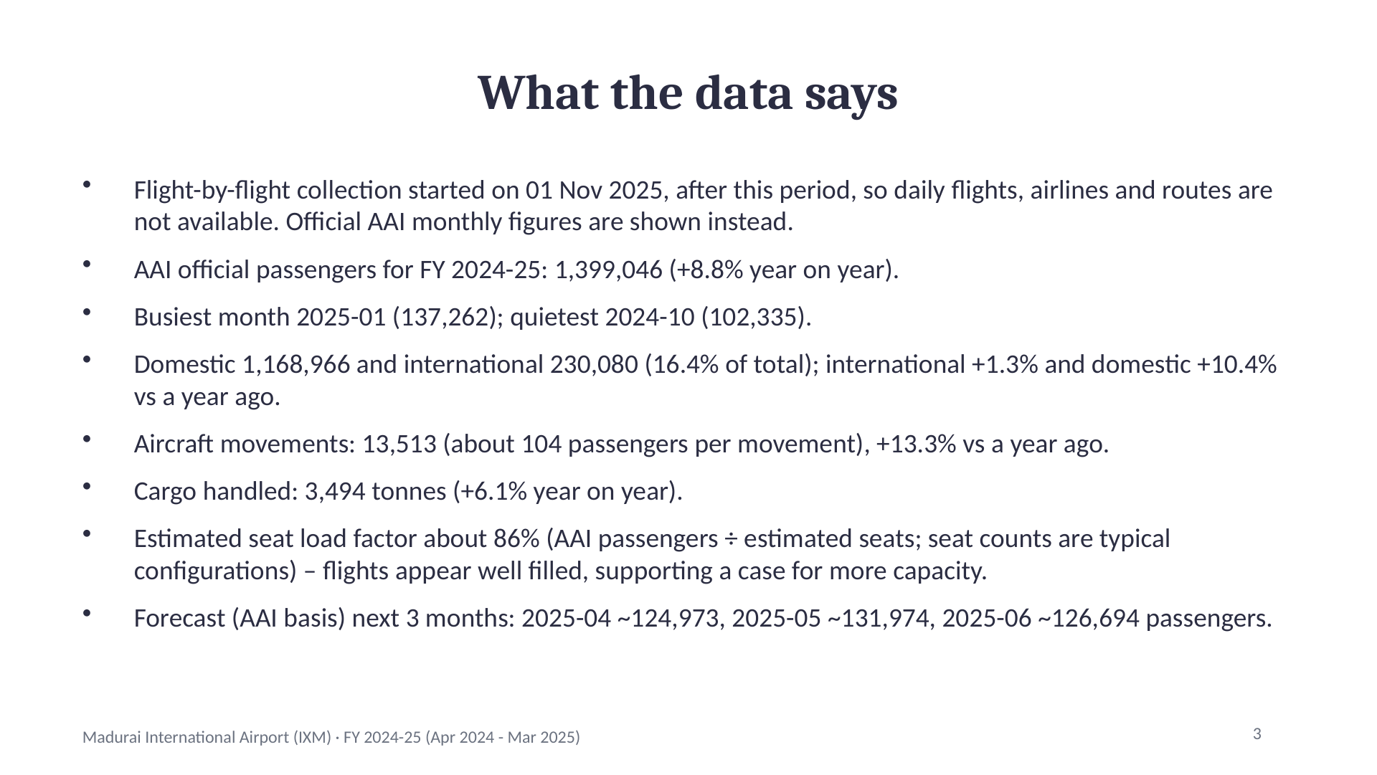
Notes:
What the data says
Flight-by-flight collection started on 01 Nov 2025, after this period, so daily flights, airlines and routes are not available. Official AAI monthly figures are shown instead.
AAI official passengers for FY 2024-25: 1,399,046 (+8.8% year on year).
Busiest month 2025-01 (137,262); quietest 2024-10 (102,335).
Domestic 1,168,966 and international 230,080 (16.4% of total); international +1.3% and domestic +10.4% vs a year ago.
Aircraft movements: 13,513 (about 104 passengers per movement), +13.3% vs a year ago.
Cargo handled: 3,494 tonnes (+6.1% year on year).
Estimated seat load factor about 86% (AAI passengers ÷ estimated seats; seat counts are typical configurations) – flights appear well filled, supporting a case for more capacity.
Forecast (AAI basis) next 3 months: 2025-04 ~124,973, 2025-05 ~131,974, 2025-06 ~126,694 passengers.
3

Slide 4
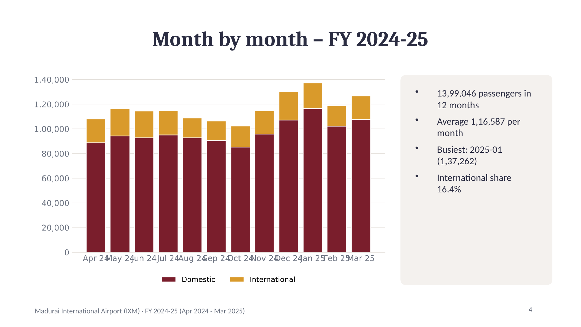
Notes:
Month by month – FY 2024-25
13,99,046 passengers in 12 months
Average 1,16,587 per month
Busiest: 2025-01 (1,37,262)
International share 16.4%
4

Slide 5
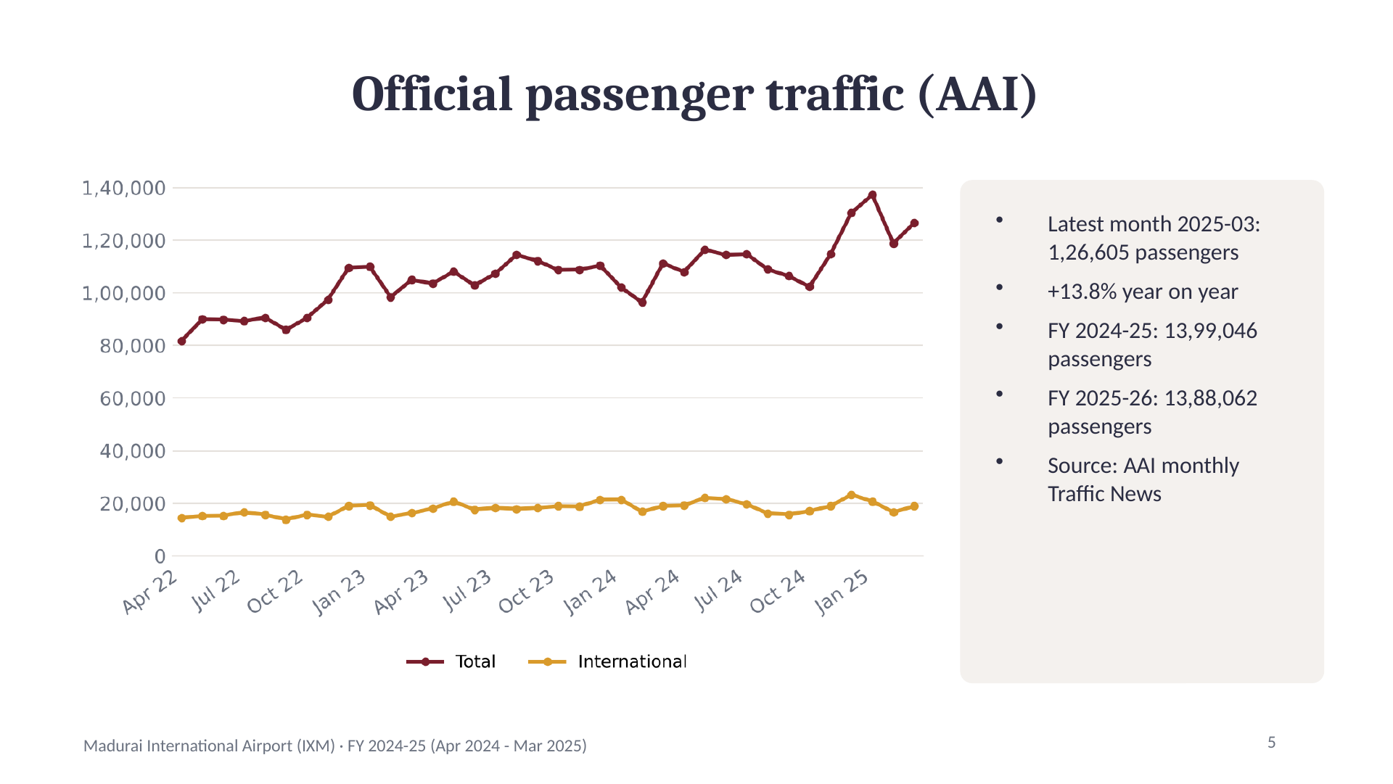
Notes:
Official passenger traffic (AAI)
Latest month 2025-03: 1,26,605 passengers
+13.8% year on year
FY 2024-25: 13,99,046 passengers
FY 2025-26: 13,88,062 passengers
Source: AAI monthly Traffic News
5

Slide 6
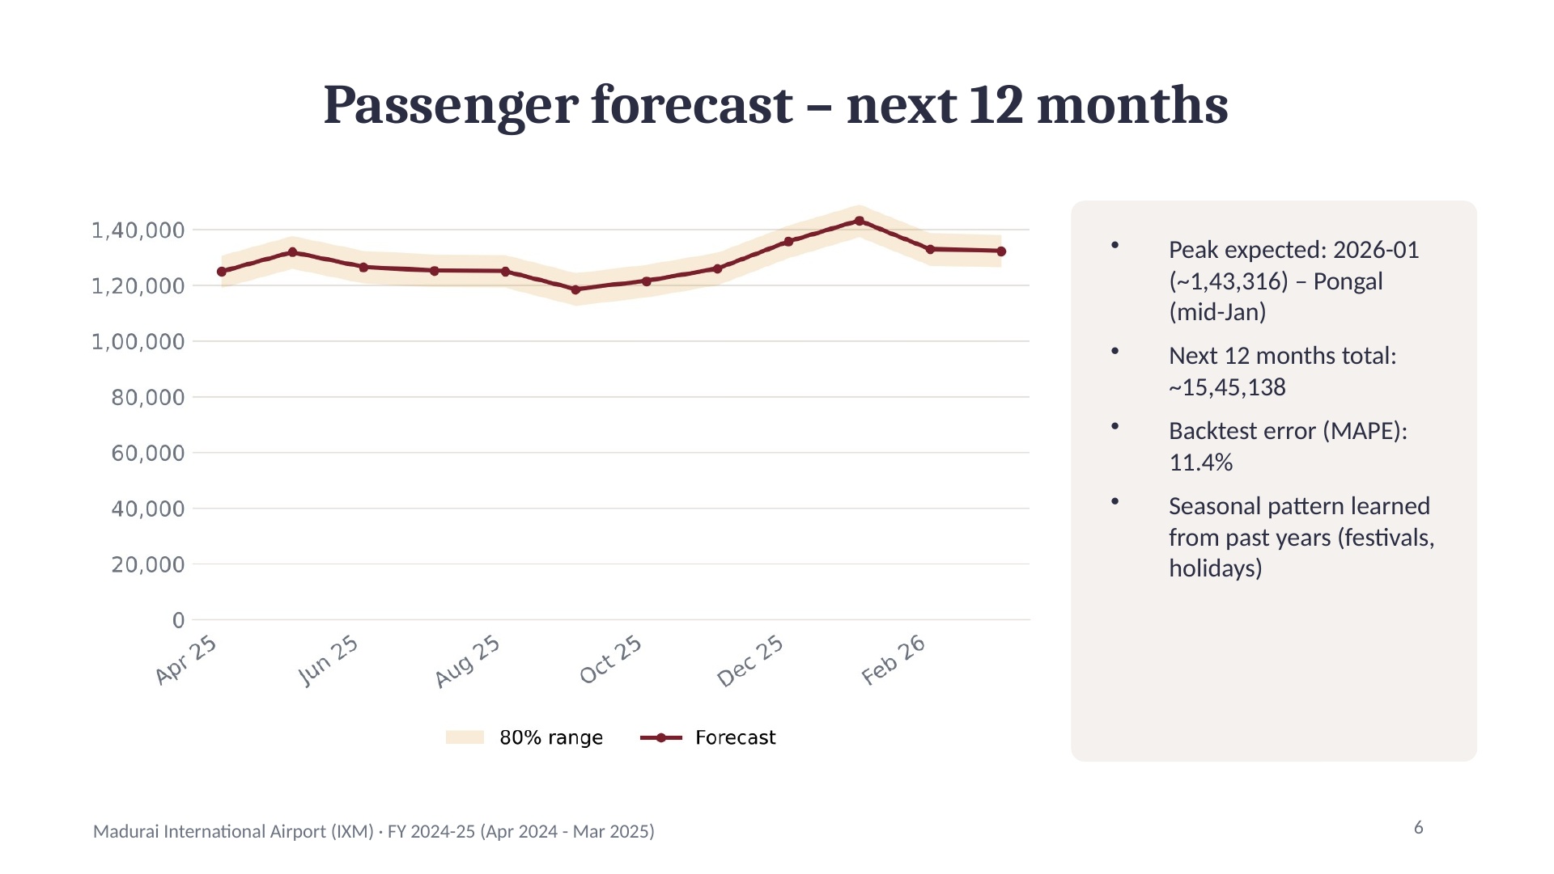
Notes:
Passenger forecast – next 12 months
Peak expected: 2026-01 (~1,43,316) – Pongal (mid-Jan)
Next 12 months total: ~15,45,138
Backtest error (MAPE): 11.4%
Seasonal pattern learned from past years (festivals, holidays)
6

Slide 7
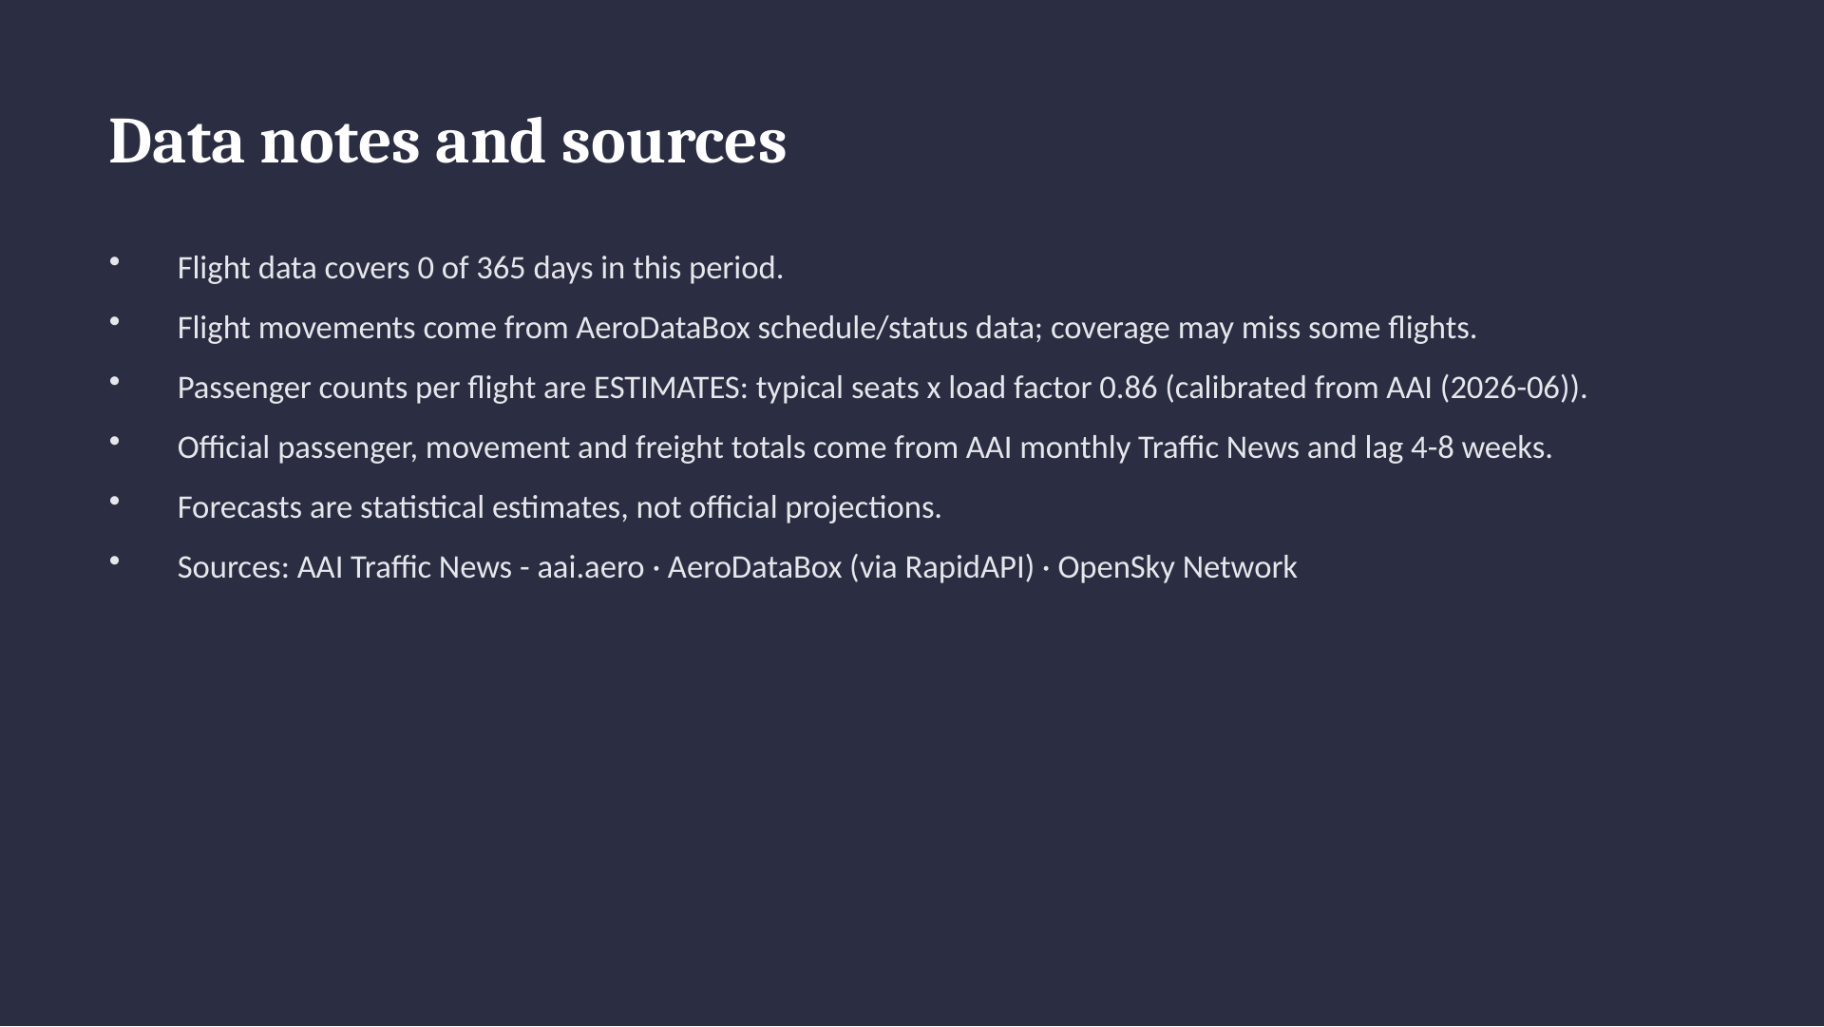
Notes:
Data notes and sources
Flight data covers 0 of 365 days in this period.
Flight movements come from AeroDataBox schedule/status data; coverage may miss some flights.
Passenger counts per flight are ESTIMATES: typical seats x load factor 0.86 (calibrated from AAI (2026-06)).
Official passenger, movement and freight totals come from AAI monthly Traffic News and lag 4-8 weeks.
Forecasts are statistical estimates, not official projections.
Sources: AAI Traffic News - aai.aero · AeroDataBox (via RapidAPI) · OpenSky Network

