Slide 1
MADURAI AIRPORT · IXM / VOMD
Yearly traffic report
FY 2025-26 (Apr 2025 - Mar 2026)
Flights · passengers · airlines · routes · cargo · forecast
Generated 2026-11-01 · data: AAI, AeroDataBox, OpenSky

Slide 2
Key numbers at a glance
12,70,412
1,76,863
12,020
4,070
Passengers (AAI)
International passengers
Aircraft movements
Cargo (tonnes)
▼ 1.1% vs a year ago (11 mo.)
▼ 16.2% vs a year ago (11 mo.)
▼ 3% vs a year ago (11 mo.)
▲ 27.2% vs a year ago (11 mo.)
Official AAI figures for FY 2025-26: domestic 10,93,549 passengers (11 of 12 months; 2025-11 not published). Flight-level detail covers 62 of 365 days.
Passengers per flight are estimated: typical seats × load factor 0.86 (calibrated from AAI (2026-06)). Data covers 62 of 365 days.

Slide 3
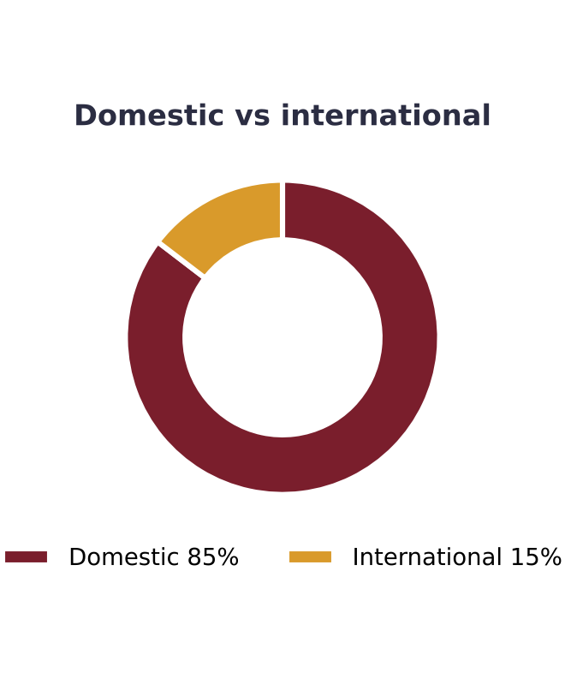
What the data says
1904 flight movements (953 arrivals, 951 departures).
IndiGo operated 81.5% of movements - the largest carrier.
Busiest route: Chennai with 822 movements (~13.26/day).
International movements: 278 (14.6% of total).
Peak hour: 13:00-13:59 local with 274 scheduled movements.
6 flights were cancelled or diverted.
AAI data covers 11 of 12 months (missing: 2025-11); totals below are for available months.
AAI official passengers for FY 2025-26: 1,270,412 (-1.1% year on year).

Slide 4
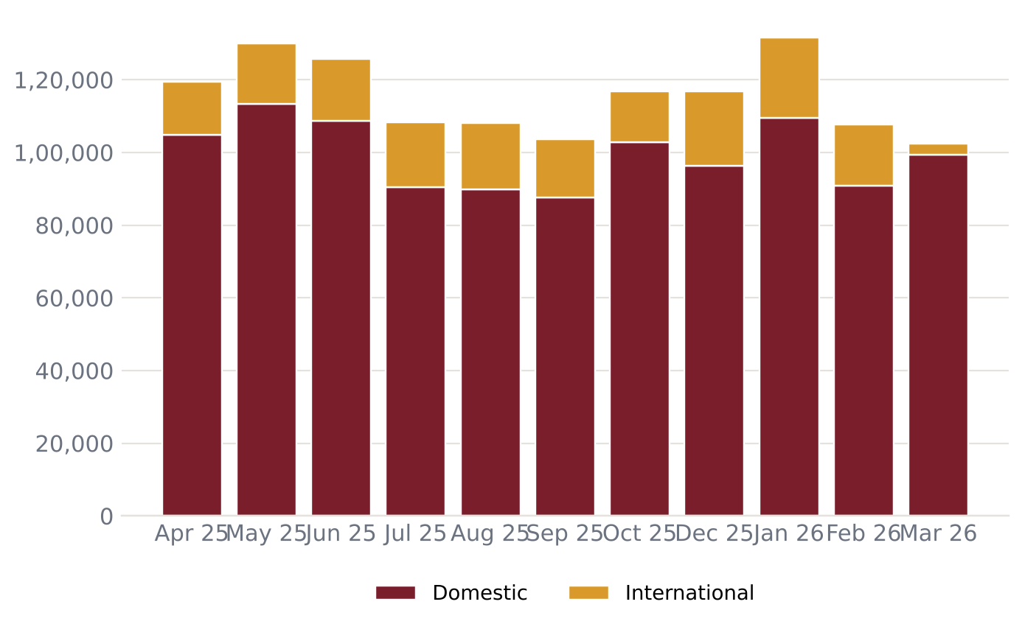
Month by month – FY 2025-26
12,70,412 passengers in 11 months
Average 1,15,492 per month
Busiest: 2026-01 (1,31,627)
International share 13.9%
Not published by AAI: 2025-11

Slide 5
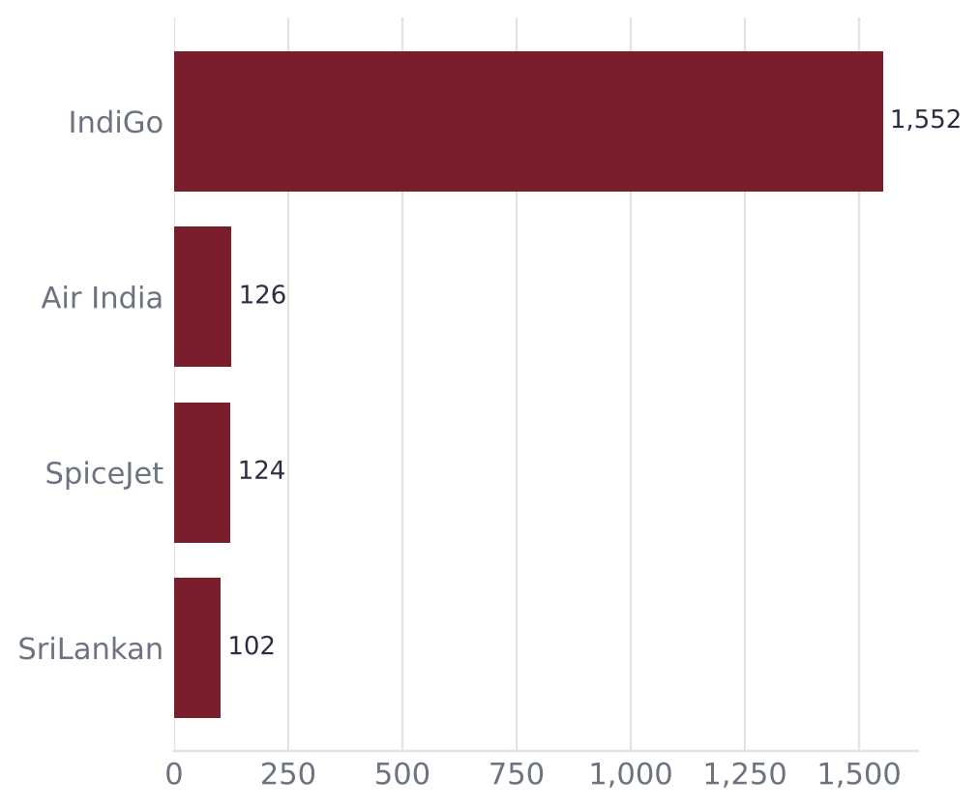
Airlines serving Madurai
Airline | Flights | Share | Est. pax
IndiGo | 1,552 | 81.5% | 1,68,412
Air India | 126 | 6.6% | 20,248
SpiceJet | 124 | 6.5% | 20,116
SriLankan | 102 | 5.4% | 16,347

Slide 6
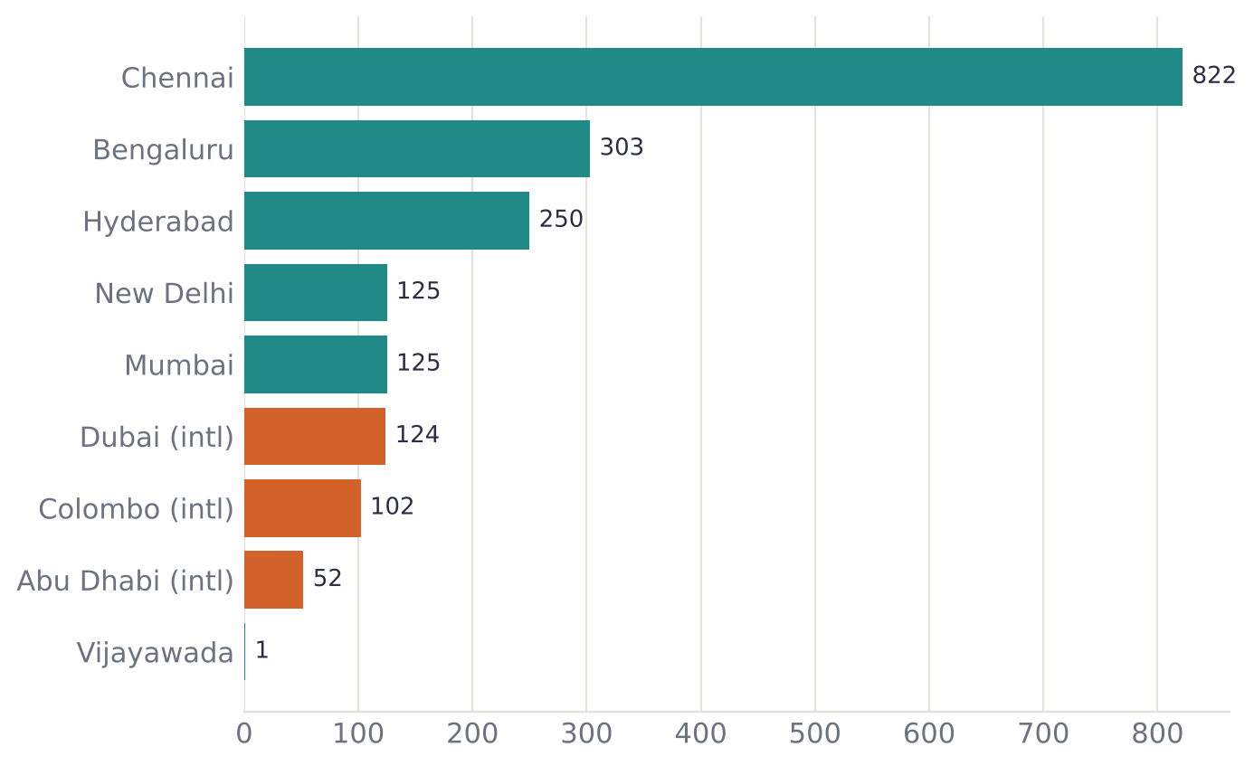
Routes and connectivity
9 destinations connected
3 international: Dubai, Colombo, Abu Dhabi
Top route: Chennai (~13.26/day)
Orange bars marked (intl) are international routes

Slide 7
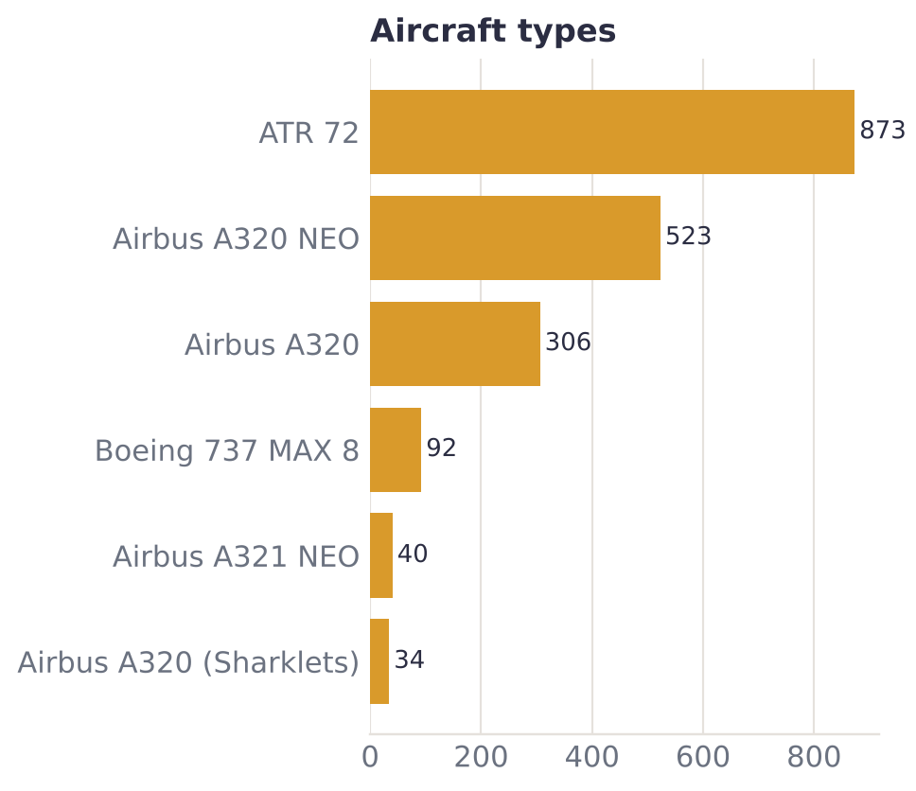
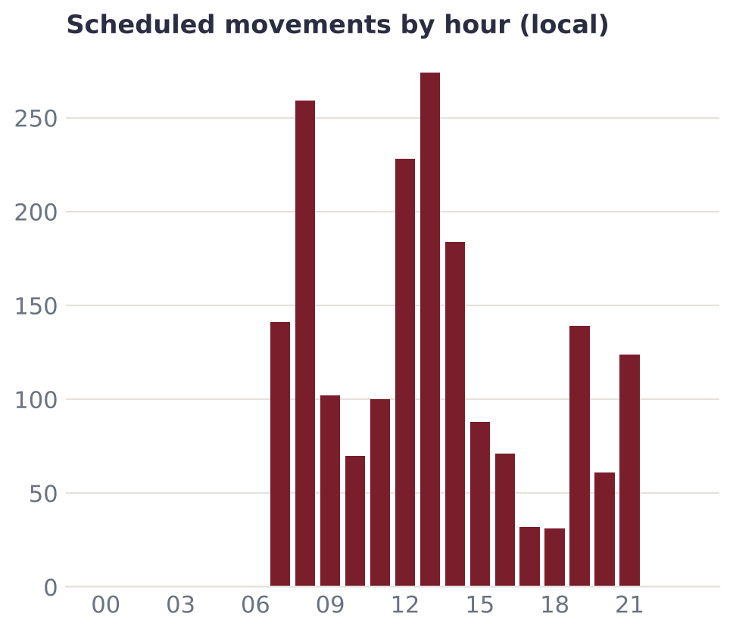
Fleet mix and peak hours

Slide 8
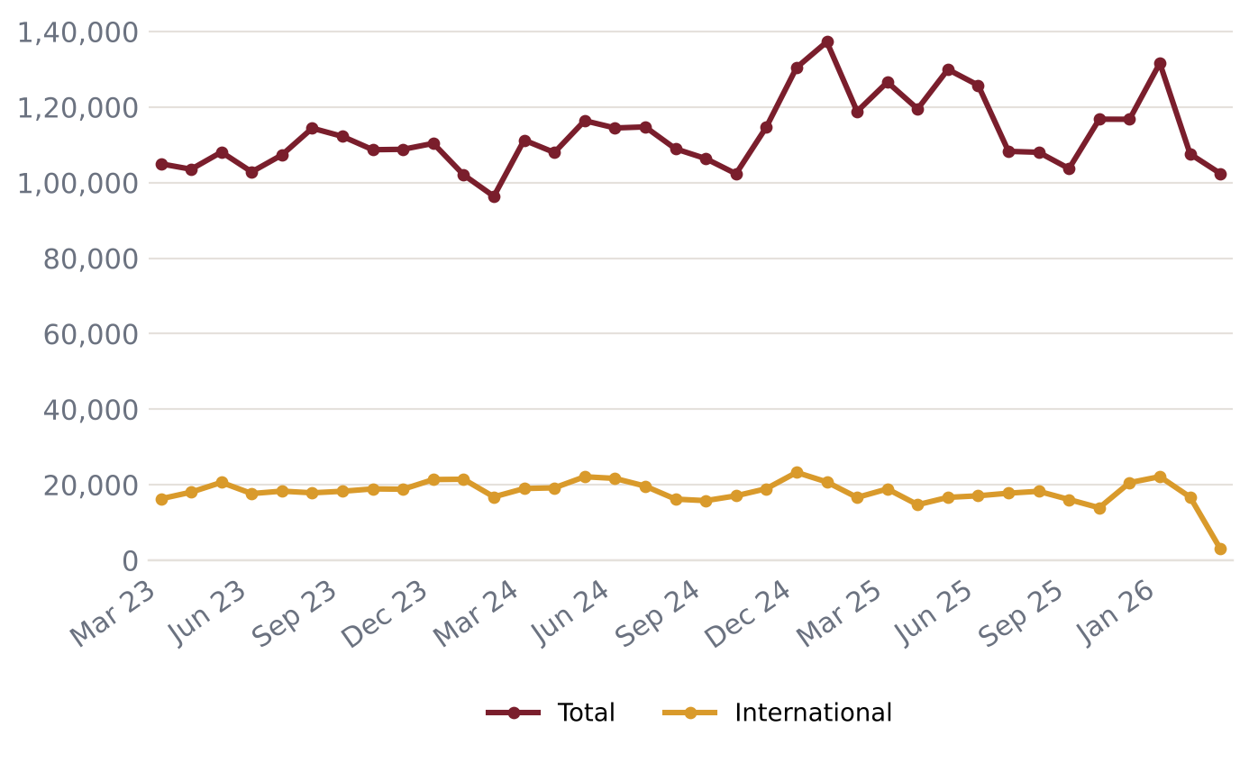
Official passenger traffic (AAI)
Latest month 2026-03: 1,02,396 passengers
-19.1% year on year
FY 2024-25: 13,99,046 passengers
FY 2025-26: 13,88,062 passengers
Source: AAI monthly Traffic News

Slide 9
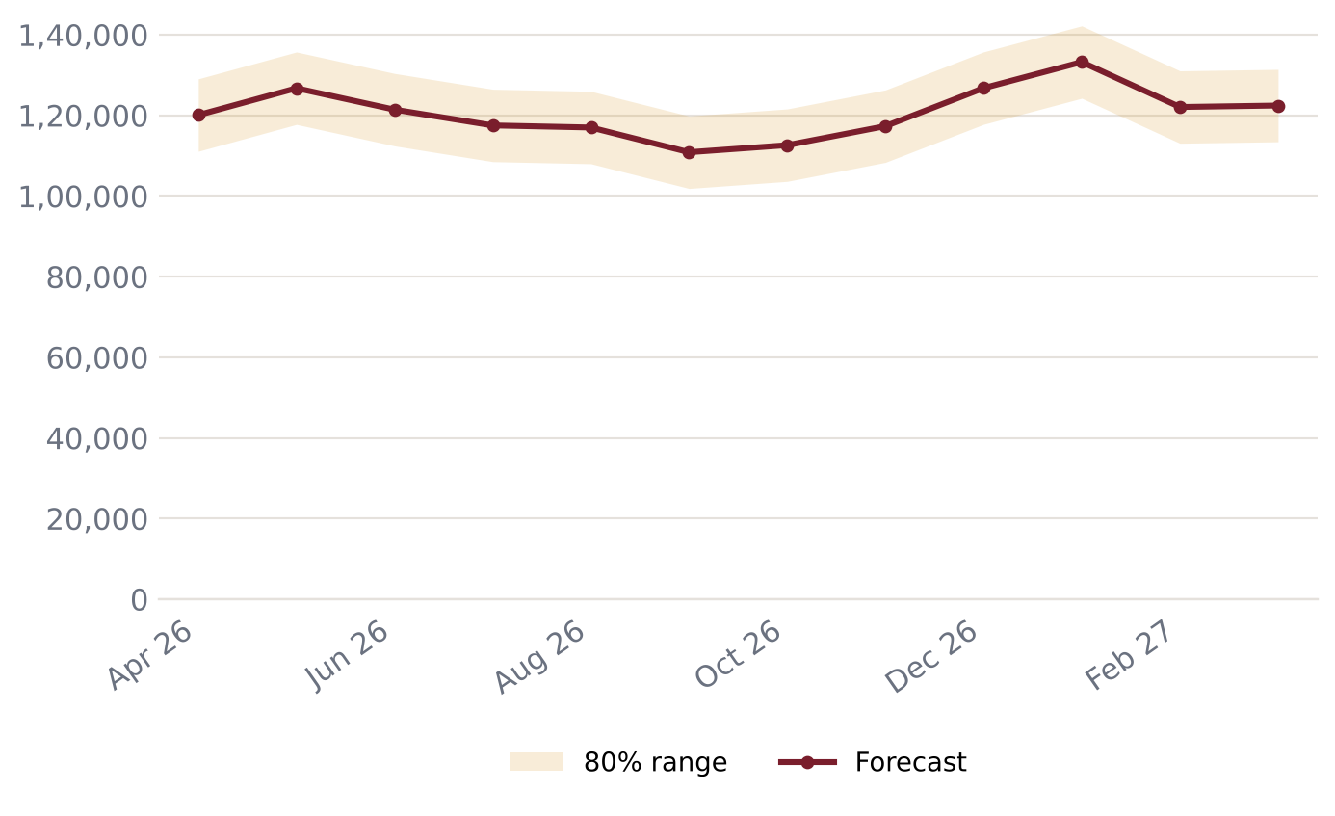
Passenger forecast – next 12 months
Peak expected: 2027-01 (~1,33,244) – Pongal (mid-Jan)
Next 12 months total: ~14,48,127
Backtest error (MAPE): 7.2%
Seasonal pattern learned from past years (festivals, holidays)

Slide 10
Data notes and sources
Flight data covers 62 of 365 days in this period.
Flight movements come from AeroDataBox schedule/status data; coverage may miss some flights.
Passenger counts per flight are ESTIMATES: typical seats x load factor 0.86 (calibrated from AAI (2026-06)).
Official passenger, movement and freight totals come from AAI monthly Traffic News and lag 4-8 weeks.
Forecasts are statistical estimates, not official projections.
AAI months not yet collected (skipped in the trend chart): 2025-11.
Sources: AAI Traffic News - aai.aero · AeroDataBox (via RapidAPI) · OpenSky Network

