Slide 1
MADURAI AIRPORT · IXM / VOMD
Ten years of traffic – and how Madurai can catch up
Review of FY 2016-17 to FY 2026-27 (to Sep 26) with recommendations for authorities and airlines
Prepared by Arun Prasath J · Data: AAI (124 months), AeroDataBox (95 days of flights) · 2026-11-01

Slide 2
Executive summary
13.9 lakh
+21.9%
#32 → #40
−59,923
passengers in FY 2025-26
all-India growth, same period
Madurai's national rank
international passengers lost
-8.7% vs FY18-19 peak
FY18-19 to FY25-26
by passengers
Mar–Jul 2026 vs 2025 (Gulf suspension)
Madurai is the only airport in its peer group still below its pre-COVID peak; Trichy grew +40.7% and now carries 1.6× Madurai's traffic.
Had Madurai grown like India since FY18-19 it would handle about 18.5 lakh passengers a year – roughly 4.6 lakh more than today.
The data point to airline capacity and connectivity, not the terminal, as the constraint: about 48% of the 2.9 million annual capacity is used and the busiest hour averages only 4.4–5.0 movements a day.
Priorities: restore and widen Gulf links, use the new international status to bring in foreign airlines, upgauge Chennai/Bengaluru from turboprops, use night slots, attract a second airline.

Slide 3
What this analysis is built on – and how it was checked
AAI official traffic
AeroDataBox flight records
Published context
124 monthly reports, Apr 16 – Sep 26
Passengers (domestic/international), aircraft movements, cargo tonnes
8 complete financial years (2017-18 to 2024-25) add up exactly to AAI's published annual totals
Not published / not found: 2016-10, 2025-11
95 days of individual flights (airline, route, aircraft, times)
Jan 26: 776 flights vs 801 AAI movements (96.9%)
Jun 26: 1,114 flights vs 1,128 AAI movements (98.8%)
Only months with complete daily data are used for network analysis
Peer airports & all-India totals: AAI figures via Wikipedia
Infrastructure & policy: Ministry replies, news reports (dated, listed in the Excel)
Scenarios are what-if paths, not forecasts

Slide 4
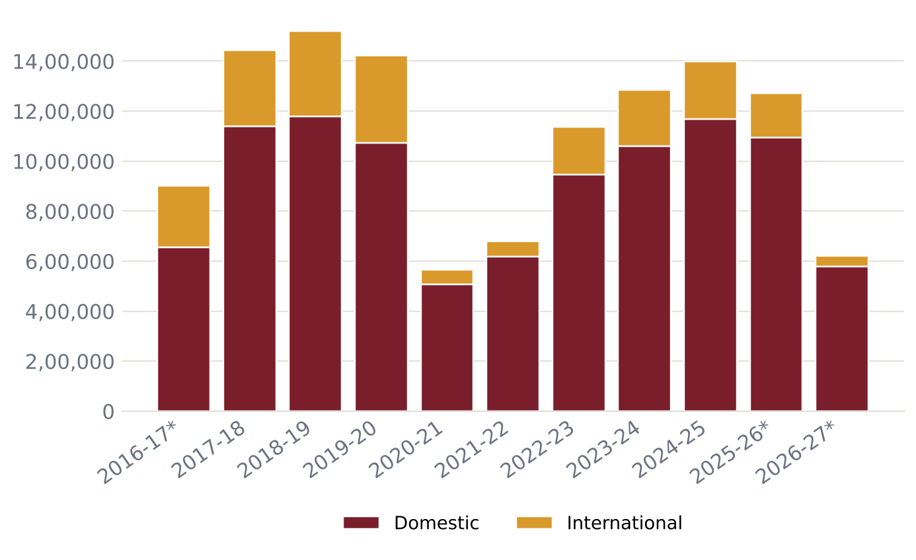
Ten years of passengers: a pre-COVID peak not yet regained
Peak: 15,20,016 in FY 2018-19
COVID low: 5,65,539 in FY 2020-21 (37% of peak)
Best since: 13,99,046 in FY 2024-25 (92% of peak)
FY 2025-26: 13,88,062 (published total; −0.8%)
* partial year: FY16-17 (Oct 2016 missing), FY25-26 (Nov 2025 missing), FY26-27 (Apr–Sep)
Source: AAI monthly Traffic News (aai.aero), compiled by the IXM Pulse tracker

Slide 5
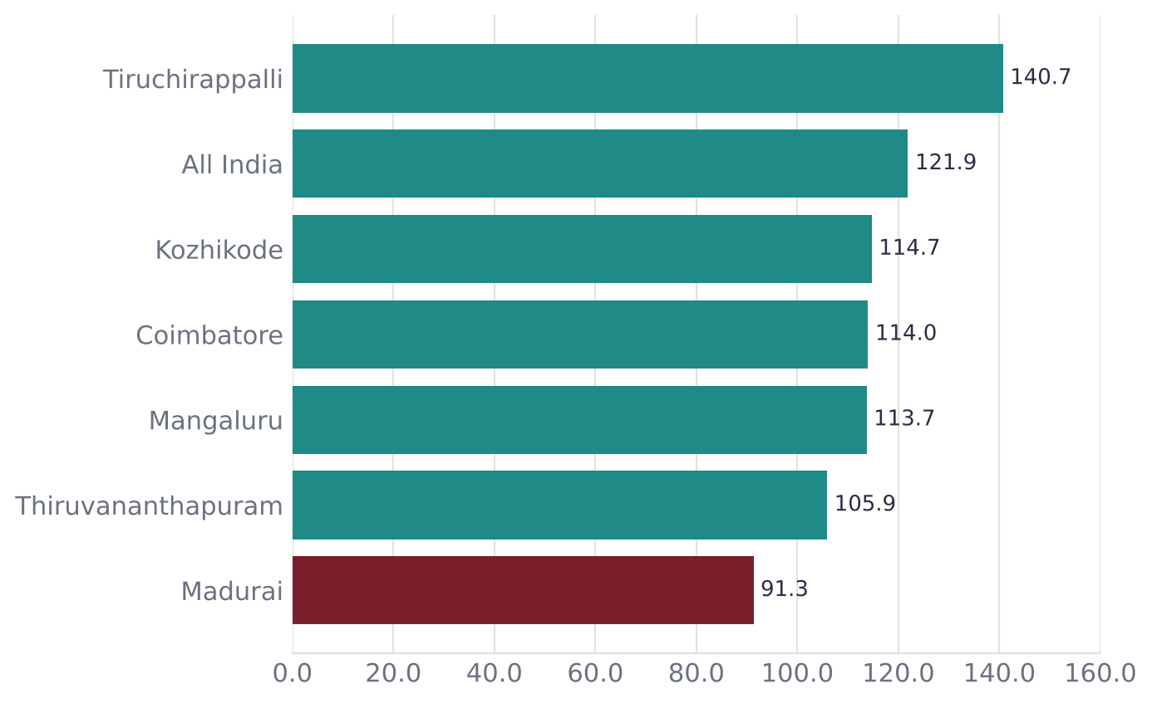
Peers grew past pre-COVID levels – Madurai did not
Index: FY 2025-26 passengers as % of FY 2018-19 (last full pre-COVID year)
Madurai 91.3 – the only one below 100
All India 121.9; Trichy 140.7
Madurai's annual change: -1.29% a year vs India +2.87%
Source: AAI annual figures as tabulated on Wikipedia 'List of busiest airports in India' (verify before quoting)

Slide 6
Falling down the national table
Airport | FY 2018-19 | FY 2025-26 | Change | Rank 18-19 | Rank 25-26
Thiruvananthapuram (TRV) | 44,34,459 | 46,94,206 | +5.9% | #14 | #16
Kozhikode (CCJ) | 33,60,847 | 38,55,618 | +14.7% | #17 | #21
Coimbatore (CJB) | 30,00,882 | 34,20,745 | +14.0% | #19 | #23
Mangaluru (IXE) | 22,40,664 | 25,48,088 | +13.7% | #27 | #30
Tiruchirappalli (TRZ) | 15,78,831 | 22,21,024 | +40.7% | #31 | #31
Madurai (IXM) | 15,20,016 | 13,88,062 | -8.7% | #32 | #40
In FY 2018-19 Madurai (15,20,016) and Trichy (15,78,831) were neck and neck; by FY 2025-26 Trichy handled 8,32,962 more passengers a year.
Source: AAI annual figures as tabulated on Wikipedia 'List of busiest airports in India' (verify before quoting)

Slide 7
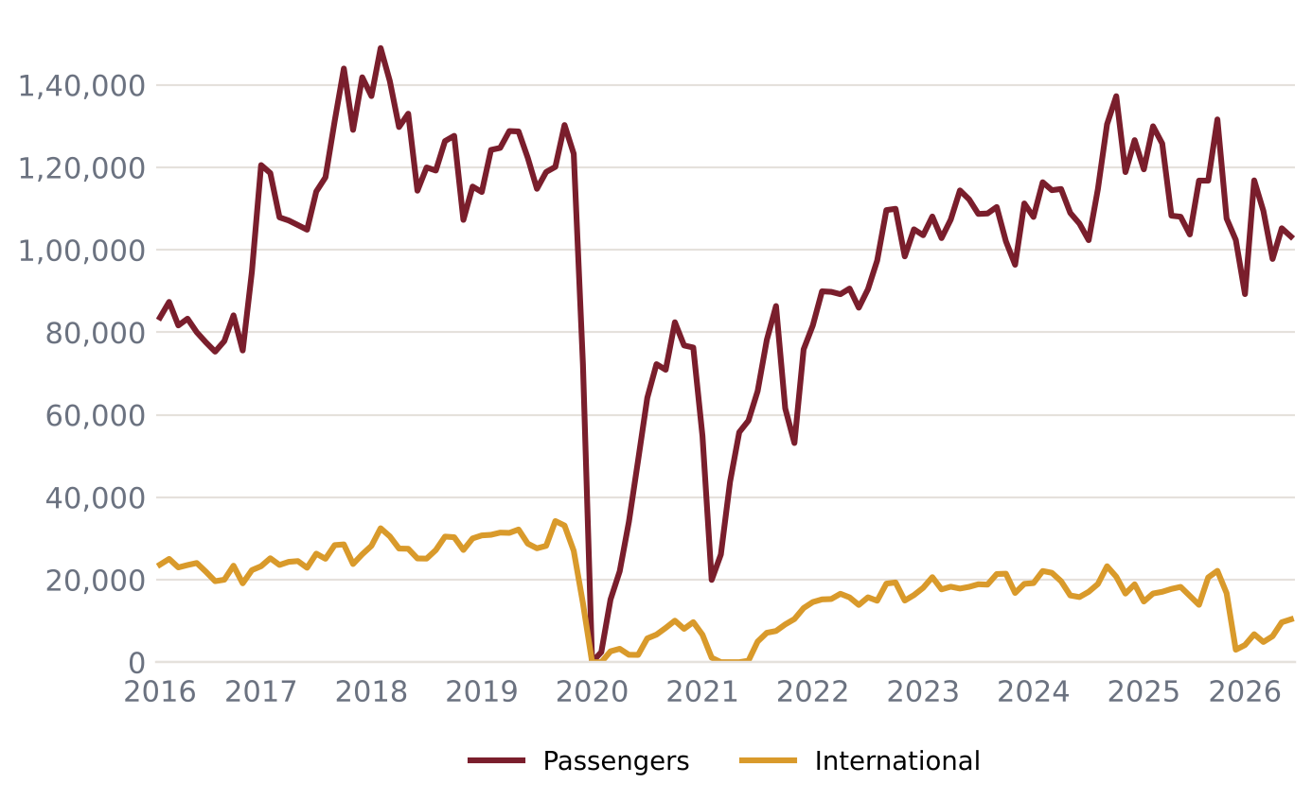
Month by month since 2016
Busiest month on record: May 18 (1,48,929)
Mar 2020 – mid 2022: COVID collapse and slow recovery
From Mar 2026: Gulf flights suspended – international traffic drops to a fraction
Latest: Sep 26 1,03,203 passengers
Source: AAI monthly Traffic News (aai.aero), compiled by the IXM Pulse tracker

Slide 8
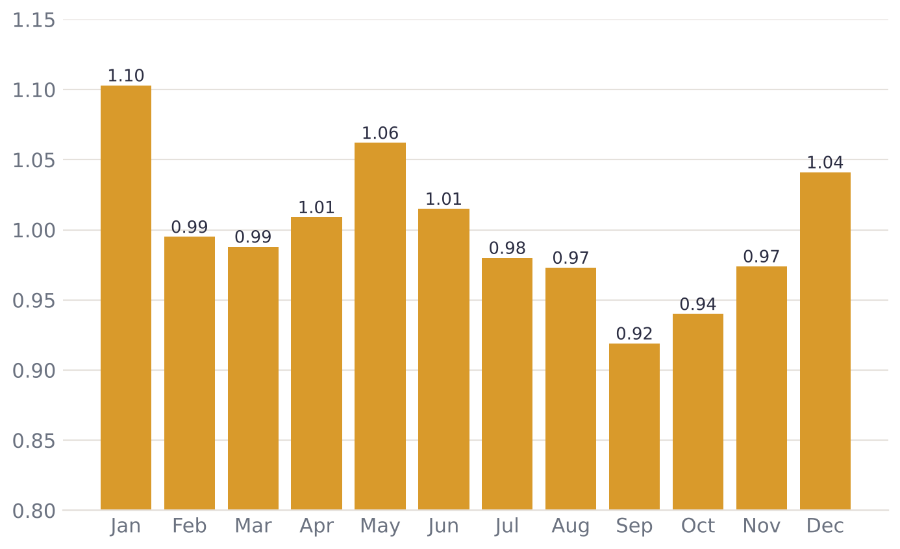
A festival and holiday rhythm airlines can plan around
1.00 = an average month
Peaks: Jan 1.10, May 1.06, Dec 1.04 – in line with Pongal, summer and year-end holidays (our interpretation of the timing)
Lows: Oct 0.94, Sep 0.92
Peak months run about 15–20% above the quietest – a case for seasonal extra flights
Source: AAI monthly Traffic News (aai.aero), compiled by the IXM Pulse tracker (seasonal model, COVID months excluded)

Slide 9
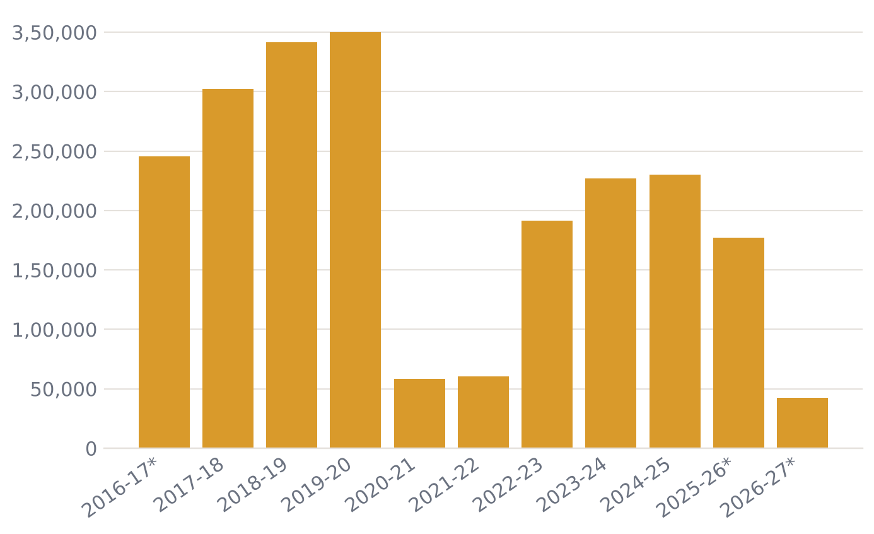
International travel: once a quarter of all passengers
International share: 24.6% in FY19-20 → 16.4% in FY24-25 → 13.9% in FY25-26*
Peak international year: FY 2019-20 (3,49,816)
FY 2024-25: 2,30,080 – still 34% below peak
Madurai serves a large Gulf & South-East Asian diaspora market – the biggest growth lever
Source: AAI monthly Traffic News (aai.aero), compiled by the IXM Pulse tracker

Slide 10
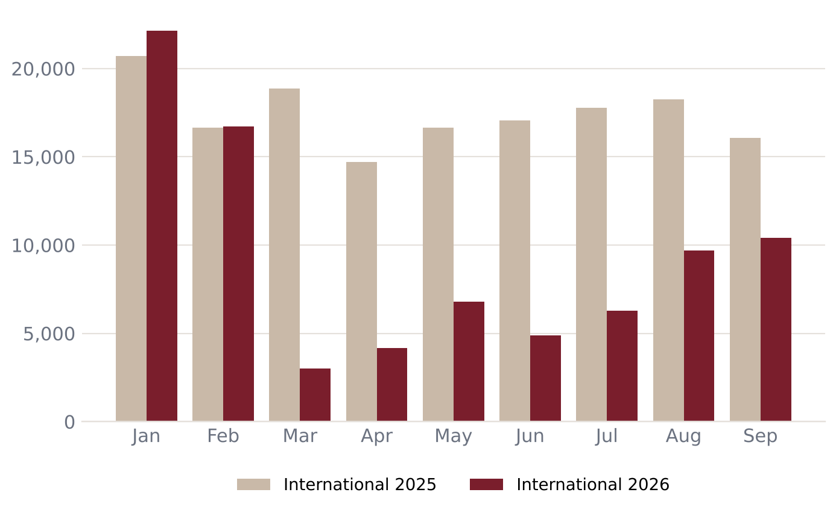
2026: the Gulf suspension – and a weak domestic first half
Dubai & Abu Dhabi flights suspended from end-Feb 2026 (Gulf conflict); resumption from 14 Aug
Mar–Jul 2026: about 59,923 fewer international passengers than a year earlier
Domestic was also down 2.9–18.8% year on year in Jan–Jun 2026
Latest month: domestic +5.9% and international -35.4% in Sep 26
Source: AAI monthly Traffic News (aai.aero), compiled by the IXM Pulse tracker; DT Next, 26 Jun 2026

Slide 11
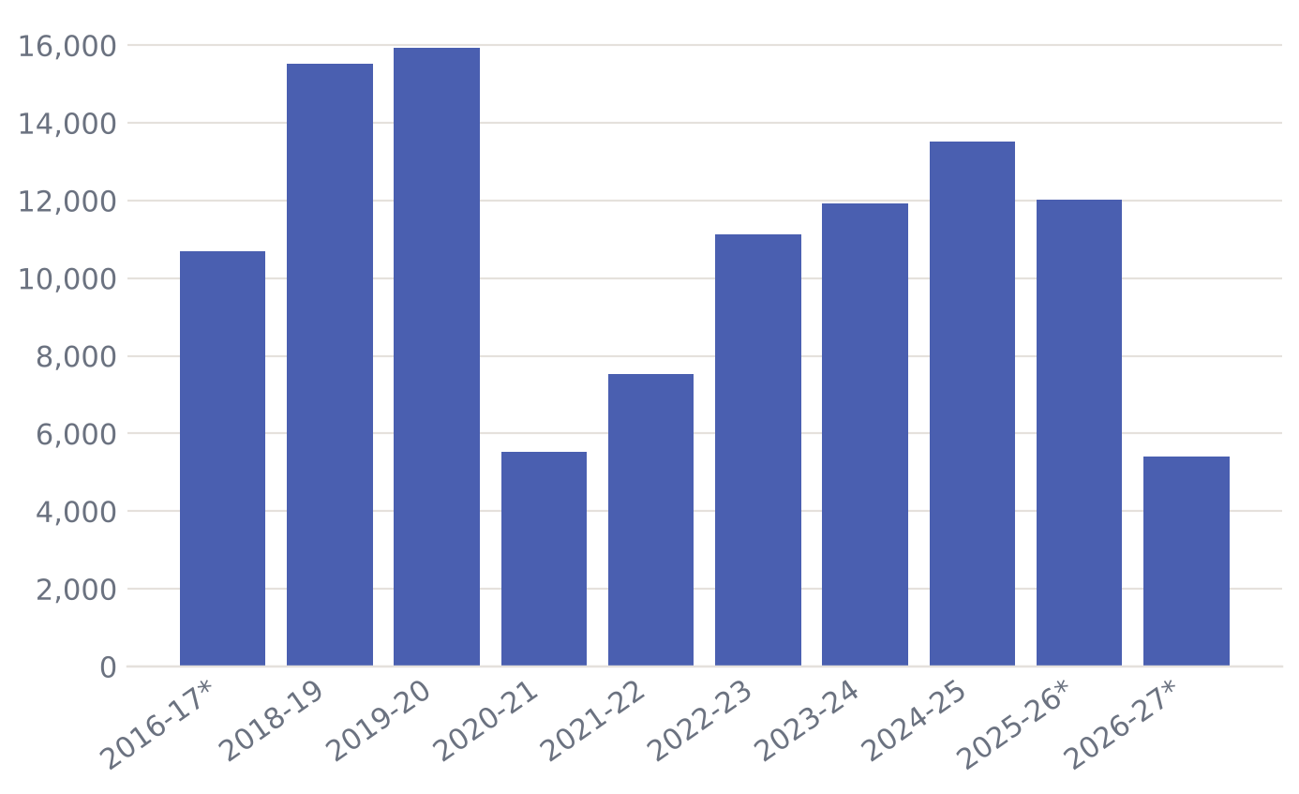
Fewer flights, fuller flights
Movements peaked at 15,925 in FY19-20; 13,513 in FY24-25
Passengers per movement: FY23-24: 108, FY24-25: 104, FY25-26: 106, FY26-27: 115 (FY19-20: 89)
More passengers per movement means fuller and/or larger aircraft – AAI does not publish seats, so the split is not known. Fewer movements does mean fewer choices of flight times
Source: AAI monthly Traffic News (aai.aero), compiled by the IXM Pulse tracker

Slide 12
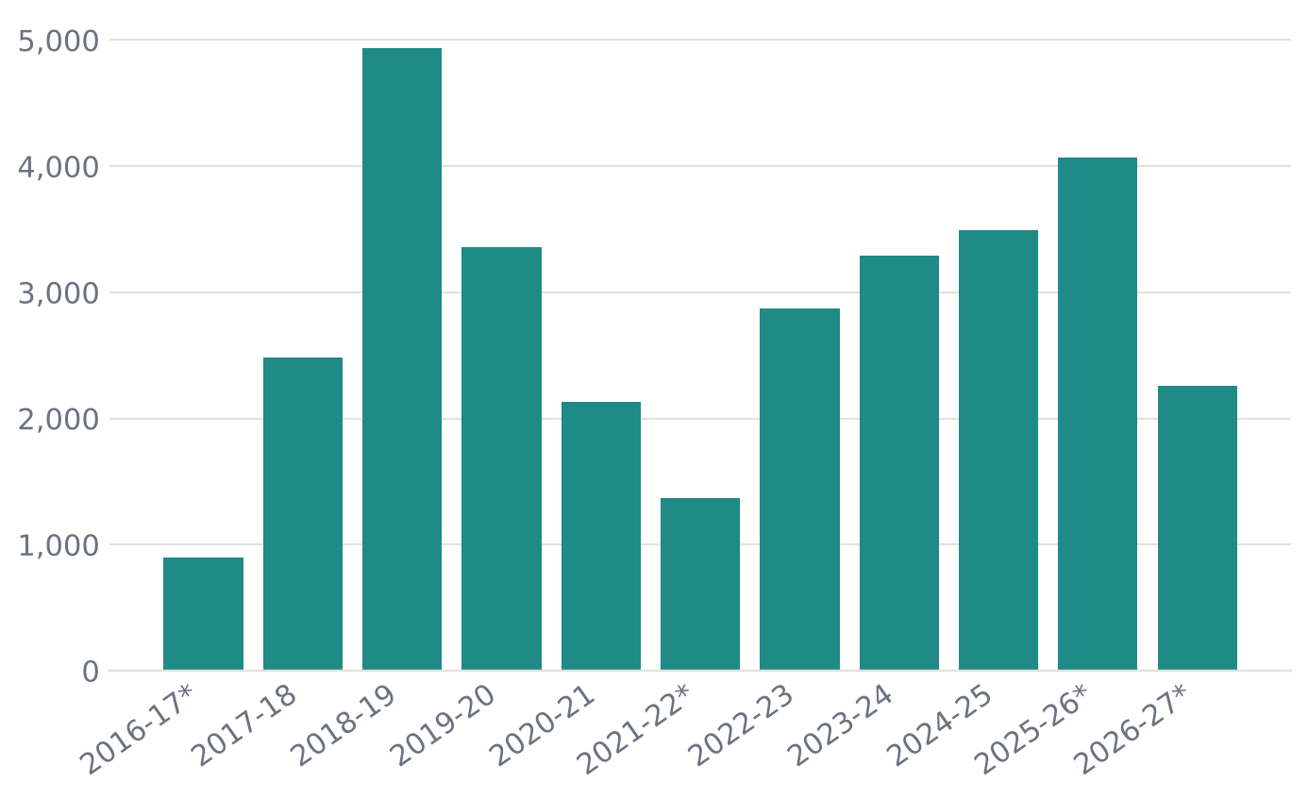
Air cargo: climbing back towards its 2018-19 peak
Cargo is reported every month since 2016; it jumped in FY17-18 and peaked at 4,934 t in FY 2018-19 (confirmed by AAI's revised figures)
FY 2024-25: 3,494 t; FY 2025-26: 4,070 t in 11 months
FY 2026-27 so far: 2,260 t in 6 months
Cargo is growing while passengers stagnate. AAI does not split belly-hold and freighter cargo, so the driver of growth cannot be told from this data
Source: AAI monthly Traffic News (aai.aero), compiled by the IXM Pulse tracker

Slide 13
The network today: few destinations, one dominant airline
Destination | Dep/week Nov 25 | Dep/week Jan 26 | Dep/week Jun 26 | Airlines (Jun 26)
Chennai | 63 | 29.8 | 63 | Air India, IndiGo
Bengaluru | 20.1 | 14 | 31.5 | IndiGo
Hyderabad | 14.2 | 14 | 10.5 | IndiGo
New Delhi | 7 | 7 | 7 | IndiGo
Dubai ✈ | 7 | 7 | – | suspended
Mumbai | 7 | 7 | 7 | IndiGo
Colombo ✈ | 5.6 | 5.9 | 4.2 | SriLankan
Abu Dhabi ✈ | 2.8 | 2.9 | – | suspended
Navi Mumbai | – | – | 6.8 | IndiGo
✈ international. Departures per week averaged over the month; return flights not counted twice.
Source: AeroDataBox flight records collected by the IXM Pulse tracker

Slide 14
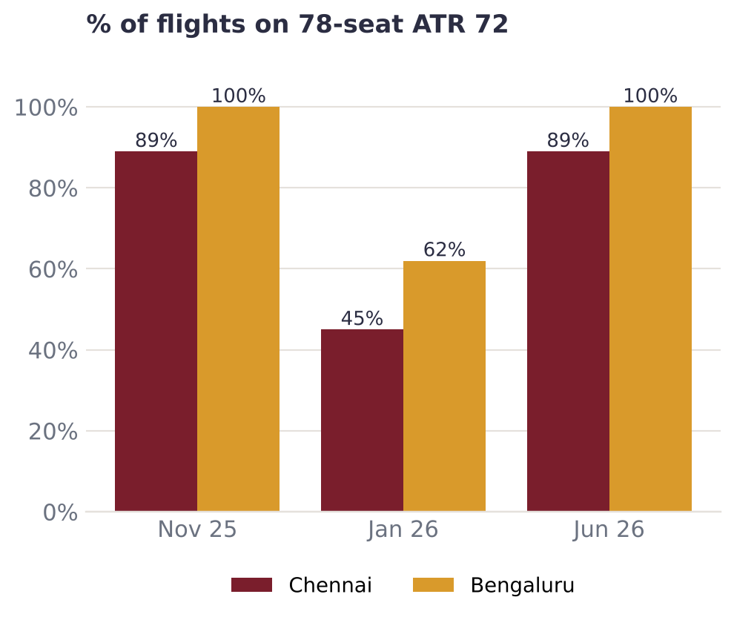
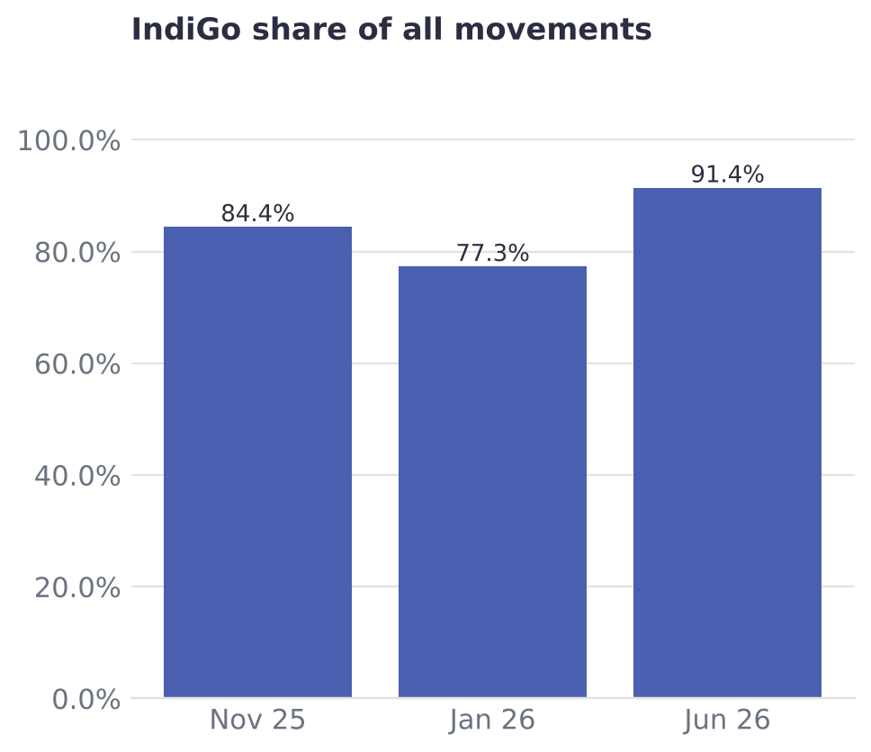
Turboprops on busy routes, one airline dominates
Source: AeroDataBox flight records collected by the IXM Pulse tracker

Slide 15
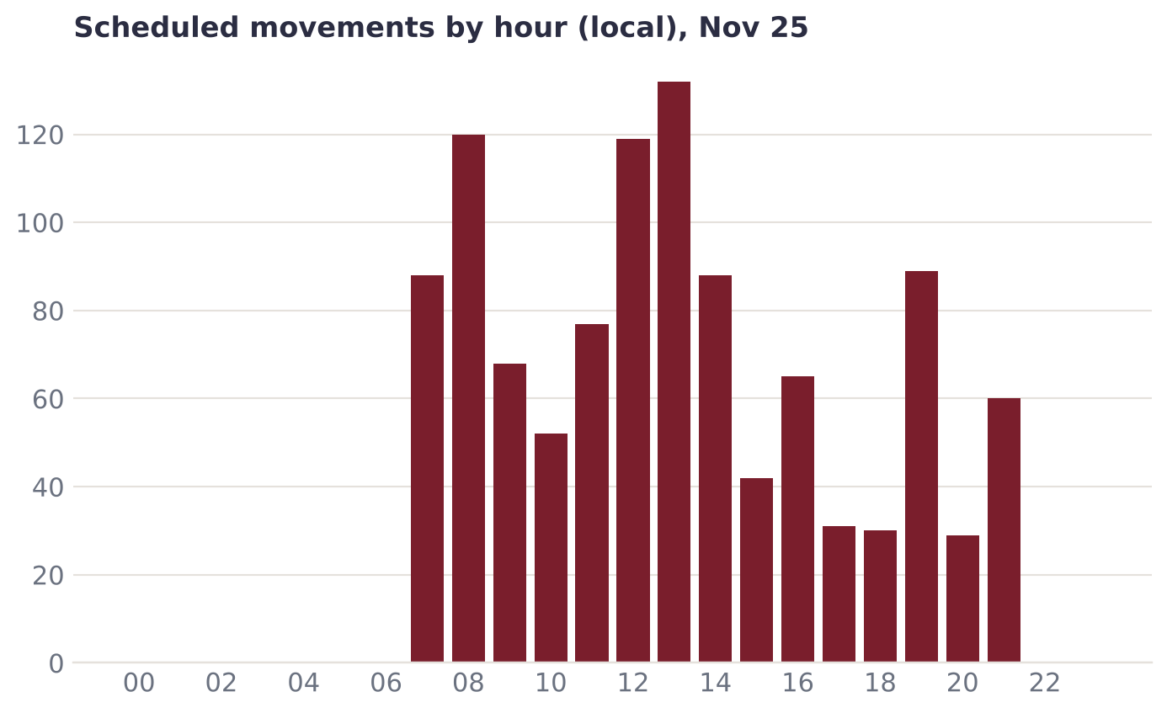
Daytime only: no scheduled flights 22:00–06:00
24-hour operations started in Oct 2024 (reported)
Night movements (22:00–06:00): Nov 25 0, Jan 26 0, Jun 26 0
Night slots let airlines use aircraft that fly elsewhere by day and suit onward Gulf connections – unused night capacity is an opportunity (rationale, not measured here)
Source: AeroDataBox flight records collected by the IXM Pulse tracker

Slide 16
Infrastructure: terminal headroom, runway limits
48%
2,285 m
543 / 653
Mar 2026
terminal capacity used
runway today
acres handed over
international airport status
1.39M of 2.9M passengers a year
3,810 m planned (wide-body)
Aug 2025 – no completion date
Union Cabinet approval
Busiest hour in the flight data: 4.4–5.0 movements a day on average. The terminal is not the bottleneck this decade: even the fastest what-if path (slide 17) reaches about 61% of capacity by FY 2030-31.
The runway is: wide-body aircraft (A330/B777) need the 3,810 m extension – essential for long-haul and heavy cargo.
Madurai has been outside bilateral air service agreements, which kept foreign airlines away – the new international status is the moment to change this.
Source: Swarajya 22 Aug 2025; Wikipedia 'Madurai Airport'; Mysuru Infra Hub 5 Oct 2024

Slide 17
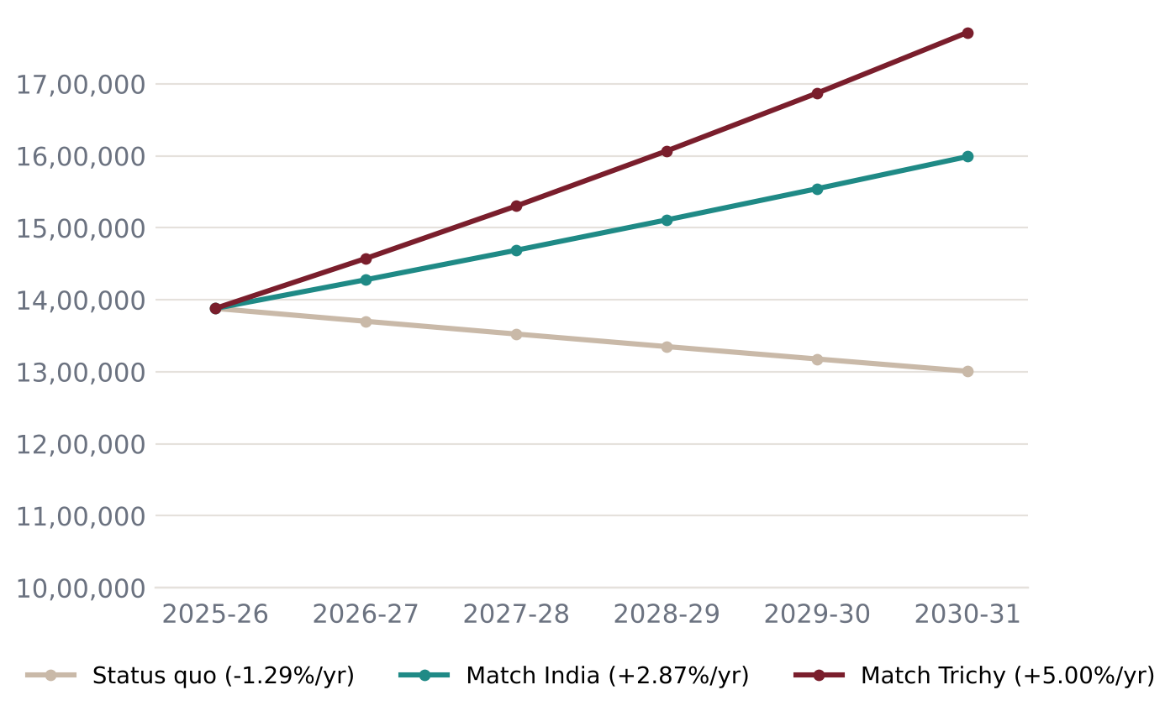
Outlook: decisions, not destiny
What-if paths from the FY 2025-26 published total, using growth rates actually observed FY18-19→FY25-26:
Status quo: 13.0 lakh by FY 2030-31
Match India: 16.0 lakh by FY 2030-31
Match Trichy: 17.7 lakh by FY 2030-31
Statistical 12-month forecast (Oct 26–Sep 27): about 13.4 lakh (backtest error 9.1%)
Source: AAI monthly Traffic News (aai.aero), compiled by the IXM Pulse tracker; scenario growth rates from AAI annual figures

Slide 18
What Madurai should ask for (1/3)
# | Ask | Evidence | To whom | Priority
1 | Restore Gulf services in full and add Sharjah, Muscat, Kuwait and Doha | International passengers fell by about 59,923 in Mar–Jul 2026 vs the same months of 2025 during the Gulf suspension; international share was 22.5% in FY18-19 | SpiceJet (Dubai) and IndiGo (Abu Dhabi), which flew these before the suspension; other Indian and Gulf carriers; MoCA | High
2 | Use the new international status: seek point-of-call rights for foreign carriers (Gulf, Sri Lanka, Malaysia, Singapore) | International status approved Mar 2026; Madurai was outside bilateral agreements, which kept foreign airlines away | MoCA, Ministry of External Affairs, State Government | High
3 | Upgauge Chennai and Bengaluru from ATR 72 turboprops to A320-family jets | Share of flights on 78-seat ATR 72s – 2025-11: Chennai 89% (63.0 dep/wk), Bengaluru 100% (20.1 dep/wk); 2026-01: Chennai 45% (29.8 dep/wk), Bengaluru 62% (14.0 dep/wk); 2026-06: Chennai 89% (63.0 dep/wk), Bengaluru 100% (31.5 dep/wk) | IndiGo, Air India | High
Source: Evidence computed from AAI and AeroDataBox data in this review; context sources listed in the Excel workbook

Slide 19
What Madurai should ask for (2/3)
# | Ask | Evidence | To whom | Priority
4 | Use the 24-hour licence: night slots for international and long domestic flights | 0 scheduled movements between 22:00 and 06:00 across 3 complete months of flight data (2025-11, 2026-01, 2026-06), although 24-hour operations began in Oct 2024 | AAI Madurai, airlines | Medium
5 | Attract a second large domestic airline to reduce dependence on one carrier | IndiGo share of movements – 2025-11: 84.4%; 2026-01: 77.3%; 2026-06: 91.4% | Air India group, Akasa Air, State Government (incentives) | Medium
6 | Test candidate new direct routes to unserved metros, e.g. Kolkata, Pune, Ahmedabad (hypotheses – demand not shown by this data) | 8 regular destinations in 2026-01; Madurai fell from rank 32 to 40 among Indian airports between FY18-19 and FY25-26 | Airlines, State Government (viability-gap / UDAN-type support) | Medium
Source: Evidence computed from AAI and AeroDataBox data in this review; context sources listed in the Excel workbook

Slide 20
What Madurai should ask for (3/3)
# | Ask | Evidence | To whom | Priority
7 | Complete the remaining land handover and fix a timeline for the 3,810 m runway | 109.94 of 653.35 acres pending (Aug 2025); wide-body capability needed for long-haul and heavy cargo | State Government, AAI | Medium
8 | Grow air cargo: export facilitation for perishables and regional produce | Cargo 4,070 t in 11 months of FY25-26 vs 3,494 t in all of FY24-25, while passengers fell | AAI Cargo Logistics, Customs, State export agencies | Medium
9 | Publish route-level origin–destination data so routes can be planned on evidence | Only monthly airport totals are public; route-level demand is unknown | DGCA, AAI | Low
Source: Evidence computed from AAI and AeroDataBox data in this review; context sources listed in the Excel workbook

Slide 21
Opportunities to create
Diaspora corridors
Heritage & pilgrim gateway
Gulf, Singapore, Malaysia and Sri Lanka routes – international was 21–25% of traffic before COVID (AAI). Target: restore and exceed FY19-20's 3,49,816 international passengers.
Meenakshi Amman Temple, Rameswaram and Kodaikanal are within reach; the Dec–Jan peaks could support seasonal and charter flights. (Qualitative – no visitor data in this review.)
Air cargo from the south
Night slots & based aircraft
Cargo grew while passengers stalled. International status plus customs and cold-chain facilities can serve agricultural and regional exporters.
Zero scheduled night movements despite 24-hour operations. An airline basing aircraft overnight in Madurai enables early departures and late returns.

Slide 22
Next steps and limits of this review
Share this evidence with AAI Madurai, the Ministry of Civil Aviation, the State Government and airlines; track progress monthly on the IXM Pulse dashboard.
Ask DGCA/AAI for route-level origin–destination data – it would turn route proposals from hypotheses into business cases.
Limits: AAI months 2016-10 and 2025-11 not available; flight-level detail covers 95 days (AeroDataBox keeps 365 days of history); peer figures are AAI totals via Wikipedia, without a domestic/international split.
Not analysed (no data here): fares, catchment and leakage to Trichy or other airports, road and rail competition, and airline-by-airline history before Nov 2025 – so the causes of the fall since FY18-19 are not proven by this review.
Scenarios are illustrative what-ifs using observed growth rates; the 12-month forecast is a statistical model, not an official projection.
Dashboard: jarunprasath.github.io/madurai-airport-tracker · Contact: linkedin.com/in/arunprasathj

