Slide 1
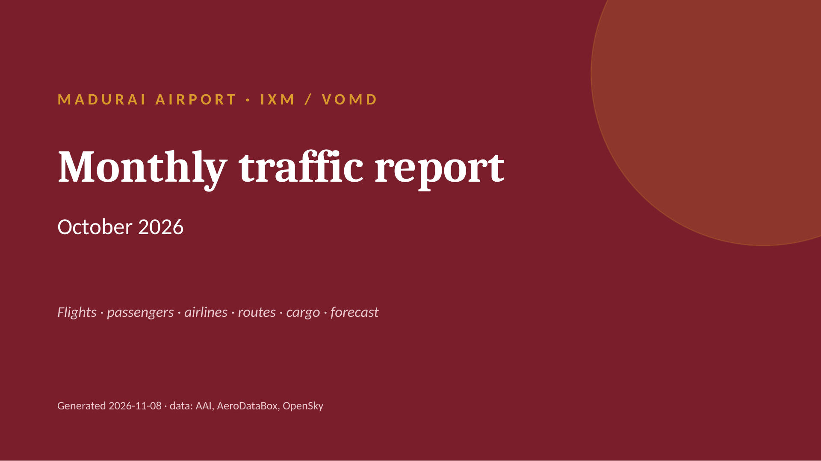
Notes:
MADURAI AIRPORT · IXM / VOMD
Monthly traffic report
October 2026
Flights · passengers · airlines · routes · cargo · forecast
Generated 2026-11-08 · data: AAI, AeroDataBox, OpenSky

Slide 2
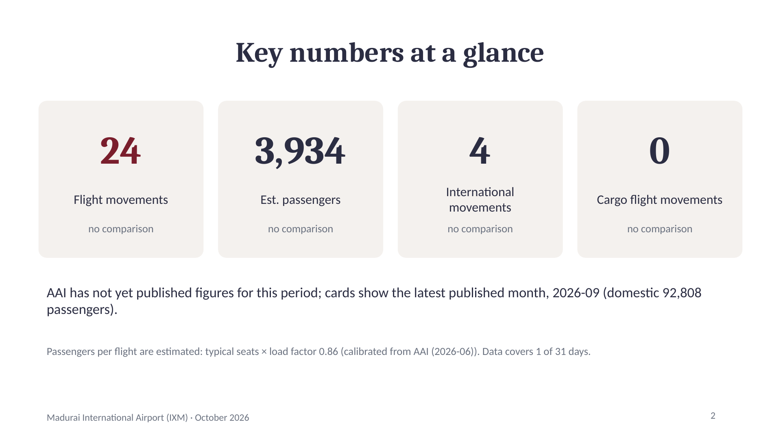
Notes:
Key numbers at a glance
24
Flight movements
no comparison
3,934
Est. passengers
no comparison
4
International movements
no comparison
0
Cargo flight movements
no comparison
AAI has not yet published figures for this period; cards show the latest published month, 2026-09 (domestic 92,808 passengers).
Passengers per flight are estimated: typical seats × load factor 0.86 (calibrated from AAI (2026-06)). Data covers 1 of 31 days.
2

Slide 3
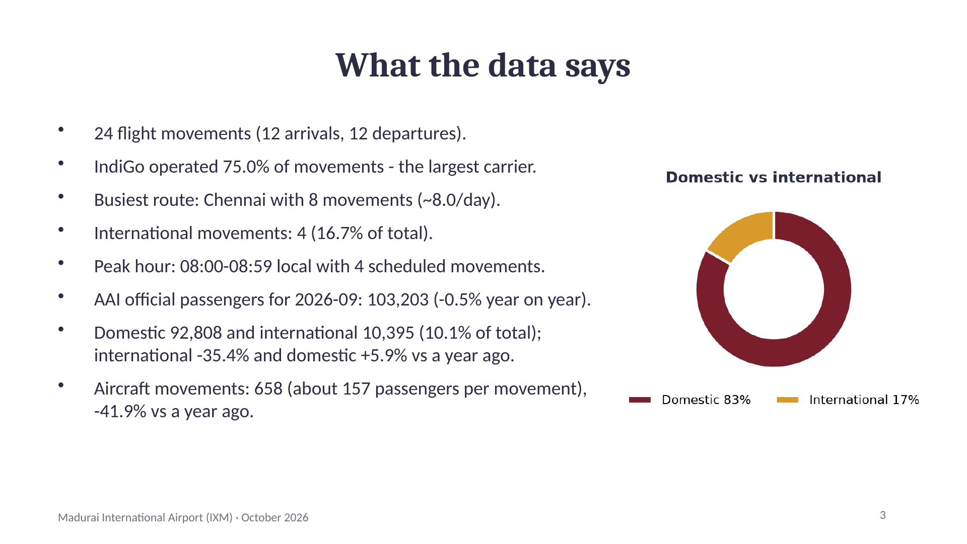
Notes:
What the data says
24 flight movements (12 arrivals, 12 departures).
IndiGo operated 75.0% of movements - the largest carrier.
Busiest route: Chennai with 8 movements (~8.0/day).
International movements: 4 (16.7% of total).
Peak hour: 08:00-08:59 local with 4 scheduled movements.
AAI official passengers for 2026-09: 103,203 (-0.5% year on year).
Domestic 92,808 and international 10,395 (10.1% of total); international -35.4% and domestic +5.9% vs a year ago.
Aircraft movements: 658 (about 157 passengers per movement), -41.9% vs a year ago.
3

Slide 4
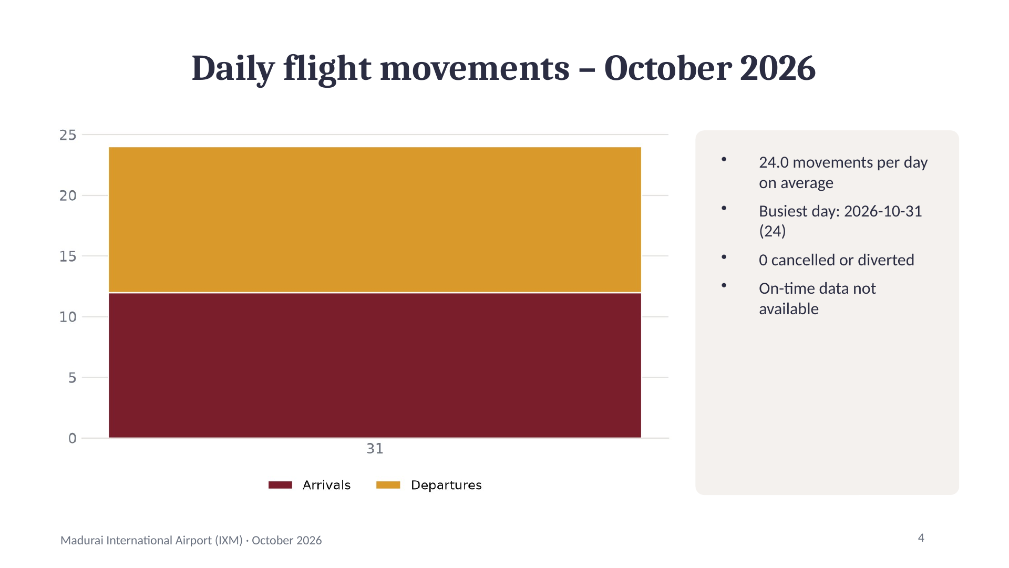
Notes:
Daily flight movements – October 2026
24.0 movements per day on average
Busiest day: 2026-10-31 (24)
0 cancelled or diverted
On-time data not available
4

Slide 5
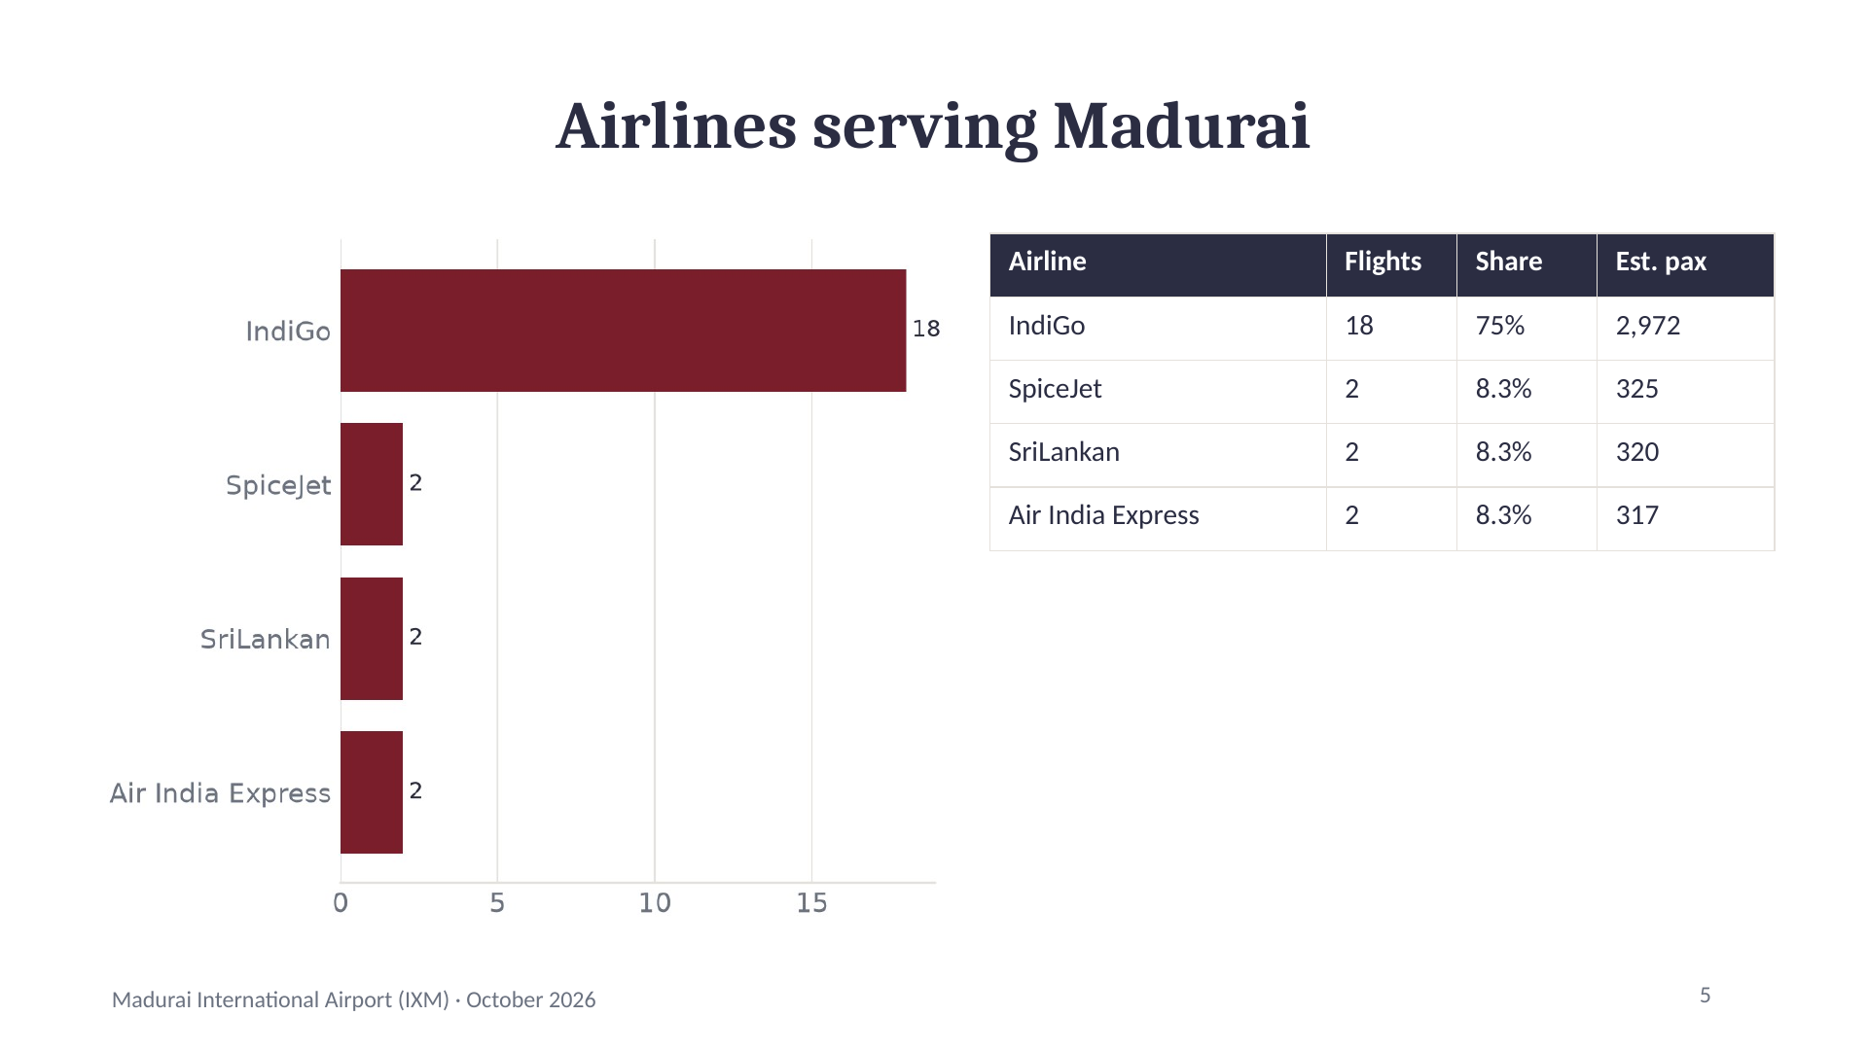
Notes:
Airlines serving Madurai
Airline | Flights | Share | Est. pax
IndiGo | 18 | 75% | 2,972
SpiceJet | 2 | 8.3% | 325
SriLankan | 2 | 8.3% | 320
Air India Express | 2 | 8.3% | 317
5

Slide 6
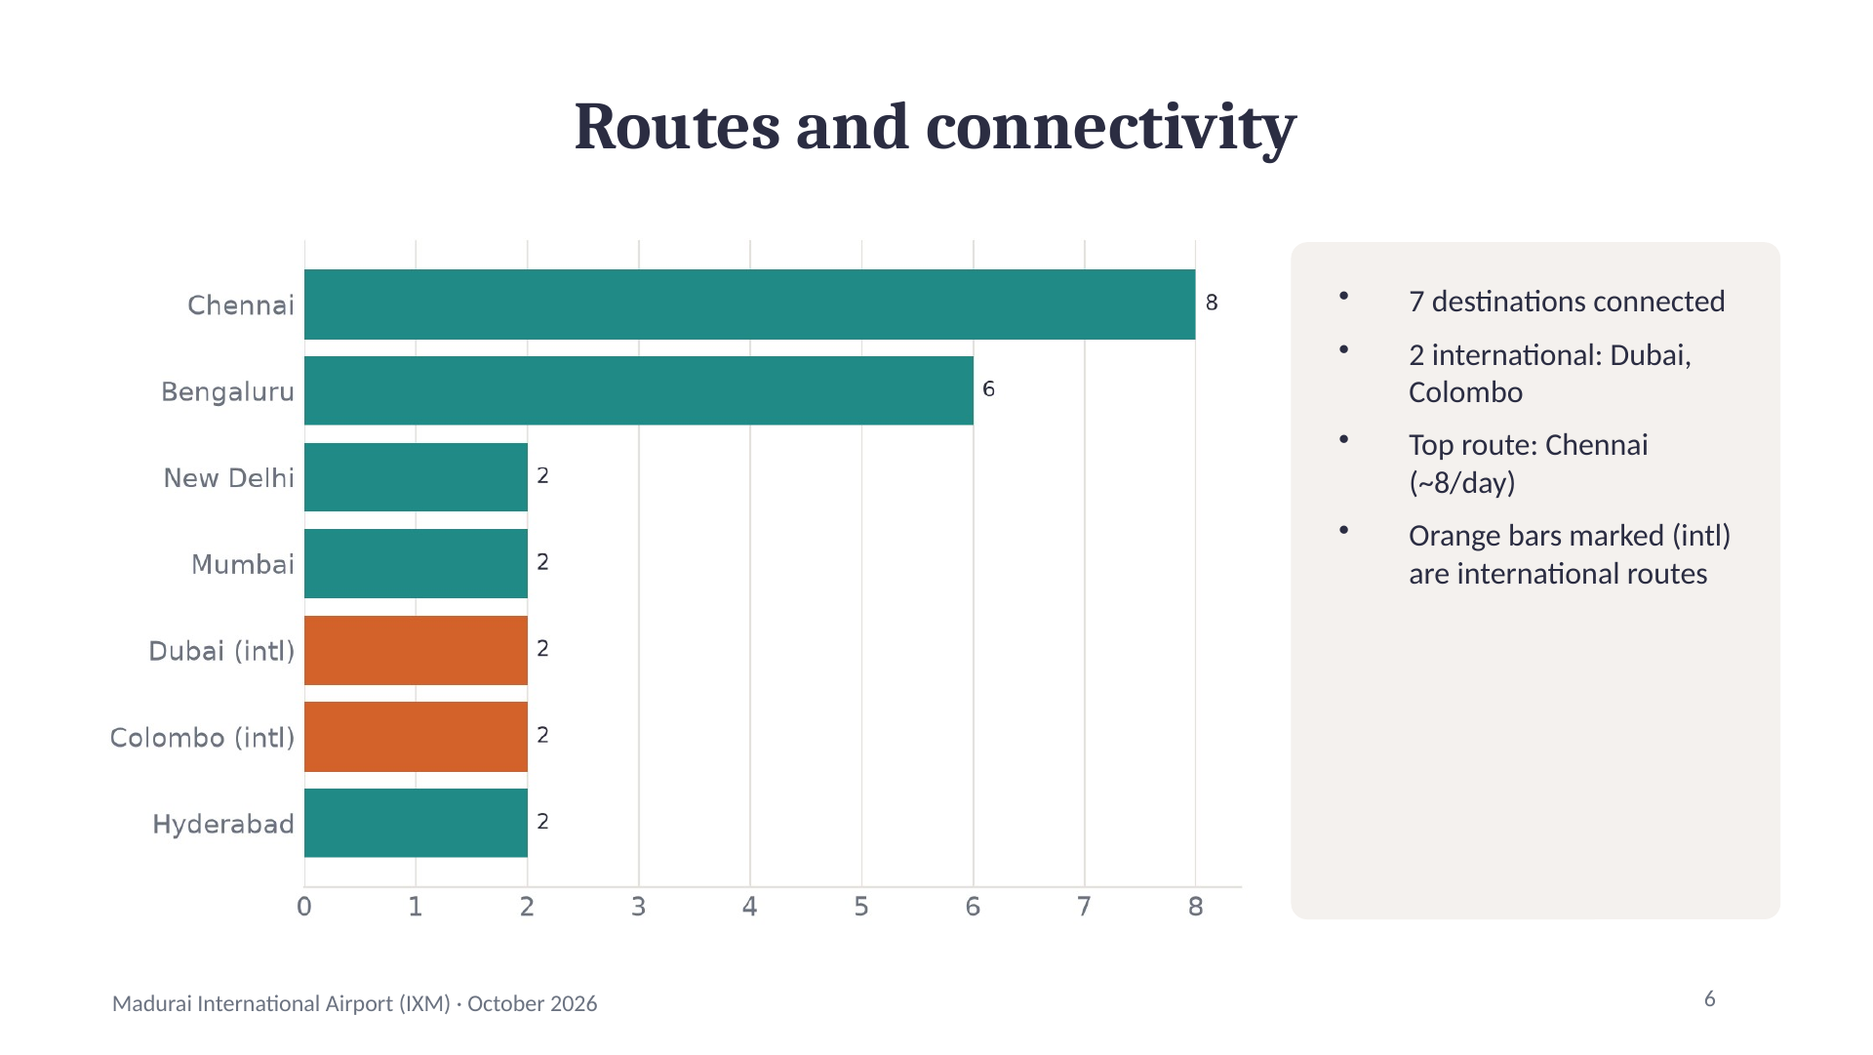
Notes:
Routes and connectivity
7 destinations connected
2 international: Dubai, Colombo
Top route: Chennai (~8/day)
Orange bars marked (intl) are international routes
6

Slide 7
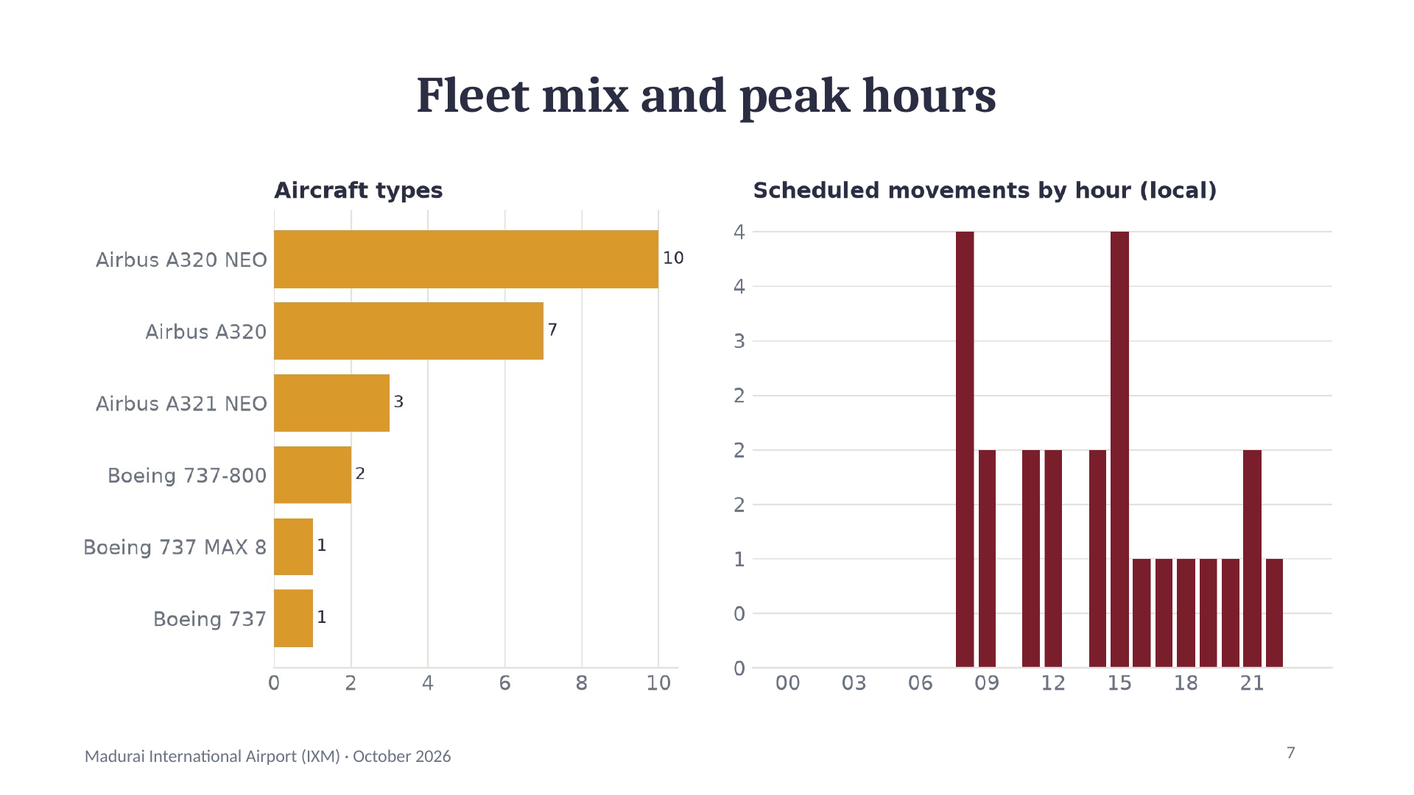
Notes:
Fleet mix and peak hours
7

Slide 8
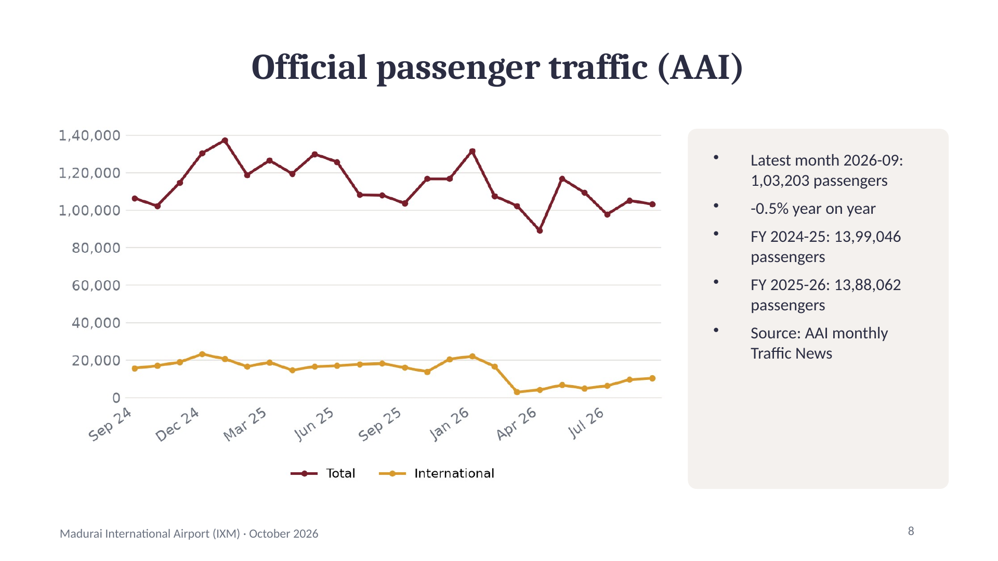
Notes:
Official passenger traffic (AAI)
Latest month 2026-09: 1,03,203 passengers
-0.5% year on year
FY 2024-25: 13,99,046 passengers
FY 2025-26: 13,88,062 passengers
Source: AAI monthly Traffic News
8

Slide 9
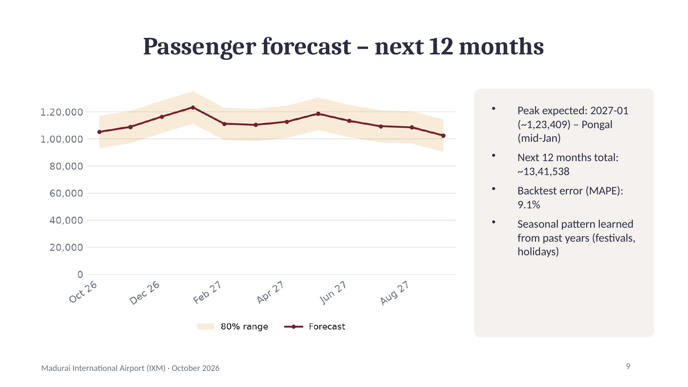
Notes:
Passenger forecast – next 12 months
Peak expected: 2027-01 (~1,23,409) – Pongal (mid-Jan)
Next 12 months total: ~13,41,538
Backtest error (MAPE): 9.1%
Seasonal pattern learned from past years (festivals, holidays)
9

Slide 10
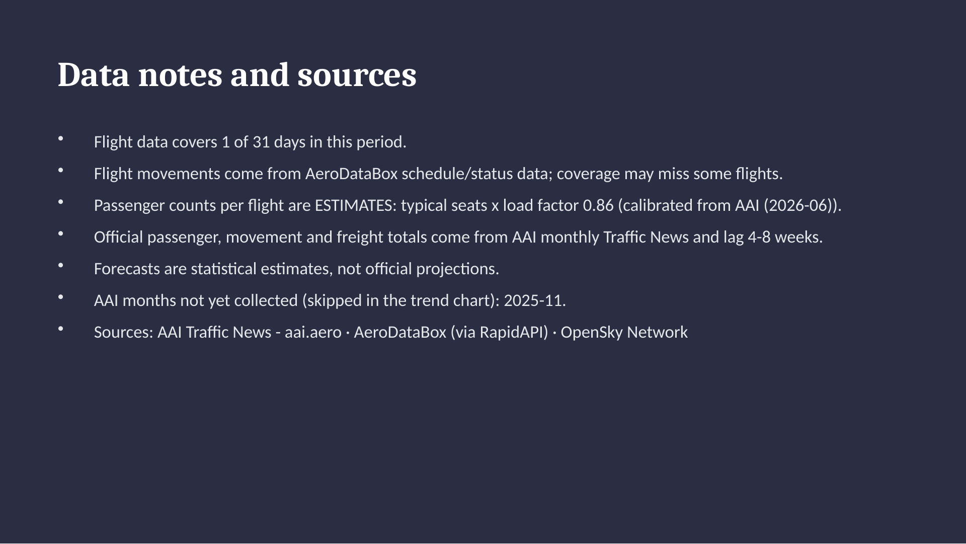
Notes:
Data notes and sources
Flight data covers 1 of 31 days in this period.
Flight movements come from AeroDataBox schedule/status data; coverage may miss some flights.
Passenger counts per flight are ESTIMATES: typical seats x load factor 0.86 (calibrated from AAI (2026-06)).
Official passenger, movement and freight totals come from AAI monthly Traffic News and lag 4-8 weeks.
Forecasts are statistical estimates, not official projections.
AAI months not yet collected (skipped in the trend chart): 2025-11.
Sources: AAI Traffic News - aai.aero · AeroDataBox (via RapidAPI) · OpenSky Network

