Slide 1
Github
Introduction to git

Slide 2
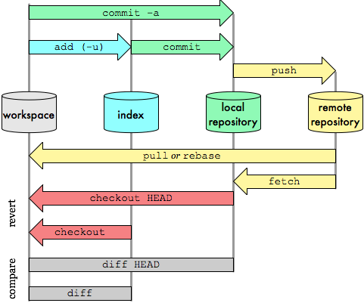
The Big Picture
Git Data Transport Commands
(http://osteel.com)
Now we’ll talk about this part

Slide 3

Why Github
Largest open source git hosting site
Public and private options
User-centric rather than project-centric
Try it
Log onto github
Walk through the tutorials

Slide 4

How do I use github?
Set up a user account
public account is free, students can request 5 private
e.g. jrGabrillo
Remember your password!
Create a repository
e.g. GitDemoCode
Push your master branch (later we’ll deal with other branches, just work with master for now)
Add collaborators (if public, everyone can read, but not write. If private, must be collaborator to even read)
http://git-scm.com/book/en/v2/Git-Basics-Working-with-Remotes

Slide 5
Typical workflow
Person A
Setup project & repo
push code onto github
edit/commit
edit/commit
pull/push
Person B
clone code from github
edit/commit/push
edit…
edit… commit
pull/push
This is just the flow, specific commands on following slides.
It’s also possible to create your project first on github, then clone (i.e., no git init)

Slide 6
Remote repository
Remote repository is a bare repository
There is no working directory
Four transfer protocols
http – this is what I recommend/use
local (not covered – good for shared filesystems)
git (not covered – fast but more setup)
SSH (supplementary material at end of slides, not covered)

Slide 7
Smart http
Added to git in v. 1.6.6
Read about it:
http://git-scm.com/2010/03/04/smart-http.html
Use it on the client:
git clone https://github.com/jrGabrillo/helloWorld.git
protocol
userID
repository
When you create a repo on github, it will show you the HTTPS clone URL
Avoid typos: a) copy the URL, b) in git bash, click git-icon/edit/paste OR press Insert.

Slide 8
Create the repo – Option 1
Log onto github
Click on + to add repository
Enter name
Add .gitignore, good to have a README
Click on Settings to control access (Collaborators tab)
On PC, do git clone

Slide 9
Create the repo – Option 2
Create your Android Project
Create your local repo
git init
git commit –m “Initial commit”
Create a repo on github
Add a “shortname” for your git repository
git remote add [shortname] [url]
git remote add origin https://github.com:[user name]/[repository name].git
e.g: git remote add origin https://github.com:jrGabrillo/helloWorld.git
Remember: You can copy/paste the repo url from github
Push your code onto github
git push –u [remote-name] [branch-name].
e.g: git push –u origin master – enter username/password

Slide 10
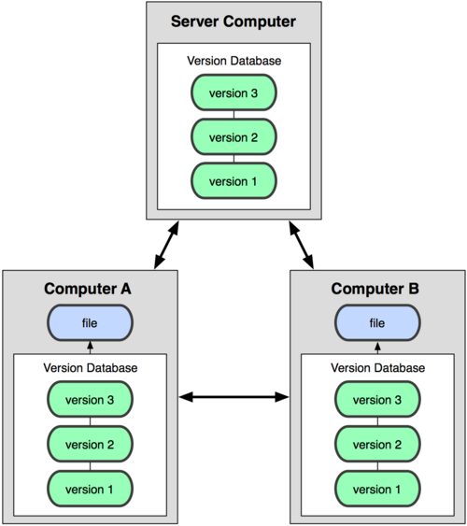
Collaborating via github - cloning
git clone - adds the remote repository under the name origin
git clone https://github.com:[user name]/[repository name].git
e.g: git clone https://github.com:jrGabrillo/helloWorld.git

Slide 11
Supplemental

Slide 12
SSH
Used to be most common transport for git
Pros
Allows reads and writes
Authenticated network protocol
Secure: data transfer is encrypted and authenticated
Efficient: makes data as compact as possible
Cons
No anonymous read-only access

Slide 13
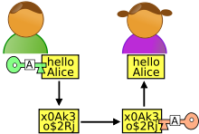
Sidebar: What is SSH?
SSH is a protocol used for secure network communication
Getting files from github
Generate public/private keys (ssh-keygen)
Distribute public keys (add key to github)
Someone (github) sends secure “message” (files) – they encode with public key
You receive the message/files – decode with private key (only you know)
Putting files on github
Process is reversed to send files to github
You have the github public key (see github_rsa.pub, in Documents and Settings/Cyndi/.ssh on my machine)
Use it to encode when sending
github uses their private key to decode

Slide 14
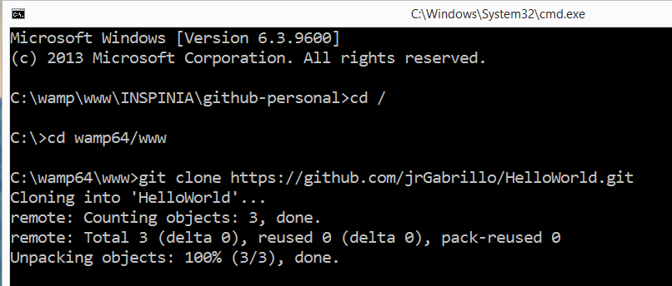
Cloning example
Assume I have a repo named HelloWorld.git
The repo will be saved in this case in wamp64/www/HelloWorld folder

Slide 15
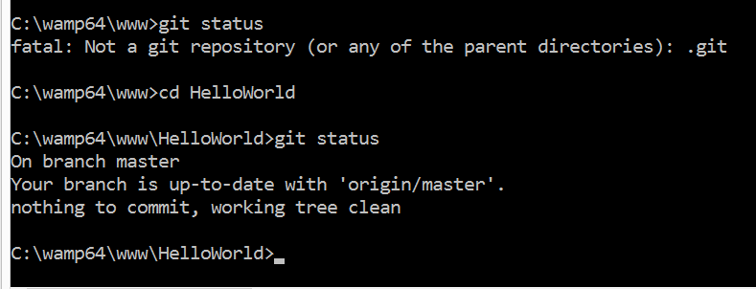
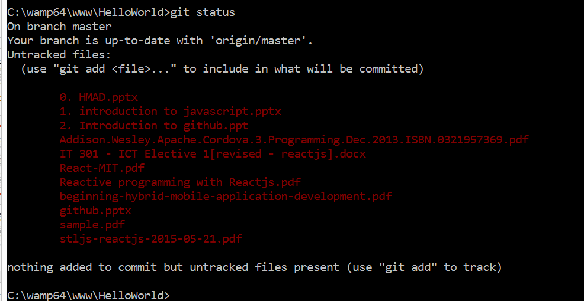
Checking Changes
Go inside the cloned repository folder then fire the “git status” command.
Repository with changes
Repository with no changes

Slide 16
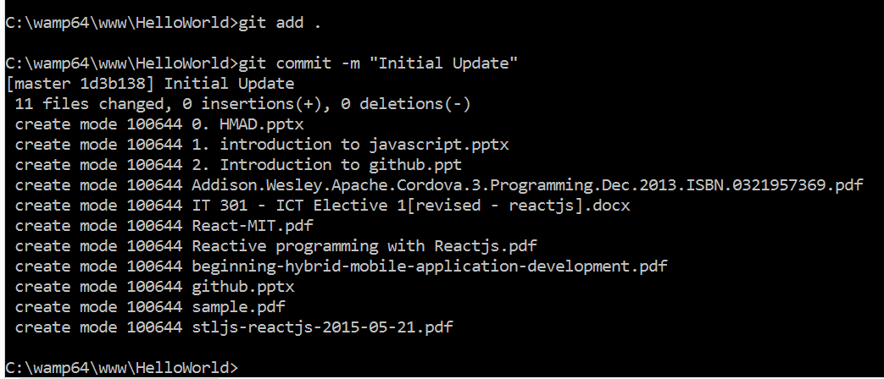
Uploading changes
Commit changes – updates local repo

Slide 17
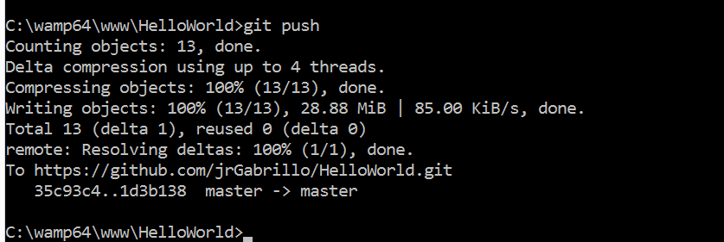
Uploading changes

Slide 18
Keep everyone in sync
Be very careful not to make conflicting changes!
Merge with conflicts covered later
Two options for synchronizing:
Fetch/merge
Pull
Pull is usually simpler, but we’ll cover both.

Slide 19
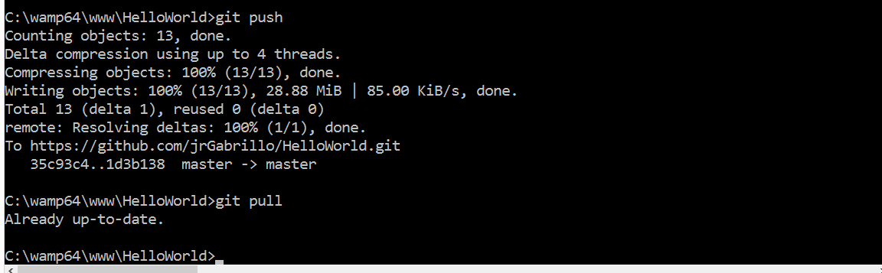
Pull example – on original machine
If you’re careful to avoid conflicts, and you’re working on the master branch, easier to just pull.
Make some changes on original machine
Don’t forget to commit!

