Slide 1
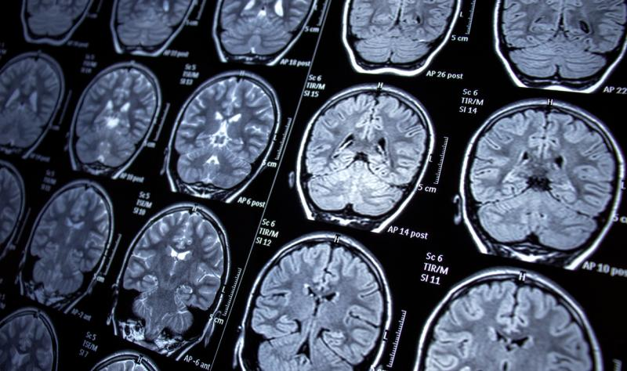
Data Mining Project
Predicting hearing threshold using Brain MRI scans
Group 4
Members –
Charanjit Singh
Parampreet Singh
Tejashree Challagundla

Slide 2
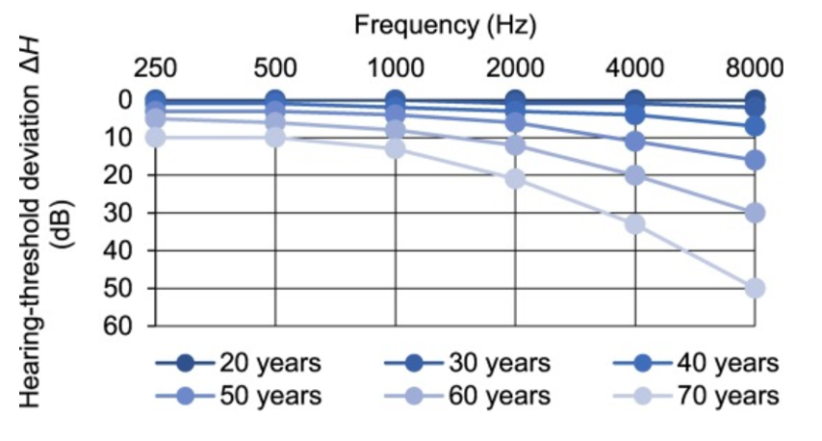

Introduction
Hearing loss can deeply affect one’s experience of life.
It can be due to dysfunction or damage in any part of auditory pathway.
Common reasons of hearing loss: age related, loud noises, medical conditions.
Metabolic and Sensory components are strongly related to age related hearing loss.
Brain MRI can help in understanding cognitive changes in hearing loss.
According to an NIH Report, Over 50% of Americans older than 75 years have difficulty in hearing
Source: https://doi.org/10.1016/j.tins.2020.07.005
FIGURE 1

Slide 3
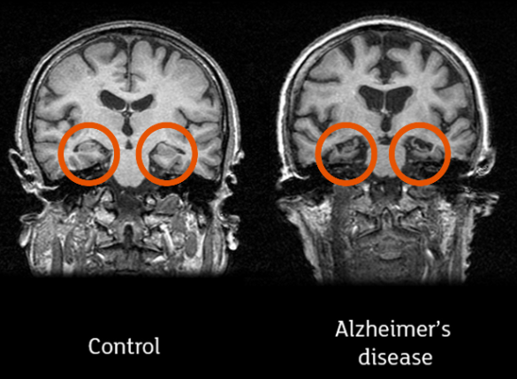
Problem Statement
Brain MRI scans determine various diseases like Alzheimer’s.
The MRI scans provide detailed images of the brain and detect structural changes.
To determine the onset of cognitive loss in hearing from MRI, it is essential to study a relationship.
So, our aim is to predict the hearing threshold from Brain MRI scans!
Using MRI Scans to detect Alzheimer’s Disease.
FIGURE 2

Slide 4
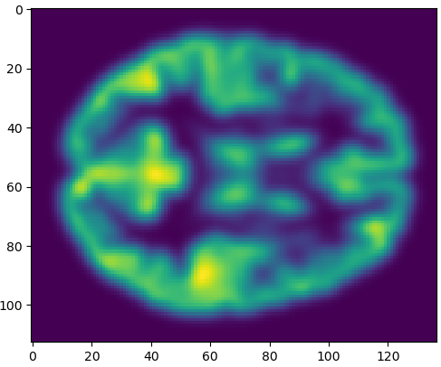
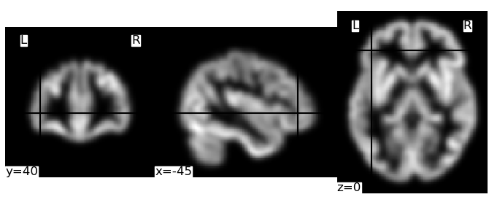
Dataset
Dataset includes 171 subject’s gray matter images of Brain MRI scans.
MRI scans are .nii files which is a file format used for storing medical imaging data
It includes both the 3D volume of the scan and associated metadata.
A csv file contains associated hearing thresholds at two different pure-tone frequencies. (500 and 4000Hz).
Dataset Augmentation: Concatenated the dataset with itself to increase size and normalized.
Raking
Rows

Slide 5
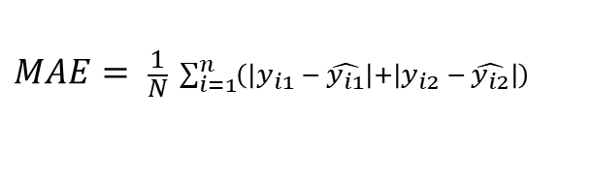
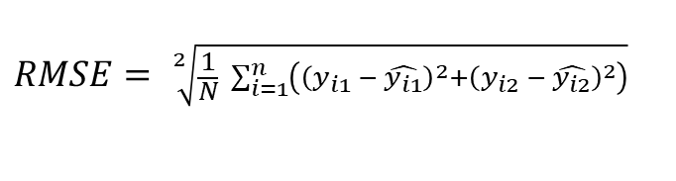
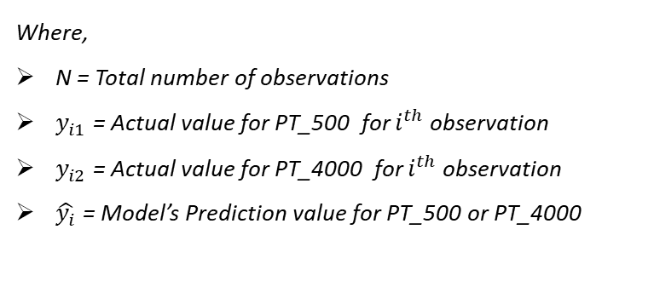
Loss and Accuracy Metrics
To compare the accuracy of regression models, we have used the MAE and RMSE values.
Mean Absolute Error
Root Mean Square Error
The MAE is calculated as the average of the absolute differences between the predicted values and the actual values. Mathematically, it is represented as:
The RMSE is calculated as the square root of the average of the squares of the differences between the predicted values and the actual values. Its formula is given by:
$$MAE= \frac{1}{N} \sum_{i=1}^{n}{\left(\left|y_{i1} − \hat{y_{i1}}\right|+\left|y_{i2} − \hat{y_{i2}}\right|\right)}$$
$$RMSE= \sqrt[2]{\frac{1}{N} \sum_{i=1}^{n}{\left({\left(y_{i1} − \hat{y_{i1}}\right)}^{2}+{\left(y_{i2} − \hat{y_{i2}}\right)}^{2}\right)}}$$
Where,
N = Total number of observations
$y_{i1}$ = Actual value for PT_500 for $i^{th}$ observation
$y_{i2}$ = Actual value for PT_4000 for $i^{th}$ observation
$\hat{y_{i}}$ = Model’s Prediction value for PT_500 or PT_4000

Slide 6

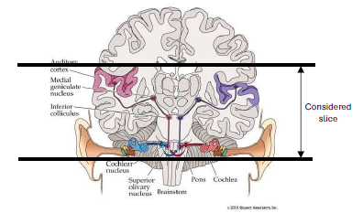
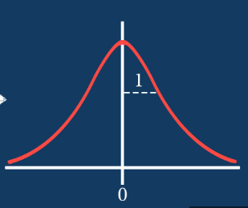
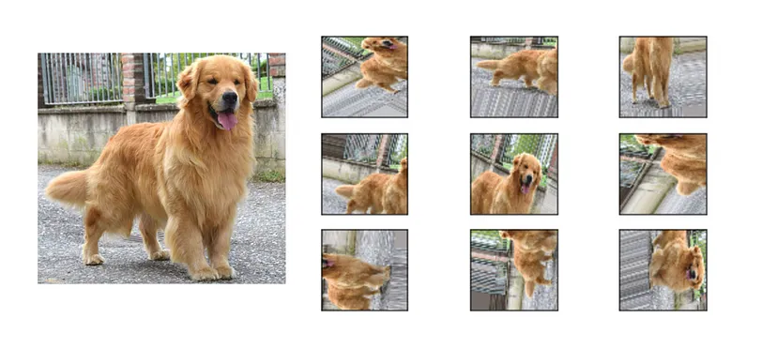
Data Preprocessing
Data Extraction and Conversion
Segmentation of Relevant Brain Regions
Standardization
Data Augmentation
Convert MRI scans from .nii format to structured NumPy arrays.
Python library NiBabel for reading .nii files.
Data transformed into a programmatically accessible format.
Select specific slices that are most indicative of regions associated with auditory processing.
Computational resources focused on the most relevant sections of the brain.
Reduced dataset complexity, ensuring learning from the most pertinent features.
Standardize the MRI scans to the range [0, 1].
Minimize the impact of variance in scan qualities.
Enhanced consistency across the dataset, crucial for comparative analysis.
Concatenated each processed slice with itself, effectively doubling the dataset.
Amplified the limited training data available.
Prevents overfitting and improves the robustness and generalizability of the predictive model.

Slide 7
Prediction Model Approaches
Machine Learning Models
CNN
SVR
XGBoost
CNNs are specialized deep learning models for processing data with grid-like topology, such as images.
SVR seeks to find a hyperplane that best fits the data points in a continuous space.
XGBoost is a highly efficient gradient boosting framework that uses decision tree ensembles.
Highly effective in spatial feature extraction
Strong performance in image-related tasks
Effective in high-dimensional spaces
Versatility in kernel selection
High performance and speed for large datasets
Handles various data types and structures
High computational cost
Prone to overfitting
Struggles with new items (cold start problem)
May recommend popular items excessively
Complex parameter tuning
Less intuitive model interpretation

Slide 8
Model 1: Convolutional Neural Network
CNNs are specialized for processing grid-like data structures, making them ideal for image analysis, particularly in medical imaging.
CNN model automatically detects and learns complex spatial hierarchies of features that correlate with hearing thresholds.
CNN Model Architecture Overview:
Input Shape: (113, 40, 113, 1)
Convolutional Layers: 3 layers with filters of 64, 128, and 256, each using 3x3x3 kernels, 'relu' activation, and followed by batch normalization and max pooling.
Dense Layers: Two fully connected layers with 256 and 128 neurons, both applying 'relu' activation, L2 regularization, and 50% dropout.
Output: Linear activation with 2 outputs corresponding to different hearing thresholds.
Optimizer: Adam with exponential decay learning rate starting at 1e-5.
Loss Function: Mean squared error
(171, 113, 40, 113, 1)
(171, 55, 19, 55, 64)
256 nodes
(171, 26, 8, 26, 128)
128 nodes
64 x (3, 3, 3)
256 x (3, 3, 3)
PT_500
128 x (3, 3, 3)
PT_4000
* Batch Normalization, MaxPooling3D used after each convolutional layer.
* Droput is used for each dense layer.
3 Convolutional Layers
2 Dense Layers

Slide 9
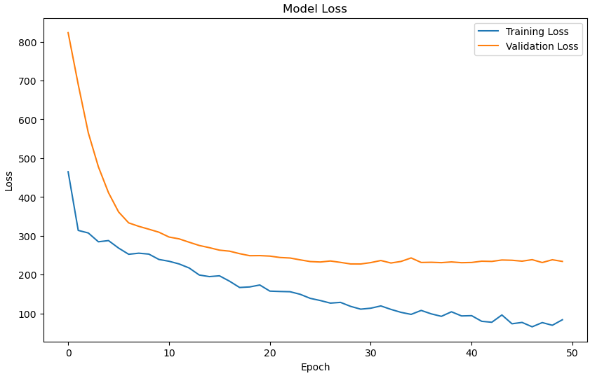
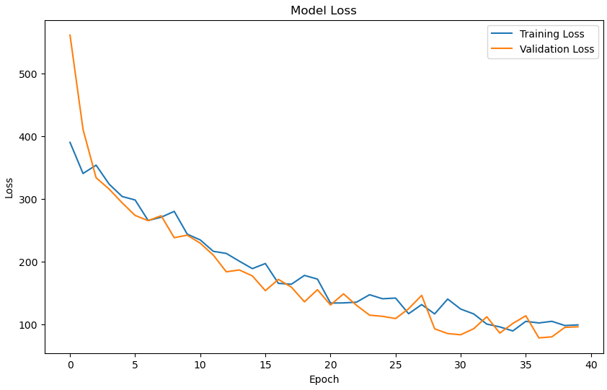
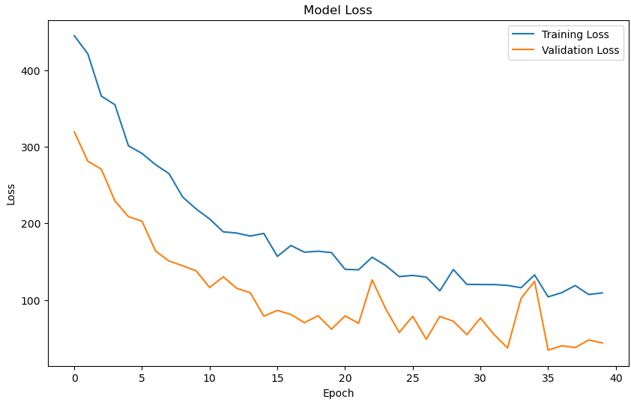
CNN Results
Model Evaluation
The CNN layers extract features from the images.
Model seems to learn the features effectively.
The model is bound to perform better on a larger dataset.
MAE | RMSE
11.24 | 15.16
Low regularization (0.001)
Overfitting
Lower dropout (0.5) & high regularization rate (0.01)
Model with lowest Validation Loss
Training Loss
Training Loss
Training Loss
Validation Loss
Validation Loss
Validation Loss

Slide 10
Model 2: PCA-SVR Pipeline
Combines Principal Component Analysis (PCA) and Support Vector Regression (SVR) for enhanced predictive modeling of complex brain MRI data.
MAE | RMSE
12.45 | 15.63
Image Flattening
Principal Component Analysis
Support Vector Regression
Output
Transforms the 3D MRI scan matrices into 1D vectors.
Shape – [410670,]
Reduces data to 10 principal components, capturing the most significant variance.
Strips away noise and redundant information.
Hyperparameters:
n_components: 10
svd_solver: 'auto'
whiten: False
Trained on PCA-reduced data to predict outcomes within a margin of error.
Hyperparameters:
C: 1.0
epsilon: 0.2
kernel: 'rbf’
gamma: 'scale’
Outputs the hearing thresholds for two distinct frequencies—
500 Hz (PT_500)
4000 Hz (PT_4000)

Slide 11
Model 3: XGBoost Regressor
XGBoost is an advanced gradient boosting machine learning framework that excels in dealing with structured data like the feature-rich brain MRI scans.
Given the high-dimensional nature of MRI data, XGBoost's ability to perform feature selection helps in reducing complexity and focusing on the most predictive attributes for hearing thresholds.
Feature Selection and Reduction:
Applied SelectKBest with f_regression to pinpoint the top 9 features for each frequency.
Effectively distilled the high-volume MRI data, removing noise and irrelevant information that could overshadow the predictive patterns for hearing loss.
Modeling with XGBoost:
Wrapped XGBoost within MultiOutputRegressor to simultaneously predict hearing thresholds at both frequencies.
Used GridSearchCV to identify the best model parameters such as –
max_depth
n_estimators
learning_rate
subsample
Training and Validation:
Incorporated early stopping based on validation MSE to refine model training.
Monitored and plotted MSE over training epochs, providing clear evidence of learning efficiency and model optimization.

Slide 12
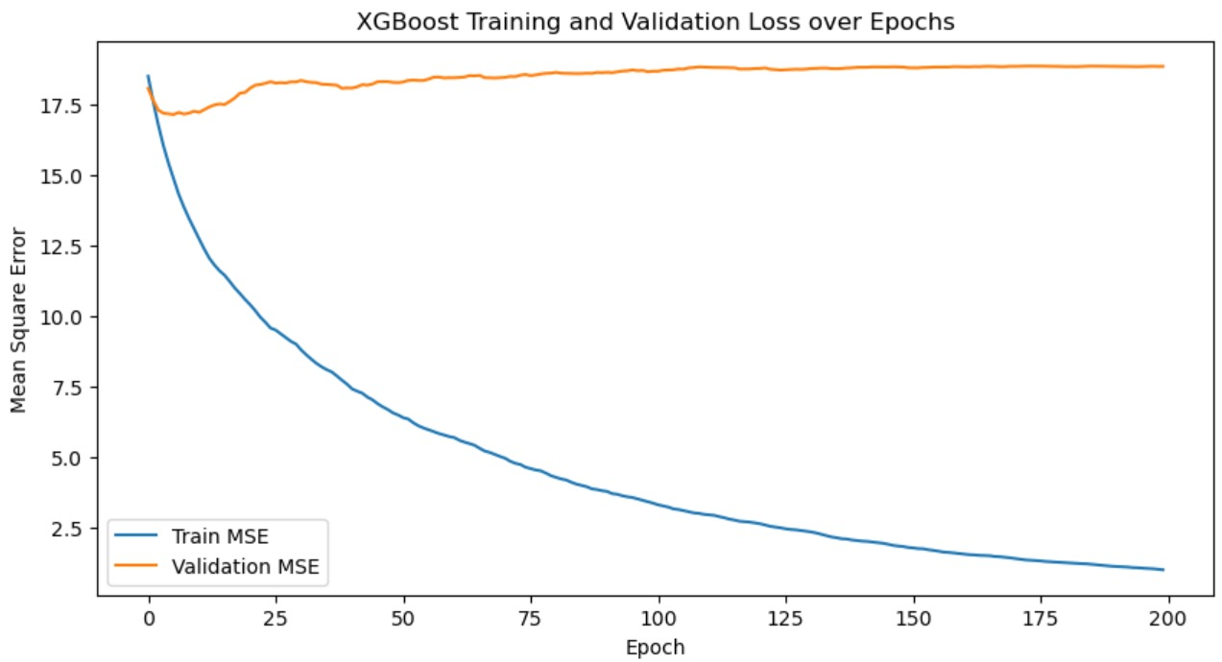
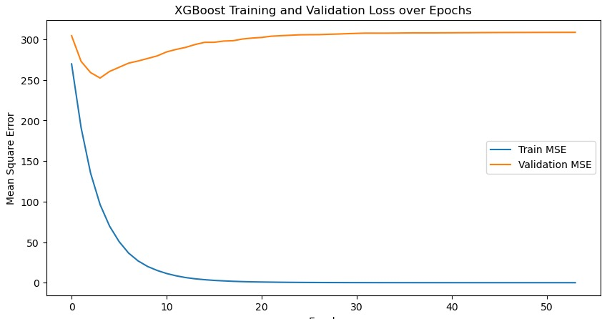
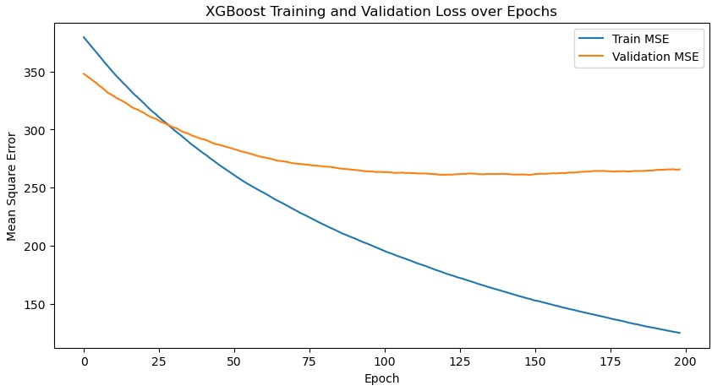
XGBoost Results
Handles missing data, making it robust to incomplete datasets
Prevents overfitting, hence enhancing model performance on unseen data
Scalable and efficient implementation of gradient boosting
MAE | RMSE
14.38 | 18.39
Model hyperparameters:
{ 'max_depth': 6,
'learning_rate': 0.01,
'subsample': 0.7,
'colsample_bytree': 0.7,
'reg_lambda': 10,
'booster': 'gbtree
'n_estimators’: 5 }
Model hyperparameters:
{ 'max_depth': 2,
'learning_rate': 0.005,
'subsample': 0.6,
'colsample_bytree': 0.6,
'objective': 'reg:squarederror',
'reg_lambda': 2.5,
'booster': 'dart' }
Model hyperparameters:
{ ‘colsample_bytree': 0.7,
‘learning_rate': 0.2,
‘max_depth': 4,
‘n_estimators': 200,
‘subsample': 0.9}

Slide 13
Results and Discussion
Model | Evaluation Metric | Result
CNN | MAE | 11.24
 | MSE | 15.16
SVR | MAE | 12.45
 | MSE | 15.63
XGBoost | MAE | 14.38
 | MSE | 18.39
CNN
PT_500 (Actual) | PT_500 (Predicted) | PT_4000 (Actual) | PT_4000 (Predicted)
60 | 59.16 | 10 | 13.12
43 | 42.97 | 18 | 14.20
45 | 41.94 | 5 | 8.07
53 | 51.20 | 23 | 19.2
10 | 9.6 | 0 | 3.44
Best Model
Predictions
Predictions
CNN
SVR
XGBoost

Slide 14
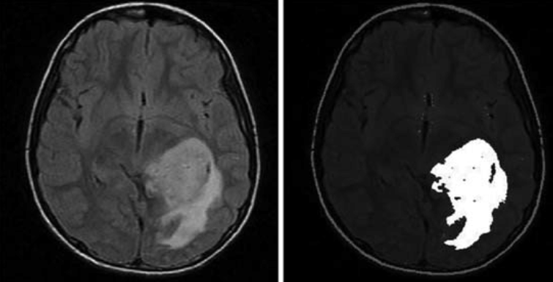
Conclusion and Future Work
Conclusion
CNN outperformed SVR and XGBoost indicating its superior ability to handle the spatial complexity of MRI data.
The results underscore the importance of matching algorithm capabilities with data characteristics; CNNs, with their inherent design for image data, provided more accurate predictions in this context compared to SVR and XGBoost.
Future Work
Explore deeper and more complex CNN architectures or hybrid models as well as leverage pre-trained models on similar tasks.
Investigating additional feature selection techniques and incorporating more domain-specific knowledge into our machine learning models.
Brain Tumor Segmentation

Slide 15


