Slide 1
Some SQL Techniques

Slide 2
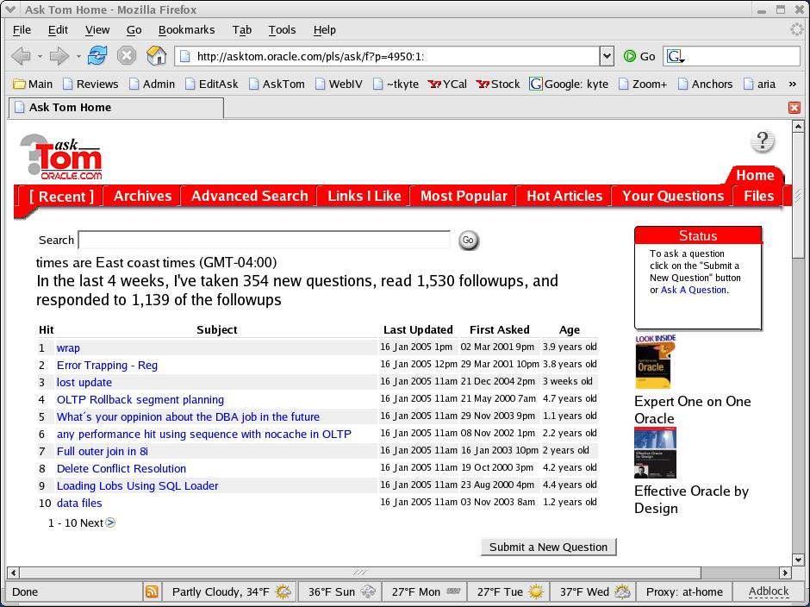



Who am I
Been with Oracle since 1993
User of Oracle since 1987
The “Tom” behind AskTom in Oracle Magazine
  www.oracle.com/oramag
Expert Oracle Database Architecture
Effective Oracle by Design
Expert One on One Oracle
Beginning Oracle

Slide 3
Agenda
What do you need to write “good” SQL
The Schema Matters
Knowing what is available
  Using rownum (yes, to 'tune')
  Scalar subqueries
  Analytics
  Some hints
Don’t tune queries!
Other things
  Materialized Views
  With subquery factoring
  Merge
  …

Slide 4
What do you need to know…
Access Paths
  There are a lot of them
  There is no best one (else there would be, well, one)
A little bit of physics
  Full scans are not evil
  Indexes are not all goodness
How the data is managed by Oracle
  high water marks for example
  IOT’s, clusters, etc
What your query needs to actually do
  Is that outer join really necessary or “just in case”

Slide 5


Structures
How the data is accessed and organized makes a difference
  Clustering
Select *
from orders o, line_items li
where o.order# = li.order#
And o.order# = :order
ORDERS & LINE ITEMS
ORDERS
LINE ITEMS

Slide 6

Structures
How the data is accessed and organized makes a difference
  Clustering
  Index Organized Tables
STOCKS
Select avg(price)
From stocks
Where symbol = ‘ORCL’
And stock_dt >= sysdate-5;
STOCKS

Slide 7

Structures
How the data is accessed and organized makes a difference
  Clustering
  Index Organized Tables
  Partitioning
ORDERS
ORDERS
ORDERS
Europe
USA
Jan
Feb
Jan
Feb
Composite Partition
Higher Performance
More flexibility to match business needs
Partition
Divide and Conquer
Easier to Manage
Improve Performance
Large Table
Difficult to Manage

Slide 8


Structures
How the data is accessed and organized makes a difference
  Clustering
  Index Organized Tables
  Partitioning
  Compression
Up To
4X
Compression

Slide 9
The Schema Matters
A Lot!
Tune this query:
Select DOCUMENT_NAME, META_DATA
from documents
where userid=:x;
That is about as easy as it gets (the SQL)
Not too much we can do to rewrite it…
But we’d like to make it better.
Iot01.sql
Cf.sql

Slide 10
The Schema Matters
There are
  B*Tree clusters
  Hash clusters
  IOT’s
  Segment Compression
  Index Key Compression
  Function Based Indexes
  Domain Indexes
  Use them when appropriate

Slide 11
Knowing what is available
There is a lot out there…
I learn something new every day
Skimming the docs works
  Oh, I remember something similar…
Check out the “whats new in” at the head of the docs
Participate in the forums
Things change… Some things must be “discovered”
Ignulls.sql

Slide 12
Things Change
begin
for x in
( select *
from big_table.big_table
where rownum <= 10000 )
loop
null;
end loop;
end;

Slide 13
Things Change
declare
type array is table of big_table%rowtype;
l_data array;
cursor c is
select * from big_table where rownum <= 1000;
begin
open c;
loop
fetch c bulk collect into l_data limit 100;
for i in 1 .. l_data.count
loop
null;
end loop;
exit when c%notfound;
end loop;
close c;
end;

Slide 14
Things Change 9i
SELECT * FROM BIG_TABLE.BIG_TABLE WHERE ROWNUM <= 10000
call count cpu elapsed query rows
------- ------ -------- ---------- ---------- ----------
Parse 1 0.01 0.00 0 0
Execute 1 0.00 0.00 0 0
Fetch 10001 0.15 0.17 10005 10000
------- ------ -------- ---------- ---------- ----------
total 10003 0.16 0.17 10005 10000

Slide 15
Things Change 10g
SELECT * FROM BIG_TABLE.BIG_TABLE WHERE ROWNUM <= 10000
call count cpu elapsed query rows
------- ------ -------- ---------- ---------- ----------
Parse 1 0.00 0.00 0 0
Execute 1 0.00 0.00 0 0
Fetch 101 0.05 0.07 152 10000
------- ------ -------- ---------- ---------- ----------
total 103 0.05 0.07 152 10000

Slide 16
Using ROWNUM
Psuedo Column – not a “real” column
Assigned after the predicate (sort of during) but before any sort/aggregation
Select x,y
from t where rownum < 10
order by x
Versus
Select * from
(select x,y from t order by x)
where rownum < 10

Slide 17
Using ROWNUM
Incremented after a successful output
Select * from t where rownum = 2
Rownum = 1
For x in ( select * from t )
Loop
if ( rownum = 2 )
then
output record
rownum = rownum+1;
end if
End loop

Slide 18
Using ROWNUM
To reduce the number of times a function is called..
When you have two queries that run light speed separately
  But not so together
  Generally a mixed “CBO/RBO” problem
  Use of RBO with a feature that kicks in the CBO
  Rownum can be a temporary fix till all things are CBO
rn01.sql

Slide 19
Using ROWNUM
Top-N queries
Select *
from (select * from t where … order by X )
where rownum <= 10;
Does not have to sort the entire set
Sets up an “array” conceptually
Gets the first 10
When we get the 11th, see if it is in the top 10
  If so, push out an existing array element, slide this in
  Else throw it out and get the next one.
Do not attempt this in CODE! (well – what about 10g?)
rn02.sql

Slide 20
Using ROWNUM
Pagination
Select *
From ( select a.*, ROWNUM rnum
From ( your_query_goes_here ) a
Where ROWNUM <= :MAX_ROW_TO_FETCH )
Where rnum >= :MIN_ROW_TO_FETCH;
Everything from prior slide goes here…
Never ever let them “count the rows”, never.
Do not attempt this in CODE!
rn03.sql

Slide 21
Scalar Subqueries
The ability to use a single column, single row query where you would normally use a “value”
Select dname, ‘Some Value’
From dept
That example shows a possible use of scalar subquerys – outer join removal

Slide 22
Scalar Subqueries
The ability to use a single column, single row query where you would normally use a “value”
Select dname, (select count(*)
from emp
where emp.deptno =
:dept.deptno ) cnt
From dept
That example shows a possible use of scalar subquerys – outer join removal

Slide 23
Scalar Subqueries
Outer join removal for “fast return” queries
  That works great for a single column
  What about when you need more than one?
ss01.sql

Slide 24
Scalar Subqueries
Reducing PLSQL function calls via scalar subquery caching
Select * from t where x = pkg.getval()
versus
Select * from t where x =
(select pkg.getval() from dual)
How to call them (scalar subqueries) “as little as possible”
ss02.sql

Slide 25
Generating Data
I need to fill in the gaps – even if there is missing data, I need to see it for that day
Outer join (or partition outer join in 10g) to this
Select to_date(:x,’fmt’)+level-1
from dual
Connect by level <= :n
gd.sql

Slide 26
Recursive Subquery Factoring
ANSI SQL replacement for connect by
Can be
  Easier to understand than connect by
  Unless of course, you have been using connect by for 22 years – in which case it looks confusing
  Used to solve Sudoku puzzles!

Slide 27
Generating Data
I need to bind an “in-list”
Select …
from …
where column in ( :bind );
parse.sql

Slide 28
Analytics
Ordered Array Semantics in SQL queries
Select deptno,ename,sal
from emp
over (partition by deptno
Row_number()
Order by sal desc )
SCOTT 3000
FORD 3000
JONES 2975
ADAMS 1100
SMITH 800
1
2
3
4
5
Deptno Ename Sal
King 5000
Clark 2450
Miller 1300
1
2
3
10
20
30

Slide 29
Analytics
A running total (demo001.sql)
Percentages within a group (demo002.sql)
Top-N queries (demo003.sql)
Moving Averages (demo004.sql)
Ranking Queries (demo005.sql)
Medians (med.sql)
And the list is infinitely long
  "Analytics are the coolest thing to happen to SQL since the keyword Select"
  Lets look at a complex example

Slide 30
Analytics
I am not able to find the exact answer to my question. I have records like this:
Time Amount
11/22/2003 12:22:01 100
11/22/2003 12:22:03 200
11/22/2003 12:22:04 300
11/22/2003 12:22:45 100
11/22/2003 12:22:46 200
11/22/2003 12:23:12 100
11/22/2003 12:23:12 200
What I need to do is sum the amounts where the time of the records is within 3 seconds of each other. In the case where the data is like this:
11/22/2003 12:22:03 200
11/22/2003 12:22:04 200
11/22/2003 12:22:05 200
11/22/2003 12:22:06 200
11/22/2003 12:22:07 200
11/22/2003 12:22:08 200
11/22/2003 12:22:09 200
There would only be one row with the total for all the rows. (Basically, we are looking for "instances" where we define an instance such that all the records within the instance are no more than three seconds apart. So there can be 1 or many records all of the same instance and the resulting summation would have one summary record per instance.) Would you please point me in the right direction?

Slide 31
Analytics
Start with first row (thinking iteratively here)
  If prior row is within 3 seconds -- same group, continue
    Abs(lag(x) over (order by x)-x) <= 3 seconds
  Else new group, break and get a "new" group id
  Need to use analytics on top of analytics
    Inline views -- very powerful here
  Demo006.sql

Slide 32
Some Hints
People either
  Swear on them
  Swear about them
I like hints that give the optimizer information
I do not like so much hints that tell the optimizer “how to do it”

Slide 33
Some Hints
ALL_ROWS
FIRST_ROWS(n) or FIRST_ROWS
CHOOSE
(NO)REWRITE
DRIVING_SITE
(NO)PARALLEL
(NO)APPEND
CURSOR_SHARING_EXACT
DYNAMIC_SAMPLING ds.sql
*CARDINALITY cardinality.sql

Slide 34
Some Hints
Except for the good hints…
  When you are trying to prove the optimizer made the wrong decision
  In the event of an emergency fix. With the intention to get the real fix
  Hardly ever in my experience

Slide 35
Don’t tune queries!

Slide 36
Think in SETS!

Slide 37
Other Things
Materialized Views
With subquery factoring
Merge
External Tables
350 some odd new things in 10g
Hundreds of new things in 9ir2 over r1
9ir1 over 8i
8i over 8.0
And so on…

Slide 38

“Question Authority.”
Make the experts prove everything
Statements that should raise your eyebrows:
  It is my opinion...
  I claim...
  I think...
  I feel…
Everything can (and should) be proven
TKPROF goes a long way here
Statspack is great
“Runstats” is a tool I use as well (search asktom for runstats)
Things change, expect that
It only takes a single counter case
Notes:
I’d like to close up with a thought. There are lots of “experts” out there expousing “facts”. Many of the facts are really opinions or myths in disgiuse. I would encourage you to question them, make them prove things. It is something I do everyday on my site – i don’t just “say things”, I say something and then back it up. Sometimes – I find I have to change my initial answer before I publish it because the facts did not support my hypothesis. Everything that is true is provable – just ask for the proof. And remember – it only takes a single counter case to disprove something. I only need to show ONCE that having 10,000 extents does not materially affect performance – no matter how many times people say “but it must”.

Slide 39
Questions

