Slide 1
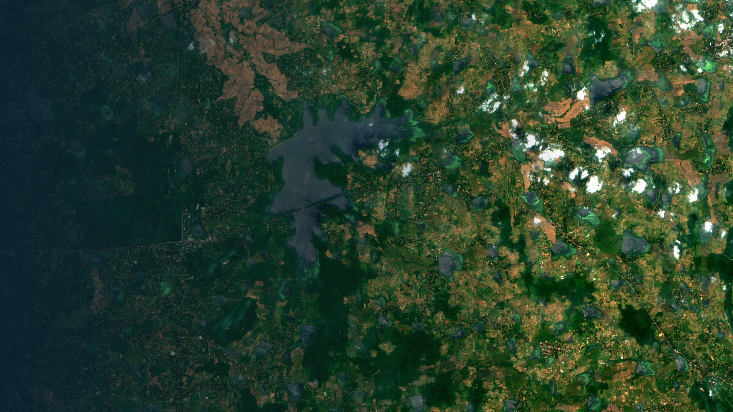
SWOT Tank Water Tracker for Sri Lanka
IS4990 COMPREHENSIVE GROUP PROJECT · PROJECT PROPOSAL
An AI system that estimates how much water each tank holds, using free satellite data
Group 6 · JARVIS
Supervisors: Dr. Upeksha Ganegoda (IT) · Prof. (Mrs) Thanuja Sandanayake (IDS)
October 2026
Tanks around Mahakanadarawa, Sentinel-2, 28 Feb 2026. Contains modified Copernicus Sentinel data 2026.

Slide 2
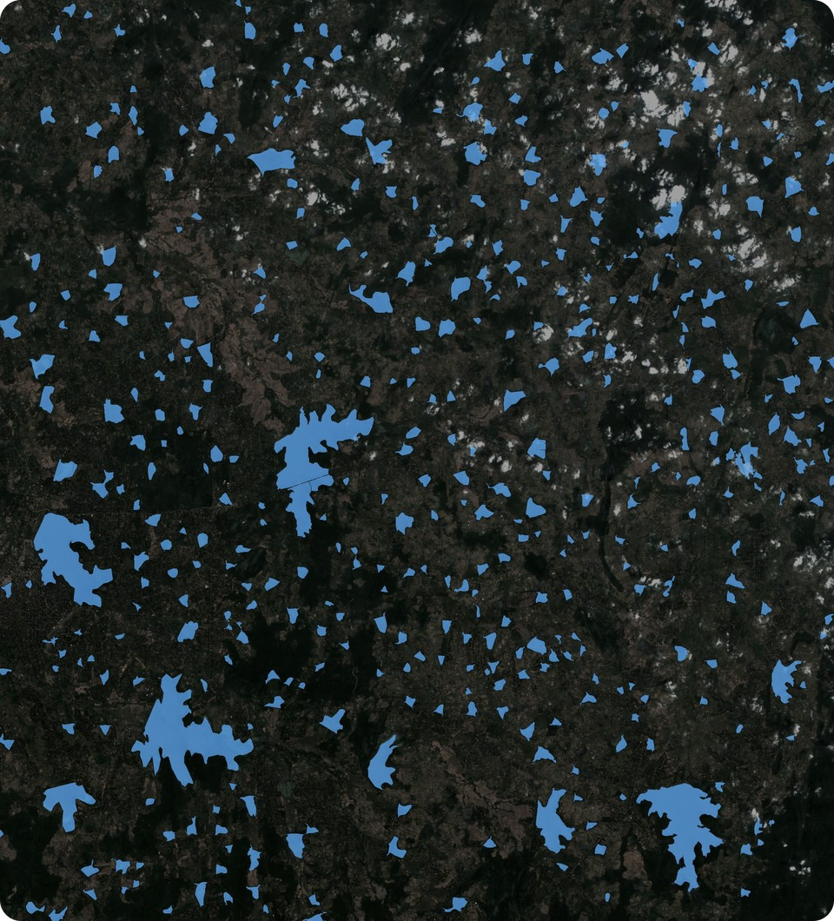
Why: dry-zone farming depends on tank water
~23,000
small tanks of 80 ha or less in Sri Lanka, the base of dry-zone farming
National Tanks Survey, in Lopane et al., 2025
2
seasons a year. Before each, farmers plan the crop by the water in the tank
Cultivation meetings at village tanks, Oka et al., 2015
1,160
small tanks damaged by Cyclone Ditwah in November 2025
Department of Agrarian Development, December 2025
Knowing each tank's water helps farmers plan the season, and helps officers share water and prepare for floods.
432 tanks of 6.25 ha or more in our study area (blue)
Sentinel-2, 28 Feb 2026 · outlines © OpenStreetMap contributors
But today, nobody can say how much water most tanks hold.

Slide 3





The problem we solve
THE PROBLEM
For most Sri Lankan tanks, nobody can say how much water they hold right now, and there is no low-cost way to measure it often.
WHY IT IS STILL UNSOLVED
No gauges on village tanks
Maps show area, not volume
Only 118 reservoirs publish daily water levels
IFAD maps over 10,650 water bodies, but by area only
Irrigation Department, Reservoir Status, 25 Oct 2026
IFAD, 2026
Clouds and water plants hide the water
SWOT gives height, not volume
Only 17–22% of Sentinel-2 dates were clear over our tanks; plants cover 3 of our 8 village tanks
Height only, and not yet checked on Sri Lankan tanks
Our data check, October 2026
NASA and CNES satellite, launched December 2022
Our answer: an AI system that turns free satellite data into each tank's storage, in m³ and % full, every 5–12 days, checked against gauges.
For farmer organisations, the Department of Agrarian Development (village tanks) and the Irrigation Department (reservoirs).

Slide 4

SWOT gives the height. We turn it into water
What SWOT gives
What our project adds
The water height of each lake, about twice every 21 days
Only for lakes in its prior lake list
Mostly "suspect" readings on small village tanks
No volume, and nothing between passes
Water area from Sentinel-1 and Sentinel-2 by AI, even under cloud and water plants
A height–area–volume curve for every tank
Storage in m³ and % full, every 5–12 days
Accuracy checked against Irrigation Department gauges
A dashboard for irrigation officers and farmers
SWOT is the ruler. We turn its readings into water in the tank.

Slide 5
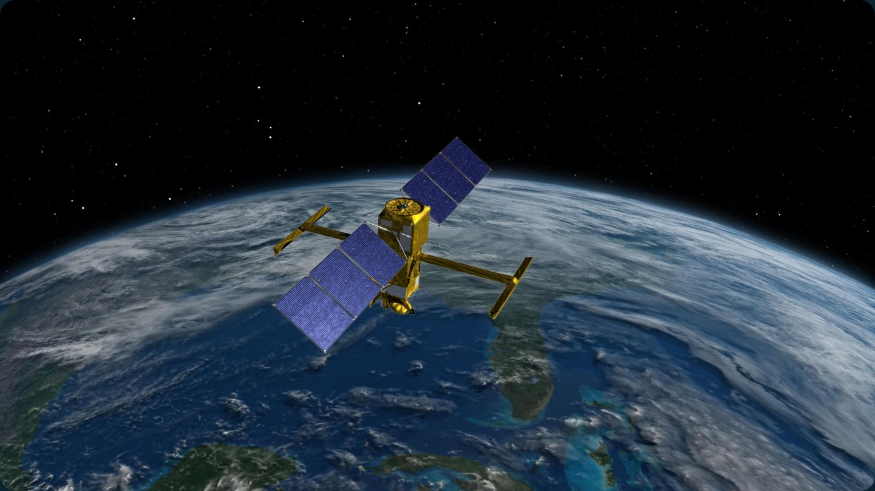
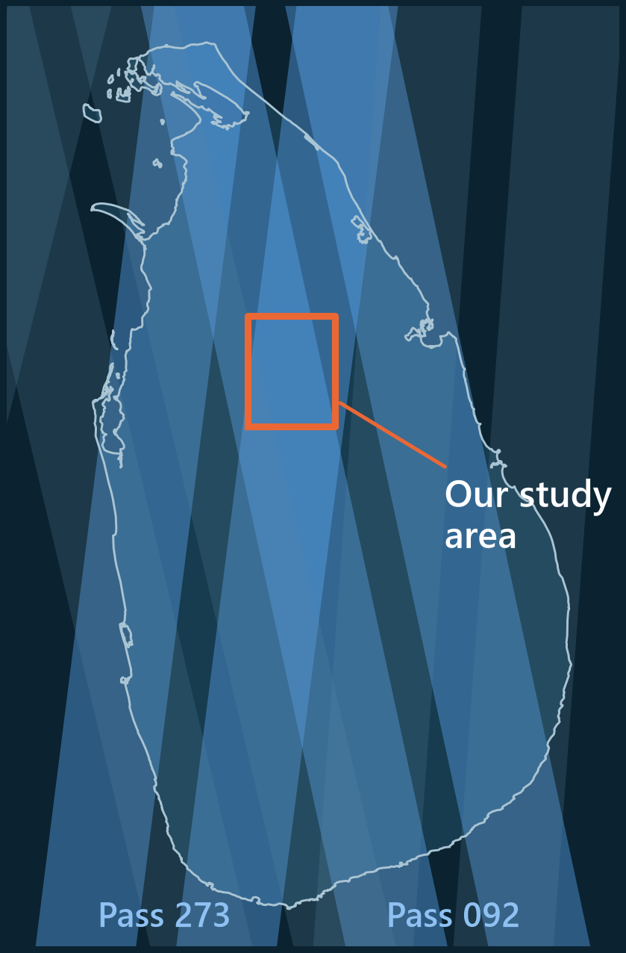
SWOT: a satellite that measures water height
Illustration: NASA/JPL-Caltech
Dec 2022
120 km
21 days
2 passes
launched by NASA and CNES (France)
wide strip measured on each pass
until the same pass comes back
see our tanks: 273 and 092

Slide 6
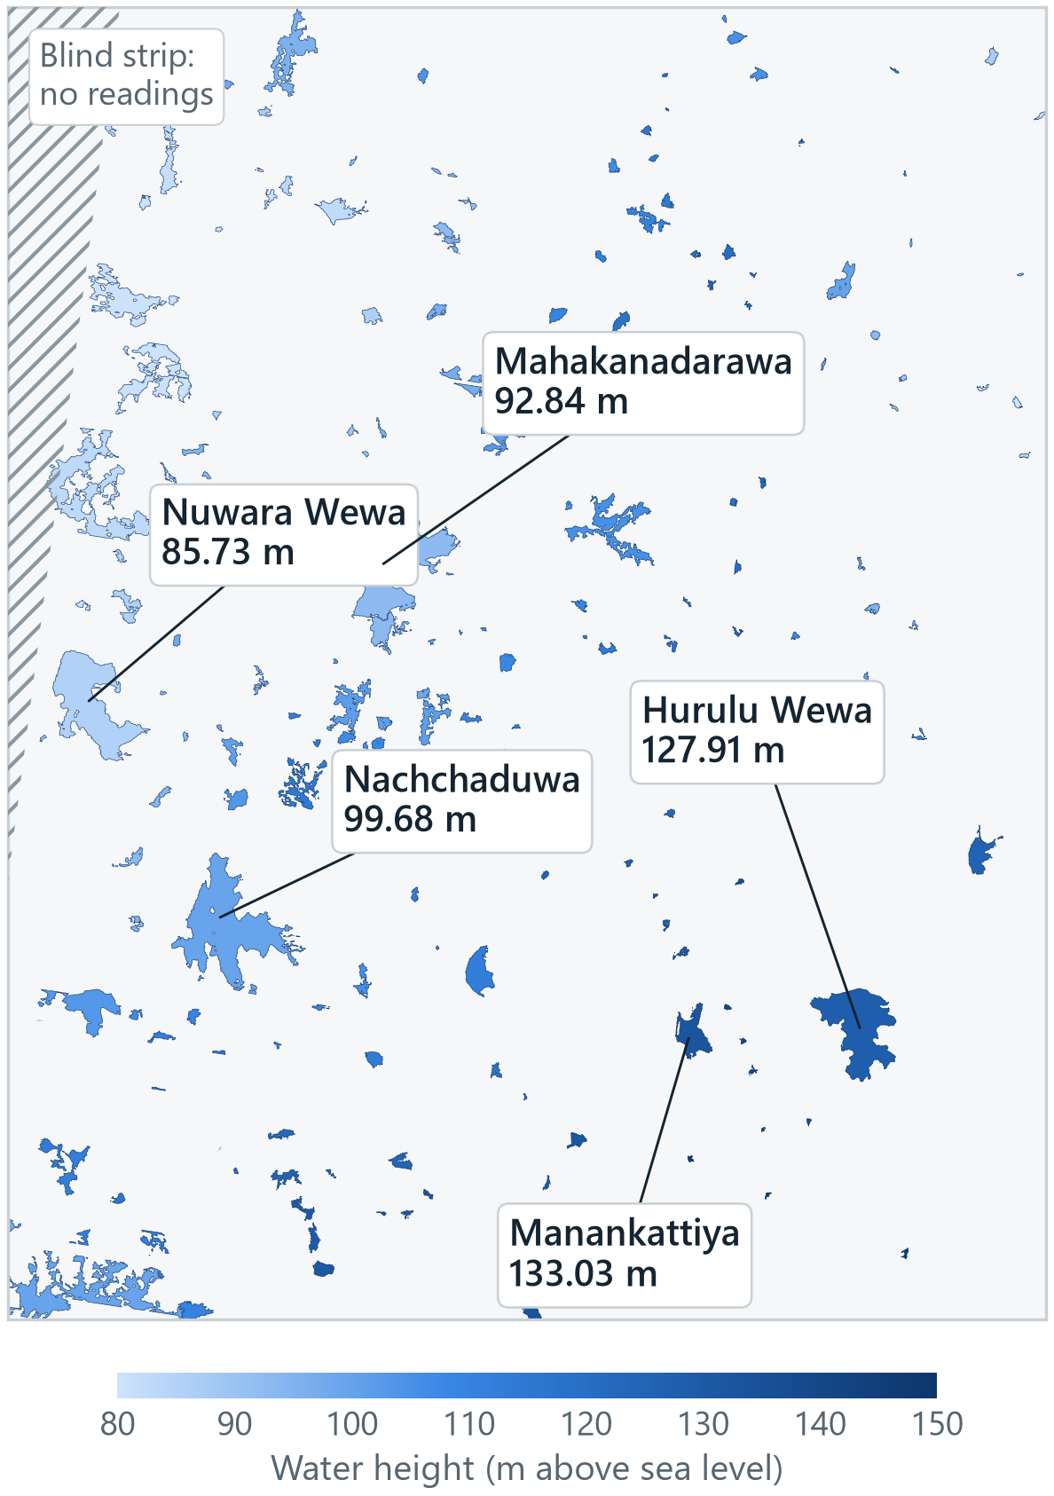



What SWOT sees: one pass, every lake at once
198
lakes measured in a single pass
SWOT pass 273 on 11 Oct 2026, in our 44 × 55 km study area
Each colour is the water height SWOT measured, in metres above sea level.
All 5 of our reservoirs were measured on this pass, for example Hurulu Wewa at 127.91 m.
SWOT cannot measure the strip right under itself, shown hatched on the map.
Data: NASA/JPL and CNES, SWOT Lake Single-Pass product, version D, from NASA PO.DAAC.

Slide 7
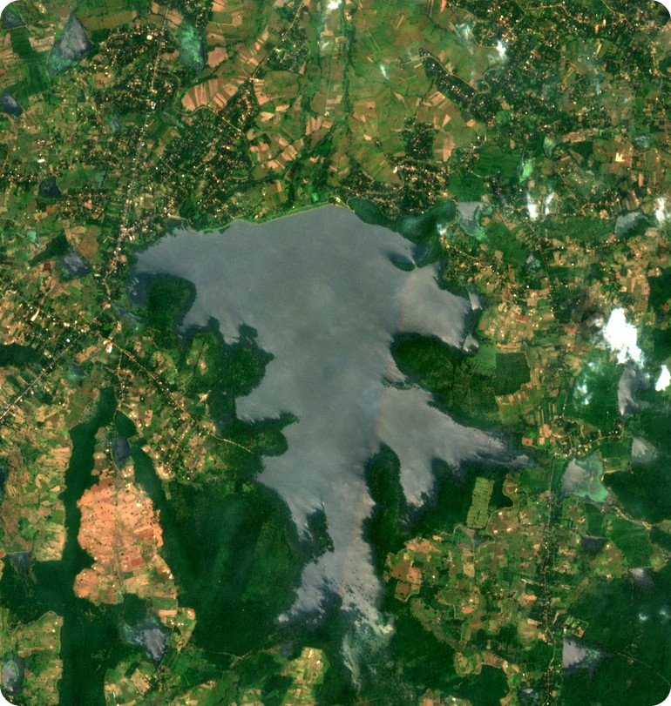
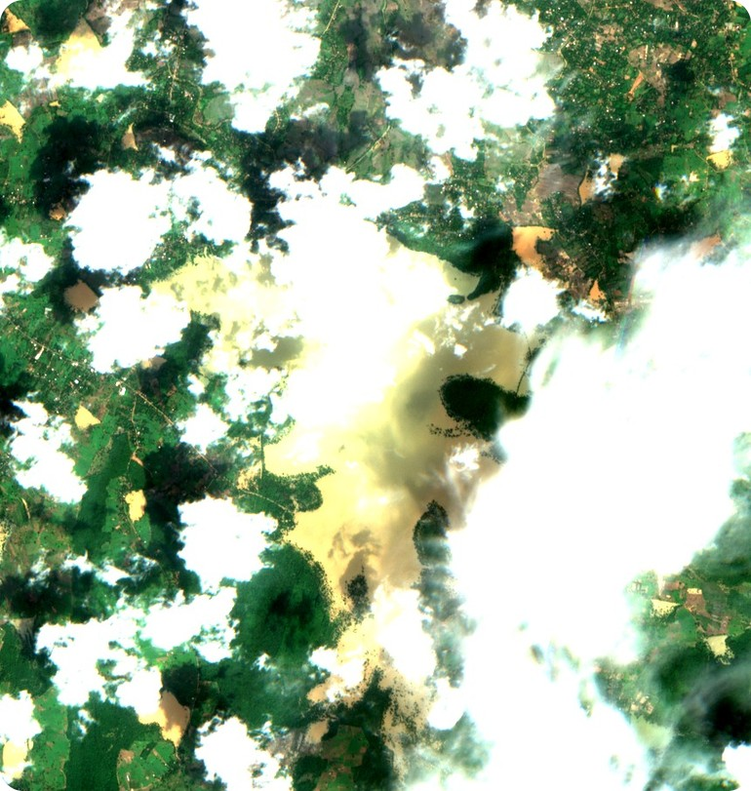
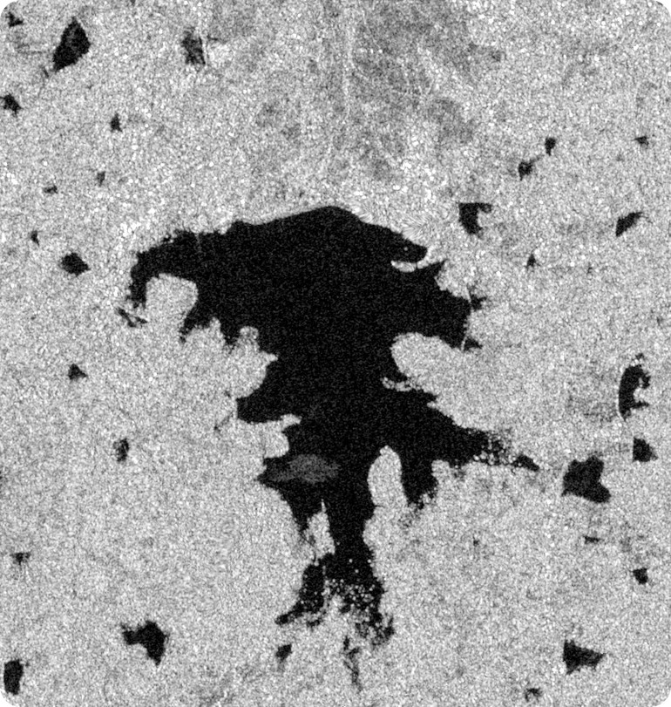
Clouds hide the tanks. Radar sees through them
Sentinel-2, clear day
Sentinel-2, monsoon cloud
Sentinel-1 radar
Hurulu Wewa, 28 Feb 2026 · optical, 10 m
Hurulu Wewa, 30 Nov 2025 · the tank is hidden
Hurulu Wewa, 2 Dec 2025 · water shows dark
Only 17–22% of Sentinel-2 dates were clear over our test tanks, so radar is a core input.
Contains modified Copernicus Sentinel data 2025–2026.

Slide 8
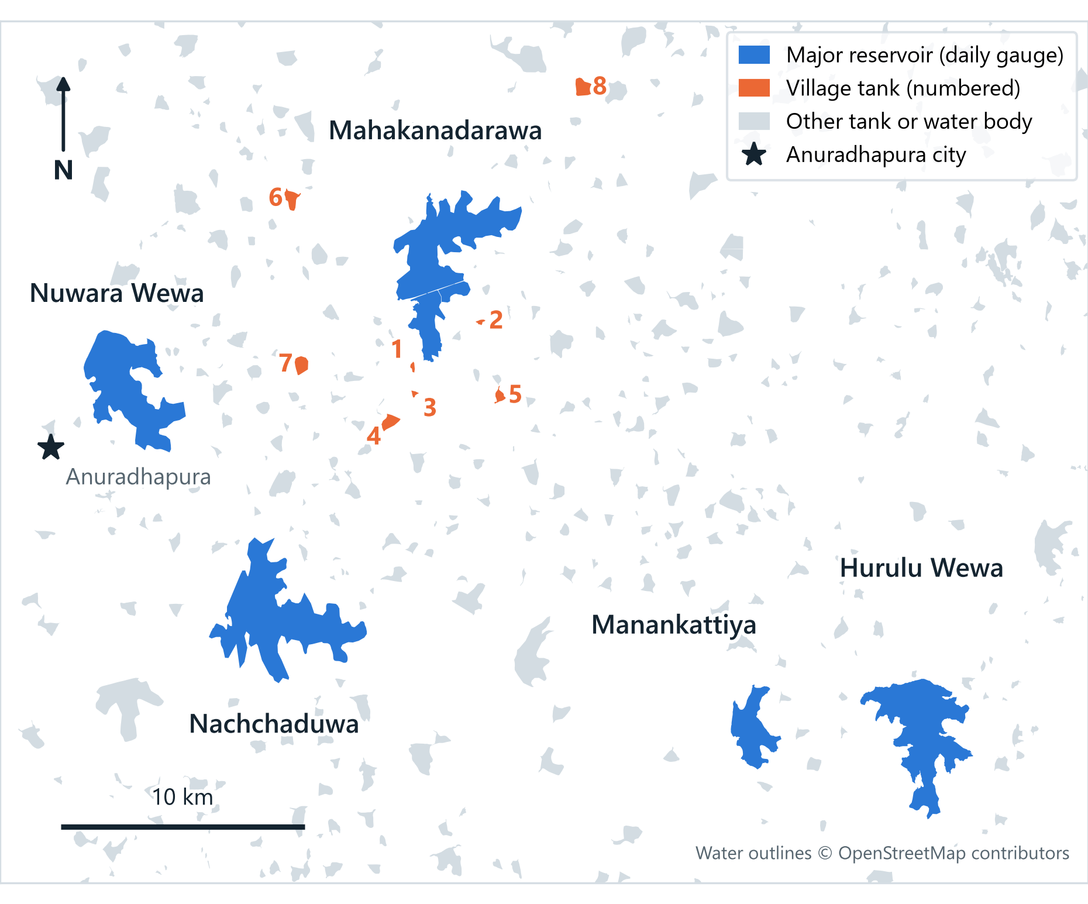



Study area: 5 reservoirs and 8 village tanks
5 major reservoirs
Hurulu Wewa, Mahakanadarawa, Manankattiya, Nachchaduwa and Nuwara Wewa, all with daily gauge readings
8 village tanks
0.4–5 km from Mahakanadarawa: 2 open water, 3 mixed and 3 mostly covered by water plants
Seen by SWOT passes 273 and 092
All 13 tanks, about twice every 21 days, with 47–90 usable readings each since July 2023
Why here
Dry-zone tank cascades (ellanga), flat land, and official gauges to check against

Slide 9
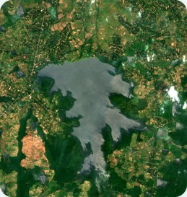
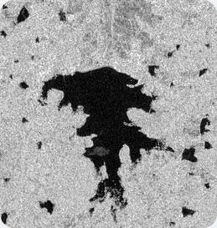
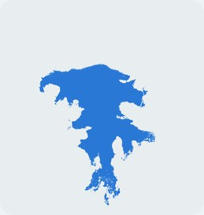

How it works
Sentinel-1 and Sentinel-2
AI water map
Radar and optical images, every 5–12 days
Open water, water under plants, and land
Height–area–volume curve
Storage every
5–12 days
One per tank: each SWOT height paired with the AI water area of the same day
Each new water map becomes a volume, shown on a dashboard
SWOT water heights
From NASA's Hydrocron service since July 2023, with poor readings removed
Checked against Irrigation Department gauges and official storage figures

Slide 10
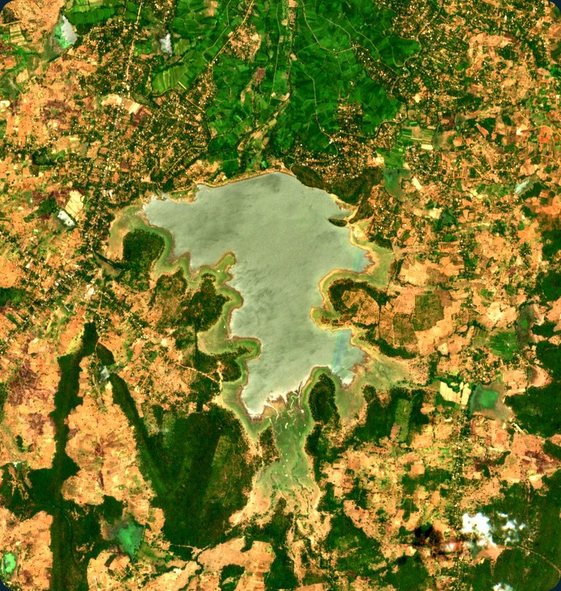
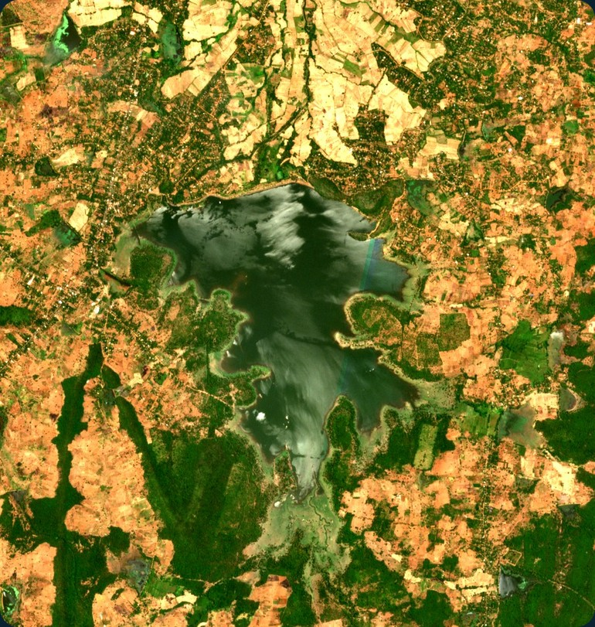

Our method in three pictures: Hurulu Wewa
Low
Half full
Full
127.59 m SWOT height
129.50 m SWOT height
132.35 m SWOT height
6.1 km² of water
8.3 km² of water
10.8 km² of water
Sentinel-2 29 Jul 2023 · SWOT 30 Jul 2023
Sentinel-2 and SWOT, 30 Jul 2025
Sentinel-2 28 Feb 2026 · SWOT 10 Mar 2026

Slide 11
Three years of SWOT water levels
Monthly average of best-quality readings, in metres above each reservoir's lowest month.
The sharp rise at the end of 2025 is Cyclone Ditwah.
71 best-quality readings
63 best-quality readings
57 best-quality readings
55 best-quality readings
53 best-quality readings
rose and fell up to 5.0 m
rose and fell up to 4.4 m
rose and fell up to 3.7 m
rose and fell up to 3.0 m
rose and fell up to 4.3 m
Source: NASA PO.DAAC Hydrocron, SWOT lake product version D, July 2023 to October 2026. Gaps are months without a best-quality reading.

Slide 12

We tested the data before proposing
Five quick checks in October 2026, using the real SWOT, Sentinel-2 and gauge data.
1 · LAKE IDS
2 · HEIGHTS
3 · GAUGE CHECK
4 · WATER AREA
5 · TRAINING DATA
86%
26,641
~1 m
17–22%
2
of Irrigation Department tanks in our area have a SWOT lake ID (43 of 50); 58% of all mapped tanks
SWOT readings on 400 lakes since July 2023; village tanks get mostly "suspect" readings
difference between SWOT and gauges on 4 reservoirs, with readings 13 to 20 days apart
of Sentinel-2 dates clear; water plants hide the water in 3 village tanks
labelled water datasets ready to use: Sen1Floods11 and S1S2‑Water
RISK
RISK
OK
RISK
PASS
Verdict: GO, with changes. Sentinel-1 radar and a water-plant class became core parts of the plan, and RQ2 now tests SWOT's "suspect" readings.

Slide 13
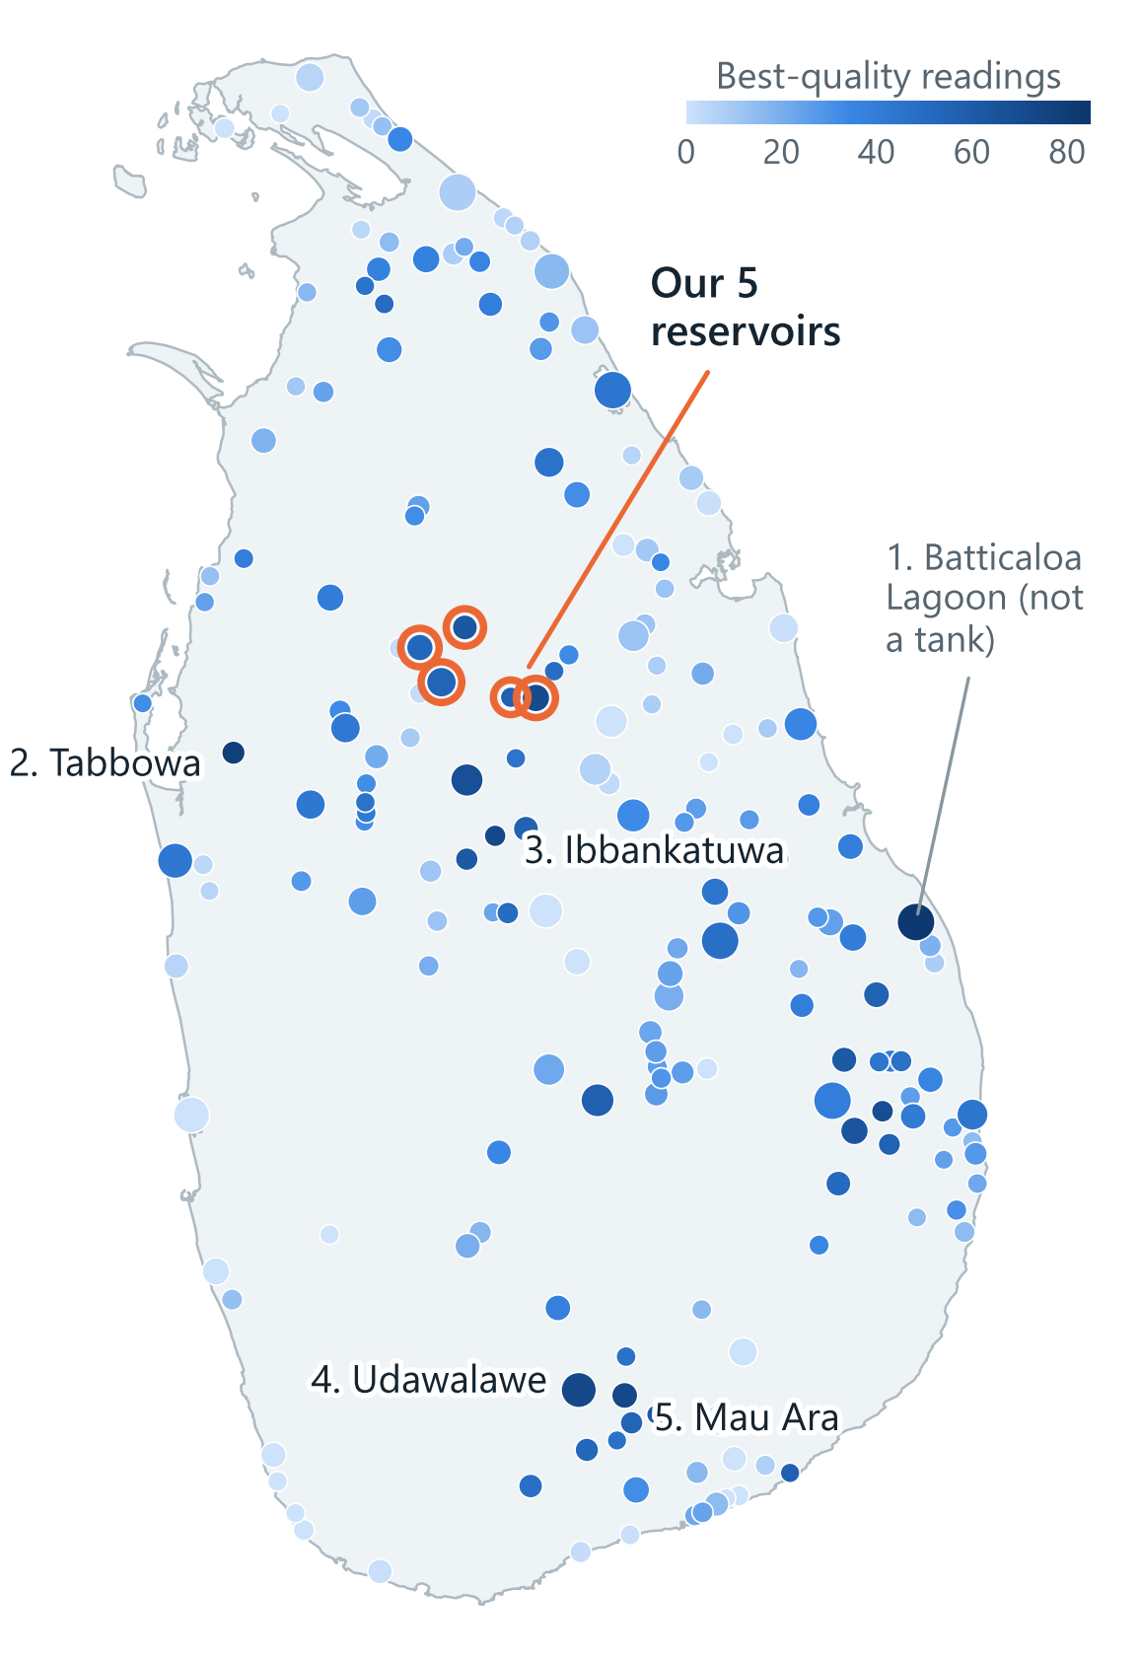


Why these tanks? We checked all of Sri Lanka
6th of 187
Hurulu Wewa's rank among Sri Lanka's big lakes (1 km² or more), by best-quality SWOT readings
All 5 of ours are in the island's top 22, and they are the top 5 in our study area
The island's top tanks are spread from Puttalam to Hambantota, far from our village tanks
Ours sit next to the 8 village tanks and share the same 2 SWOT passes
All 5 have daily Irrigation Department gauges; 2 of the island's top 5 tanks do not
Best quality: quality flag 0, crossover flag 0–1, dark water 10% or less (Köhn and Nielsen, 2026).

Slide 14
Research questions
1
How accurately can deep learning map tank water from Sentinel-1 and Sentinel-2, even under cloud or water plants?
2
How accurate is SWOT on reservoirs and on small village tanks, and can its "suspect" readings be trusted?
Measured by IoU and F1 against hand-labelled water masks
Measured by error in cm against gauge readings
3
Does AI water area plus SWOT height give storage close to official and measured values?
4
Can storage be forecast 2–4 weeks ahead from recent storage and rainfall?
Measured by error as a % of capacity
Stretch goal, compared with a "no change" forecast

Slide 15



Who does what: one research question each
Each of us owns one core research question from start to finish.
MEMBER A
MEMBER B
MEMBER C
AI water maps
SWOT and gauges
Storage and dashboard
RQ1
RQ2
RQ3
RQ4 stretch
Labelled water masks of Sri Lankan tanks
Sentinel-1 and Sentinel-2 deep-learning model
A water-plant class for covered tanks
SWOT heights from Hydrocron, poor readings removed
Gauge data: daily records, history and field photos
Tests whether "suspect" readings can be trusted
Height–area–volume curve for each tank
Storage every 5–12 days, checked against official figures
Dashboard, and the forecast if time allows
Output: water maps for all tanks
Output: SWOT accuracy report
Output: storage series and dashboard
All three: field visits on SWOT pass dates, labelling water masks, the thesis and the research paper.

Slide 16


What we will deliver, and when
A labelled dataset of Sri Lankan tank water masks
Nov 2026
Proposal, ethics and data requests
An AI water map that works under cloud and water plants
15 Dec 2026
Study area confirmed after the cascade and name checks
Height–area–volume curves for all 13 tanks
Dec 2026 – Apr 2027
Labelled data, gauge readings, AI water model and SWOT curves
Storage every 5–12 days, shown on a dashboard
Mar – May 2027
Storage estimates, validation and dashboard
A research paper, for example for UoM's ICITR conference
30 Jun 2027
Thesis, paper and final submission

Slide 17
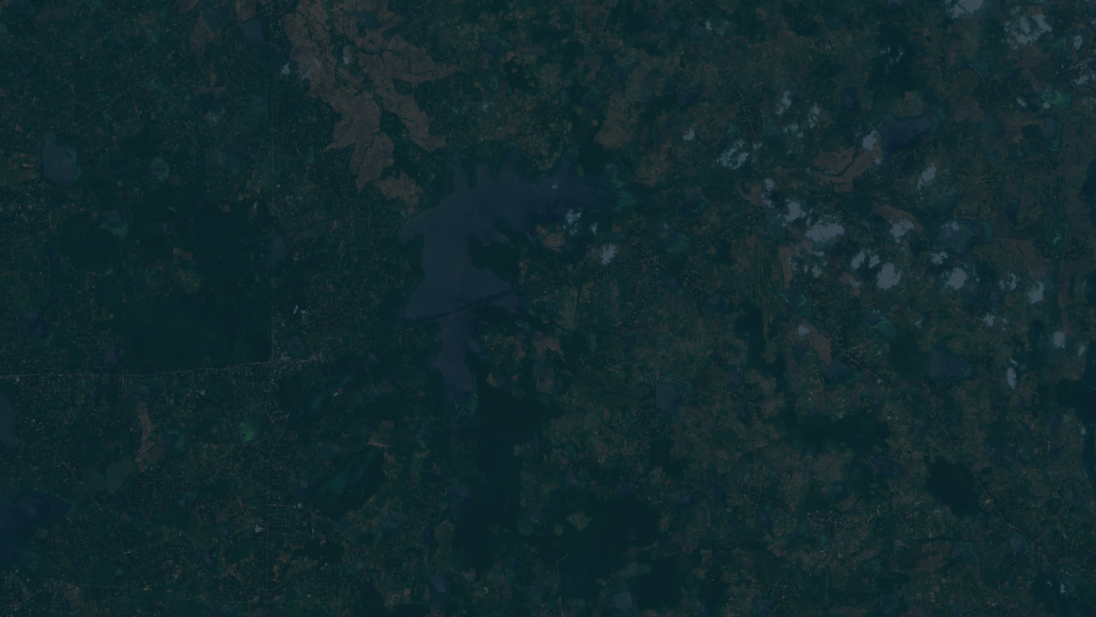

Thank you
Questions and feedback are welcome.
Data sources
SWOT: NASA/JPL and CNES, Lake Single-Pass product version D (PO.DAAC, Hydrocron)
Sentinel-1 and Sentinel-2: ESA Copernicus (Earth Search and Microsoft Planetary Computer)
Reservoir levels and outlines: Irrigation Department of Sri Lanka
Tank outlines © OpenStreetMap contributors; Sri Lanka boundary: geoBoundaries
SWOT illustration: NASA/JPL-Caltech
See SWOT readings for any lake:
SWOT Lake and River Explorer

